Slide 1
Implementation – Part II
(Installation, Documentation, & Training)
Class 26

Slide 2
Introduction
Describe the process of coding and testing.
Review preparing a test plan for an information system.
Apply four installation strategies: direct, parallel, single location, & phased installation
Distinguish between system & user documentation
Write task-oriented user documentation
Describe the process of training end users.

Slide 3

SDLC
Project Identification
& Selection
Project Initiation
& Planning
Analysis
Logical Design
Physical Design
Implementation
***
Maintenance

Slide 4
Implementation Phase Deliverables
Coding
  Code Programs & Database Structures
  Program Documentation
    Structure charts, Structured English, Decision tables/trees, Data flow diagrams
Testing
  Test Scenarios & Test Data
  Results of Program & System Testing
Installation
  Installation & Conversion Plans
    Software and hardware installation, Data conversion plan, Site & facility remodeling plan
  User Guides & Training Plan

Slide 5
Installation
Process of moving from old system to new system
Conversion of data must be planned
Four approaches to installation
  Direct (Big Bang)
  Parallel Installation
  Single Location Installation
  Phased Installation

Slide 6
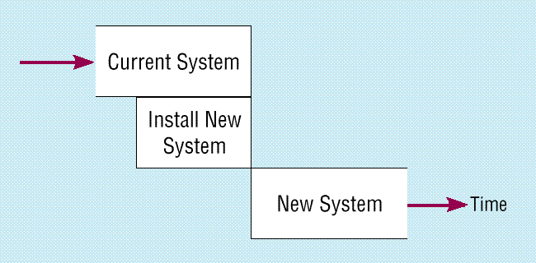
Direct Installation

Slide 7
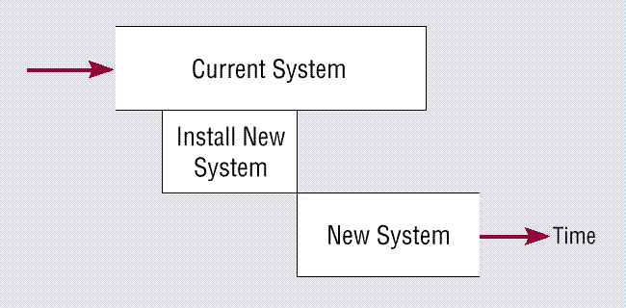
Parallel Installation

Slide 8
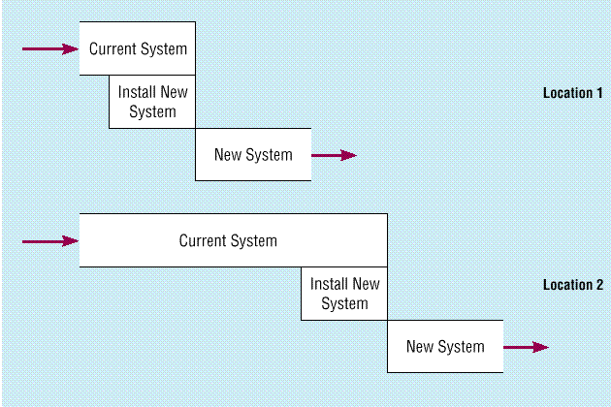
Single Location Installation

Slide 9
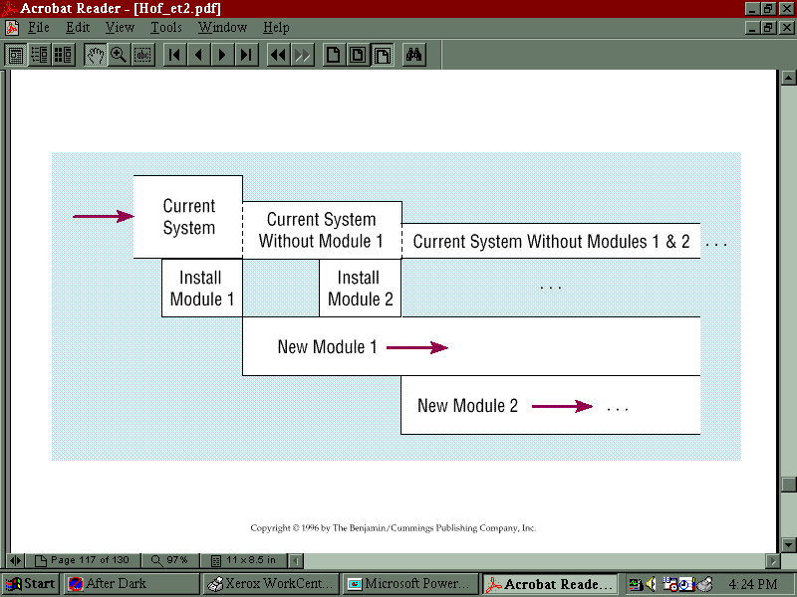
Phased Installation

Slide 10
Which way is best?
Parallel Installation
Single Location Installation
Phased Installation

Slide 11
Is implementation a success?
Is the system used?
  1.
  2.
  3.
  4.
  5.
  6.
Is the user satisfied?

Slide 12
System Implementation Failures
New Jersey Motor Vehicles Division
FLORIDA

Slide 13


Two Audiences for the Final Documentation
IS Personnel
Users

Slide 14
System Documentation
Detailed information about a system’s design specs, its internal workings, and its functionality

Slide 15
User Documentation
Written or visual information about an application system, how it works, and how to use it.

Slide 16
What Makes Good Documentation?
Contains an overview, index, getting started instructions, I.e. – very structured
Describes functionalities
Contains task-based documentation
  “How to’s…”
  Frequently Asked Questions
  Messages & their meanings

Slide 17
Training the end-users
What do users want?
  Training early on
  Training manual
  Straightforward teaching techniques
    1.
    2.
    3.

Slide 18
Training Methodologies
Instructor Led
One-on-One
User-Led
External sources

Slide 19
Supporting the End-user
Information Center / Help desk
Automating support
Resident expert
Other things to consider:
  Providing recovery and backup
  Disaster recovery
  PC maintenance

