Slide 1
Sentiment Analysis
By: Mohamed Benaicha
Portfolio: https://github.com/mohbenaicha

Slide 2
Summary
Problem: derive dominant sentiment from social media post/ product review - specifically on book reviews.
Hypothesis: sentence transformers should be able to understand sentiment from text that is properly and extensively normalized
Methodology: normalize NLP data; train transformers on labelled data; transfer learning from pre-trained transformers on all of the data
Findings:
70% test accuracy on locally trained and pre-trained networks
Existing labels not very reflective of review sentiment
Transfer learning works much, much better at picking up dominant sentiment
Text summary arbitrarily filters out important aspects of a record
Data/data collection: unique book review data collected over a period of 3-4 weeks features reviewer, review text, rating, book genres.
the choice of book reviews was that they are unique to – say – Amazon product reviews or IMBD movie reviews
Salient challenges/ recommendations for improvements:
Network size: massive networks require heavy-duty and sophisticated deployment infrastructure;
Improvements: cloud infrastructure best short-term scalable option
Long reviews: still extremely challenging for transformers to handle long sentences;
Improvements: use text summarization (this was attempted in this project but did not work well; alternative: ‘every-other-token/ every-other-token sentence’ – creates latency during live inference
Sentiment complexity: more than one sentiment in a review
book/movie reviews feature sentiment about the plot of the movie/book, but also about the quality of directing/writing
A number of records feature neutral sentiment
Improvements: ‘per-record-sentiment’ which are summed up to get over all sentiment – creates inference latency in production

Slide 3
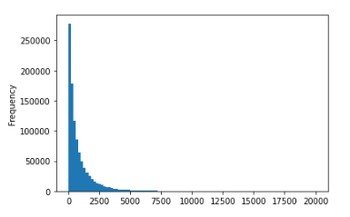
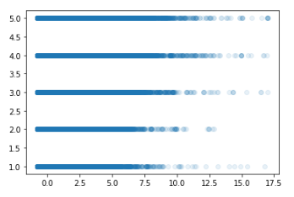
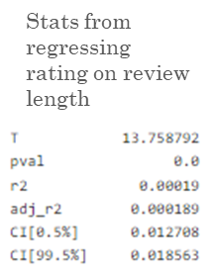
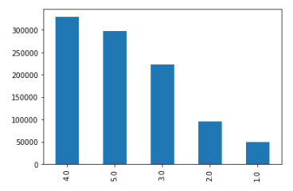
Data Exploration
1.7 million book reviews
Features: user, review text, rating, book genres
Review text ranges between 1-4000 words, with a right skew (much more shorter review than long ones)
there is further a statistically significant relationship between review length and rating
Book review count against ratings exhibits a non-uniform distribution
720 + book genres
700K unique users
50-60K unique books
Review length
Review character length / 1000
Show in counts instead of probabilities
Rating out of 5

Slide 4
Feature engineering
Normalization: punctuation, capitalization, filtering only alphabet characters, lemmatization, tokenization
Tools: regex, tensorflow text, pandas

Slide 5



Modelling
TF Hub’s trainable BERT encoder + classifier models
(supervised learning)
Long training, fast inference, accuracy subject to the quality of labels
Hyperparameters:
Optimizer: adam being the faster and most versatile
LR: 10e-5 for slow learning
SBERT’s pre-trained BERT preprocessor-classifier architectures
(supervised transfer learning)
Short training, fast inference, accuracy subject to the quality of labels
Hugging Face’s pre-trained BERT/BART preprocessor-classifier models
(unsupervised transfer learning)
Fast inference, accurate through sampling + human evaluation
Key takeaway: the existing labels on the dataset reflect the user’s opinion of the book and not the actual sentiment of the post, hence supervised learning isn’t an ideal option; this was test and backed by the fact that each of the above model yielded accuracy metrics of 70%; however, judging the unsupervised label propagation done by SBERT’s and HuggingFace’s transformers, the (eye-balled) accuracy from 100 random records is significantly higher than 70%, meaning manually training a network does not work well given the labels don’t reflect the sentiment of the review, instead pre-trained sentence transformers capture sentiment much better (with the contributors of such networks claiming some of them to have an accuracy of 91%)

Slide 6
Pipeline
Training: cleaning, normalization, summarization[optional]*, encoding, classification, evaluation
Inference: cleaning validation, normalization, summarization[required]*, encoding, classification
* Records could be cut short or eliminated during the cleaning/normalization processes.

Slide 7
Challenges
Development:
Long train times, and numerous hypothesis to test
Labelled data that reflects the overall sentiment of the review
Choice of how to consistently deal with long reviews
Hyper parameter choices are nearly infinite and have consequence on production models
Production:
Very large networks (large constant memory space allocated creates scaling problems)
Custom networks don’t allow for things like DNN pruning for fast model deployment
Inference latency (nlp data requires extensive transformation and validation before inference is done)
* Records could be cut short or eliminated during the cleaning/normalization processes.

Slide 8
Production package
Modules for training (ex: pipeline.py)
Modules for modelling tools and data processing utilities (ex: import_date.py)
Modules for package building/ publishing (ex setup.py, README.md)
Modules for validation and testing (ex: PyTest)
Modules for REST APIs (ex: app.py, api.py)
Saved model/weights object, fitted encoders object, string lookups objects, etc. (ex: Tensorflow/PyTorch/ scikit-learn joblib files)
CI/CD files (ex: I use CircleCI config files)
Config/ env variable/code dependency files (ex: model config, app config, api config, Docker, CircleCI, etc.)
Shell/bash scripts for various deployments steps (ex: bootstrapping for cloud-based deployment, EC2; Docker container building; Kubernetes services)

Slide 9
Source code
https://github.com/mohbenaicha/Reviewer-sentiment-analysis-BERT

