Slide 1
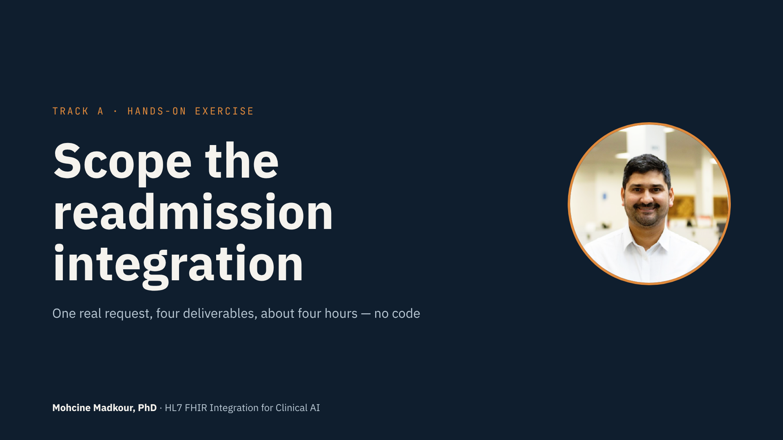
Notes:
• Welcome to the Track A hands-on exercise.
• You'll use all of Module 1 on one realistic request.
• No code. But you'll produce four real documents.
• And at the end you'll open a real HL7 v2 feed and find its problems.
• About four hours. You don't have to do it in one sitting.

Slide 2
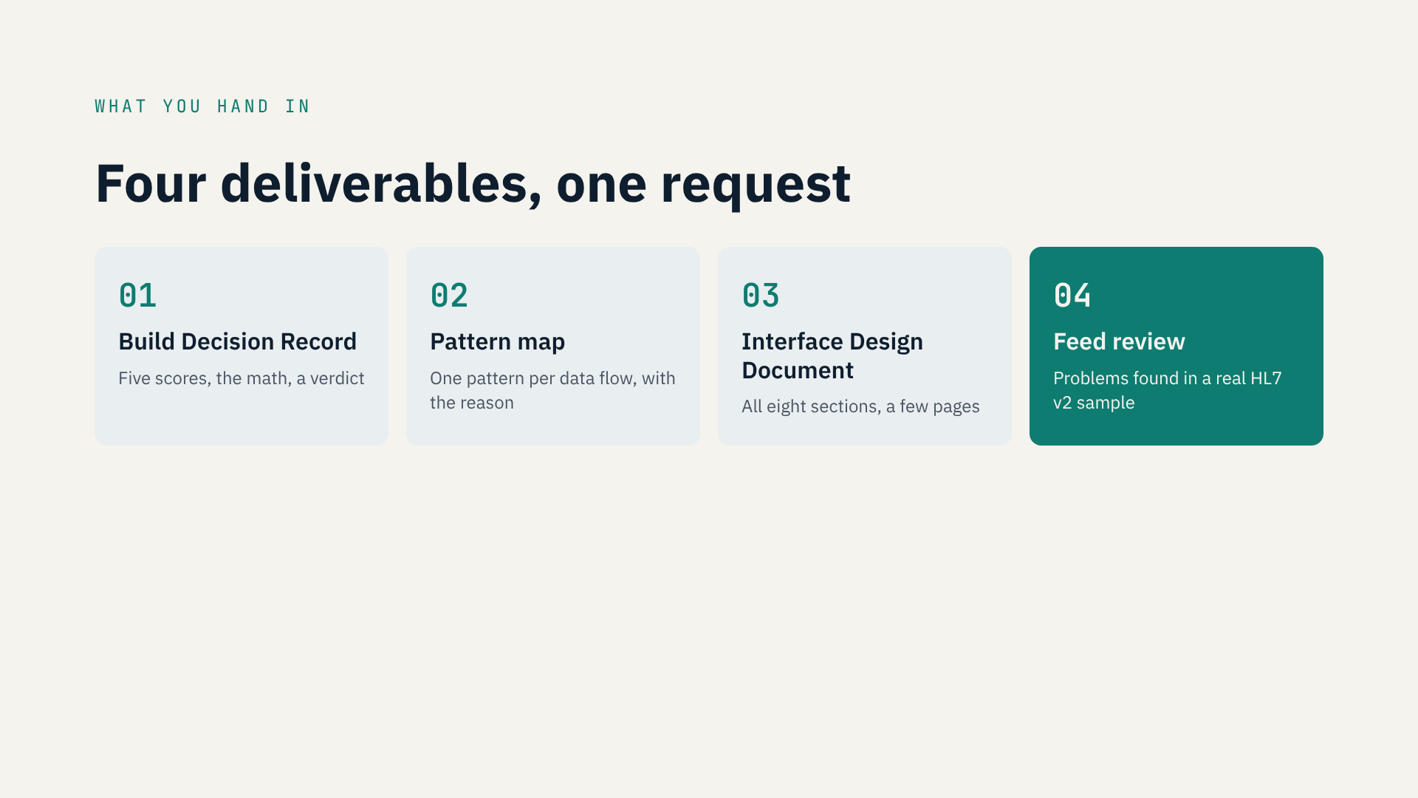
Notes:
• Four deliverables, one request.
• 1 · Build Decision Record: five scores, the math, a verdict.
• 2 · Pattern map: each data flow, one pattern, and why.
• 3 · Interface Design Document: all eight sections, a few pages.
• 4 · Feed review: find what's wrong in a sample HL7 v2 feed.
• The first three use Module 1's templates. The fourth previews Track B.

Slide 3
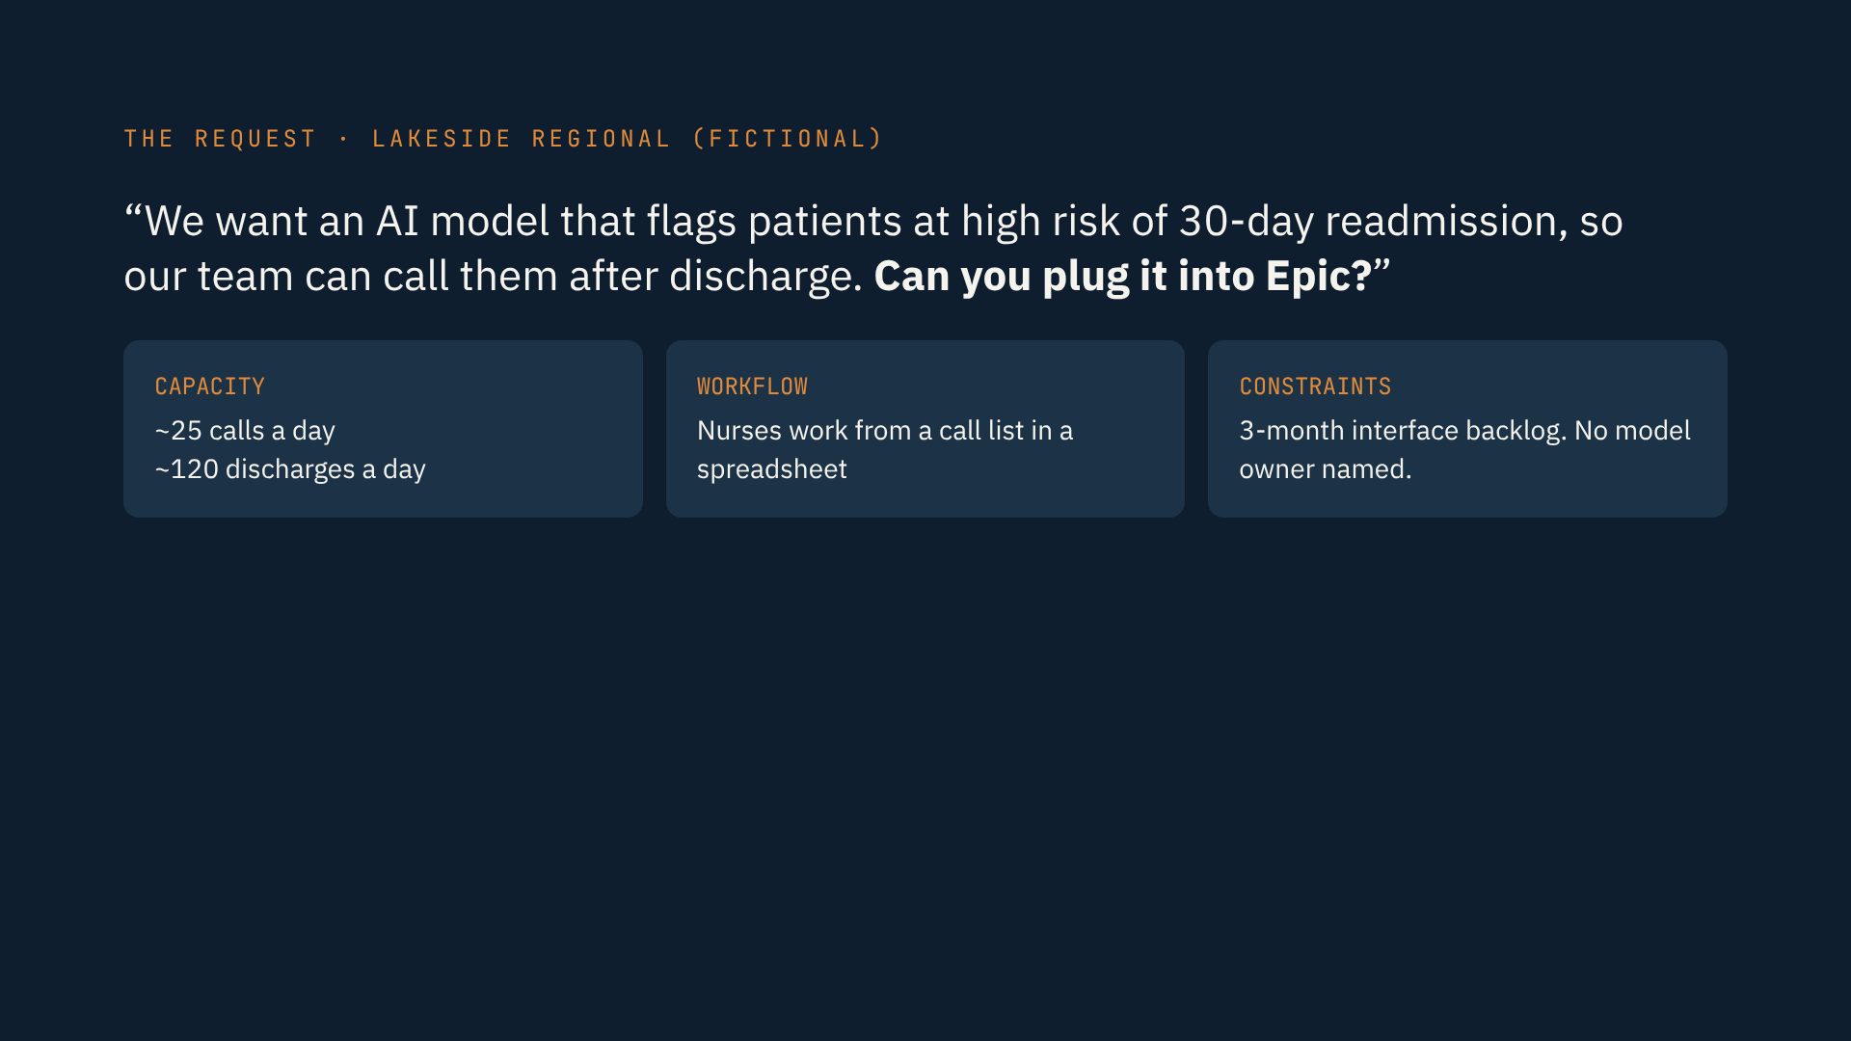
Notes:
• The request is fictional, but you'll get ones like it.
• Lakeside Regional wants a model that flags 30-day readmission risk.
• The goal: nurses call high-risk patients after discharge.
• Two nurses, about 25 calls a day, out of about 120 discharges.
• They work from a spreadsheet, not the chart.
• Three-month interface backlog. No model owner named.
• “Plug it into Epic” is a solution. Find out if it's the right one.
• Full scenario: Resource 3.

Slide 4
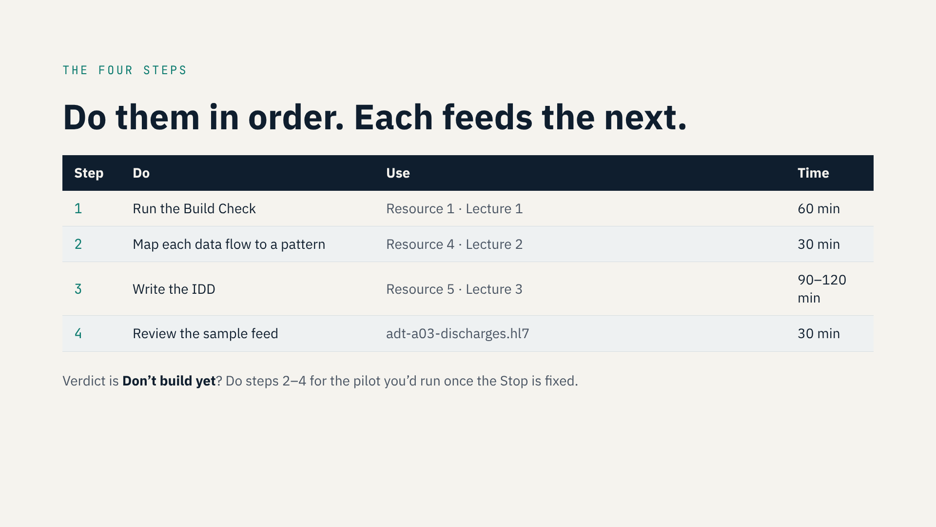
Notes:
• Four steps, in order. Each feeds the next.
• 1 · Build Check with Resource 1. About an hour.
• 2 · Pattern map with Resource 4. Thirty minutes.
• 3 · IDD with Resource 5. The longest step.
• 4 · Feed review. Next slide.
• Verdict is “Don't build yet”? Still do steps 2–4 for the pilot.
• And say what has to change first. That's what you'd do at work.

Slide 5
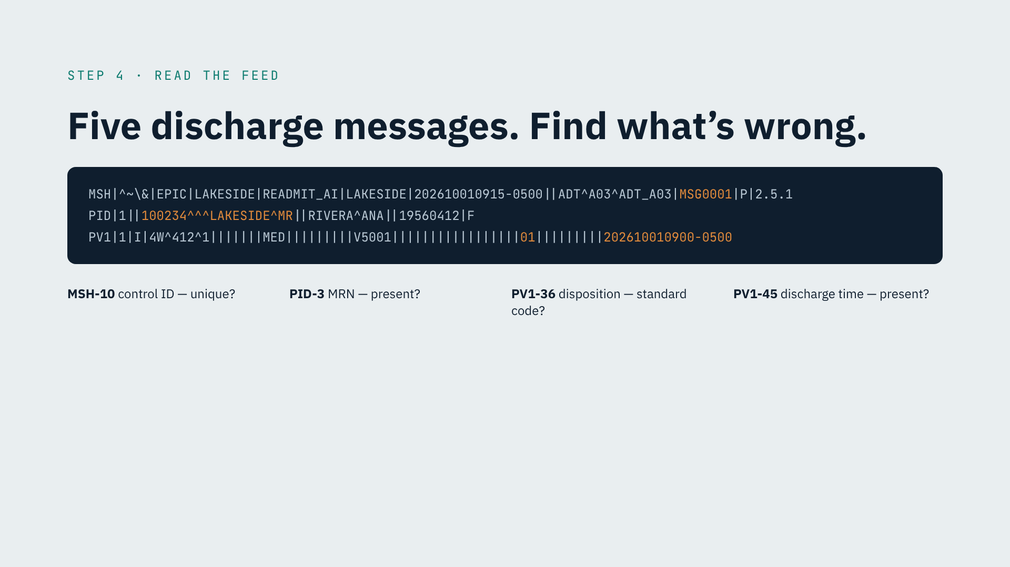
Notes:
• Step 4 is the hands-on part.
• Five HL7 v2 discharge messages, ADT A03. Patients are fictional.
• This first one is clean. Check the four highlighted fields.
• MSH-10: control ID. Should be unique.
• PID-3: the patient's MRN.
• PV1-36: discharge disposition. 01 means home.
• PV1-45: discharge date and time.
• Count the pipes to find a field. In MSH, the first pipe is field one.
• Check the other four messages. Find at least three problems.
• Each problem becomes a row in your IDD.

Slide 6
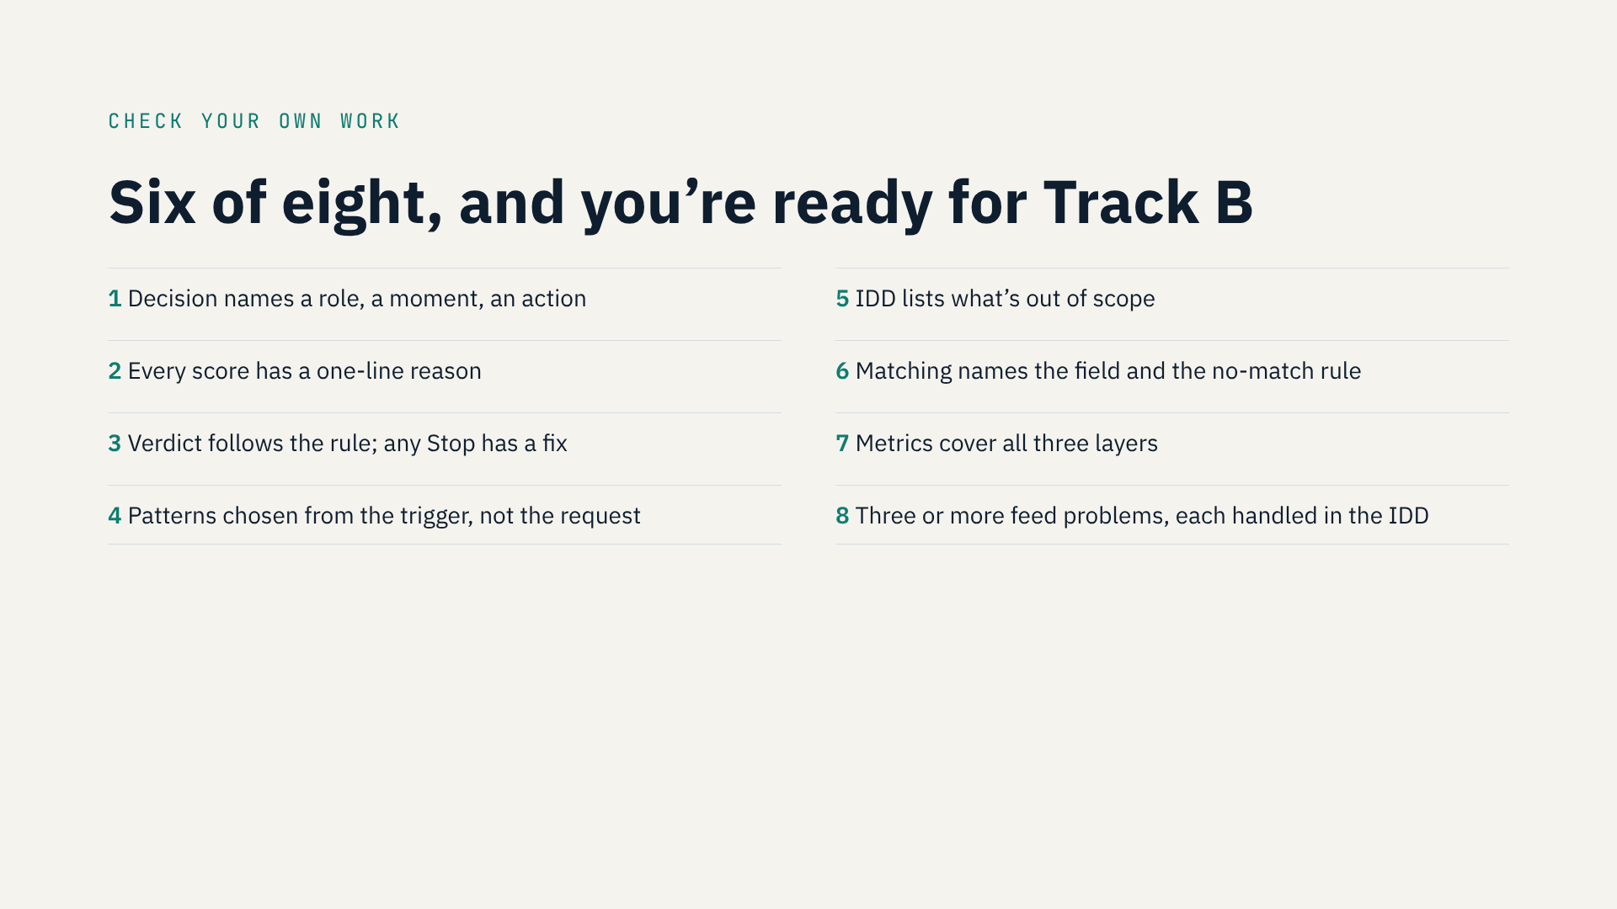
Notes:
• Check your work against eight points.
• 1 · The decision names a role, a moment, an action.
• 2 · Every score has a reason.
• 3 · The verdict follows the rule; any Stop has a fix.
• 4 · Patterns come from the trigger, not the request's words.
• 5 · The IDD lists what's out of scope.
• 6 · Matching names the field and the no-match rule.
• 7 · Metrics cover all three layers.
• 8 · Three or more feed problems, each handled.
• Six of eight, and you're ready for Track B.

Slide 7
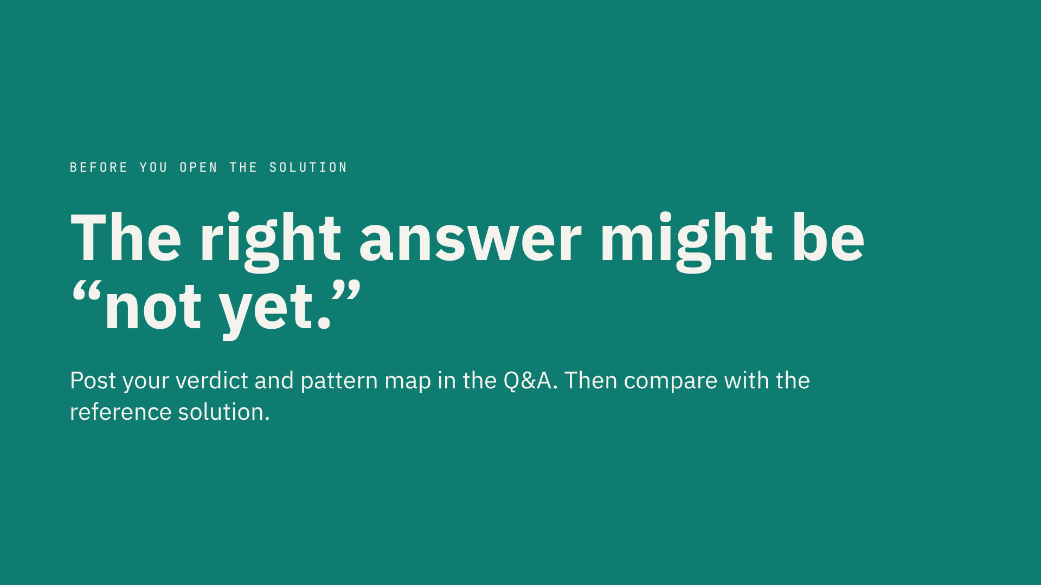
Notes:
• Don't assume the answer is “build it.”
• A well-reasoned “not yet” is a real deliverable.
• Look hard at ownership and at how the nurses actually work.
• Post your verdict and pattern map in the Q&A. I read them.
• Then open the reference solution — not before.
• It's one defensible answer. If yours differs and holds up, tell me.

Slide 8
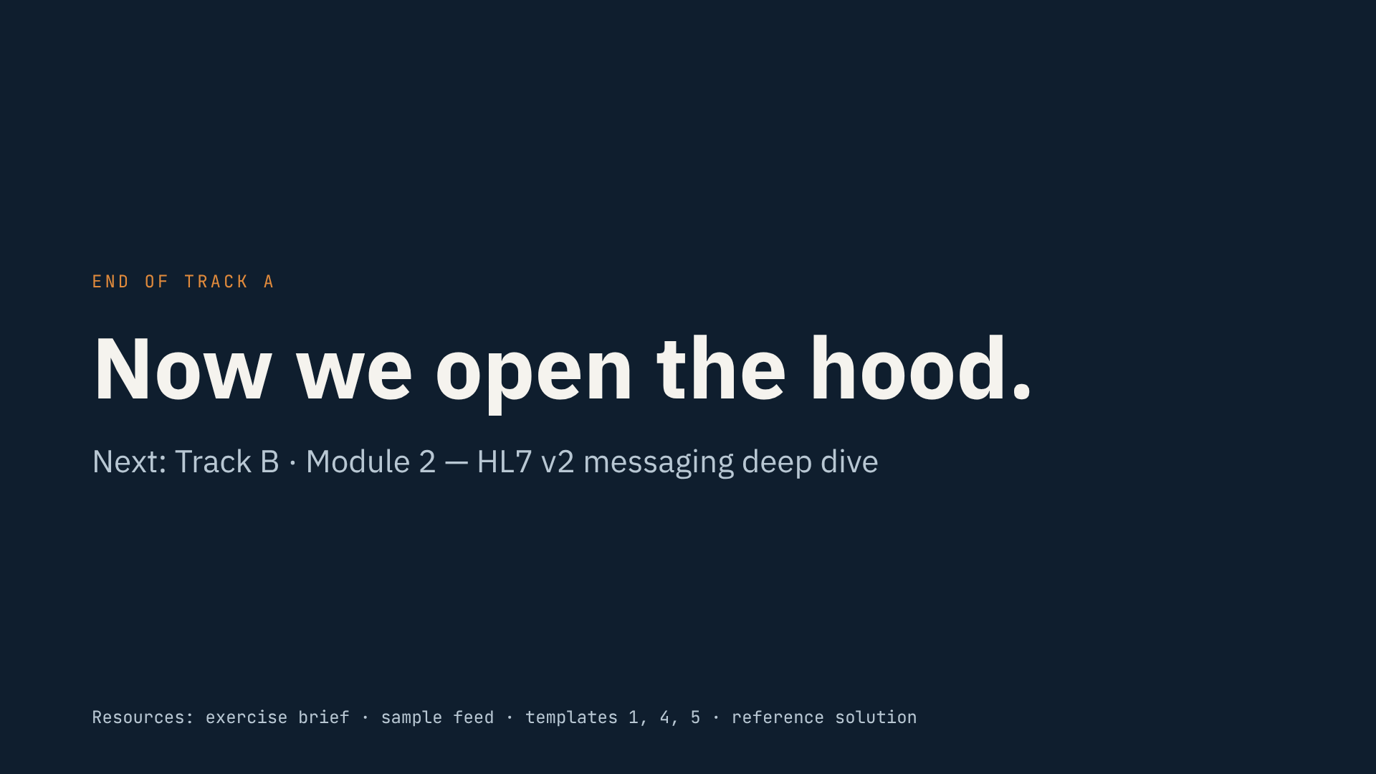
Notes:
• That's the end of Track A.
• You can now decide what to build, how it moves, and what can break — before coding.
• Track B opens the hood: HL7 v2, segment by segment.
• Those five discharge messages will look familiar.
• Bring your IDD. We'll build against it.
• See you in Module 2.

