Slide 1
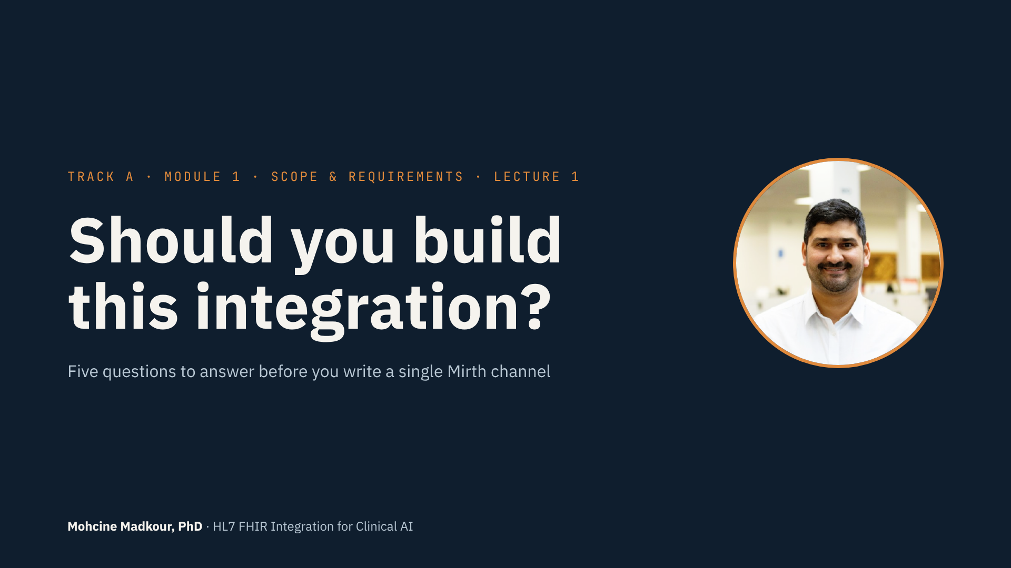
Notes:
• Welcome to Module 1.
• Skipped Module 0? Go back — it's short and explains the labs.
• This is the only module with no code. On purpose.
• Every other module teaches how to build. This one teaches whether to build.
• The most expensive mistake isn't a bug. It's a working pipeline nobody needed.
• You build it, run it, and get paged for it — so you should ask first.
• By the end: a five-question check and a one-page decision record.

Slide 2
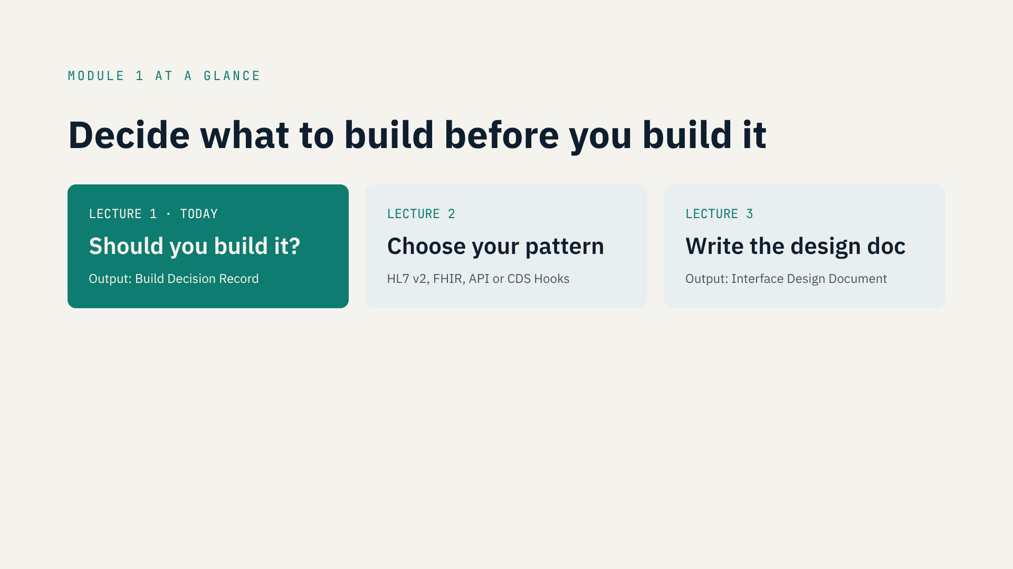
Notes:
• Module 1 has three lectures, three decisions, in this order.
• Lecture 1: should we build it? Output: a Build Decision Record.
• Lecture 2: which pattern? HL7 v2, FHIR, bulk export, API or CDS Hooks.
• Lecture 3: the Interface Design Document — the spec everyone signs.
• Most teams start with lecture 3, or jump straight to code.
• We earn the right to build first.

Slide 3
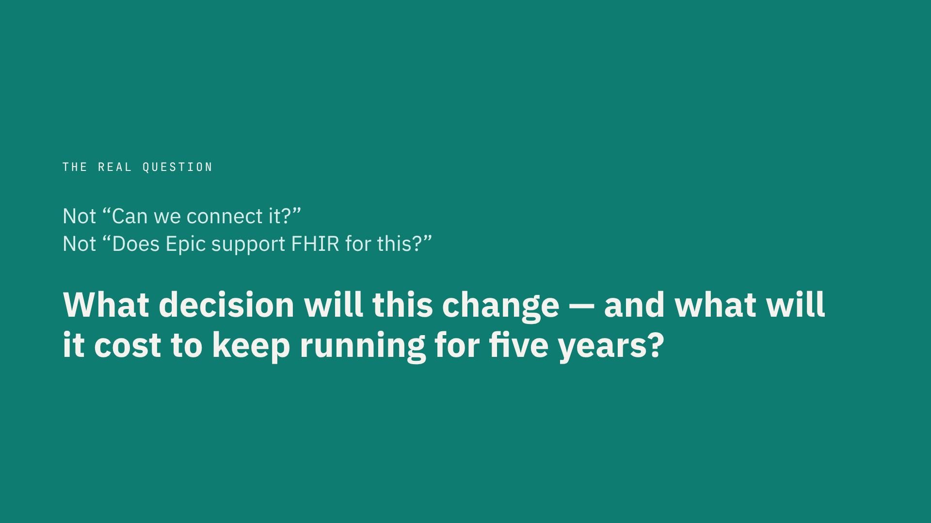
Notes:
• The question almost nobody asks at the start.
• Not “Can we connect it?” Not “Does Epic support FHIR for this?”
• First: what decision will this change, and who makes it?
• No decision and no person? Then it's a plumbing project, not a use case.
• Second: what will it cost to keep running for five years?
• Not to build it. To run it. That's where the money and the pain go.
• Let's start with that second question.

Slide 4
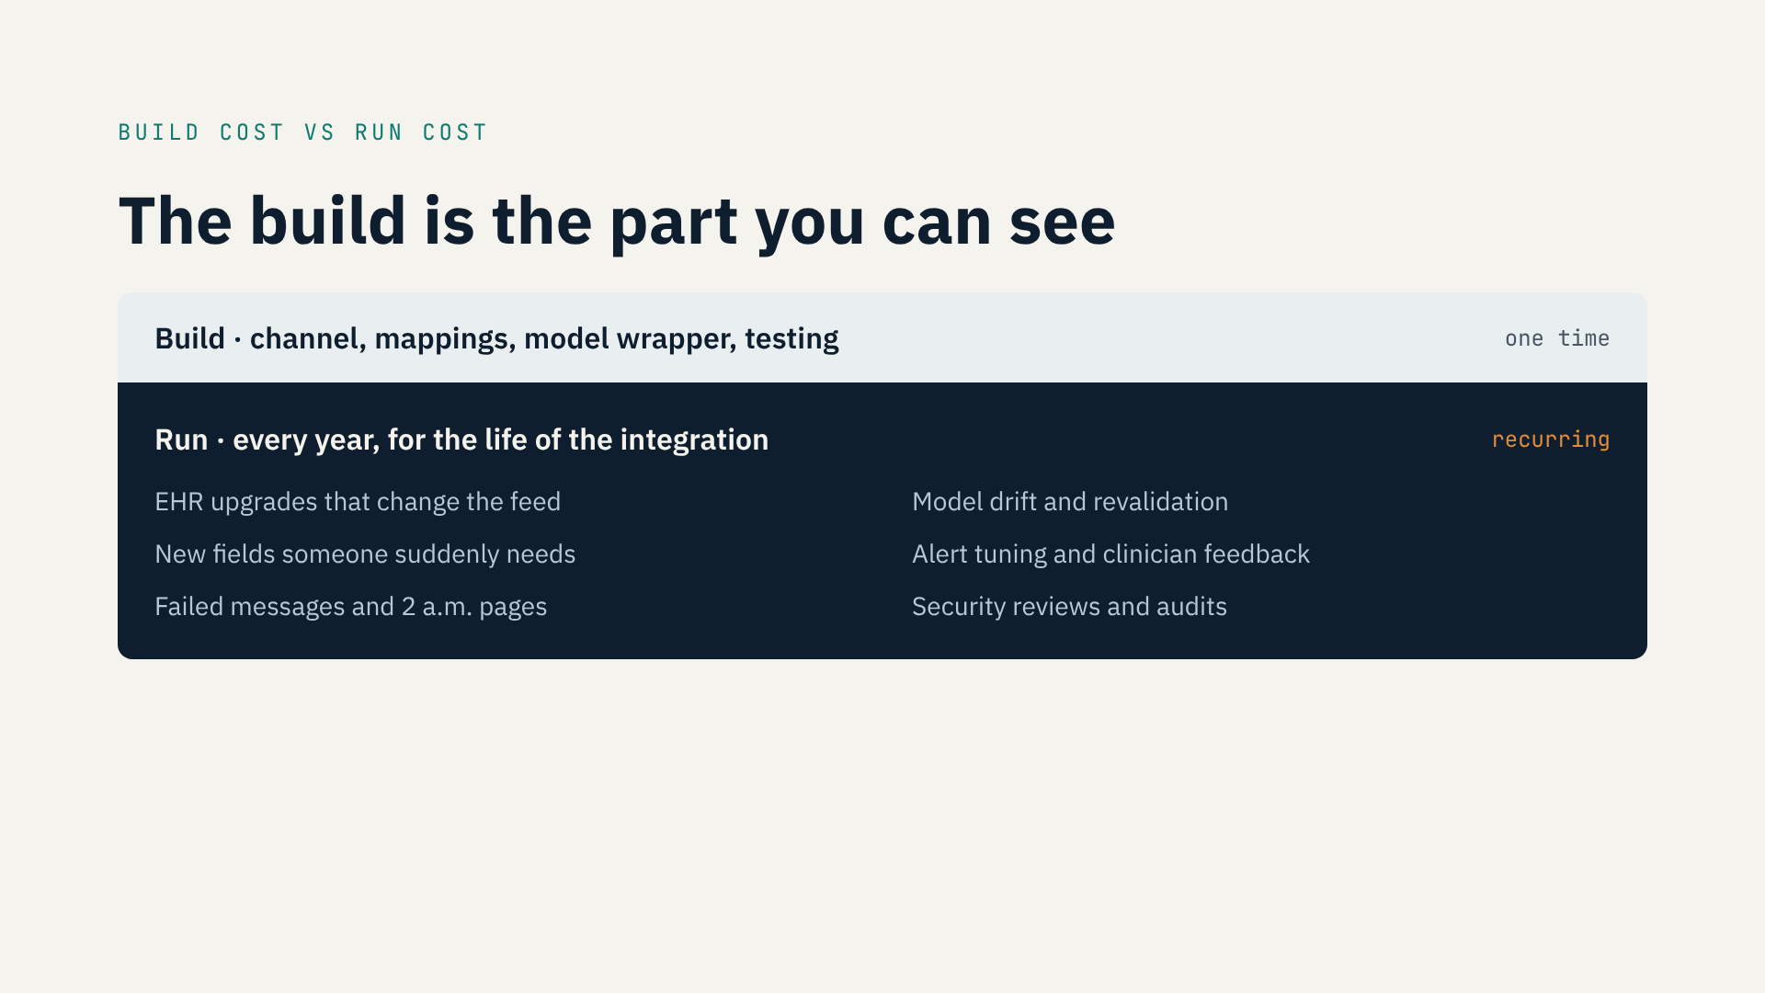
Notes:
• The build is what everyone sees: channel, mappings, model wrapper, tests.
• The run is underneath, and it never ends.
• EHR upgrades change the feed.
• Someone always wants one more field.
• Messages fail. Someone gets paged at 2 a.m.
• Security reviews it every year.
• Clinical AI adds a second thing that ages: the model. It drifts and needs revalidation.
• [Optional: your own rule of thumb — run cost vs. build cost on a real project.]
• Honest cost = build + yearly run × years you keep it alive.

Slide 5
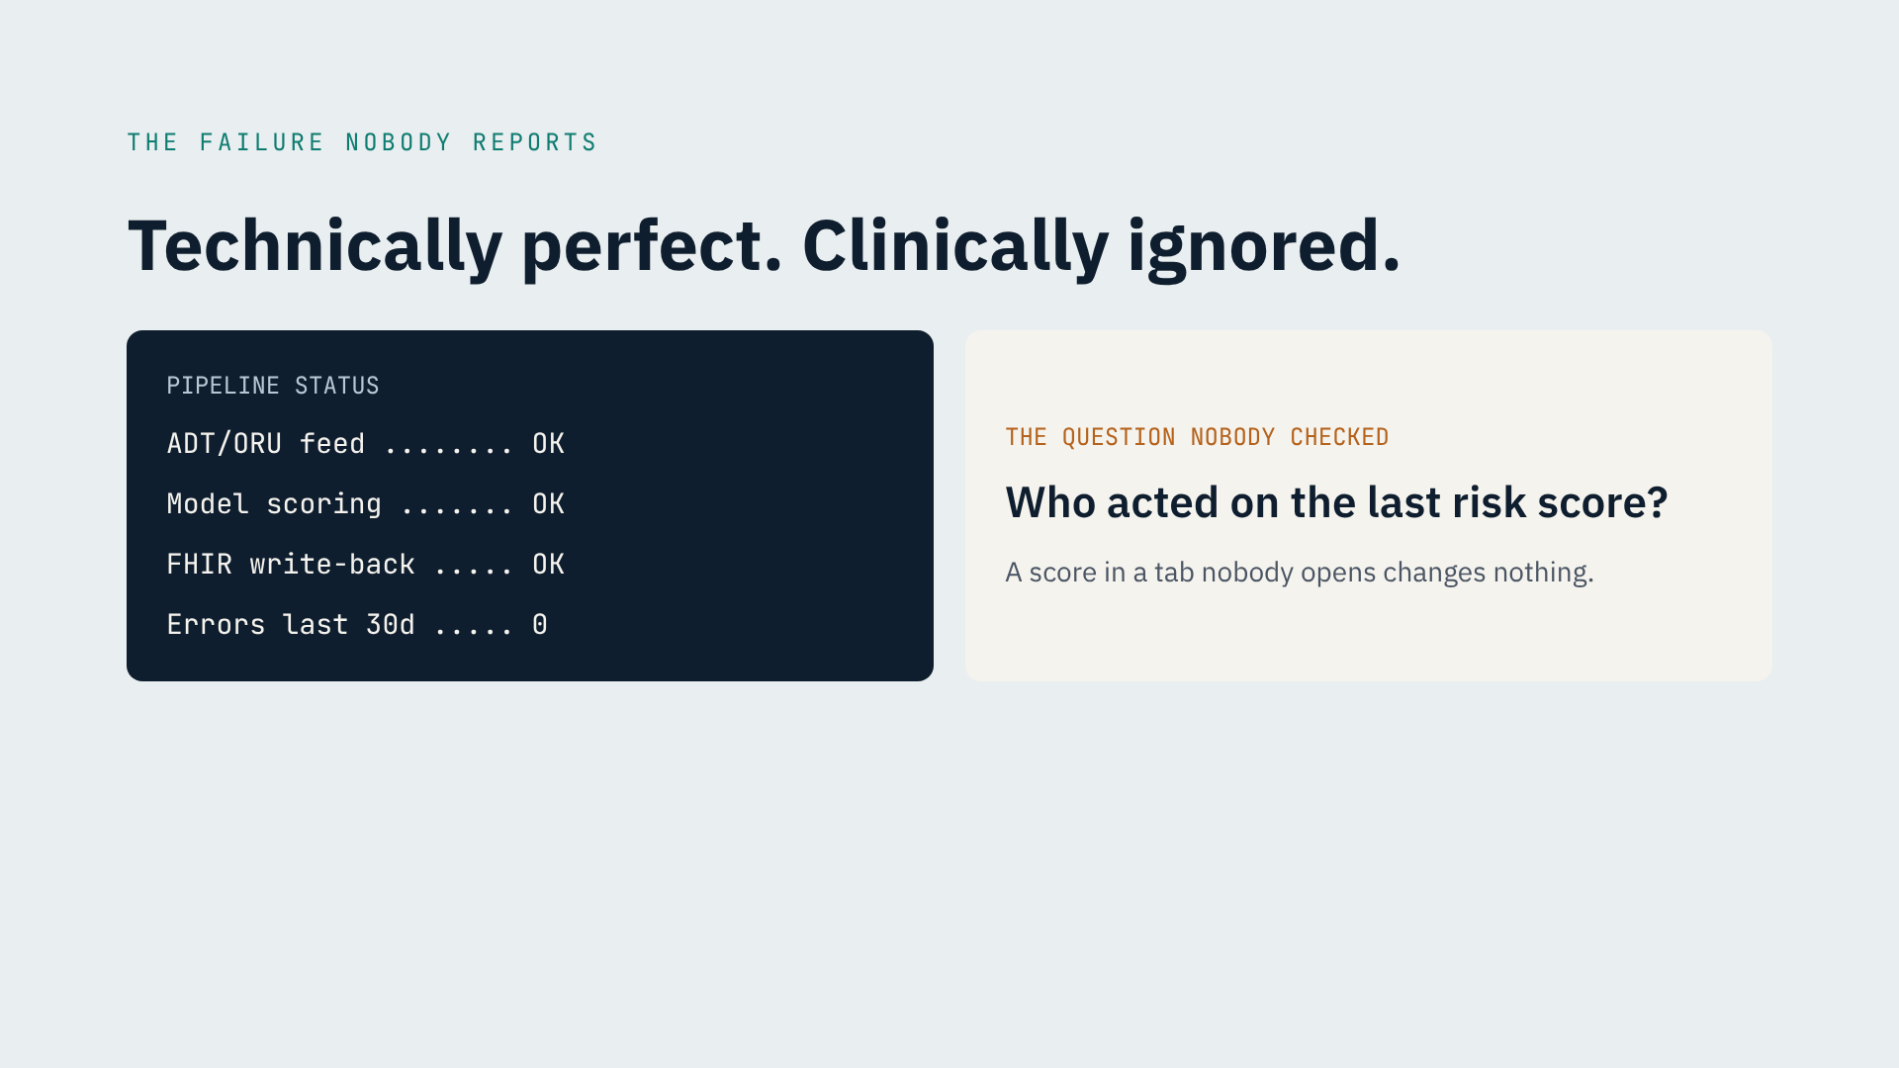
Notes:
• Here's a failure you'll never see in an incident report.
• Left: the pipeline is perfect. Feed up, scoring every hour, zero errors in 30 days.
• Right: the question nobody asked — who acted on the last score?
• If the score lands where nobody looks, or after the decision, it changed nothing.
• So we start from the decision, not from the data.

Slide 6
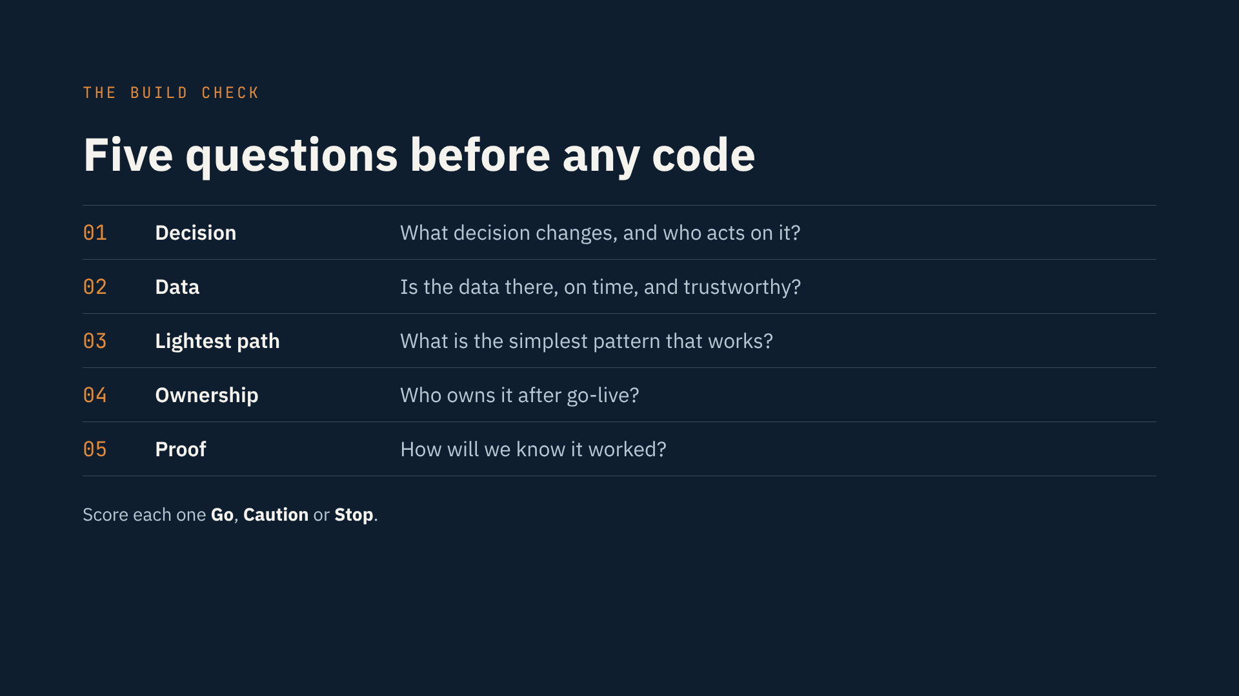
Notes:
• This is the tool for this lecture: the Build Check.
• Five questions, answered before anyone writes code.
• Decision, data, lightest path, ownership, proof.
• Score each one Go, Caution or Stop.
• One working session with the requester and the interface team.
• It ends in a one-page record.
• I'll run each question on our sepsis pipeline.

Slide 7
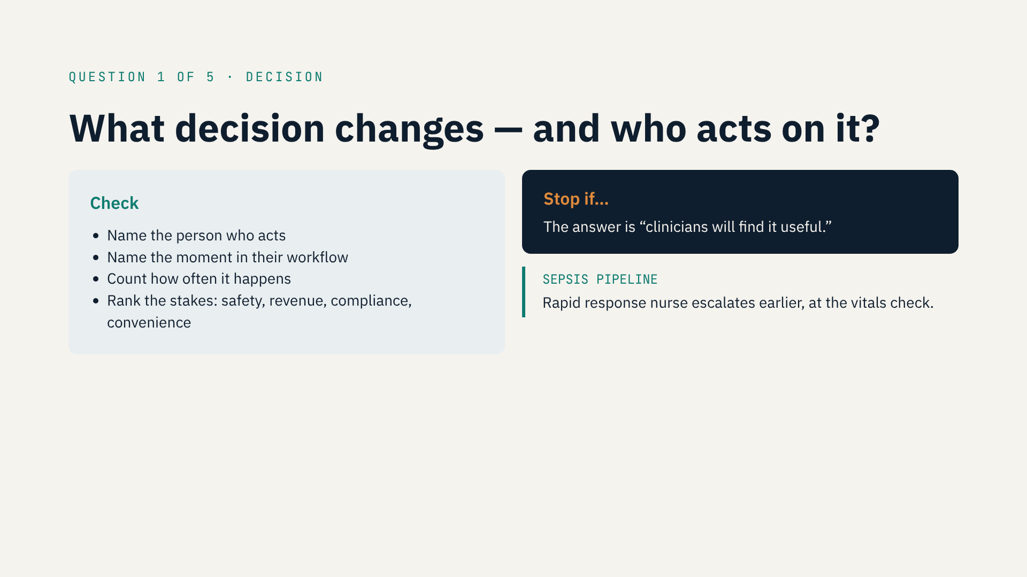
Notes:
• Question one: what decision changes, and who acts on it?
• Write down four things.
• One: the person who acts. A role, not “the care team.”
• Two: the moment in their workflow.
• Three: how often it happens.
• Four: the stakes. Safety first, then revenue and compliance, then convenience.
• Stop signal: “clinicians will find it useful.” That’s not a use case yet.
• Sepsis example: the rapid response nurse, at the vitals check, escalates earlier.
• Every shift, safety-critical. A clear Go.
• Remember: a person, a moment, an action. Missing one? Stop here.

Slide 8
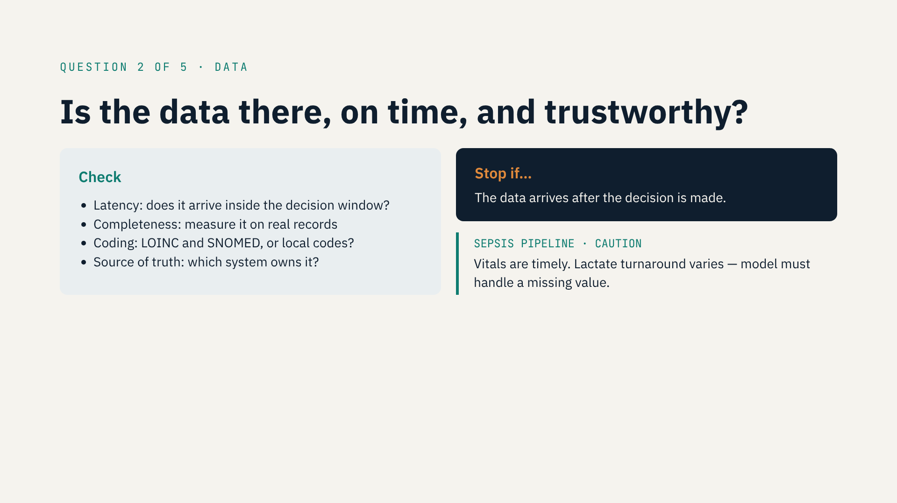
Notes:
• Question two: is the data there, on time, and trustworthy?
• Latency: does it arrive inside the decision window?
• Completeness: pull a real sample and measure. Don't trust the data dictionary.
• Coding: LOINC, or local codes that change site to site?
• Source of truth: if a value lives in three systems, pick one.
• Stop signal: the data arrives after the decision is made.
• Sepsis: Caution. Vitals are on time; lactate often isn't.
• That becomes a requirement: the model must handle a missing lactate.

Slide 9
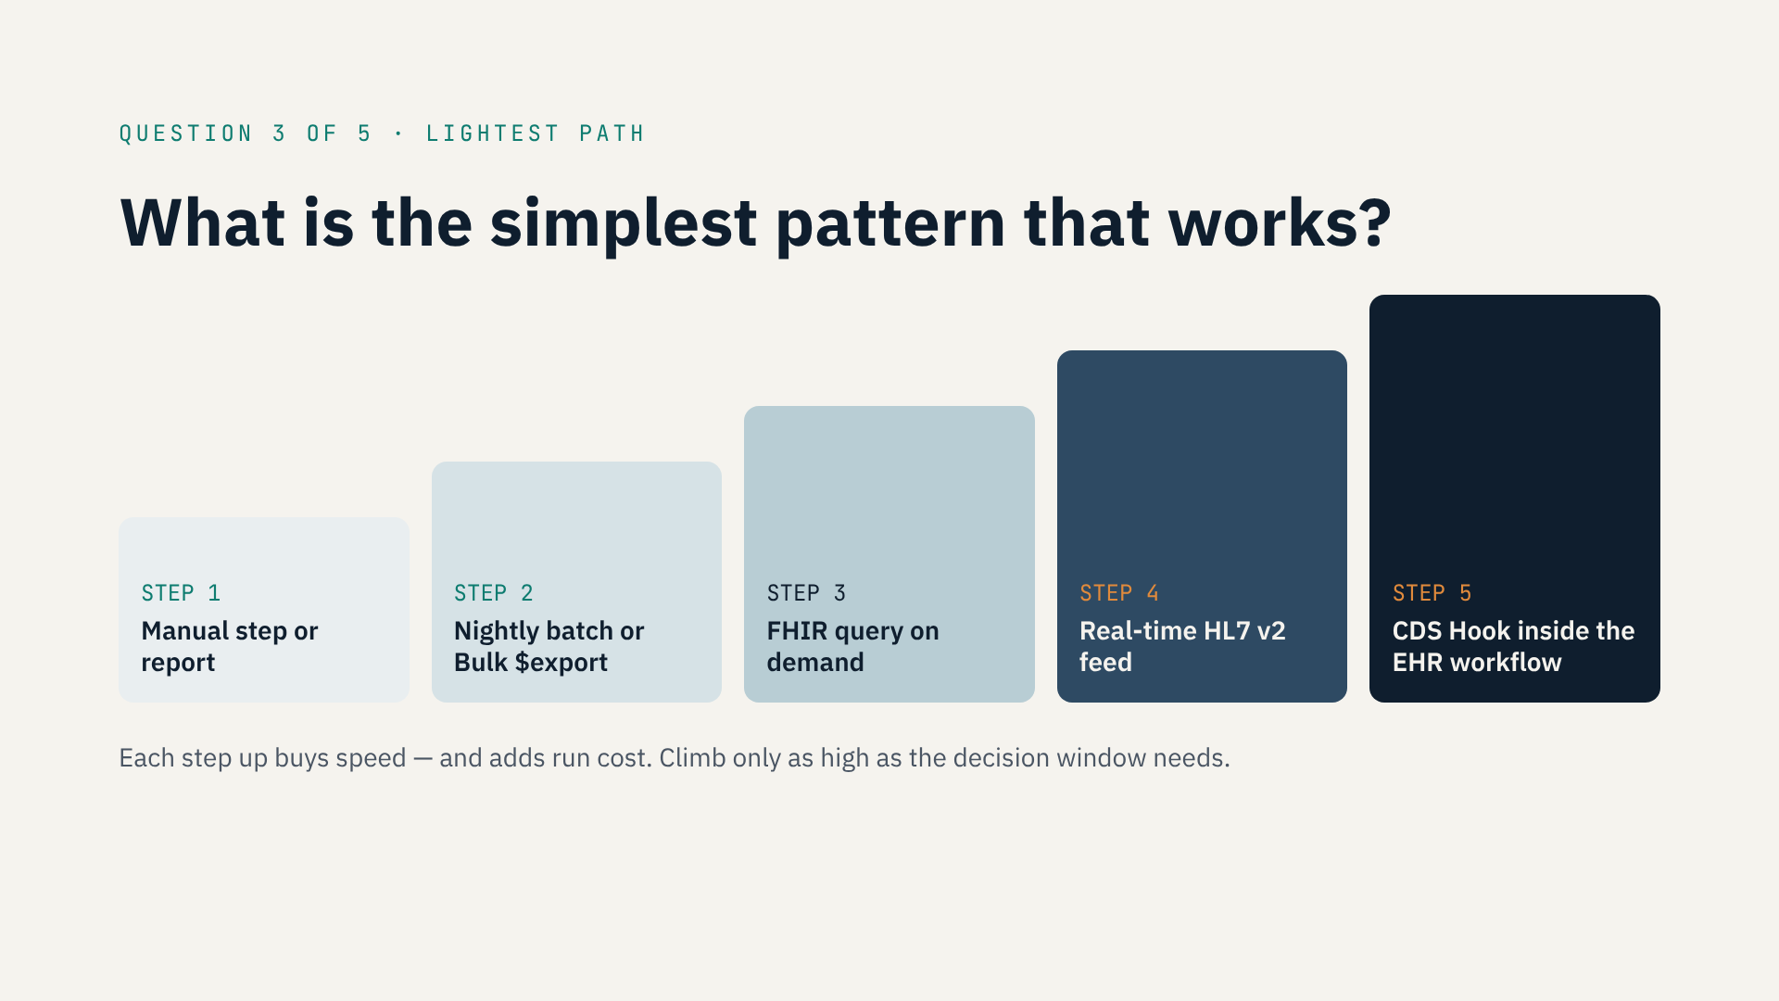
Notes:
• Question three: what's the simplest pattern that works?
• Engineers love the top of this ladder. It's also the most expensive to run.
• Step 1: a manual step or report. Fine for rare events.
• Step 2: nightly batch or Bulk export. Enough if the decision is tomorrow.
• Step 3: FHIR query on demand. No feed to maintain.
• Step 4: real-time HL7 v2 feed. Now you monitor and replay messages.
• Step 5: CDS Hook in the EHR. Highest impact, highest cost.
• Rule: climb only as high as the decision window needs.
• First ask: would a workflow change or training fix it?
• Sepsis: window is hours, action is in the EHR. Steps 4–5 justified. Go.

Slide 10
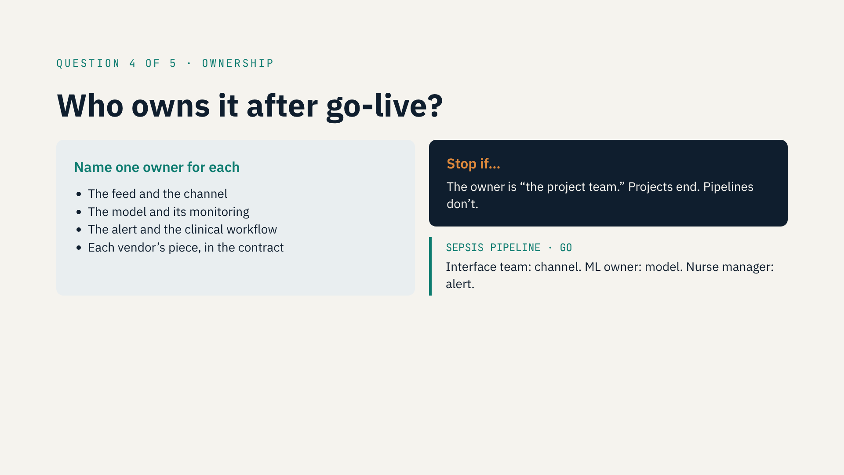
Notes:
• Question four: who owns it after go-live?
• The feed and the channel: usually the interface team.
• The model and its monitoring: you, or your ML team.
• The alert and the workflow: a clinical owner, like a nurse manager.
• Vendors: write each one's responsibility into the contract.
• Stop signal: the owner is “the project team.” Projects end. Pipelines don't.
• [Optional: a quick story of a pipeline that lost its owner.]
• Sepsis: interface team, ML owner, nurse manager. Three names. Go.

Slide 11
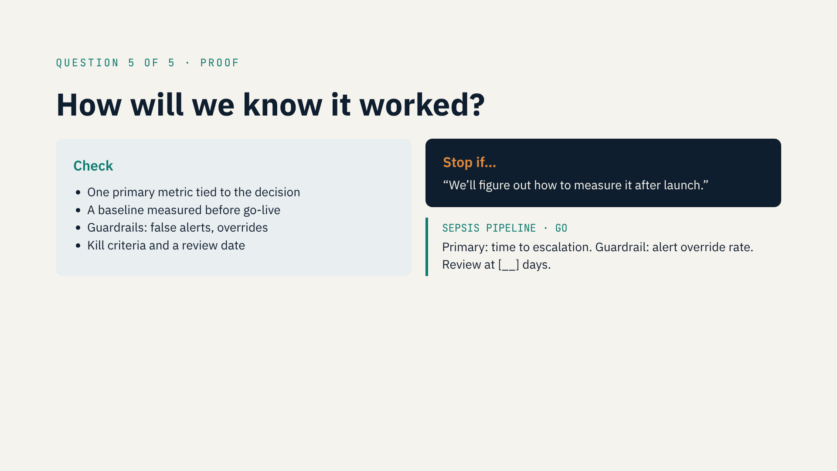
Notes:
• Question five: how will we know it worked?
• I care most about this one — it's what I do at EvalTrust.
• One primary metric tied to the decision. Not AUC — the action.
• A baseline measured before go-live.
• Guardrails: false-alert rate and override rate.
• Kill criteria and a review date, decided in advance.
• Stop signal: “we'll figure out how to measure it after launch.”
• Sepsis: time to escalation, override rate, review at [__] days. Go.

Slide 12
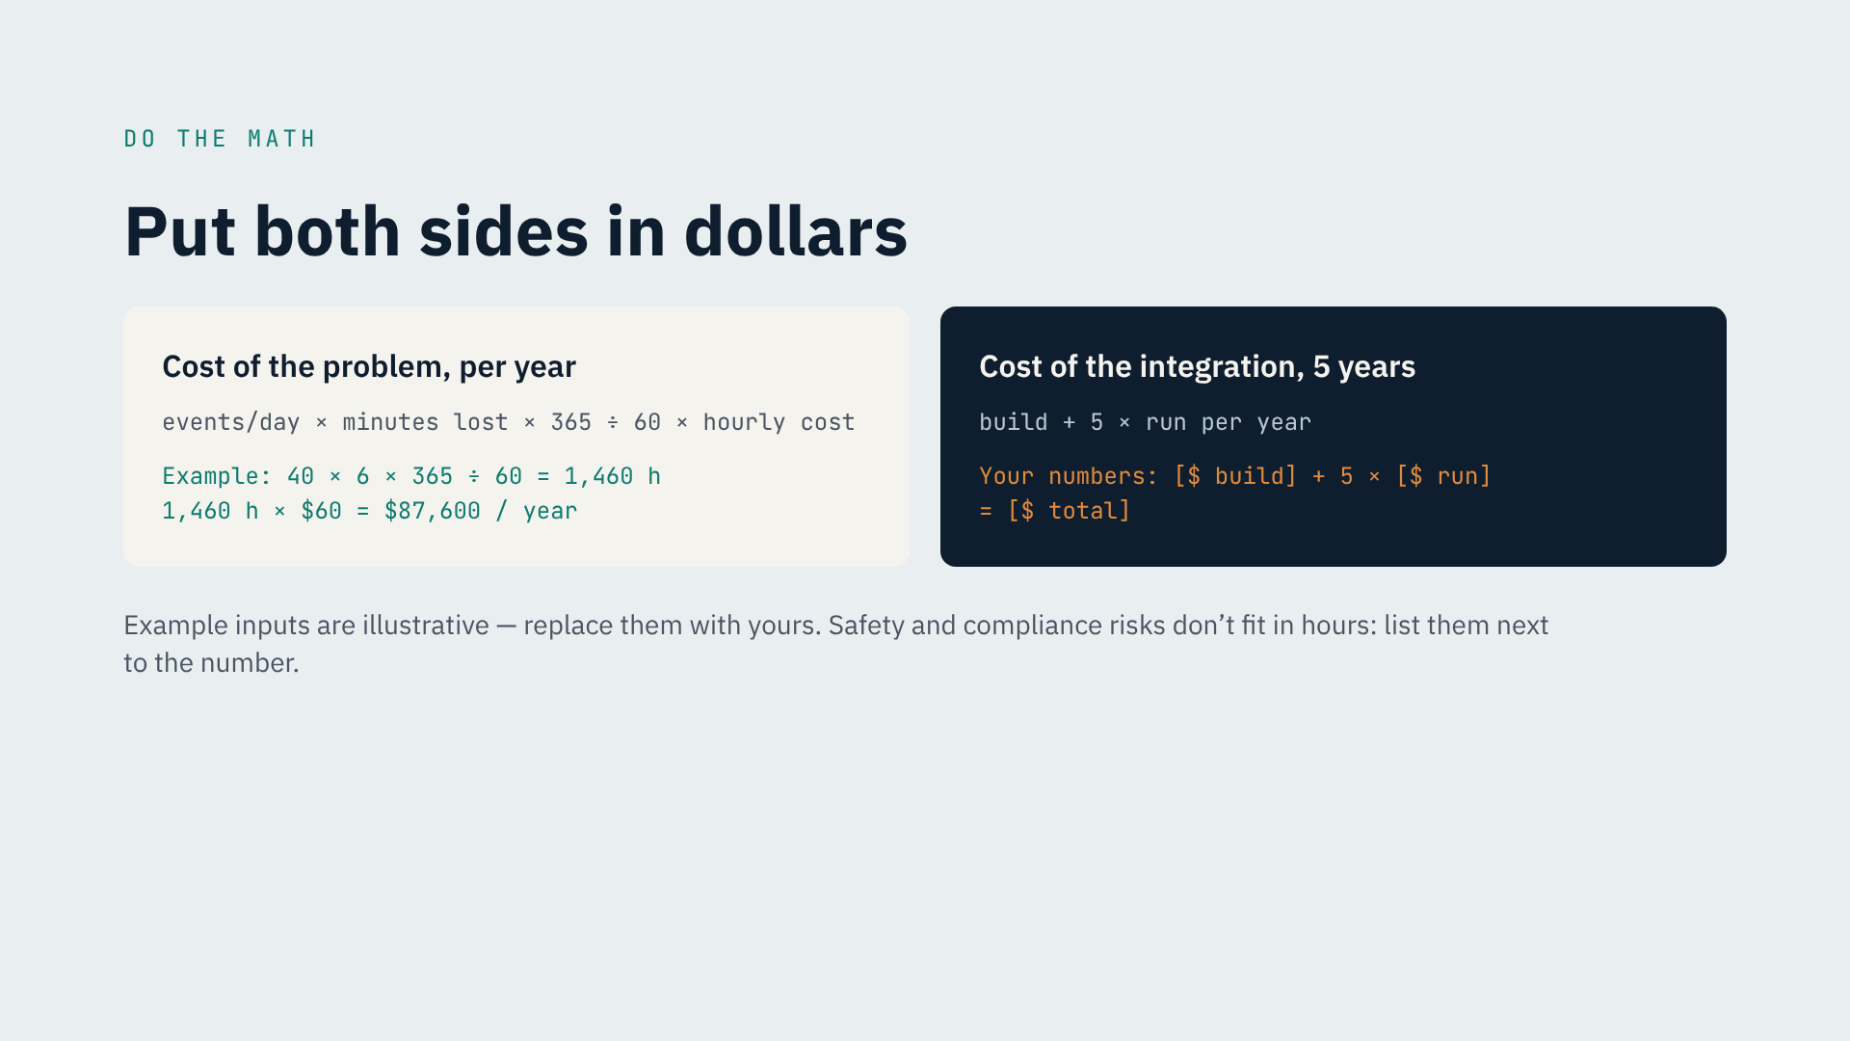
Notes:
• Put both sides in dollars. Leaders understand it.
• Left: cost of the problem per year.
• Events per day × minutes lost × 365 ÷ 60 × hourly cost.
• Example, made-up inputs: 40 × 6 × 365 ÷ 60 = 1,460 hours. At $60/hour: $87,600 a year.
• Measure your own inputs. Don't guess.
• Right: five-year cost = build + 5 × yearly run cost.
• Safety and compliance risks don't fit in hours. List them next to the number.
• [Optional: real numbers from a project of yours.]

Slide 13
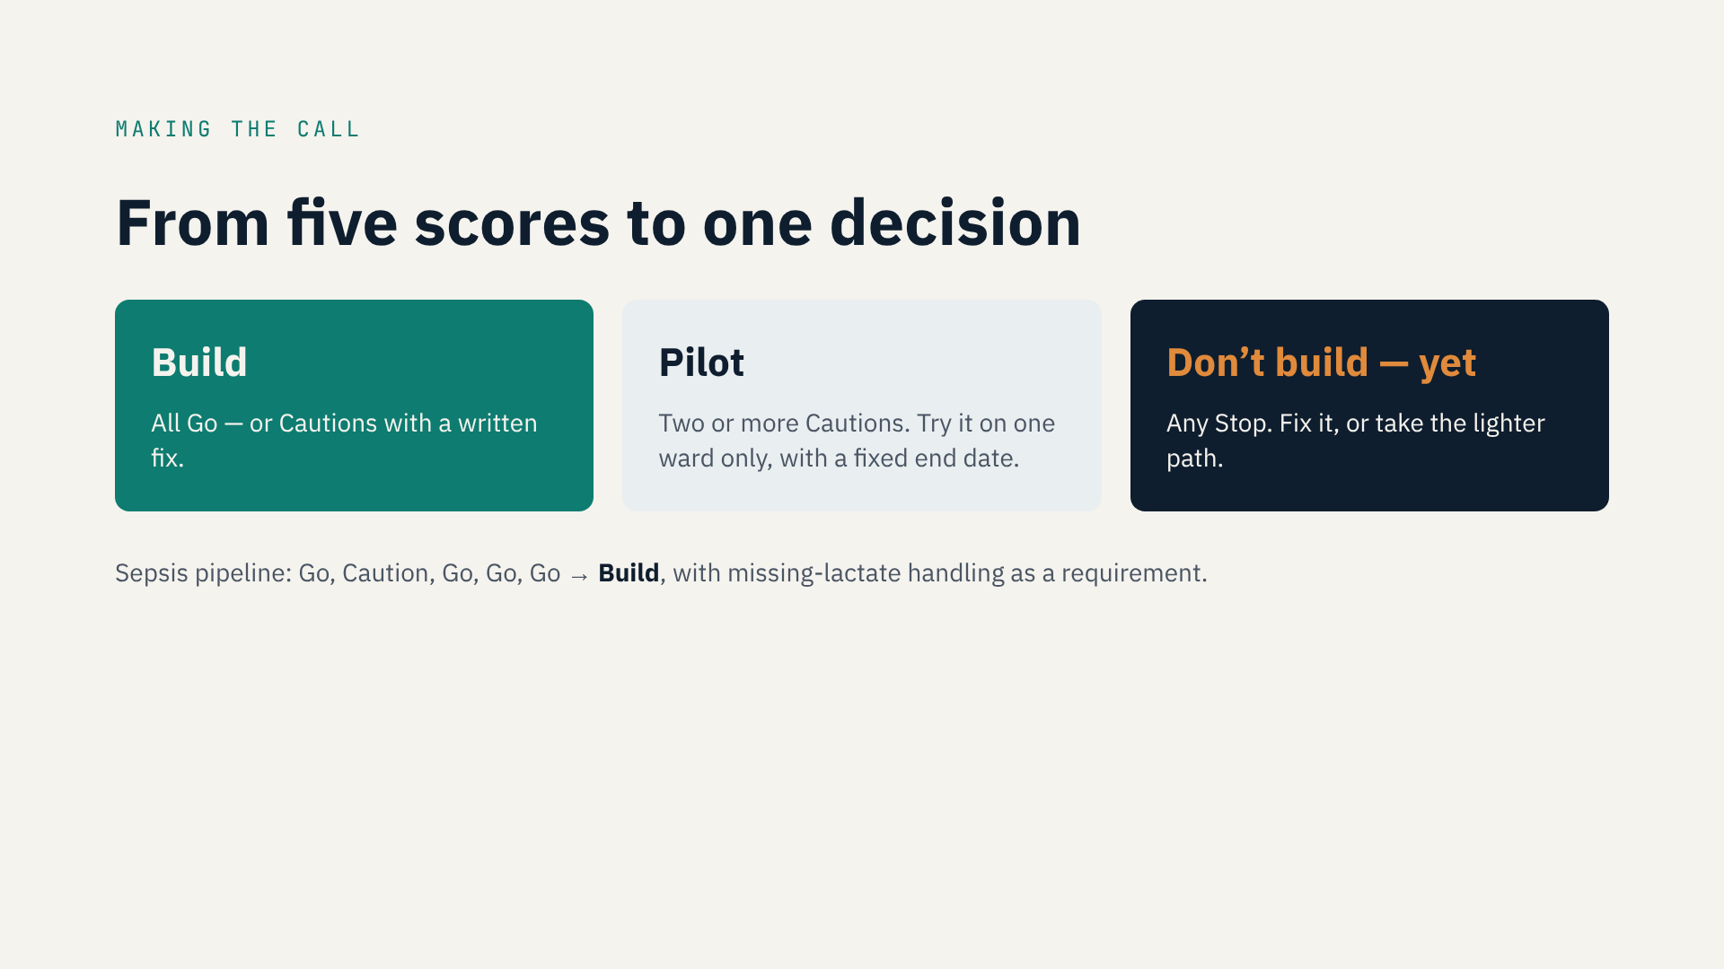
Notes:
• Five scores become one decision.
• Build: all Go, or each Caution has a written fix.
• Pilot: two or more Cautions. Promising, but with real unknowns.
• Try it on one ward only — not the whole hospital — with a fixed end date, say 60 days.
• On that date, check your metrics: build it fully, adjust it, or stop.
• Don't build yet: any Stop. Fix it, or take a lighter path.
• Must-haves (regulation, safety): run the check anyway. It shapes how you build.
• Sepsis: Go, Caution, Go, Go, Go → Build, with missing-lactate handling.
• Decide with the clinical owner and the interface lead — not alone.

Slide 14
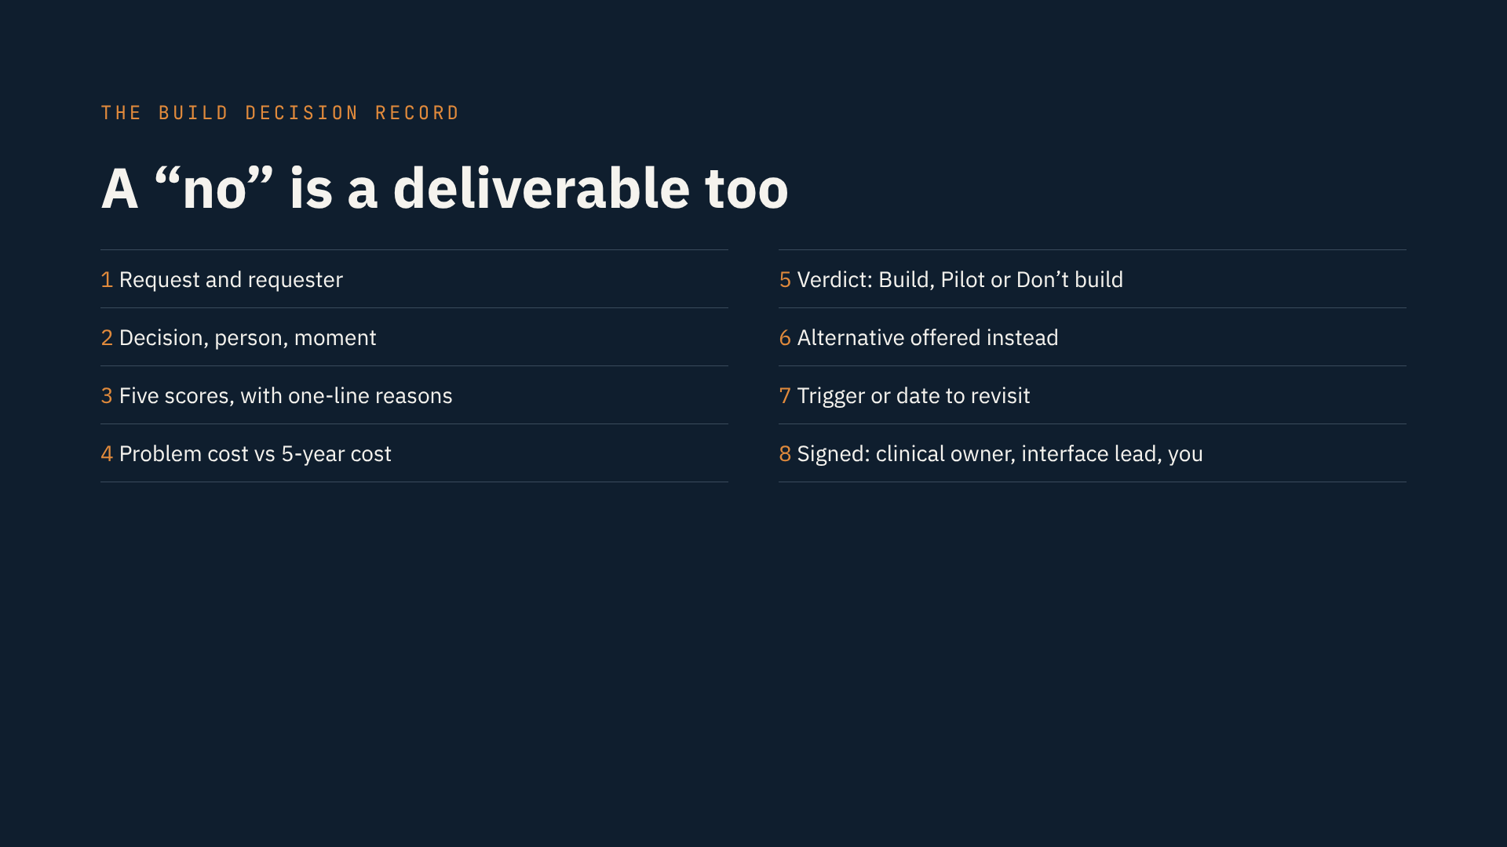
Notes:
• Every verdict goes into a Build Decision Record. One page, eight fields.
• 1 · The request and who asked.
• 2 · The decision: person and moment.
• 3 · Five scores, each with a reason.
• 4 · Problem cost vs. five-year cost.
• 5 · The verdict.
• 6 · The alternative you offer instead.
• 7 · When to look again.
• 8 · Signatures: clinical owner, interface lead, you.
• A well-documented no is a real deliverable. It protects your team's time.
• [Optional: a time you said no — or wish you had.]

Slide 15
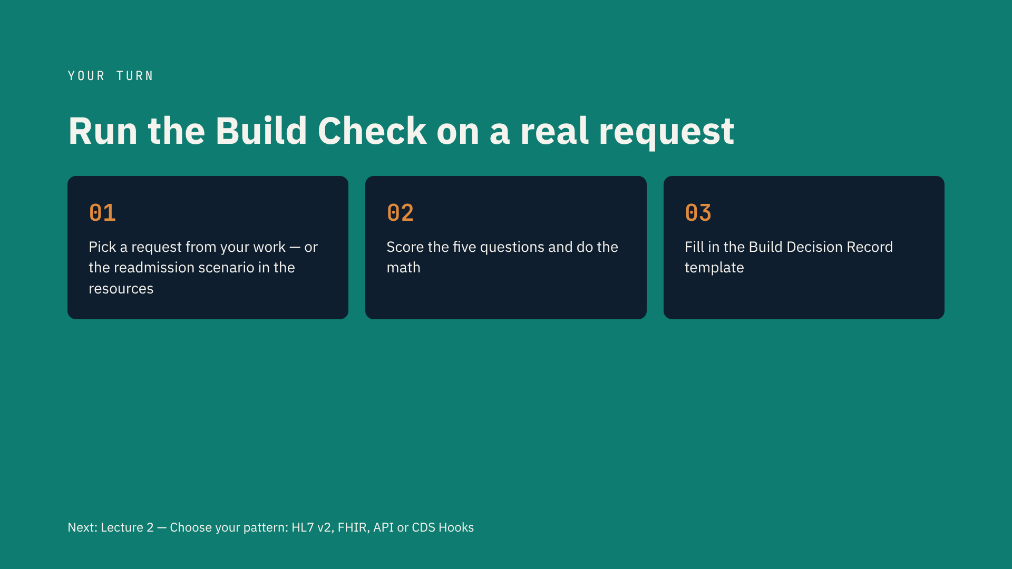
Notes:
• Your turn.
• Step 1: pick a real request — or the readmission scenario in the resources.
• Step 2: score all five questions, with a reason each. Do the math.
• Step 3: fill in the Build Decision Record. Then compare with my sepsis example.
• Budget about an hour.
• Done in ten minutes? You probably wrote “clinicians will find it useful.” Go back to question one.
• Post your verdict in the Q&A. I'm most interested in the “Don't build” ones.
• Next lecture: which pattern?

