Slide 1
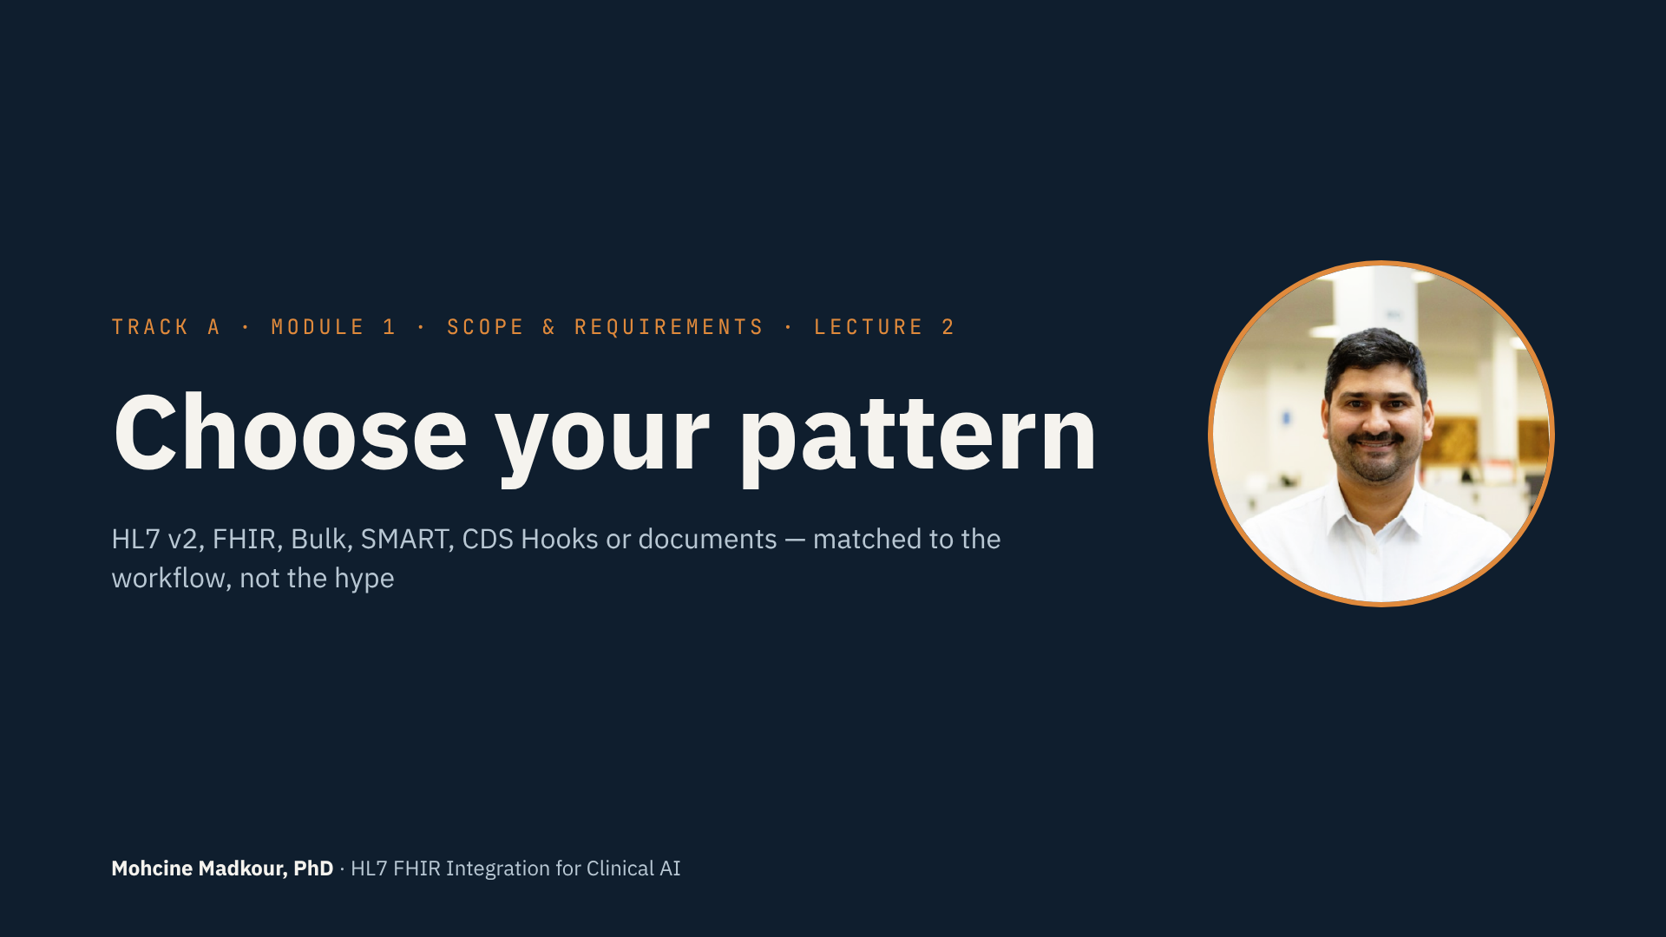
Notes:
• Welcome to lecture 2.
• Last lecture: should we build? Now: which pattern?
• Common mistake: “we're doing a FHIR integration” before anyone describes the workflow.
• FHIR isn't one thing, and it isn't always the answer.
• Inside hospitals, much real-time data still moves as HL7 v2.
• Today: six patterns, a quick way to choose, and our sepsis pipeline as an example.
• About fifteen minutes. Keep a notepad — there's an exercise at the end.

Slide 2
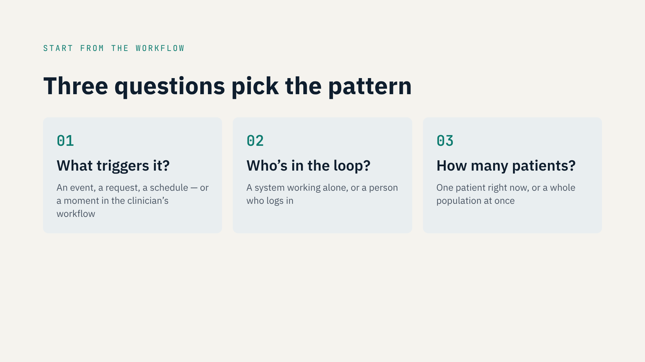
Notes:
• Three questions pick the pattern for you.
• One: what triggers it? An event, a request, a schedule, or a workflow moment.
• Two: who's in the loop? A system alone, or a person who logs in.
• Three: how many patients? One right now, or a whole population.
• None of these mention HL7 or FHIR. They're about the workflow.
• You already answered most of them in the Build Check.

Slide 3
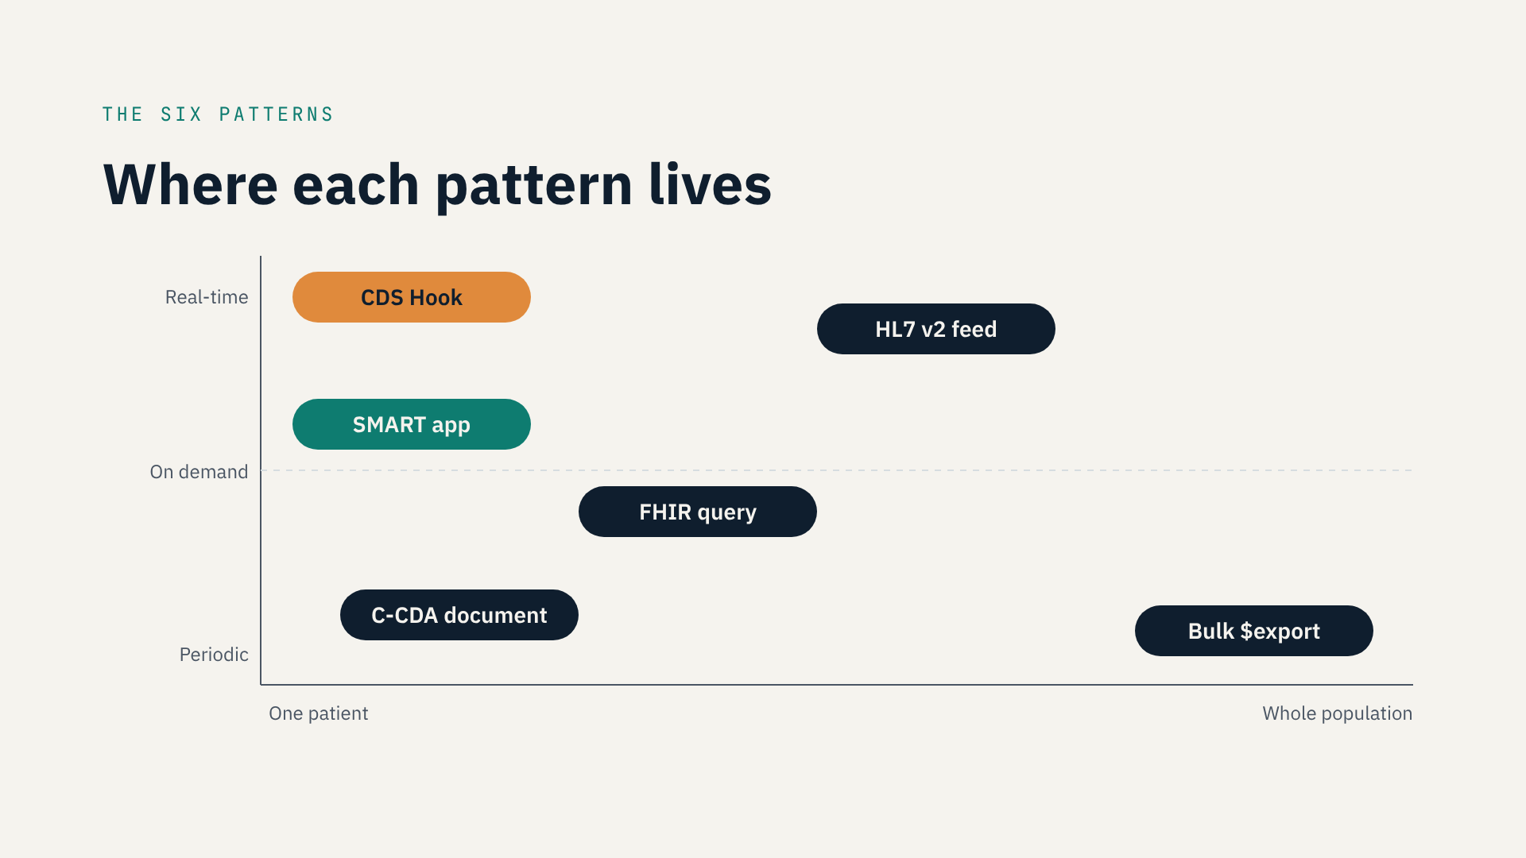
Notes:
• Six patterns on one map.
• Up: fresher data. Right: more patients.
• Top left, orange: CDS Hooks. Real-time, one patient, inside the workflow.
• Top middle: HL7 v2 feed. Real-time events for every patient.
• Left, teal: SMART app. A person opens it for one patient.
• Middle: FHIR query. Your system asks for one patient's data.
• Lower left: C-CDA document. A one-time snapshot between organizations.
• Bottom right: Bulk export. Thousands of patients on a schedule — your training data.

Slide 4
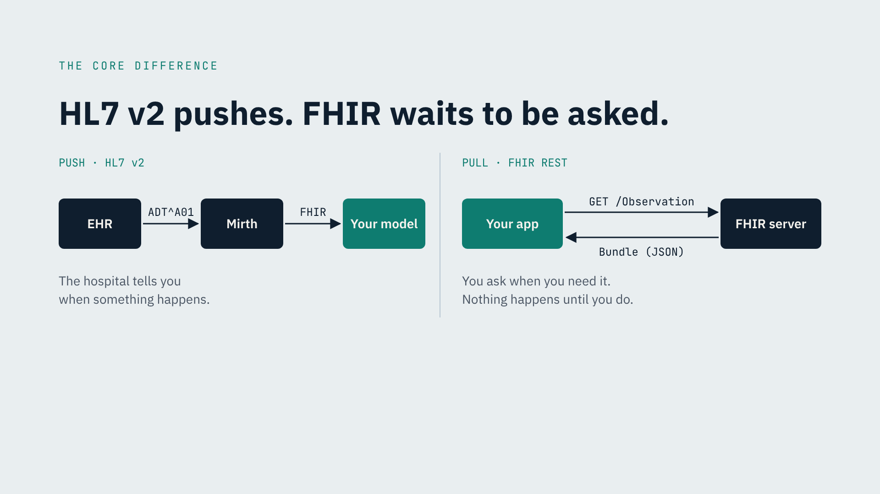
Notes:
• The one technical idea to remember: push vs. pull.
• HL7 v2 is push. Something happens — the EHR sends a message.
• It goes over MLLP to Mirth, gets transformed, reaches your model.
• Reliable and mature. But formats are rigid and vary by site.
• FHIR REST is pull. You ask, the server answers with a Bundle.
• Great for on-demand access. But you don't know when something changed.
• FHIR Subscriptions exist, but support varies. Check your site first.
• Push for events. Pull for questions. Most pipelines need both.

Slide 5
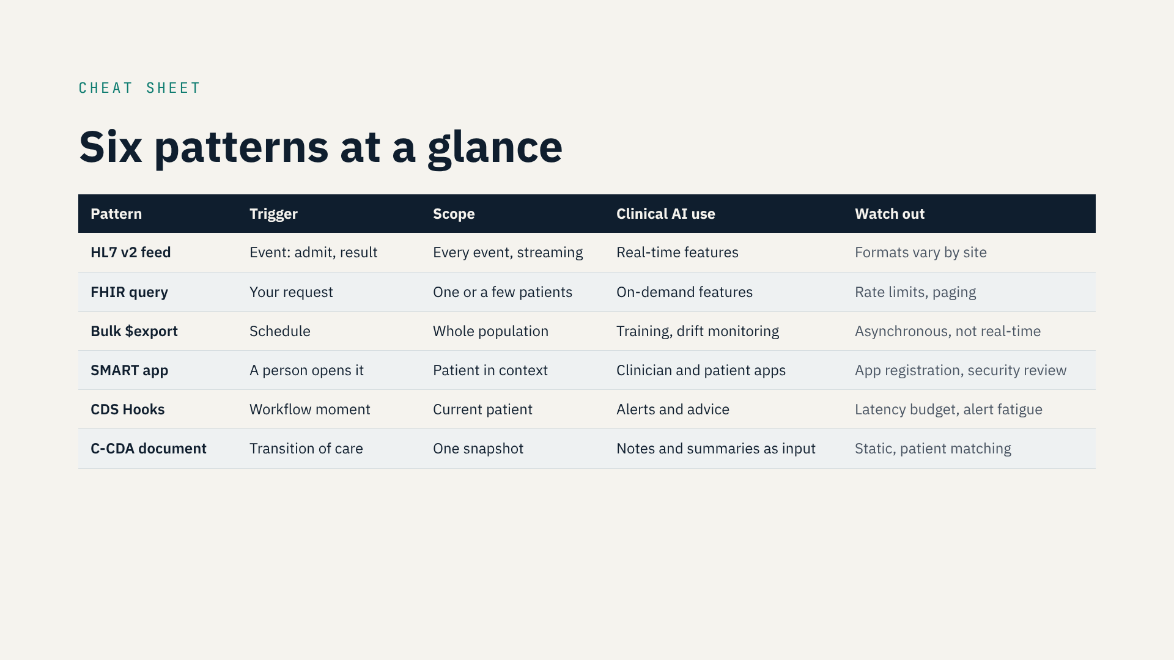
Notes:
• The whole lecture on one slide. It's in the resources too.
• HL7 v2 feed: events, every patient. Real-time features. Watch: site-specific formats.
• FHIR query: your request, one patient. On-demand features. Watch: rate limits.
• Bulk export: scheduled, whole population. Training and drift. Never real-time.
• SMART app: a person opens it. Clinician and patient apps. Watch: app review.
• CDS Hooks: a workflow moment. Alerts and advice. Watch: latency, alert fatigue.
• C-CDA: transition of care. NLP input. Watch: static, patient matching.

Slide 6
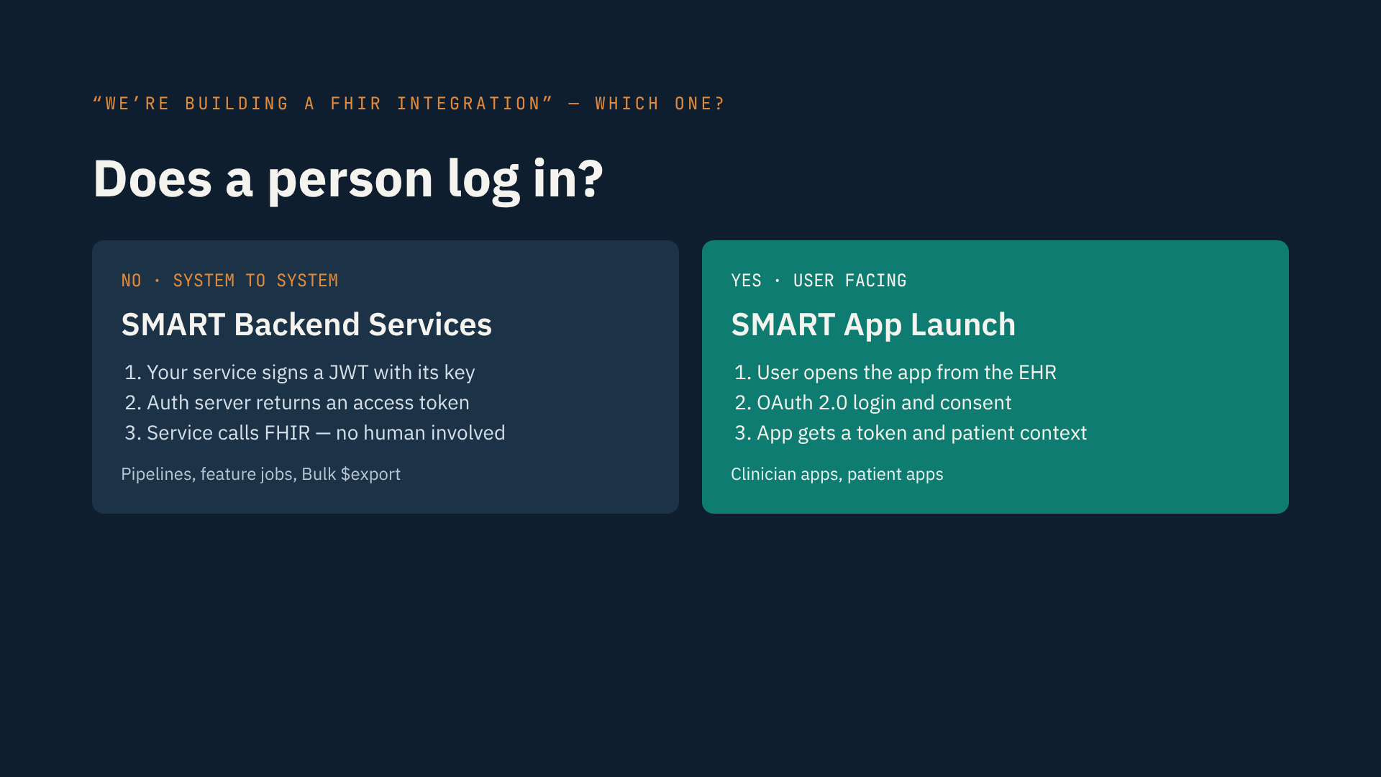
Notes:
• The distinction that confuses most teams.
• “We're building a FHIR integration” — which kind?
• Ask: does a person log in?
• No → SMART Backend Services. Your service signs a JWT and gets a token. No human.
• Used by pipelines, feature jobs, Bulk export. You'll build it in Track C.
• Yes → SMART App Launch. User opens the app, logs in with OAuth, app gets patient context.
• Same FHIR API. Different security, registration and testing.
• Decide early. Finding out mid-build costs weeks.

Slide 7
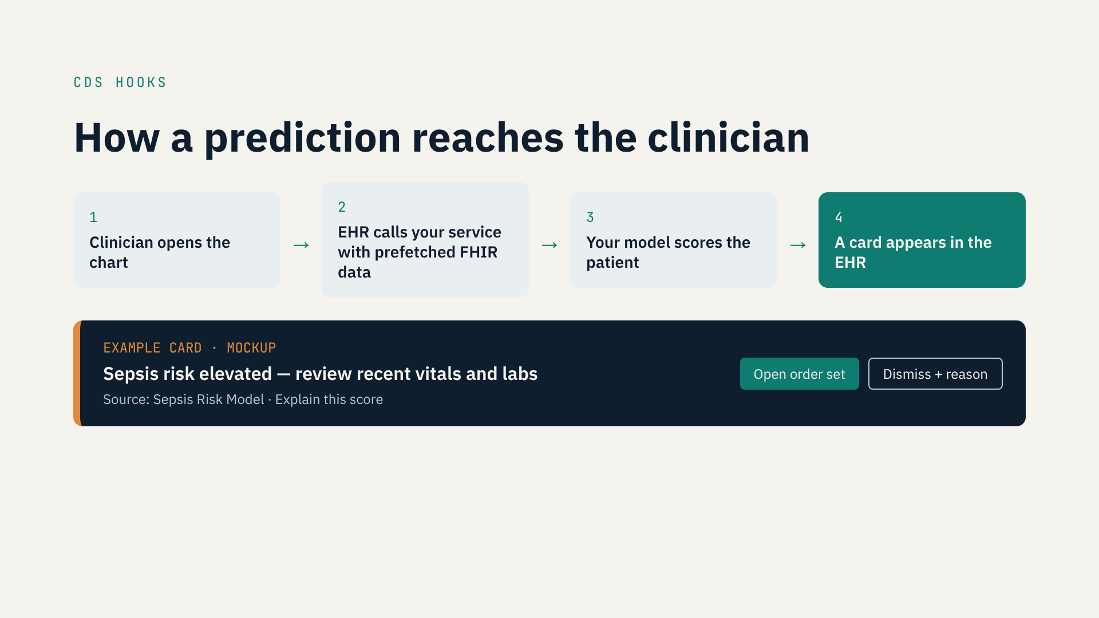
Notes:
• CDS Hooks is where your model meets a human decision.
• 1 · The clinician opens a chart or signs an order. That's the hook.
• 2 · The EHR calls your service, with prefetched FHIR data.
• 3 · Your model scores the patient — fast. The clinician is waiting.
• 4 · Your service returns a card. The EHR shows it.
• The mockup: a message, the source, an explanation, actions.
• “Dismiss with a reason” is your evaluation data.
• Override rate is your guardrail metric. You'll build this in Track C.

Slide 8
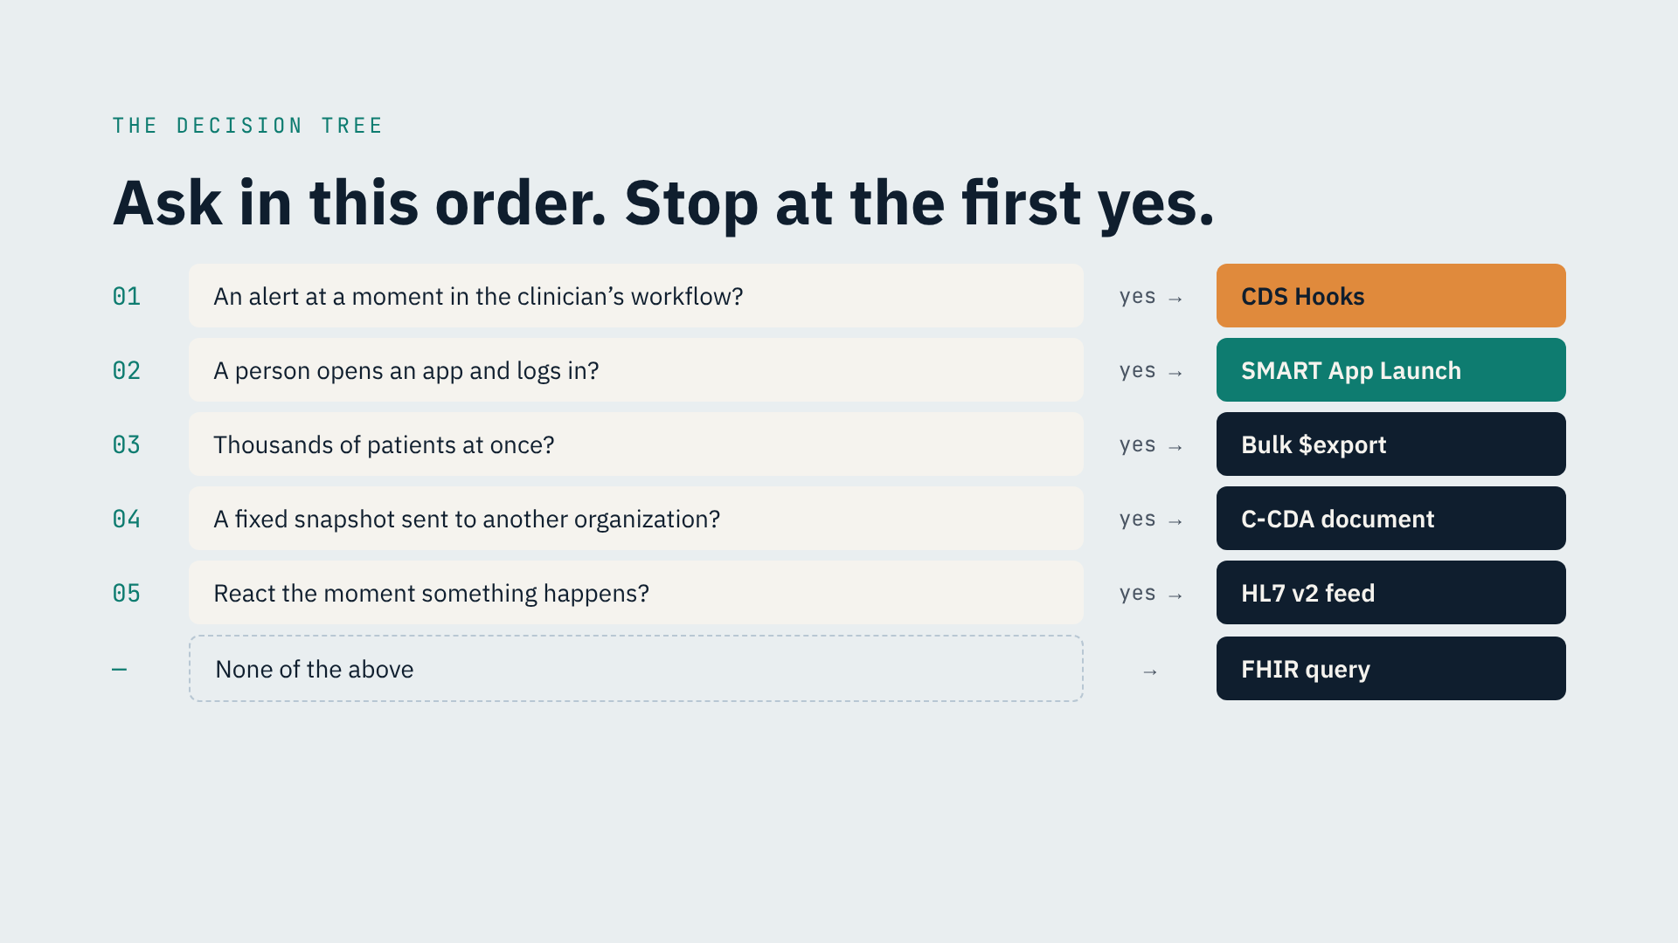
Notes:
• Ask in this order. Stop at the first yes.
• 1 · Alert at a workflow moment? → CDS Hooks.
• 2 · A person opens an app and logs in? → SMART App Launch.
• 3 · Thousands of patients at once? → Bulk export.
• 4 · Fixed snapshot to another organization? → C-CDA.
• 5 · React the moment something happens? → HL7 v2 feed.
• None of these? → FHIR query with backend services.
• People and scale come first — they're hardest to change later.
• This gives the pattern for one data flow. Real products have several.

Slide 9
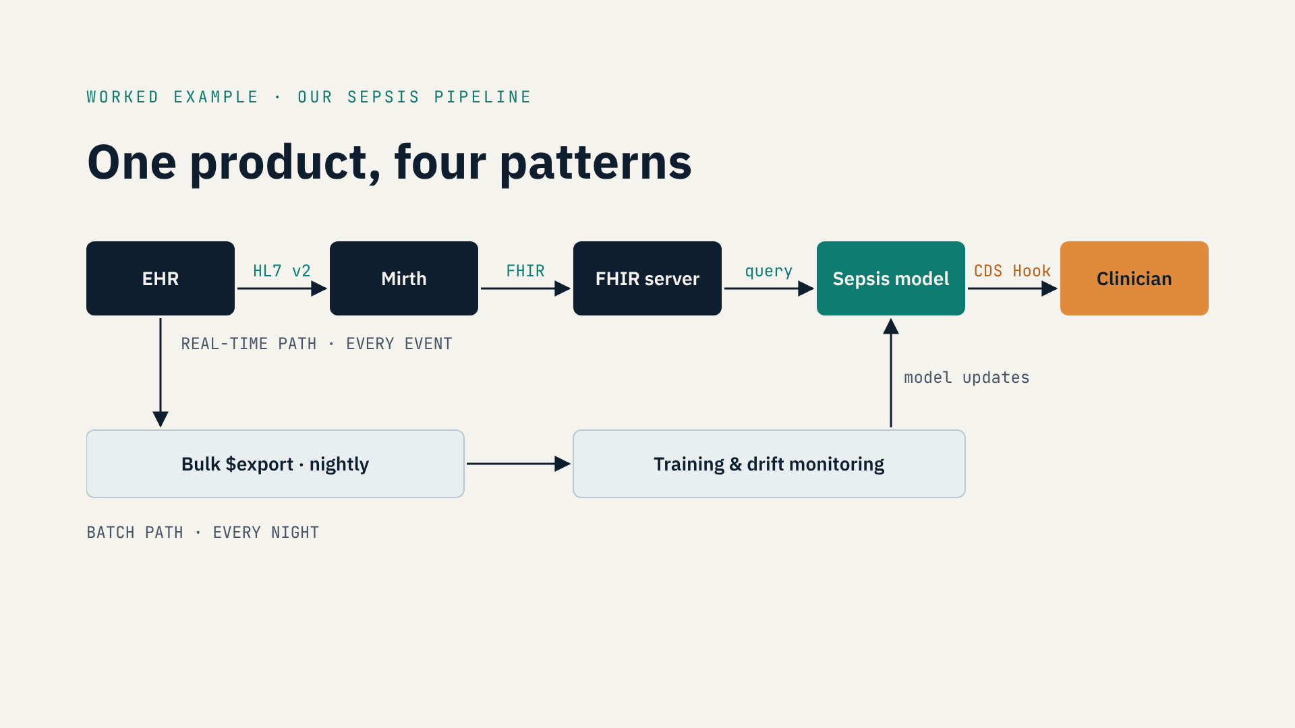
Notes:
• Our sepsis pipeline uses four patterns.
• Top row, real time: EHR pushes HL7 v2 to Mirth.
• Mirth writes FHIR resources to our FHIR server.
• The model queries FHIR for features — backend services, no human.
• The result reaches the clinician as a CDS Hooks card.
• Bottom row, nightly: Bulk export for training and drift monitoring.
• “Is it HL7 or FHIR?” Usually: both, for different flows.
• You document each flow's pattern in the IDD — next lecture.

Slide 10
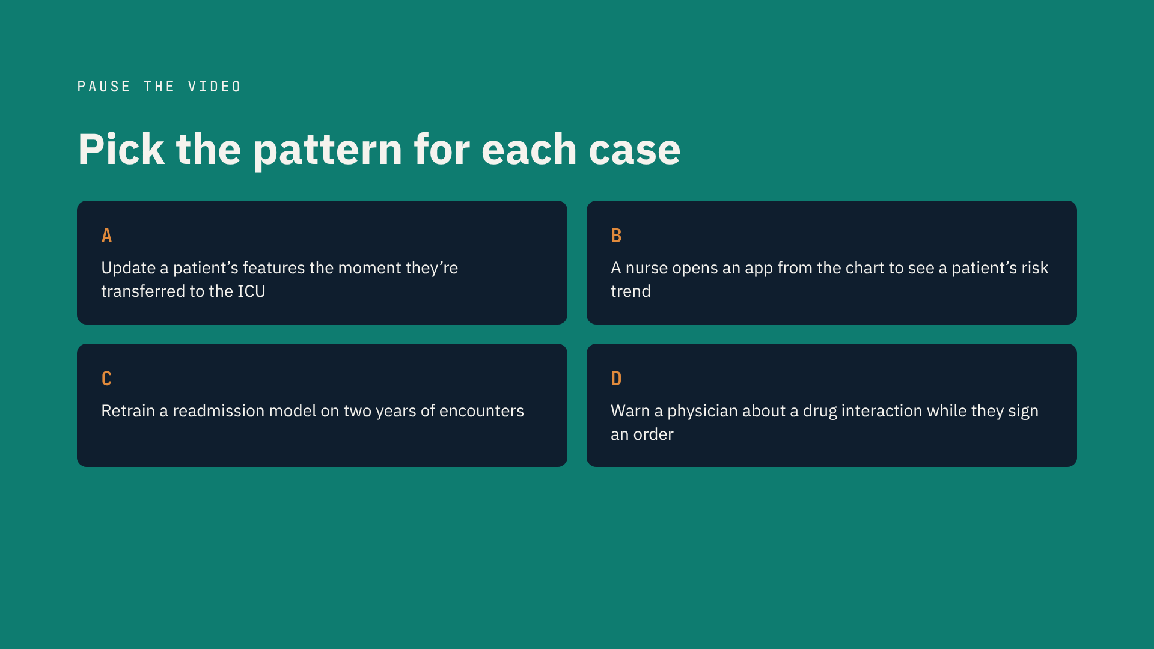
Notes:
• Your turn. Pause the video.
• For each case, write the pattern and one sentence why.
• A: update features the moment a patient moves to the ICU.
• B: a nurse opens an app from the chart to see a risk trend.
• C: retrain a readmission model on two years of encounters.
• D: warn a physician about a drug interaction while signing an order.
• Use the decision tree. Answers on the next slide.

Slide 11
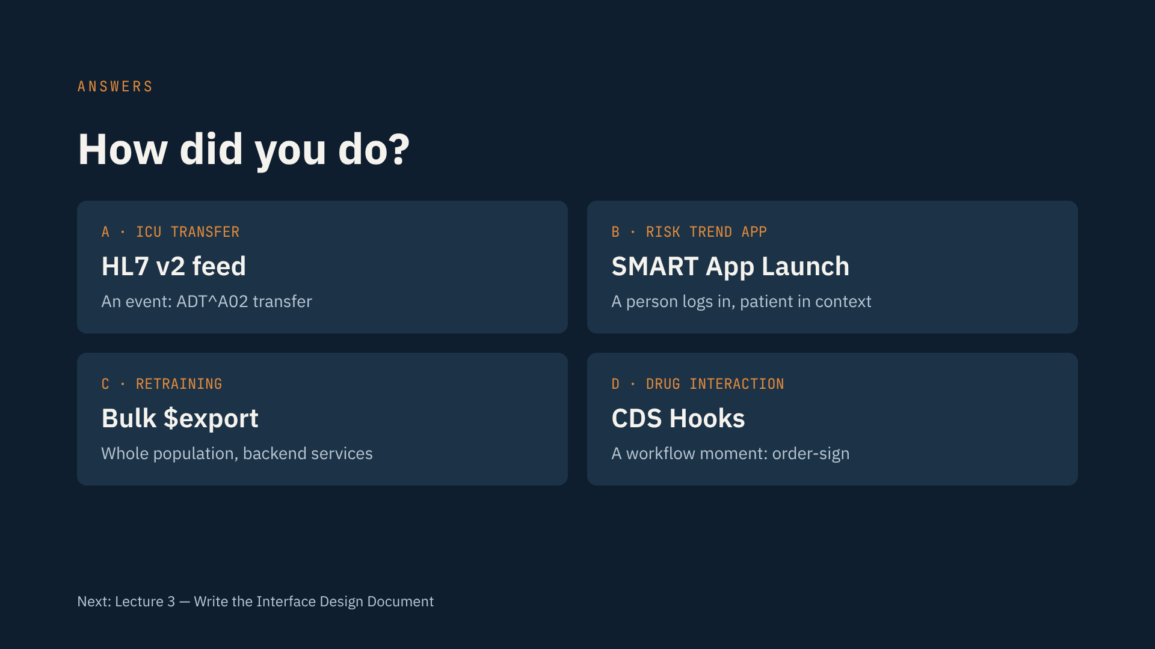
Notes:
• A, ICU transfer: HL7 v2 feed. It's an event — ADT A02.
• B, risk-trend app: SMART App Launch. A nurse logs in, patient in context.
• C, retraining: Bulk export. Don't send thousands of single FHIR queries.
• D, drug interaction: CDS Hooks, on order-sign.
• Missed one? Find the tree question you skipped.
• Post your answers — and your own tricky cases — in the Q&A.
• Next: the Interface Design Document.

