Slide 1
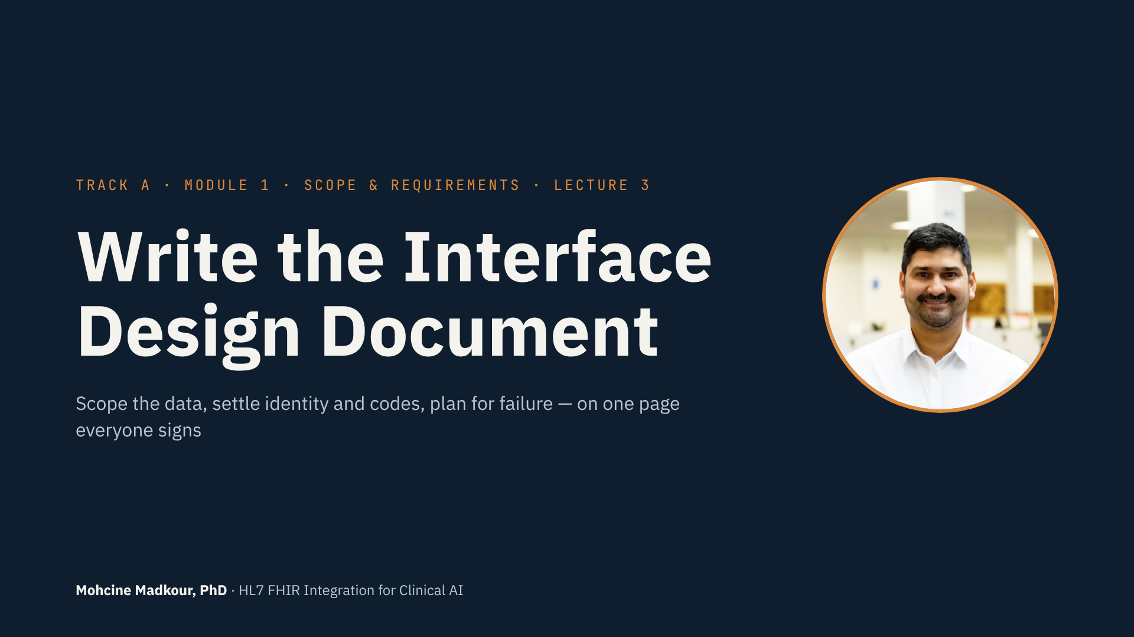
Notes:
• The last lecture of Module 1.
• You've decided whether to build and picked your patterns.
• Now you write it down: the Interface Design Document, or IDD.
• It's the one document the interface team, the clinical owner and you all work from.
• First the scoping decisions: data, codes, patient matching.
• Then the IDD, section by section, on our sepsis pipeline.
• Template and sepsis example are in the resources.

Slide 2
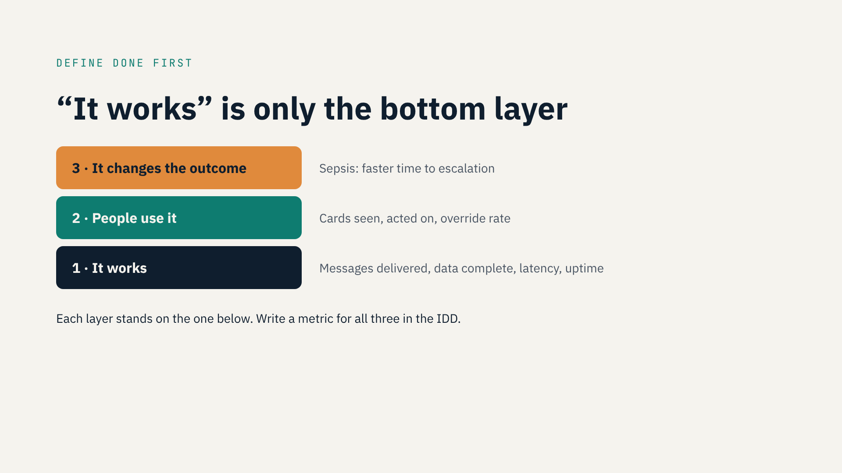
Notes:
• Define “done” before you scope anything.
• Layer 1: it works. Delivery, completeness, latency, uptime.
• Layer 2: people use it. Cards seen, acted on, override rate.
• Layer 3: it changes the outcome. For sepsis: time to escalation.
• Each layer stands on the one below.
• Put at least one metric per layer in the IDD.
• Only layer 1? You can prove it works — not that it was worth building.

Slide 3
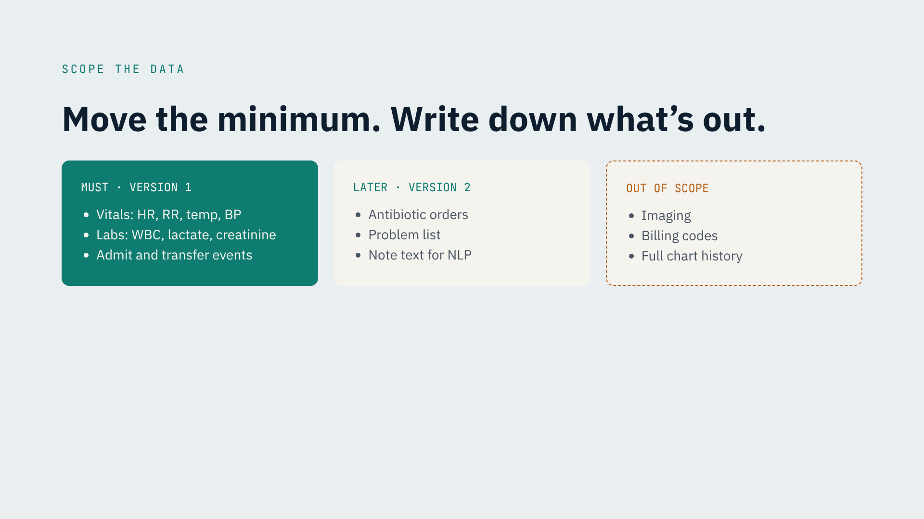
Notes:
• How much data should move? The minimum.
• Every extra field means more mapping, testing, maintenance and PHI to secure.
• ML engineers: more features feel better. Add them later, with evidence.
• Must, version 1: core vitals, three labs, admit and transfer events.
• Later, version 2: antibiotic orders, problem list, note text.
• Out of scope: imaging, billing codes, full history.
• The out-of-scope list protects you when someone asks in month three.

Slide 4
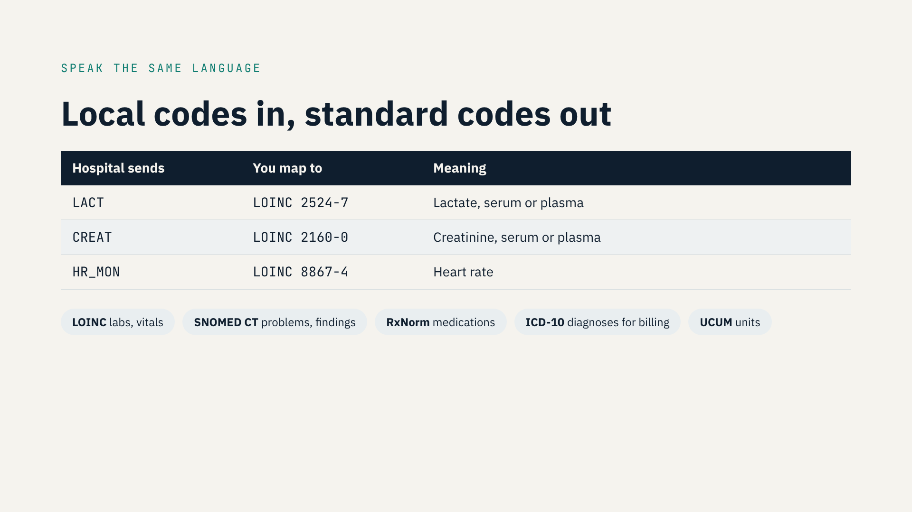
Notes:
• Moving data is easy. Making it mean the same thing is hard.
• Hospitals send local codes: LACT, LACTIC, or a number.
• A model trained on one site's codes gets nothing at another site.
• Map every concept to a standard code.
• LOINC for labs and vitals. SNOMED CT for problems. RxNorm for meds.
• ICD-10 for billing diagnoses. UCUM for units.
• Wrong mapping = wrong model, with no error message.
• The mapping table goes in the IDD.

Slide 5
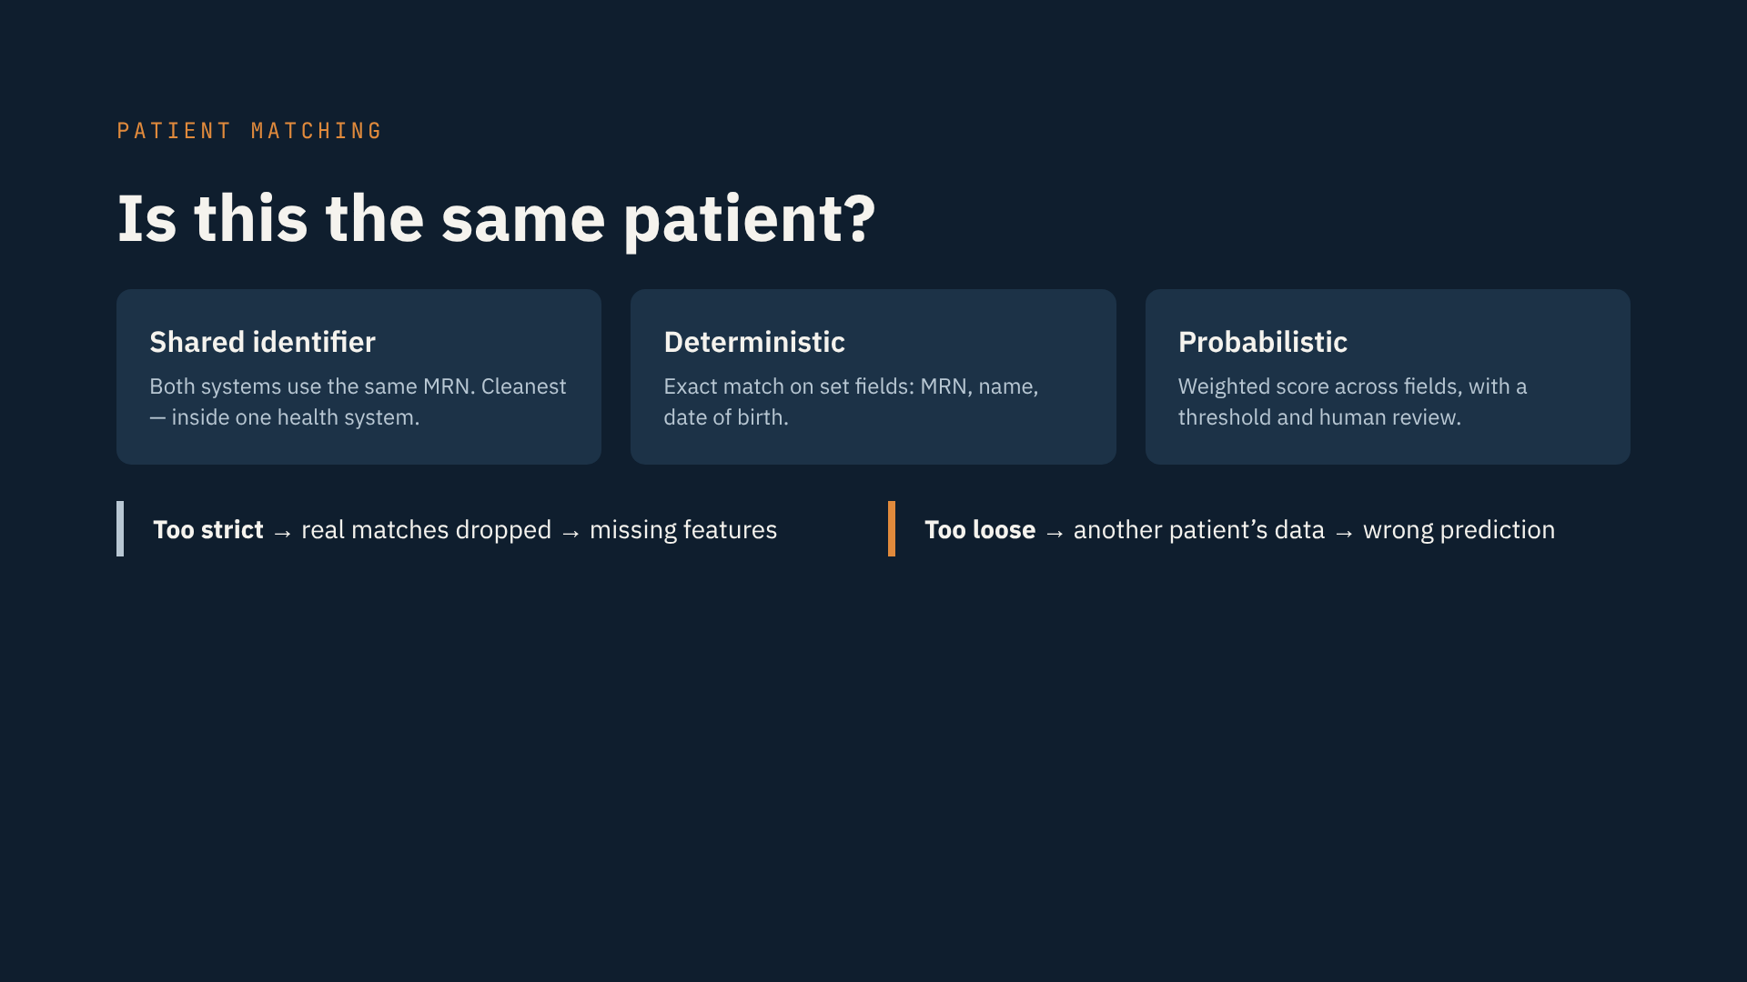
Notes:
• Is this the same patient?
• Shared identifier: same MRN in both systems. Cleanest.
• Deterministic: exact match on MRN, name, date of birth.
• Probabilistic: a score across fields, with human review.
• Too strict → real matches dropped → missing features.
• Too loose → another patient's data → wrong prediction. A safety issue.
• Write the rule and the owner in the IDD.
• Sepsis: one hospital, match on the MRN in PID-3.

Slide 6
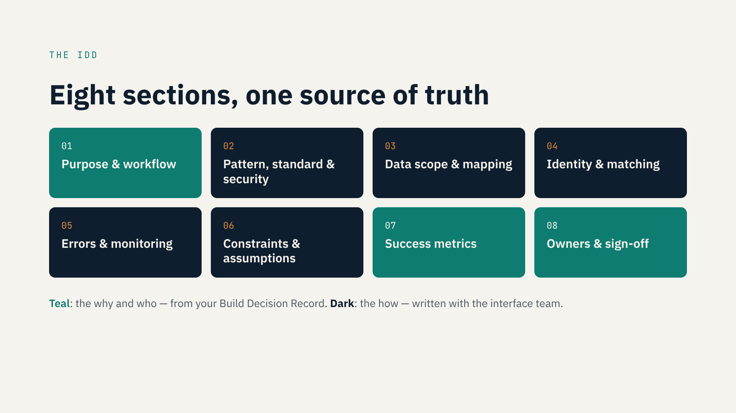
Notes:
• The IDD has eight sections.
• 1 · Purpose and workflow.
• 2 · Pattern, standard and security.
• 3 · Data scope and mapping.
• 4 · Identity and matching.
• 5 · Errors and monitoring.
• 6 · Constraints and assumptions.
• 7 · Success metrics.
• 8 · Owners and sign-off.
• Teal sections come from your Build Decision Record. Dark ones you write with the interface team.
• Keep it to a few pages. If nobody reads it, it's not a source of truth.

Slide 7
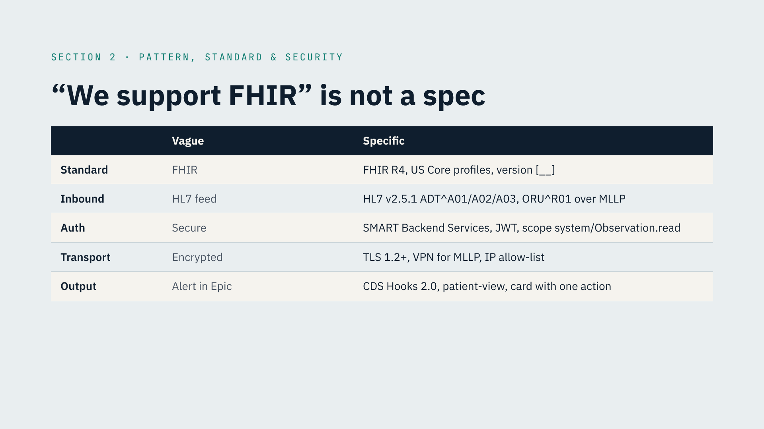
Notes:
• Section 2 is where vague words cause rework.
• “FHIR” → FHIR R4, US Core, and the exact version.
• “HL7 feed” → v2.5.1, ADT A01/A02/A03 and ORU R01, over MLLP.
• “Secure” → SMART Backend Services, signed JWT, narrowest scopes.
• “Encrypted” → TLS 1.2+, VPN for MLLP, IP allow-list.
• “Alert in Epic” → CDS Hooks 2.0, patient-view, one card.
• Cloud engineers: this decides your network, secrets and security review.
• Check every value against what the site supports.

Slide 8
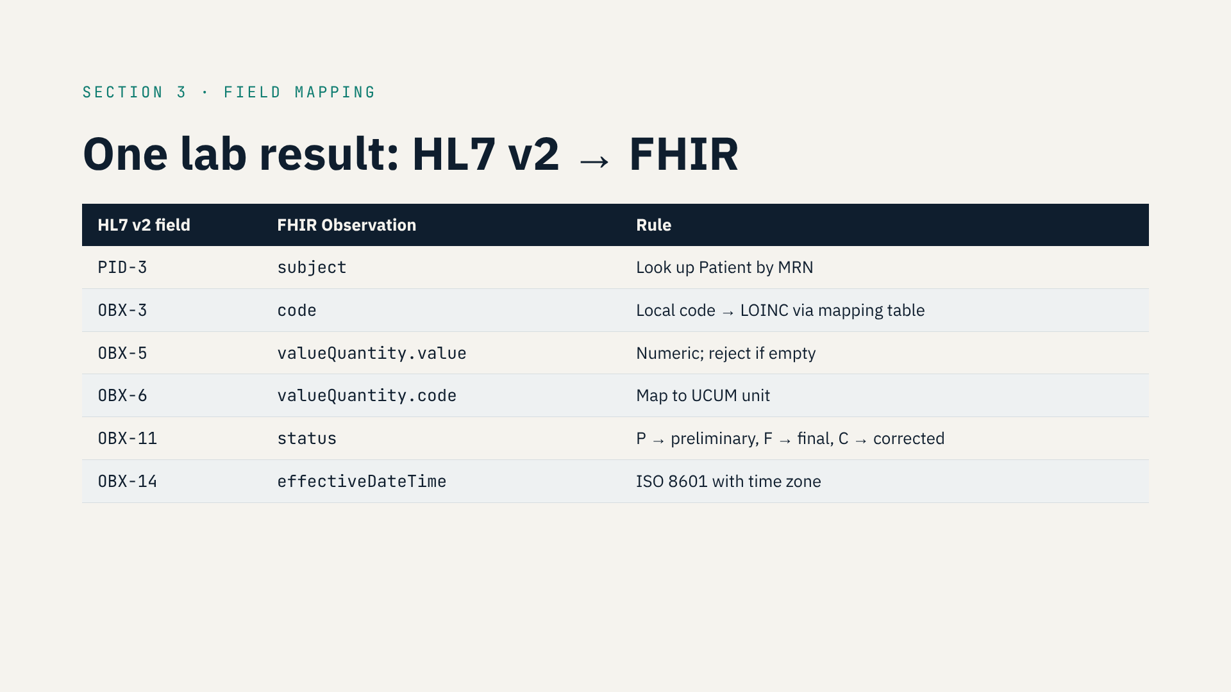
Notes:
• Section 3: one lab result, HL7 v2 to FHIR.
• PID-3 → subject. Look up the patient by MRN.
• OBX-3 → code. Local code to LOINC.
• OBX-5 → value. Numeric; reject if empty.
• OBX-6 → units, as UCUM.
• OBX-11 → status. Corrected results must update your features.
• OBX-14 → time, with time zone. Wrong zone = features off by hours.
• Interface team owns it. You review it with your features in mind.
• You'll build this mapping in Mirth in Track B.

Slide 9
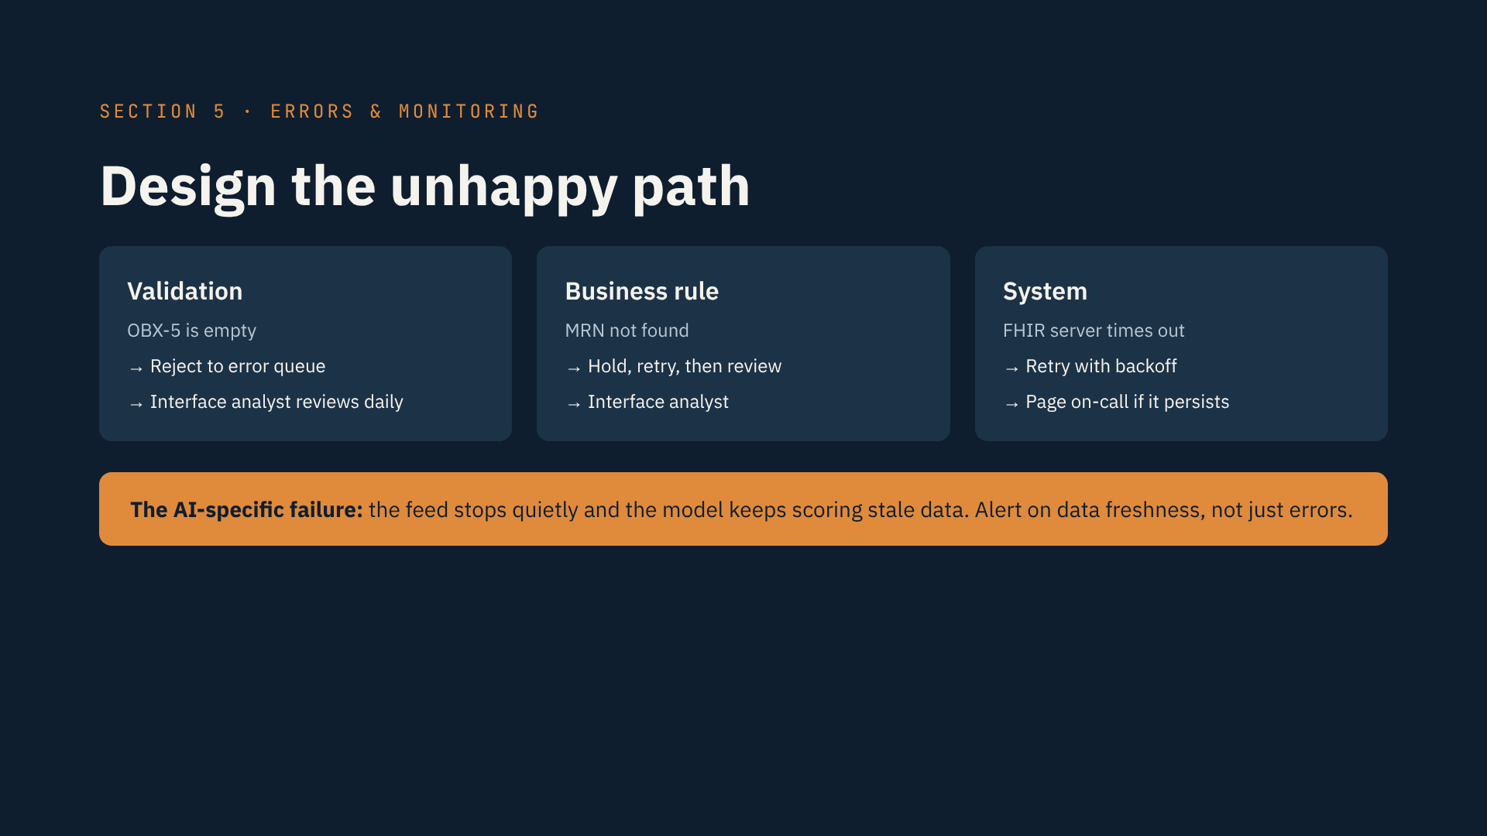
Notes:
• Section 5: what happens when it fails. It will.
• Validation error: the message is wrong. Reject to an error queue; review daily.
• Business-rule error: valid, but breaks a rule — unknown MRN. Hold, retry, review.
• System error: the other side is down. Retry with backoff; page if it persists.
• For each: what happens, who's alerted, how it's resolved.
• Log everything, success and failure.
• The AI-specific failure: the feed stops quietly, the model scores stale data.
• Alert on data freshness, not just errors.

Slide 10
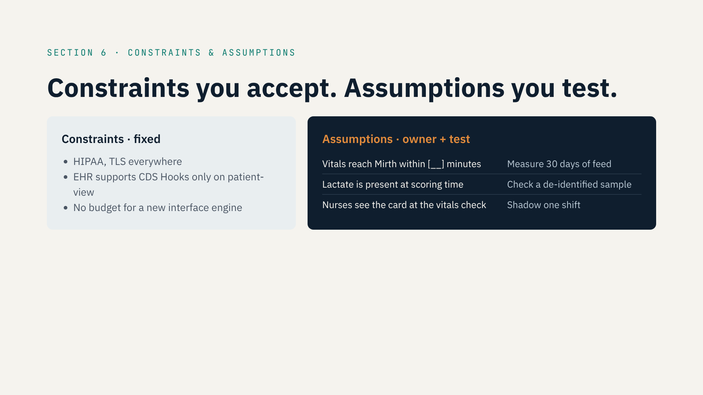
Notes:
• Section 6: constraints vs. assumptions.
• Constraints are fixed. HIPAA, TLS, what the EHR supports, budget.
• Assumptions look like facts until go-live.
• Sepsis: vitals arrive within minutes. Lactate is usually there. Nurses see the card.
• Any one wrong, and the project fails with perfect code.
• Give every assumption an owner and a test.
• Test the riskiest first — before you build.

Slide 11
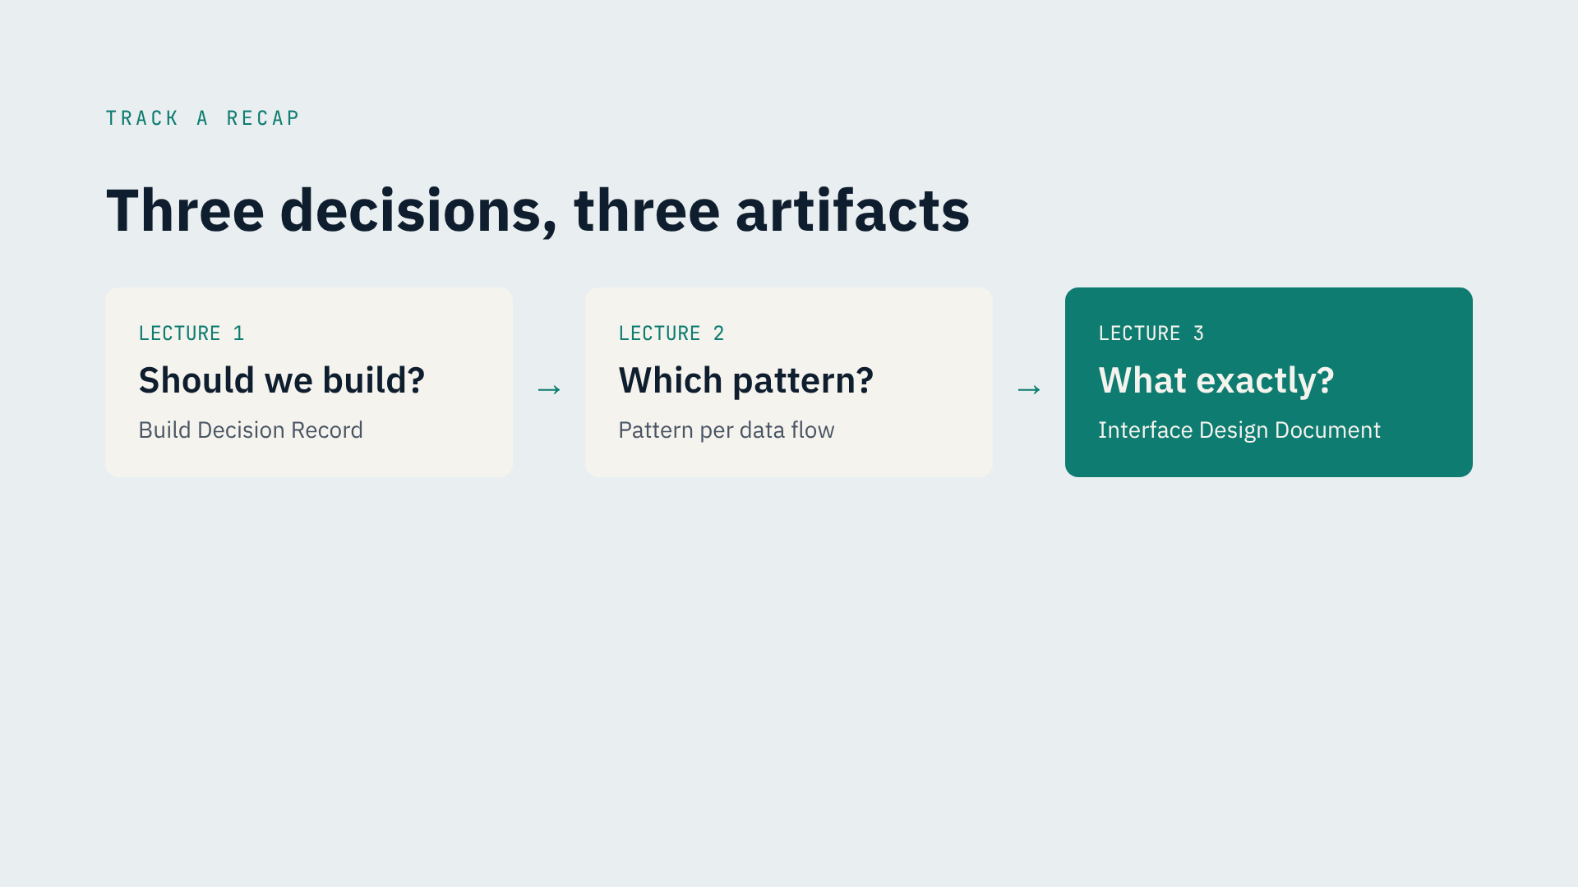
Notes:
• That wraps up Module 1 — and Track A.
• Lecture 1: should we build? → Build Decision Record.
• Lecture 2: which pattern? → a pattern per data flow.
• Lecture 3: what exactly? → Interface Design Document.
• These three separate integrations that survive from ones that get abandoned.
• No code yet, on purpose. From Track B on, every line has a reason.

Slide 12
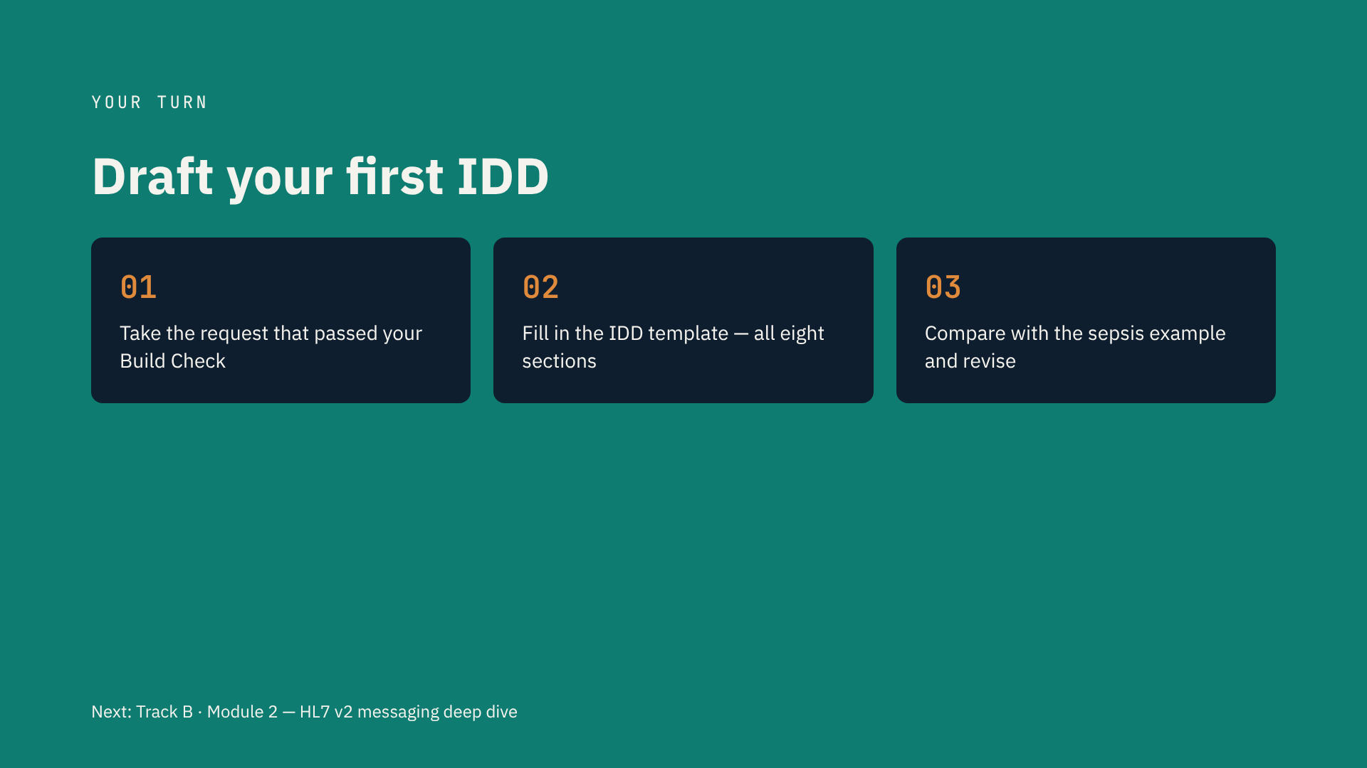
Notes:
• Your assignment.
• Take the request that passed your Build Check — or the readmission scenario.
• Fill in all eight IDD sections. Keep it short.
• Unknowns stay as placeholders. They're your questions for the interface team.
• Then compare with my sepsis IDD and revise.
• Budget two to three hours. It's the document you'll reuse at work.
• Next: Track B, Module 2 — HL7 v2, segment by segment.

