Slide 1
Machine learning and Prediction models

Slide 2
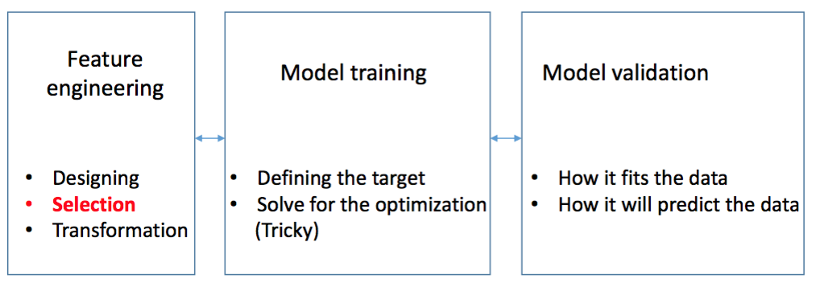
Standard machine learning process
Notes:
Define the Problem
Prepare Data
Spot Check Algorithms
Improve Results
Present Results

Slide 3
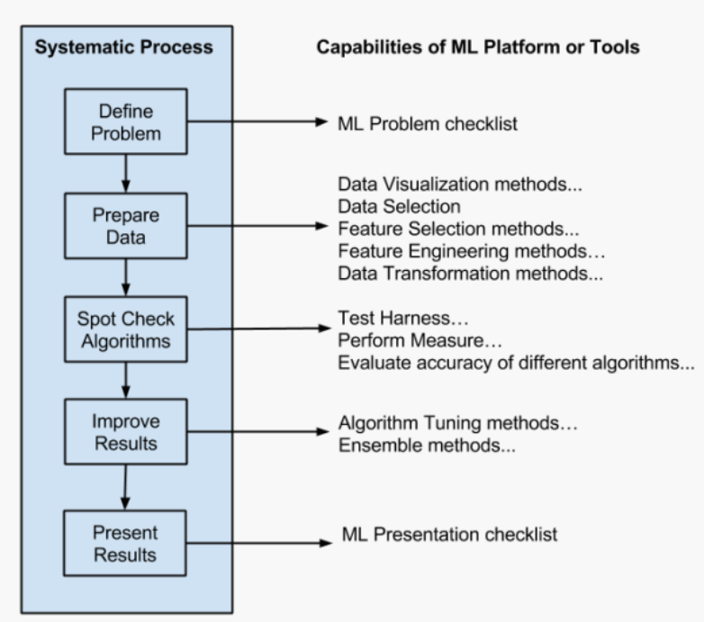

Slide 4
Define the Problem
I like to use a three step process to define the problem. I like to move quickly and I use this mini process to see the problem from a few different perspectives very quickly:
Step 1: What is the problem? Describe the problem informally and formally and list assumptions and similar problems.
Step 2: Why does the problem need to be solved? List your motivation for solving the problem, the benefits a solution provides and how the solution will be used.
Step 3: How would I solve the problem? Describe how the problem would be solved manually to flush domain knowledge.

Slide 5
Prepare Data
The actual data preparation process is three step as follows:
Step 1: Data Selection: Consider what data is available, what data is missing and what data can be removed.
Step 2: Data Preprocessing: Organize your selected data by formatting, cleaning and sampling from it.
Step 3: Data Transformation: Transform preprocessed data ready for machine learning by engineering features using scaling, attribute decomposition and attribute aggregation.

Slide 6
Present Results
The results of a complex machine learning problem are meaningless unless they are put to work.
Notes:
This typically means a presentation to stakeholders. Even if it is a competition or a problem I am working on for myself, I still go through the process of presenting the results. It’s a good practice and gives me clear learnings I can build upon next time.

Slide 7
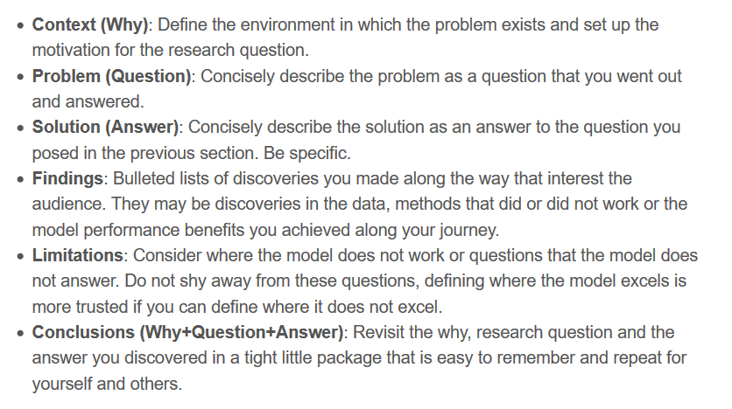
Research results Communication (Publication)

Slide 8
Feature Selection/Extraction
•Solution to a number of problems in Pattern Recognition can be achieved by choosing a better feature space.

Slide 9
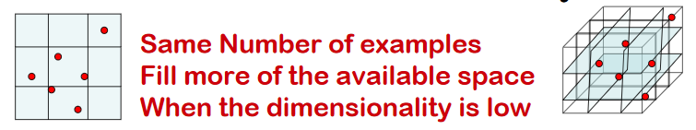
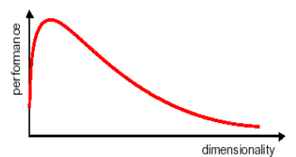
The curse of dimentionality
The Exponential growth with dimensionality in a number of examples implies to accurately estimate a function
The curse of dimensionality means that, for a given sample size, there is a maximum number of features above which the performance of our classifier will degrade rather than improve
In practice the information that was lost by discarding some features is compensated by a more accurate mapping in lower dimensional space

