Slide 1
Basic assumptions for coding:
1. Does not handle relative times such as today/tomorrow. Only worry about things like: 2 days before Event_1.
2. Always assume Granularity information is given, otherwise the default granularity is second.
- read from hasGranularity/hasDurationUnit
3. Can only define one basic Allen’s Interval Relation (13) or Point Relation (12) between two events, no union. For example, we cannot define “event1 before, contain event 2” by ourselves. But this result is possible to be inferred.

Slide 2
Adaption to Ontology:
TEO1.0.9:
1. Added DataProperty (DurationMeasurement) "hasDurationPattern" (PatternString);
TEO1.1.0:
Added 4 temporalRelations according to Allen’s interval algebra: met by, finished by, started by, overlapped by;
Added 12 temporalRelations for the definition of timeOffset: startBeforeStart, startBeforeEnd, endBeforeStart, endBeforeEnd, startAfterStart, startAfterEnd, endAfterStart, endAfterEnd, startEqualStart, startEqualEnd, endEqualStart, endEqualEnd (and their definitions).
Removed unnecessary NamedIndividuals of properties.
TEO1.1.1(8/5/2014):
Changed occurYear from object property to data property and updated definitions (equivalent class constraints) of US Federal Holidays with data type constraints (minValue).
Removed unnecessary Individuals of Years (since we changed occurYear into the data property).
Changed the property “hasDurationUnit” into a Data property.
Added one Data Property “hasGranularity”.

Slide 3


TEO-library Architecture
Loader
Parser
Reasoner
Querier
Dataset annotated by TEO
Queries
Dataset annotated by TEO
Results
OWLOntology
eventMap
(incomplete)
eventMap
(complete)

Slide 4
1. TEO Loader
Direct use of OWLAPI to load the ontology.
Both Tbox and Abox are loaded into memory.

Slide 5
2. TEO Parser
Event
Valid time (absolute time)
TimeInstant
TimeInterval
Duration
Temporal Relations
point relations w/ timeOffset
Interval relations and point relations
Output:
HashMap<String, Event> eventMap

Slide 6
2. TimeInstant Granularity
2014-06-12 15:59:51
SECOND = 2014-06-12 15:59:51, value = 1402606791742
MINUTE = 2014-06-12 15:59:00, value = 1402606740742
HOUR = 2014-06-12 15:00:00, value = 1402603200742
DAY = 2014-06-12 00:00:00, value = 1402549200742
WEEK = 2014-06-09 00:00:00, value = 1402290000742
MONTH = 2014-06-01 00:00:00, value = 1401598800742
YEAR = 2014-01-01 00:00:00, value = 1388556000742

Slide 7
2. TimeInterval
if (TimeInterval.isValidTimeInterval(startTimeInstant, endTimeInstant, duration)) {
// Assumption: if start, end and duration are valid and given, we use start and end to populate the time interval.
timeInterval = new TimeInterval(startTimeInstant, endTimeInstant);
} else {
System.out.println("Inconsistent startTime, endTime and duration for TimeInterval: " + timeIndividual.getIRI());
}

Slide 8
isValidTimeInterval(startTimeInstant, endTimeInstant, duration)
Use the maximum unit between startTime/endTime/duration to check the validation.
startTime = Sept 2nd 2008, endTime = July 2012, duration = 4Y;
max(startTime, endTime, duration) = year;
So this example is valid.
We can specify the granularity when comparing two duration values, which means 4Y3M == 4Y if gran = year.
How to construct the TimeInterval with startTime, endTime and duration given?

Slide 9
2. Assumptions for the calculation of duration
Duration getDurationFrom(TimeInstant startTimeInstant, TimeInstant endTimeInstant, Granularity gran)
If t1.gran != t2. gran, we assume the coarser time instant (t1) is at the beginning point for each finer unit.
t1 = 2013-05-05, t2 = 2014-02-12 18:30:20.
We assume t1 = 2013-05-05 00:00:00;
Then delta = t2 – t1 = 24521419560ms.
If max(t1.gran, t2. gran) <= dur.gran, we simply calculate the result according to dur.gran by truncating finer units.
If max(t1.gran, t2.gran) > dur.gran, we print out a message to notice that the computed result may not be accurate.

Slide 10
2. Assumptions for the calculation of time instant
TimeInstant getEndTimeInstantFrom(TimeInstant startTimeInstant, Duration duration, Granularity gran)
If timeInstant.gran > duration.gran, the result may not be accurate.
timeInstant = 2012-05-04, duration = 11h;
We also treat timeInstant as 2012:05:04 12am. We calculate results and print out a message to notice that the result is not accurate.
If min(timeInstant.gran, duration.gran) > gran, the result may not be accurate, we print out a message.
timeInstant = 2012-05-04 10:30 (minute), duration = 11h (hour);
Otherwise, the result is reliable.

Slide 11
2. TemporalRelations
13 Allen’s interval relations + 12 point relations
The integration of interval and point relations:
Relation between timeInstant and timeInstant.
Relation between timeInstant and timeInterval.
Relation between timeInterval and timeInstant.
Relation between timeInterval and timeInterval.
Should check the consistency of event’s TemporalType with its relations
For (subEvent, relation, objEvent):
If the given subEvent is a TimeInstant event, its relations cannot be the subset of "overlap, overlappedBy, startedBy, finishedBy, contain".
If the given objEvent is a TimeInstant event, its relations cannot be the subset of "overlap, overlappedBy, start, finish, during".

Slide 12













13 Allen’s interval relations
before | meets | overlaps | finished by | contains | starts | equals | started by | during | finishes | overlap- ped by | met by | after
p | m | o | F | D | s | e | S | d | f | O | M | P

Slide 13
Relation between timeInterval and timeInterval
*startBeforeStart (TEO default)
#endBeforeStart = Allen’s before
startBeforeEnd (TEO)
endBeforeEnd (TEO)
*startEqualStart (TEO default)
#endEqualStart = Allen’s meet
#startEqualEnd = Allen’s metBy
endEqualEnd (TEO)
*startAfterStart (TEO default)
endAfterStart (TEO)
#startAfterEnd = Allen’s after
endAfterEnd (TEO)
Defined for “timeOffset”
p
m
o
F
D
s
e
S
d
f
O
M
P
a
a
a
a
a
a
a
a
a
a
a
a
a
b
b
b
b
b
b
b
b
b
b
b
b
b
before
meet
overlap
finishedBy
contain
start
equal
startedBy
during
finish
overlappedBy
metBy
after
#endBeforeStart
#endEqualStart
#startEqualEnd
#startAfterEnd
*startBeforeStart
*startEqualStart
*startAfterStart
endBeforeEnd
endEqualEnd
endAfterEnd
endBeforeEnd
endEqualEnd
endAfterEnd
endBeforeEnd
endEqualEnd
endAfterEnd
startBeforeEnd
endAfterStart
# indicates Allen’s temporal relations, * indicates default relations in TEO

Slide 14
Relation between timeInstant and timeInterval
*startBeforeStart (TEO default)
#endBeforeStart = Allen’s before
startBeforeEnd (TEO)
endBeforeEnd (TEO)
*startEqualStart (TEO default)
#endEqualStart = Allen’s meet
#startEqualEnd = Allen’s metBy
endEqualEnd (TEO)
*startAfterStart (TEO default)
endAfterStart (TEO)
#startAfterEnd = Allen’s after
endAfterEnd (TEO)
Defined for “timeOffset”
p
s
d
f
P
a
a
a
a
a
b
b
b
b
b
a before b
a start/meet b
a during b
a finish/metBy b
a after b
#endBeforeStart
#endEqualStart
endAfterStart
endBeforeEnd
endEqualEnd
endAfterEnd
*startBeforeStart
*startEqualStart
*startAfterStart
startBeforeEnd
#startEqualEnd
#startAfterEnd
# indicates Allen’s temporal relations, * indicates default relations in TEO

Slide 15
Relation between timeInterval and timeInstant
*startBeforeStart (TEO default)
#endBeforeStart = Allen’s before
startBeforeEnd (TEO)
endBeforeEnd (TEO)
*startEqualStart (TEO default)
#endEqualStart = Allen’s meet
#startEqualEnd = Allen’s metBy
endEqualEnd (TEO)
*startAfterStart (TEO default)
endAfterStart (TEO)
#startAfterEnd = Allen’s after
endAfterEnd (TEO)
Defined for “timeOffset”
p
F
D
S
P
a
a
a
a
a
b
b
b
b
b
a before b
a finishedBy/meet b
a contain b
a startedBy/metBy b
a after b
#endBeforeStart
#endEqualStart
endAfterStart
endBeforeEnd
endEqualEnd
endAfterEnd
*startBeforeStart
*startEqualStart
*startAfterStart
startBeforeEnd
#startEqualEnd
#startAfterEnd
# indicates Allen’s temporal relations, * indicates default relations in TEO

Slide 16
Relation between timeInstant and timeInstant
*startBeforeStart (TEO default)
#endBeforeStart = Allen’s before
startBeforeEnd (TEO)
endBeforeEnd (TEO)
*startEqualStart (TEO default)
#endEqualStart = Allen’s meet
#startEqualEnd = Allen’s metBy
endEqualEnd (TEO)
*startAfterStart (TEO default)
endAfterStart (TEO)
#startAfterEnd = Allen’s after
endAfterEnd (TEO)
Defined for “timeOffset”
p
e
P
a
a
a
b
b
b
a before b
a equal/meet/metBy b
a after b
#endBeforeStart
#endEqualStart
endAfterStart
endBeforeEnd
endEqualEnd
endAfterEnd
*startBeforeStart
*startEqualStart
*startAfterStart
startBeforeEnd
#startEqualEnd
#startAfterEnd
# indicates Allen’s temporal relations, * indicates default relations in TEO

Slide 17
12 point relations
pmoFDseSdfO
oFDseSdfOMP
startBeforeEnd
endAfterStart
pmoFD
pmosd
seS
feF
dfOMP
DSOMP
*startBeforeStart
endBeforeEnd
*startEqualStart
endEqualEnd
*startAfterStart
endAfterEnd
p
m
M
P
#endBeforeStart
#endEqualStart
#startEqualEnd
#startAfterEnd
# indicates Allen’s temporal relations, * indicates default relations in TEO
We have temporal relations like startBeforeStart/startBeforeEnd… because the real data often comes with Events annotated by relations. If we just annotate time instants, before/equal/after should be sufficient. But for events’ annotation and their inference, we need higher level semantics.

Slide 18
3. TEO Reasoner
pre-reasoning:
Pellet (subproperties) + timeOffset annotation
reasonValidTime()
from Point Relations w/ timeOffsets
reasonTemporalRelations()
Pellet
Allen’s reasoning algorithm

Slide 19
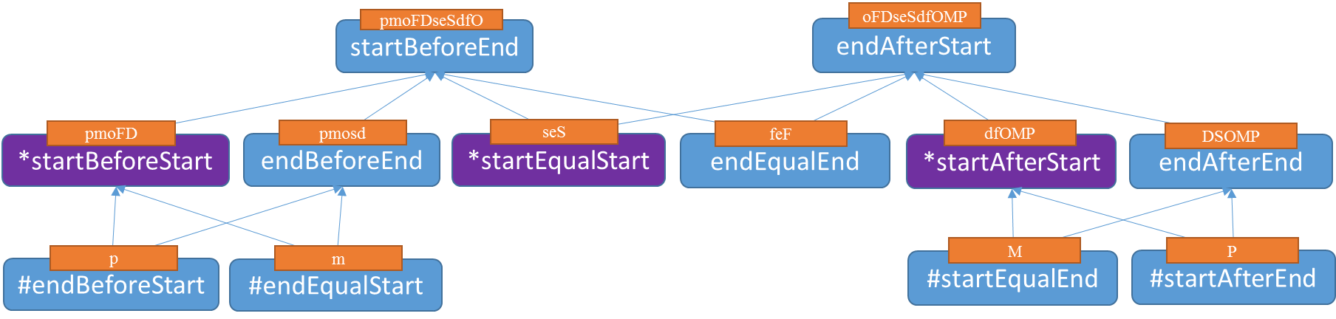
Property Axioms-Pellet(OWLAPI)
before inverseOf after
meet inverseOf metBy
overlap inverseOf overlappedBy
start inverseOf startedby
finish inverseOf finished
contain inverseOf during
equal symmetric/transitive
before = endBeforeStart (TEO)
after = startAfterEnd (TEO)
before transitive
after transitive
meet = endEqualStart (TEO)
metBy = startEqualEnd (TEO)
endBeforeStart inverseOf startAfterEnd
endBeforeEnd inverseOf endAfterEnd
startBeforeEnd inverseOf endAfterStart
startBeforeStart inverseOf startAfterStart
endBeforeStart transitive
startAfterEnd transitive
startBeforeStart transitive
startAfterStart transitive
endBeforeEnd transitive
endAfterEnd transitive
startEqualStart symmetric/transitive
endEqualEnd symmetric/transitive

Slide 20
Point Relations – the usage
Reason Timestamps from timeOffset
reason Annotation of timeOffset (not handled by OWLAPI)
absolute time info helps add more relative TemporalRelations to the graph
Queue<Event> validTimeEvents
inferred new list
Event 1
Event 4, Event 6
Event 1
Event 1
Event 2
Event 3
…
Event 3
timeline
add updated events back to the queue

Slide 21
reasonValidTime() – an example
Event 1 instant: TimeInstant1 (10:30:45, 5/15/2009)
Event 2 instant: TimeInstant2 (10am, 5/20/2010)
Event 3 interval: TimeInterval1 (hasStartTime: TimeInstant2 (10am, 5/20/201),
hasDuration: Duration1 (1Y5M10D))
Event 4 interval: TimeInterval2 (hasStartTime: TimeInsant3 (10:30:00, 5/15/2014),
hasEndTime: TimeInstant4 (August 20, 2014))
Event 5 interval: TimeInterval3 (hasStartTime: TimeInstant5 (Sept 1, 2008),
hasEndTime: TimeInstant6 (July 1, 2012),
hasDuration: Duration2 (4Y));
Event 3
Event 5
Event 4
timeline
9/1/2008
5/15/2009
5/20/2010
10/30/2011
(inferred)
7/1/2012
6/15/2014
8/20/2014
Event 1
Event 2

Slide 22
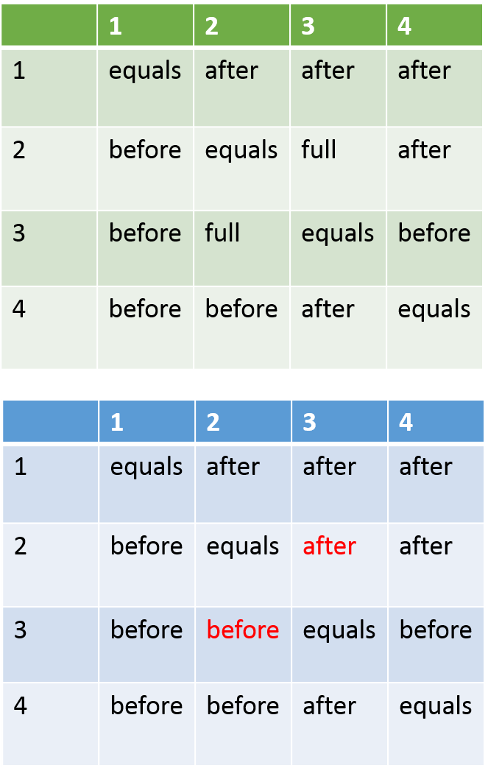
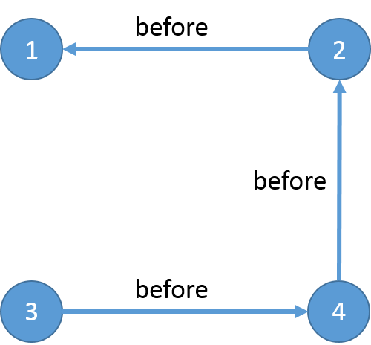
Event/Relation Graph

Slide 23
Allen’s interval algebra
composition operation
reasoning algorithm
Composition of basic interval relations
. | p | m | o | F | D | s | e | S | d | f | O | M | P
p | (p) | (p) | (p) | (p) | (p) | (p) | (p) | (p) | (pmosd) | (pmosd) | (pmosd) | (pmosd) | full
m | (p) | (p) | (p) | (p) | (p) | (m) | (m) | (m) | (osd) | (osd) | (osd) | (Fef) | (DSOMP)
o | (p) | (p) | (pmo) | (pmo) | (pmoFD) | (o) | (o) | (oFD) | (osd) | (osd) | concur | (DSO) | (DSOMP)
F | (p) | (m) | (o) | (F) | (D) | (o) | (F) | (D) | (osd) | (Fef) | (DSO) | (DSO) | (DSOMP)
D | (pmoFD) | (oFD) | (oFD) | (D) | (D) | (oFD) | (D) | (D) | concur | (DSO) | (DSO) | (DSO) | (DSOMP)
s | (p) | (p) | (pmo) | (pmo) | (pmoFD) | (s) | (s) | (seS) | (d) | (d) | (dfO) | (M) | (P)
e | (p) | (m) | (o) | (F) | (D) | (s) | (e) | (S) | (d) | (f) | (O) | (M) | (P)
S | (pmoFD) | (oFD) | (oFD) | (D) | (D) | (seS) | (S) | (S) | (dfO) | (O) | (O) | (M) | (P)
d | (p) | (p) | (pmosd) | (pmosd) | full | (d) | (d) | (dfOMP) | (d) | (d) | (dfOMP) | (P) | (P)
f | (p) | (m) | (osd) | (Fef) | (DSOMP) | (d) | (f) | (OMP) | (d) | (f) | (OMP) | (P) | (P)
O | (pmoFD) | (oFD) | concur | (DSO) | (DSOMP) | (dfO) | (O) | (OMP) | (dfO) | (O) | (OMP) | (P) | (P)
M | (pmoFD) | (seS) | (dfO) | (M) | (P) | (dfO) | (M) | (P) | (dfO) | (M) | (P) | (P) | (P)
P | full | (dfOMP) | (dfOMP) | (P) | (P) | (dfOMP) | (P) | (P) | (dfOMP) | (P) | (P) | (P) | (P)
To Add R(i, j)
Add <i,j> into queue ToDo
while ToDo is not empty:
Get next <i, j> from queue ToDo
N(i, j ) ← R(i, j);
For each node k in graph:
R(k, j) ← N(k, j) ∩ Constraints(N(k, i), R(i, j))
if R(k, j) is a proper subset of N(k, j):
add <k, j> to ToDo
For each node k in graph:
R(i, k) ← N(i, k) ∩ Constraints(N(i, j), R(j, k))
if R(i, k) is a proper subset of N(i, k):
add <i, k> to ToDo

Slide 24
4. TEO Querier
Implemented:
public List<Event> findEvents(String searchText);
public Date getEventFeature(Event event);
public Event getEventByIRIStr(String IRIStr);
public Duration getDuration(Event intervalEvent);
public Duration getDurationBetweenEvents(Event event1, Event event2, Granularity granularity);
public List<Short> getTemporalRelation (Event event1, Event event2, Granularity granularity);
public List<Event> getEventsTimeline();
3
1
2
5
6
4

Slide 25
A comprehensive example: annotation_8
event1 - timeInstant- 10:30:45 5/15/2009<second>
startEqualStart - event4
event2 - startAfterStart - event1 (timeOffset =2Y<year>)
event3 - startBeforeStart - event2 (timeOffset = 5M<month>)
event4 - endTime – 8/1/2014<day>
finishedBy – event3
event5 - duration - 1W
startAfterStart – event1 (timeOffset =3M4D<day>)
event6 - startAfterStart – event1 (timeOffset =1M<month>)
meets – event5
Event 3
Event 1
Event 6
Event 5
Event 2
Event 4
timeline
10:30:45 5/15/2009
6/15
8/19
8/26
12/15/2010
5/15/2011
8/1/2014
Magenta – asserted
Red – inferred

Slide 26
5. TEO Calendar Analyzer
07/04/2014 -> Independence Day
Independence Day in 2014 -> 07/04/2014

Slide 27
Algorithm for representing events from TEO relations

