Slide 1
Apache Kafka

Slide 2
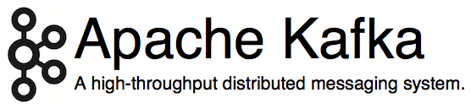
http://kafka.apache.org/
Originated at LinkedIn, open sourced in early 2011
Implemented in Scala, some Java
9 core committers, plus ~ 20 contributors
https://kafka.apache.org/committers.html
https://github.com/apache/kafka/graphs/contributors

Slide 3
Kafka?
LinkedIn’s motivation for Kafka was:
“A unified platform for handling all the real-time data feeds a large company might have.”
Must haves
High throughput to support high volume event feeds.
Support real-time processing of these feeds to create new, derived feeds.
Support large data backlogs to handle periodic ingestion from offline systems.
Guarantee fault-tolerance in the presence of machine failures.
http://kafka.apache.org/documentation.html#majordesignelements

Slide 4
Overview of Kafka core concepts
A first look
Topics, partitions, replicas, offsets
Producers, brokers, consumers
Putting it all together

Slide 5
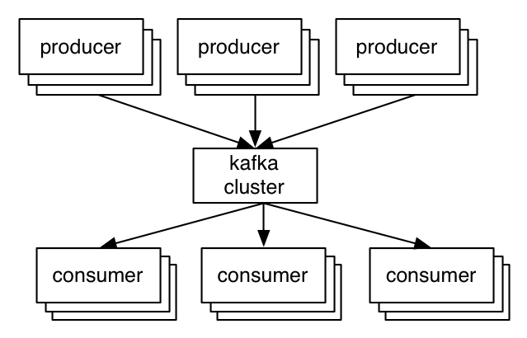
A first look
The who is who
Broker A node in Kafka Cluster
Producers write data to brokers.
Consumers read data from brokers.
All this is distributed.
The data
Data is stored in topics.
Topics are split into partitions, which are replicated.

Slide 6
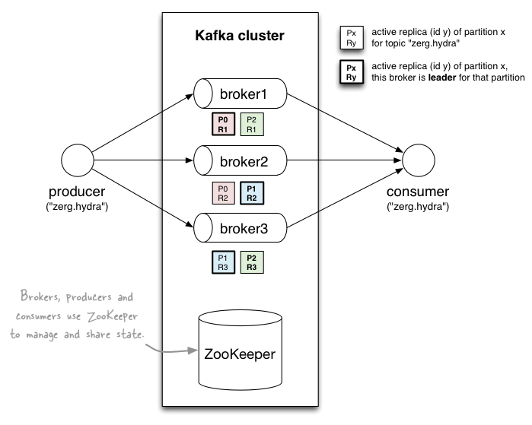
A first look
http://www.michael-noll.com/blog/2013/03/13/running-a-multi-broker-apache-kafka-cluster-on-a-single-node/

Slide 7
Topics
Consumer group C1
Consumers use an “offset pointer” to
track/control their read progress
(and decide the pace of consumption)
Consumer group C2
Producer A1
Producer A2
…
…
new
Producer An
Older msgs
Newer msgs
Producers always append to “tail”
(think: append to a file)
Broker(s)

Slide 8
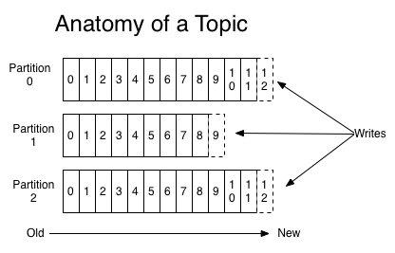
Partitions
A topic consists of partitions.
Partition: ordered + immutable sequence of messages that arecontinually appended to

Slide 9
Partition offsets
Offset: messages in the partitions are each assigned a unique (per partition) and sequential id called the offset
Consumers track their pointers via (offset, partition, topic) tuples

Slide 10
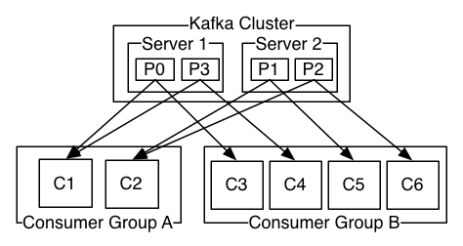
Partitions
#partitions of a topic is configurable
#partitions determines max consumer (group) parallelism
Consumer group A, with 2 consumers, reads from a 4-partition topic
Consumer group B, with 4 consumers, reads from the same topic

Slide 11
Replicas of a partition
Replicas: “backups” of a partition
They exist solely to prevent data loss.
Replicas are never read from, never written to.
They do NOT help to increase producer or consumer parallelism!
Kafka tolerates (numReplicas - 1) dead brokers before losing data
LinkedIn: numReplicas == 2 → 1 broker can die

Slide 12
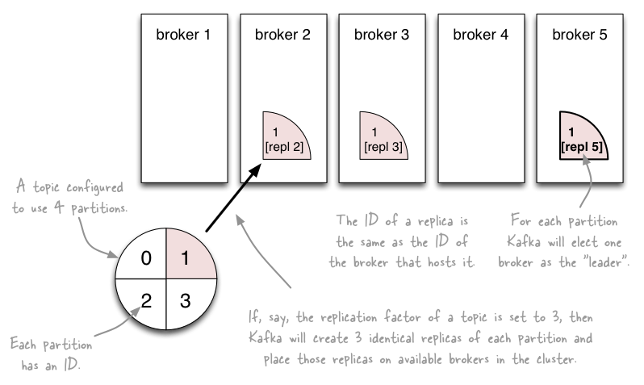
Topics vs. Partitions vs. Replicas
http://www.michael-noll.com/blog/2013/03/13/running-a-multi-broker-apache-kafka-cluster-on-a-single-node/

Slide 13
Why is Kafka so fast?
Fast writes:
While Kafka persists all data to disk, essentially all writes go to the page cache of OS, i.e. RAM.
Fast reads:
Very efficient to transfer data from page cache to a network socket
Linux: sendfile() system call
Combination of the two = fast Kafka!
Example (Operations): On a Kafka cluster where the consumers are mostly caught up you will see no read activity on the disks as they will be serving data entirely from cache.
http://kafka.apache.org/documentation.html#persistence

Slide 14
Kafka + X for processing the data?
Kafka + Storm often used in combination, e.g. Twitter
Kafka + custom
“Normal” Java multi-threaded setups
Recent additions:
Samza (since Aug ’13) – also by LinkedIn
Spark Streaming, part of Spark (since Feb ’13)
Kinesys from Amazon
Kafka + Camus for Kafka->Hadoop ingestion
https://cwiki.apache.org/confluence/display/KAFKA/Powered+By

Slide 15
Let’s recap
The who is who
Producers write data to brokers.
Consumers read data from brokers.
All this is distributed.
The data
Data is stored in topics.
Topics are split into partitions which are replicated.

