Slide 1


Slide 2
Scala, short for Scalable Language, is a hybrid functional programming language.
Scala smoothly integrates features of object-oriented and functional languages and Scala is compiled to run on the Java Virtual Machine.
Scala is object-oriented:
Scala is a pure object-oriented language in the sense that every value is an object.
Scala is functional:
Scala is also a functional language in the sense that every function is a value and because every value is an object so ultimately every function is an object.
Scala provides a lightweight syntax for defining anonymous functions, it supports higher-order functions, it allows functions to be nested, and supports currying.
Scala is statically typed:
Scala, unlike some of the other statically typed languages (C, Pascal, Rust, etc.), does not expect you to provide redundant type information. You don't have to specify a type in most cases, and you certainly don't have to repeat it.

Slide 3
Basic Syntax
Case Sensitivity − Scala is case-sensitive, which means identifier Hello and hello would have different meaning in Scala.
Class Names − For all class names, the first letter should be in Upper Case. If several words are used to form a name of the class, each inner word's first letter should be in Upper Case.
Example − class MyFirstScalaClass.
Method Names − All method names should start with a Lower Case letter. If multiple words are used to form the name of the method, then each inner word's first letter should be in Upper Case.
Example − def myMethodName()
Program File Name − Name of the program file should exactly match the object name. When saving the file you should save it using the object name (Remember Scala is case-sensitive) and append ‘.scala’ to the end of the name. (If the file name and the object name do not match your program will not compile).
Example − Assume 'HelloWorld' is the object name. Then the file should be
saved as 'HelloWorld.scala'.
def main(args: Array[String]) − Scala program processing starts from the main() method which is a mandatory part of every Scala Program.

Slide 4
Naming Conventions
Here are the rules for combining letters, numbers, and characters into valid identifiers in Scala:
A letter followed by zero or more letters and digits.
A letter followed by zero or more letters and digits, then an underscore (_), and then one or more of either letters and digits or operator characters.
One or more operator characters.
One or more of any character except a backquote, all enclosed in a pair of back-quotes.
Eg: scala> val π = 3.14159 //Valid
scala> val $ = "USD currency symbol“ // Valid
scala> val o_O = "Hmm“ //Valid
scala> val 50cent = "$0.50" //Invalid
scala> val a.b = 25 //Invalid
scala> val `a.b` = 4 //Valid

Slide 5
Variables & Values Declaration
Scala has a different syntax for declaring variables. They can be defined as value, i.e., constant or a variable. Here, myVar is declared using the keyword var. It is a variable that can change value and this is called mutable variable. Following is the syntax to define a variable using var keyword .
Syntax:
var <identifier>[: <type>] = <data>
Eg scala> var myVar : Double = 2.72
scala> myVar = 355.0 / 113.0
scala> myVar = 5
Here, myVal is declared using the keyword val. This means that it is a variable that cannot be changed and this is called immutable variable.
Eg scala> val myVal : Int = 20
scala> val greeting: String = "Hello, World"
scala> val atSymbol: Char = '@’
Let’s try out these literals by assigning them to new values without stating the type. The Scala REPL will use type inference to calculate the appropriate types for each value:
scala> val anInt = 5
scala> val pi = 3.1416

Slide 6
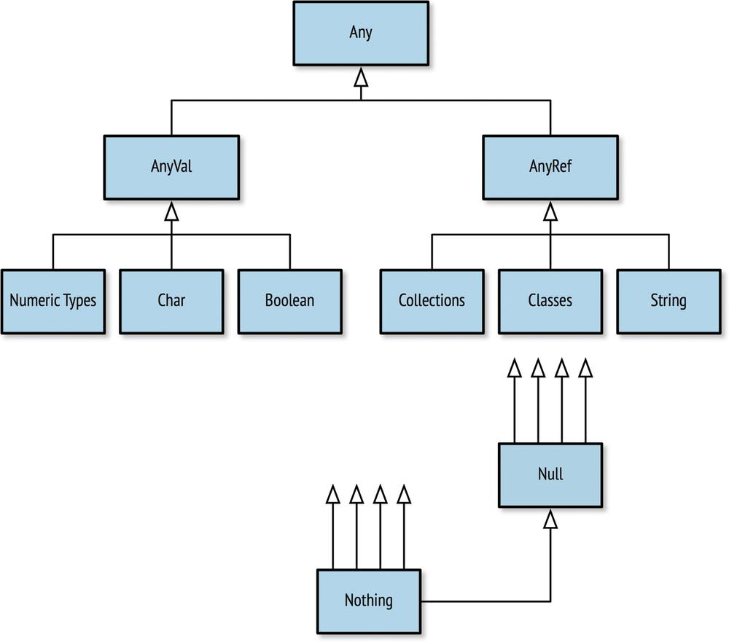
Overview of Scala Types
The Any, AnyVal, and AnyRef types are the root of Scala’s type hierarchy. Any is the absolute root, and all other types descend from its two children, AnyVal and AnyRef. The types that extend AnyVal are known as value types because they are the core values used to represent data.
All other types have AnyRef as their root and are only ever allocated on the heap as objects. The term “Ref” in “AnyRef” indicates they are reference types that are accessed via a memory reference.

Slide 7
Name | Description | Instantiable
Any | The root of all types in Scala | No
AnyVal | The root of all value types | No
AnyRef | The root of all reference (nonvalue) types | No
Nothing | The subclass of all types | No
Null | The subclass of all AnyRef types signifying a null value | No
Char | Unicode character | Yes
Boolean | true or false | Yes
String | A string of characters (i.e., text) | Yes
Unit | Denotes the lack of a value | No

Slide 8
Numeric Types
Scala has both numeric (e.g., Int and Double) and nonnumeric types (e.g., String) that can be used to define values and variables.
Unlike Java and C there is no concept of a primitive type in Scala. While the Java Virtual Machine supports the primitive integer type int and the integer class Integer, Scala only supports its own integer class, Int.
Name | Description | Size | Min | Max
Byte | Signed integer | 1 byte | –127 | 128
Short | Signed integer | 2 bytes | –32768 | 32767
Int | Signed integer | 4 bytes | –2³¹ | 2³¹–1
Long | Signed integer | 8 bytes | –2⁶³ | 2⁶³–1
Float | Signed floating point | 4 bytes | n/a | n/a
Double | Signed floating point | 8 bytes | n/a | n/a

Slide 9
Char literals are written with single quotes, distinguishing them from String literals, which are written with double quotes.
scala> val c = 'A'
scala> val i: Int = c
scala> val t: Char = 116
Boolean type is limited to the values true and false. In addition to using true and false, you can also obtain Boolean values from comparison and Boolean logic operators.
scala> val isTrue = !true
scala> val isFalse = !true
scala> val unequal = (5 != 6)
scala> val isLess = (5 < 6)
Unit literal is an empty pair of parentheses, (), which if you consider it is a fine representation of not having a value. If you want you can define a value or variable with the Unit type, but again its common usage is for defining functions and expressions:
scala> val nada = ()
The other bottom type is Null, a subtype of all AnyRef types that exists to provide a type for the keyword null. A String variable, for example, can be assigned null at any time, such that the variable does not point to any string instance in memory.

Slide 10
Scala supports the ability to automatically convert numbers from one type to another based on the rank of the type.
Eg scala> val b: Byte = 10
scala> val s: Short = b
scala> val d: Double = s
Scala does not allow automatic conversion from higher ranked types to lower ranked types. This makes sense, because you could otherwise lose data if you convert to a type with less storage.
Eg scala> val l: Long = 20
scala> val i: Int = l
<console>:8: error: type mismatch;
found : Long
required: Int
val i: Int = l

Slide 11
String interpolation
Building a String based on other values is reasonably easy to do with string addition. Here is a String built by adding text before and after the Float value.
Eg scala> val approx = 355/113f
scala> println("Pi, using 355/113, is about " + approx + "." )
A more direct way to combine your values or variables inside a String is with string interpolation, a special mode where external value and variable names are recognized and resolved. The Scala notation for string interpolation is an “s” prefix added before the first double quote of the string. Then dollar sign operators ($) (with optional braces) can be used to note references to external data.
Eg scala> println(s"Pi, using 355/113, is about $approx." )
scala> val item = "apple"
scala> f"I wrote a new $item%.3s today“

Slide 12
Multiple assignments
Scala supports multiple assignments.
Eg val (myVar1, myVar2) = Pair(40, "Foo")
Scala – Operators
Scala is rich in built-in operators and provides the following types of operators
Arithmetic Operators
Relational Operators
Logical Operators
Bitwise Operators
Assignment Operators
Comments in Scala
Multiline comment
/* This is my first java program.
* This will print 'Hello World' as the output
* This is an example of multi-line comments.
*/
Singleline Comment
// Prints Hello World

Slide 13
Scala - Functions
A function is a group of statements that perform a task. You can divide up your code into separate functions.
A function definition can appear anywhere in a source file and Scala permits nested function definitions, that is, function definitions inside other function definitions. Most important point to note is that Scala function's name can have characters like +, ++, ~, &,-, --, \, /, :, etc.
Different Type of Functions are:-
Input Less Functions
def <identifier> = <expression>
eg
scala> def hi = "hi"
scala> hi //calling the functions
Defining a Function with a Return Type
def <identifier>: <type> = <expression>
eg
def add(x:Int,y:Int): Int= {x+y}
add(4,5) //calling the function

Slide 14
Functions with Empty Parentheses
def <identifier>()[: <type>] = <expression>
eg
def display() = { print("Functions with Empty Parentheses") }
display()
Function Invocation with Expression Blocks
<function identifier> <expression block>
eg
def format(amt: Double) = f"€$amt%.2f”
format{val rate = 1.32; 0.235 + 0.7123 + rate * 5.32 }
Recursive Functions
def power(x: Int, n: Int): Long = {
if (n >= 1) x * power(x, n-1)
else 1
}
power(2, 8)
Calling Functions with Named Parameters
def greet(prefix: String, name: String) = s"$prefix $name"
val greeting2 = greet(name = "Brown", prefix = "Mr")

Slide 15
Parameters with Default Values
def <identifier>(<identifier>: <type> = <value>): <type>
eg
def greet(prefix: String = "Mr", name: String) = s"$prefix$name"
val greeting1 = greet(name = "Paul")
More than one parameter
def sum(items: Int*) = {
var total = 0
for (i <- items) total = total + i
print (s"Total amount is $total")
}
sum(10,20,30,40) //calling the function
Parameter Groups
def max(x: Int)(y: Int) = if (x > y) x else y
var larger = max(20)(39)

Slide 16
Type Parameters
def identity[A](a: A): A = a
val s = identity[String]("Hello")
val d = identity[Double](2.717)
print(s"Value of s is $s")
println(s"Value of d is $d“)

Slide 17
Higher-Order Functions->A higher-order function is a function that has a value with a function type as an input parameter or return value.
def safeStringOp(s: String, f: String => String) = {
if (s != null) f(s) else s
}
def reverser(s: String) = s.reverse
safeStringOp("Ready", reverser)
Function Literals or Anonymous functions->Function that lacks a name, and assign it to a new function value
val doubler = (x: Int) => x * 2
val doubled = doubler(22)
Combined Example of Function Type and Function Literal:
def safeStringOp(s: String, f: String => String) = {
if (s != null) f(s) else s
}
safeStringOp(null, (s: String) => s.reverse)
safeStringOp("Ready", (s: String) => s.reverse)

Slide 18
Scala – Closures
A closure is a function, whose return value depends on the value of one or more variables declared outside this function.
Now factor has a reference to a variable outside the function but in the enclosing scope.
object Demo {
def main(args: Array[String]) {
println( "multiplier(1) value = " + multiplier(1) )
println( "multiplier(2) value = " + multiplier(2) )
}
var factor = 3
val multiplier = (i:Int) => i * factor
}

Slide 19
Scala Collections
Scala has a rich set of collection library. Collections are containers of things. Those containers can be sequenced, linear sets of items like List, Tuple, Option, Map, etc. The collections may have an arbitrary number of elements or be bounded to zero or one element (e.g., Option).
Understanding the Collections Hierarchy:- The Scala collections hierarchy is very rich (deep and wide), and understanding how
it’s organized can be helpful when choosing a collection to solve problem.

Slide 20
Sequences :- Digging a little deeper into the sequence hierarchy, Scala contains a large number of sequences, many of which are shown in below

Slide 21
Lists, Sets, and Maps
Let’s start with the List type, an immutable singly linked list. You can create a list by invoking it as a function, passing in its contents in the form of comma-separated parameters.
eg
scala> val numbers = List(32, 95, 24, 21, 17)
scala> val colors = List("red", "green", "blue")
scala> colors.head
scala> colors.tail
scala> colors(1)
scala> colors(2)
Let’s try out using for-loops to iterate over the “numbers” and “colors” lists:
scala> var total = 0; for (i <- numbers) { total += i }
scala> for (c <- colors) { println(c) }

Slide 22
Scala’s collections use higher-order functions extensively to iterate, map (convert a list item-by-item to a different list), reduce (fold a list into a single element), and perform a wide range of other useful operations
scala> val colors = List("red", "green", "blue")
scala> colors.foreach( (c: String) => println(c) )
scala> val sizes = colors.map( (c: String) => c.size )
scala> val numbers = List(32, 95, 24, 21, 17)
scala> val total = numbers.reduce( (a: Int, b: Int) => a + b )
A Set is an immutable and unordered collection of unique elements, but works similarly to List. Here is an example of creating a Set with duplicate items. As another subtype of Iterable, a Set instance supports the same operations as a List instance does.
scala> val unique = Set(10, 20, 30, 20, 20, 10)

