Slide 1
Hadoop File System
Mohd Hasnain(345346)

Slide 2
Basic Features: HDFS
Highly fault-tolerant – Failure is norm rather then exception
High throughput – low latency
Suitable for applications with large data sets – GB/TB/PB/ZB
Streaming access to file system data – Write once/read many times
Can be built out of commodity hardware
High aggregate data bandwidth
Scale to hundreds of nodes in a cluster
Tens of millions of files in a single instance

Slide 3
MapReduce
Cat
Bat
Dog
Other
Words
(size:
TByte)
combine
reduce
map
part0
split
reduce
combine
split
map
part1
combine
reduce
split
map
part2
split
map

Slide 4
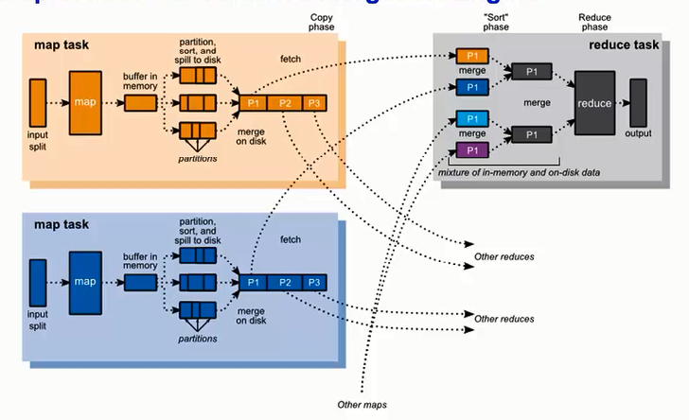

Slide 5
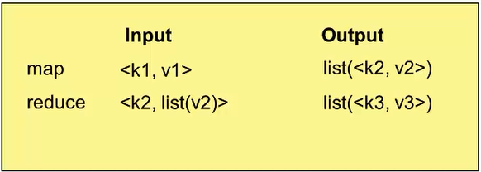
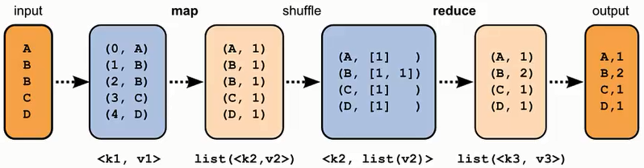

Slide 6
Namenode and Datanodes
Master/slave architecture
HDFS cluster consists of a single Namenode, a master server that manages the file system namespace and regulates access to files by clients.
There are a number of DataNodes usually one per node in a cluster.
The DataNodes manage storage attached to the nodes that they run on.
HDFS exposes a file system namespace and allows user data to be stored in files.
A file is split into one or more blocks and set of blocks are stored in DataNodes.
DataNodes: serves read, write requests, performs block creation, deletion, and replication upon instruction from Namenode.

Slide 7
Data Blocks
write-once-read-many
Minimum amount of data that it can read or write
64MB by default (or even 128 MB) – independent units
A file is chopped into 64MB chunks and stored with replication
Why Block in HDFS is so Large ?
- minimize the cost of seeks

Slide 8
FSCK -
command checks health of entire filesystem, it can also be limited to a specific directory
hadoop fsck /smith/dp/dataengine/price_link_model_nbr -files –blocks -racks
hadoop fsck /smith/dp/dataengine/price_link_model_nbr
hdfs fsck <path> [-list-corruptfileblocks | [-move | -delete | -openforwrite] [-files [-blocks [-locations | -racks]]] [-includeSnapshots]
COMMAND_OPTION | Description
path | Start checking from this path.
-delete | Delete corrupted files.
-files | Print out files being checked.
-files -blocks | Print out the block report
-files -blocks -locations | Print out locations for every block.
-files -blocks -racks | Print out network topology for data-node locations.
-includeSnapshots | Include snapshot data if the given path indicates a snapshottable directory or there are snapshottable directories under it.
-list-corruptfileblocks | Print out list of missing blocks and files they belong to.
-move | Move corrupted files to /lost+found.
-openforwrite | Print out files opened for write

Slide 9
-bash-4.1$ hadoop fs -help
Usage: hadoop fs [generic options]
[-cat [-ignoreCrc] <src> ...]
[-chmod [-R] <MODE[,MODE]... | OCTALMODE> PATH...]
[-copyFromLocal <localsrc> ... <dst>]
[-copyToLocal [-ignoreCrc] [-crc] <src> ... <localdst>]
[-count [-q] <path> ...]
[-du [-s] [-h] <path> ...]
[-get [-ignoreCrc] [-crc] <src> ... <localdst>]
[-getmerge [-nl] <src> <localdst>]
[-ls [-d] [-h] [-R] [<path> ...]]
[-mkdir [-p] <path> ...]
[-moveFromLocal <localsrc> ... <dst>]
[-moveToLocal <src> <localdst>]
[-mv <src> ... <dst>]
[-put <localsrc> ... <dst>]
[-rm [-f] [-r|-R] [-skipTrash] <src> ...]
[-rmdir [--ignore-fail-on-non-empty] <dir> ...]
[-tail [-f] <file>]

Slide 10
example
hadoop fs -ls /smith/dp/dataengine/price_link_model_nbr
hlsl /smith/dp/dataengine/price_link_model_nbr | wc –l
hcat /smith/dp/dataengine/price_link_model_nbr/part-m-00000 | wc –l
hadoop fs -cat /smith/dp/dataengine/price_link_model_nbr/part-m-00000 | wc –l
hadoop fs -count /smith/dp/dataengine/price_link_model_nbr
hadoop fs -du -s -h /smith/dp/dataengine/price_link_model_nbr
hadoop fs –df
hadoop fs -mkdir /user/mhasnai/kmart_hier_report157
hadoop fs -put test.txt /user/mhasnai/kmart_hier_report157/test1
hadoop fs -rm /user/mhasnai/kmart_hier_report157/test1

Slide 11
HDFS Architecture
Namenode
Metadata(Name, replicas..)
(/home/foo/data,6. ..
Metadata ops
Client
Block ops
Read
Datanodes
Datanodes
B
replication
Blocks
Rack1
Write
Rack2
Client

Slide 12
WARNING: Do not attempt to modify metadata directories or files. Unexpected modifications can cause HDFS downtime, or even permanent data loss. This information is provided for educational purposes only.

Slide 13
Data Replication
HDFS is designed to store very large files across machines in a large cluster.
Each file is a sequence of blocks.
All blocks in the file except the last are of the same size.
Blocks are replicated for fault tolerance.
Block size and replicas are configurable per file.
The Namenode receives a Heartbeat and a BlockReport from each DataNode in the cluster.
BlockReport contains all the blocks on a Datanode.
fsimage – An fsimage file contains the complete state of the file system at a point in time. Every file system modification is assigned a unique, monotonically increasing transaction ID. An fsimage file represents the file system state after all modifications up to a specific transaction ID.
edits – An edits file is a log that lists each file system change (file creation, deletion or modification) that was made after the most recent fsimage

Slide 14
Namenode dir structure
A newly formatted namenode creates the following directory structure:
${dfs.name.dir}/current
/VERSION → Version of HDFS
/edits → filesystem client performs a write operation (such as creating or moving a file), it is first recorded in the edit log.
/fsimage → persistent checkpoint of the filesystem metadata
/fstime
→FSIMAGE is not updated for every filesystem write operation, since writing out the fsimage file, which can grow to be gigabytes in size, would be very slow
http://hortonworks.com/blog/hdfs-metadata-directories-explained/

Slide 15
Problem
NN failure
If The edits file would grow without bound. Though this state of affairs
would have no impact on the system while the namenode is running,
if the namenode were restarted, it would take a long time to apply each of the operations in its (very long) edit log. During this time, the filesystem would be offline, which is generally undesirable.

Slide 16
secondary namenode
-checkpointing process
1. The secondary asks the primary to roll its edits file, so new edits go to a new file.
2. The secondary retrieves fsimage and edits from the primary.
3. The secondary loads fsimage into memory, applies each operation from edits, then creates a new consolidated fsimage file.
4. The secondary sends the new fsimage back to the primary.
5. The primary replaces the old fsimage with the new one from the secondary, and the old edits file with the new one it started in step 1. It also updates the fstime file to record the time that the checkpoint was taken.

Slide 17
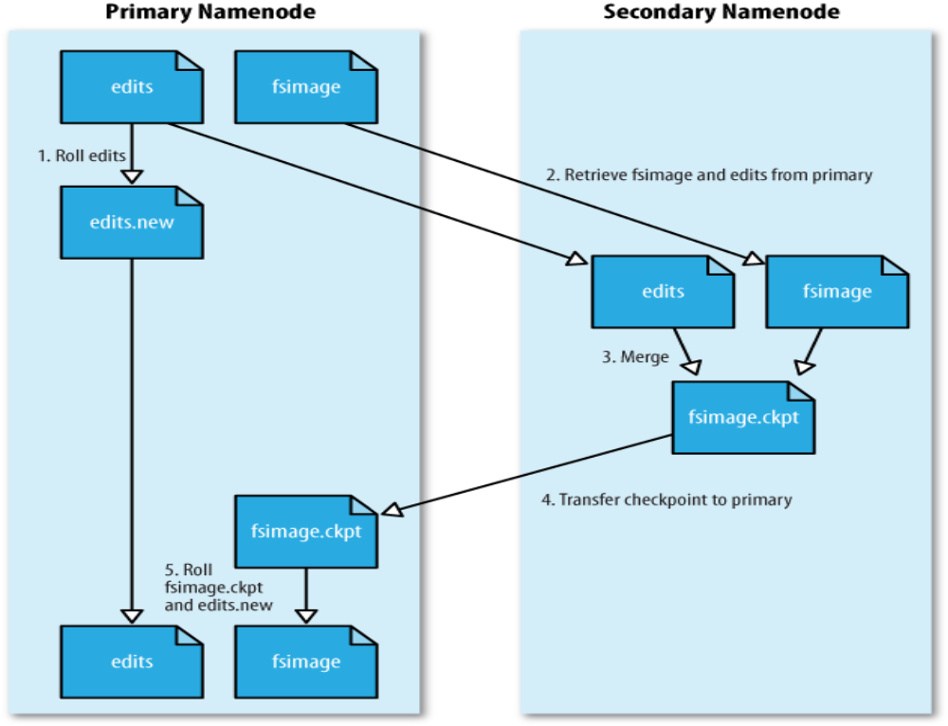

Slide 18
Cont ..
The primary has an up-to-date fsimage file
A shorter edits file (it is not necessarily empty, as it may have received some edits while the checkpoint was being taken)
3 way to start:
1) Manual by hadoop dfsadmin –saveNamespace
2) Every hour (fs.checkpoint.period in seconds)
3) Edit log has reached 64 MB (fs.checkpoint.size in bytes)
Secondary has similar memory requirements to the primary ?

Slide 19
Secondary namenode directory structure
${fs.checkpoint.dir}/current/VERSION
/edits
/fsimage
/fstime
/previous.checkpoint/VERSION
/edits
/fsimage
/fstime

Slide 20
Datanode directory structure
${dfs.data.dir}/current/VERSION
/blk_<id_1>
/blk_<id_1>.meta
/blk_<id_2>
/blk_<id_2>.meta
/...
/blk_<id_64>
/blk_<id_64>.meta
/subdir0/
/subdir1/
/...
/subdir63/

