Slide 1

Hive
Mohd Hasnain(345346)

Slide 2
Motivation
Yahoo worked on Pig to facilitate application deployment on Hadoop.
  Their need mainly was focused on unstructured data
Simultaneously Facebook started working on deploying warehouse solutions on Hadoop that resulted in Hive.
  The size of data being collected and analyzed in industry for business intelligence (BI) is growing rapidly making traditional warehousing solution prohibitively expensive.
  It is used to querying and managing large datasets residing in distributed storage.
Hive and Hadoop are extensively used in Facbook for different kinds of operations.
700 TB = 2.1Petabyte after replication!

Slide 3
Why Another Data Warehousing System?
Problem: Data, data and more data
  200GB per day in March 2008 back to 1TB compressed per day today
The Hadoop Experiment
Problem: Map/Reduce is great but every one is not a Map/Reduce expert
  I know SQL and I am a python and php expert
So what do we do: HIVE
Notes:
System that would scale

Slide 4
What is HIVE?
A system for managing and querying unstructured data as if it were structured
  Uses Map-Reduce for execution
  HDFS for Storage
Key Building Principles
  SQL as a familiar data warehousing tool
  Extensibility (Pluggable map/reduce scripts in the language of your choice, Rich and User Defined Data Types, User Defined Functions)
  Interoperability (Extensible Framework to support different file and data formats)
  Performance

Slide 5
Uses of Hive:
The Apache Hive distributed storage.
Hive provides tools to enable easy data extract/transform/load (ETL)
It provides the structure on a variety of data formats.
By using Hive, we can access files stored in Hadoop Distributed File System or in other data storage systems such as Apache HBase.

Slide 6
Limitations of Hive:
Hive is not designed for Online transaction processing (OLTP ), it is only used for the Online Analytical Processing.
Hive supports overwriting or apprehending data, but not updates and deletes.
In Hive, sub queries are not supported.

Slide 7
Why Hive is used inspite of Pig?
Hive-QL is a declarative language like SQL, PigLatin is a data flow language.
Pig: a data-flow language and environment for exploring very large datasets.
Hive: a distributed data warehouse.

Slide 8
Type System
Primitive types
  Integers:TINYINT, SMALLINT, INT, BIGINT.
  Boolean: BOOLEAN.
  Floating point numbers: FLOAT, DOUBLE .
  String: STRING.
Complex types
  Structs: {a INT; b INT}.
  Maps: M['group'].
  Arrays: ['a', 'b', 'c'], A[1] returns 'b'.

Slide 9

Hive CLI
DDL:
  create table/drop table/rename table
  alter table add column
Browsing:
  show tables
  describe table
  cat table
Loading Data
Queries

Slide 10
Data Model- Tables
Tables
  Analogous to tables in relational DBs.
  Each table has corresponding directory in HDFS.
  Example
    Page view table name – pvs
    HDFS directory
      /wh/pvs
Example:
CREATE TABLE t1(ds string, ctry float, li list<map<string,
struct<p1:int, p2:int>>);

Slide 11

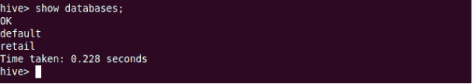


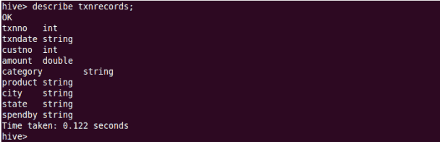
DDL

Slide 12
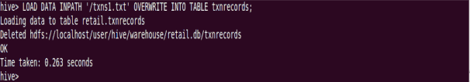
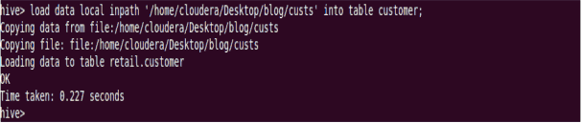
DML
LOAD data <LOCAL> inpath <file path> into table [tablename]
If the keywordlocal is specified, then in the load command will give the local file system path. If the keyword local is not specified we have to use the HDFS path of the file.

Slide 13
Hive Query Language –Contd.
Insertion
• INSERT OVERWRITE is used to overwrite the existing data in the table or partition.
• INSERT INTO is used to append the data into existing data in a table. (Note: INSERT INTO syntax is work from the version 0.8)
INSERT OVERWRITE TABLE sample1 '/tmp/hdfs_out' SELECT * FROM sample WHERE ds='2012-02-24';
INSERT OVERWRITE DIRECTORY '/tmp/hdfs_out' SELECT * FROM sample WHERE ds='2012-02-24';
INSERT OVERWRITE LOCAL DIRECTORY '/tmp/hive-sample-out' SELECT * FROM sample;

Slide 14
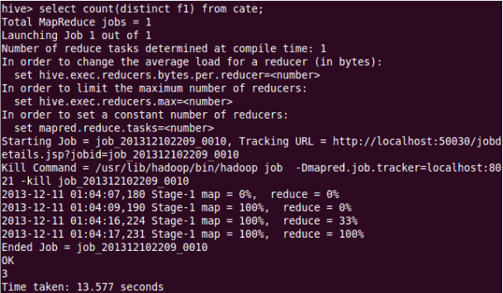
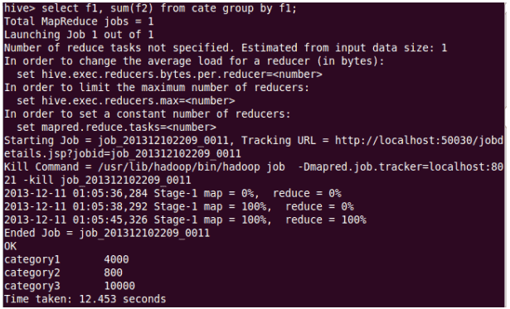

Slide 15
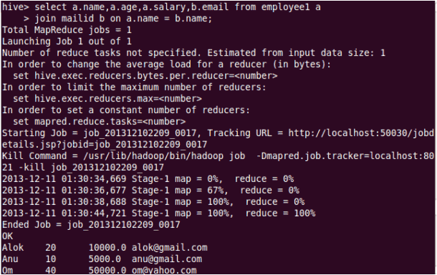

Slide 16
Hive Query Language –Contd.
Partitioning – Creating partitions
CREATE TABLE test_part(ds string, hr int)
PARTITIONED BY (ds string, hr int);
INSERT OVERWRITE TABLE
test_part PARTITION(ds='2009-01-01', hr=12)
SELECT * FROM t;
ALTER TABLE test_part
ADD PARTITION(ds='2009-02-02', hr=11);

Slide 17
Partitioning - Contd..
SELECT * FROM test_part WHERE ds='2009-01-01';
will only scan all the files within the
/user/hive/warehouse/test_part/ds=2009-01-01 directory
SELECT * FROM test_part
WHERE ds='2009-02-02' AND hr=11;
will only scan all the files within the /user/hive/warehouse/test_part/ds=2009-02-02/hr=11 directory.

Slide 18
Joins
Joins
      FROM page_view pv JOIN user u ON (pv.userid = u.id)
      INSERT INTO TABLE pv_users
      SELECT pv.*, u.gender, u.age
      WHERE pv.date = 2008-03-03;
Outer Joins
FROM page_view pv FULL OUTER JOIN user u ON (pv.userid = u.id) INSERT INTO TABLE pv_users
SELECT pv.*, u.gender, u.age
WHERE pv.date = 2008-03-03;

Slide 19
Hive Query Language
JOIN
SELECT t1.a1 as c1, t2.b1 as c2
FROM t1 JOIN t2 ON (t1.a2 = t2.b2);
INSERTION
INSERT OVERWRITE TABLE t1
SELECT * FROM t2;

Slide 20
Hive Query Language –Contd.
Map Reduce
FROM (MAP doctext USING 'python wc_mapper.py' AS (word, cnt)
FROM docs
CLUSTER BY word
)
REDUCE word, cnt USING 'python wc_reduce.py';
FROM (FROM session_table
SELECT sessionid, tstamp, data
DISTRIBUTE BY sessionid SORT BY tstamp
)
REDUCE sessionid, tstamp, data USING 'session_reducer.sh';

Slide 21
Aggregations and Multi-Table Inserts
  FROM pv_users
  INSERT INTO TABLE pv_gender_uu
    SELECT pv_users.gender, count(DISTINCT pv_users.userid)
    GROUP BY(pv_users.gender)
  INSERT INTO TABLE pv_ip_uu
    SELECT pv_users.ip, count(DISTINCT pv_users.id)
    GROUP BY(pv_users.ip);

Slide 22
Running Custom Map/Reduce Scripts
    FROM (
      FROM pv_users
      SELECT TRANSFORM(pv_users.userid, pv_users.date) USING 'map_script'
      AS(dt, uid)
      CLUSTER BY(dt)) map
    INSERT INTO TABLE pv_users_reduced
      SELECT TRANSFORM(map.dt, map.uid) USING 'reduce_script' AS (date, count);

Slide 23
Inserts into Files, Tables and Local Files
    FROM pv_users
    INSERT INTO TABLE pv_gender_sum
      SELECT pv_users.gender, count_distinct(pv_users.userid)
      GROUP BY(pv_users.gender)
    INSERT INTO DIRECTORY ‘/user/facebook/tmp/pv_age_sum.dir’
      SELECT pv_users.age, count_distinct(pv_users.userid)
      GROUP BY(pv_users.age)
    INSERT INTO LOCAL DIRECTORY ‘/home/me/pv_age_sum.dir’
    FIELDS TERMINATED BY ‘,’ LINES TERMINATED BY \013
      SELECT pv_users.age, count_distinct(pv_users.userid)
      GROUP BY(pv_users.age);

Slide 24

Conclusion
Pros
  A easy way to process large scale data
  Support SQL-based queries
  Provide more user defined interfaces to extend
  Programmability
  Efficient execution plans for performance
  Interoperability with other database tools
Cons
  Accepts only a subset of SQL queries
  No easy way to append data
  Files in HDFS are immutable
  Performance comparisons with other systems would have been more appreciable

Slide 25
Thank you ☺

