Slide 1
Machine Learning With Spark
Mohd Hasnain

Slide 2
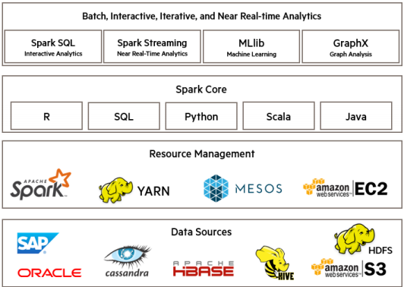

Apache Spark ecosystem

Slide 3
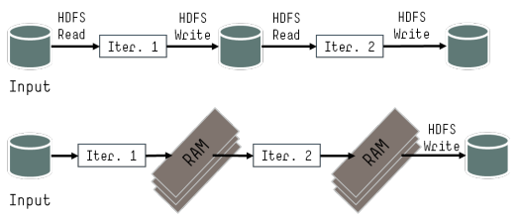

In-memory analytics

Slide 4
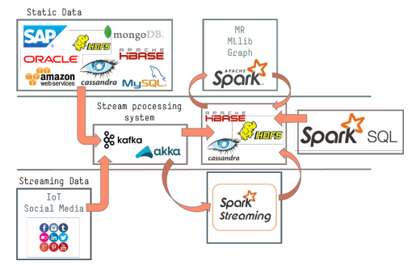

RT VS ML

Slide 5

What is MLlib?
Algorithms:
• classification: logistic regression, linear support vector machine
(SVM), naive Bayes
• regression: generalized linear regression (GLM)
• collaborative filtering: alternating least squares (ALS)
• clustering: k-means
• decomposition: singular value decomposition (SVD), principal
component analysis (PCA)

Slide 6
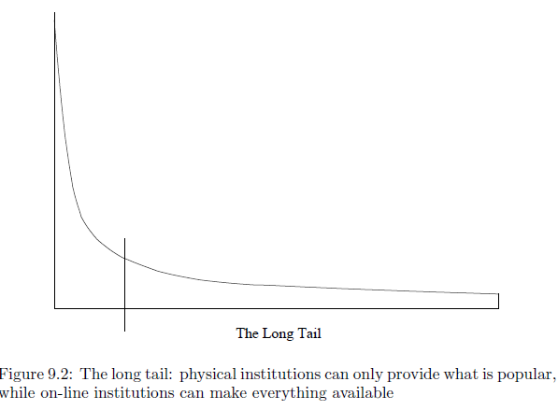


Slide 7
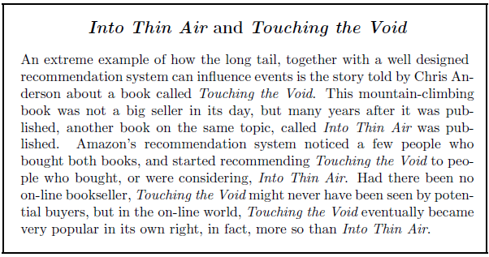


Slide 8

Mahout?
Algorithms:
• classification: logistic regression, naive Bayes, random forest, …
• collaborative filtering: ALS, …
• clustering: k-means, fuzzy k-means, …
• decomposition: SVD, randomized SVD, …

Slide 9

scikit-learn?
Algorithms:
• classification: SVM, nearest neighbors, random forest, …
• regression: support vector regression (SVR), ridge regression,
Lasso, logistic regression, …!
• clustering: k-means, spectral clustering, …
• decomposition: PCA, non-negative matrix factorization (NMF),
independent component analysis (ICA), …

Slide 10
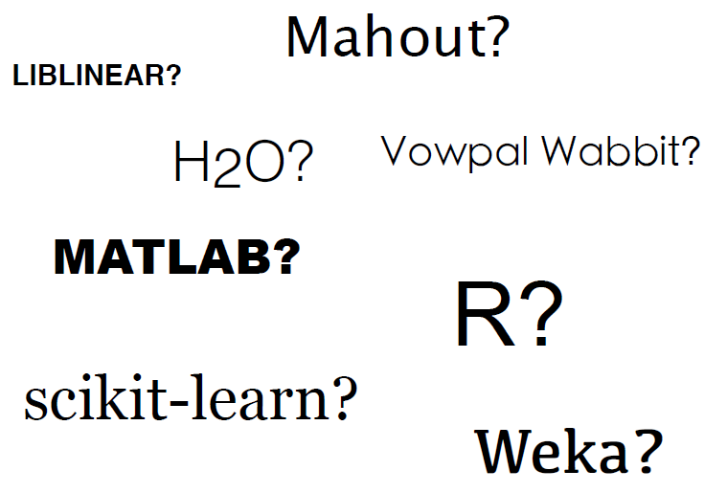


Slide 11
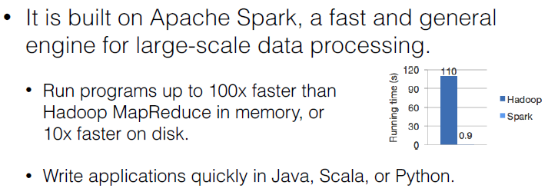

Why MLlib?

Slide 12
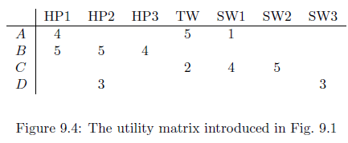

Measuring Similarity

Slide 13
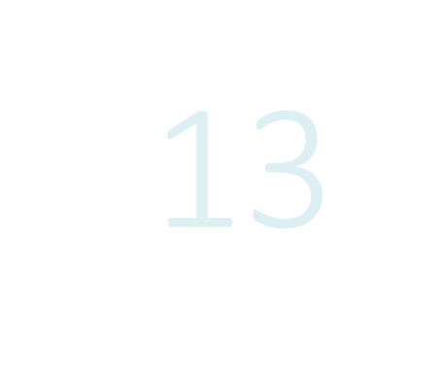
1. Content-Based systems
focus on properties of items. Similarity of items is determined by measuring the similarity in their properties.
2. Collaborative-Filtering systems
focus on the relationship between users and items. Similarity of items is determined by the similarity of the ratings of those items by the users who have rated both items.

Slide 14
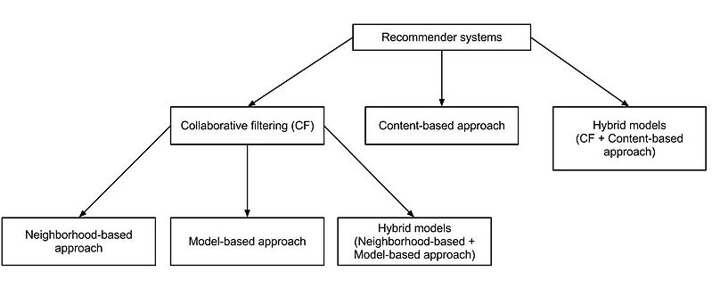


Slide 15
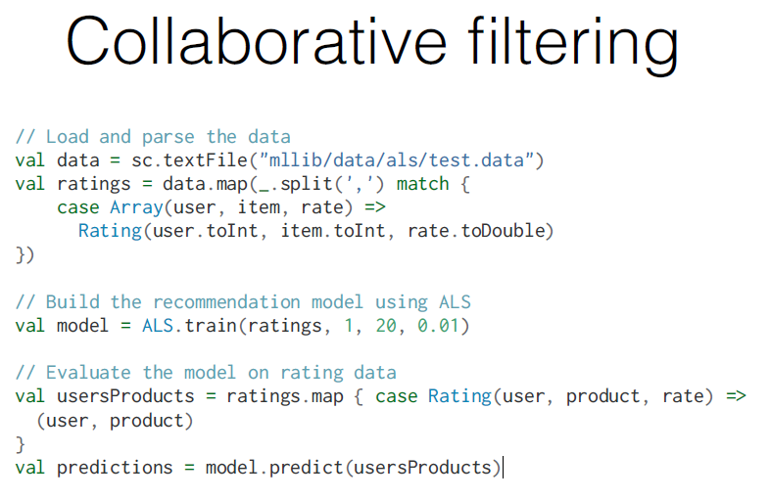


Slide 16

ALS()
numBlocks is the number of blocks used to parallelize computation (set to -1 to auto-configure).
rank is the number of latent factors (feature) in the model.
iterations is the number of iterations of ALS to run. ALS typically converges to a reasonable solution in 20 iterations or less.
lambda specifies the regularization parameter in ALS.
implicitPrefs specifies whether to use the explicit feedback ALS variant or one adapted for implicit feedback data.
alpha is a parameter applicable to the implicit feedback variant of ALS that governs the baseline confidence in preference observations.

Slide 17

bias–variance tradeoff (or dilemma)
The bias is error from erroneous assumptions in the learning algorithm. High bias can cause an algorithm to miss the relevant relations between features and target outputs (underfitting).
The variance is error from sensitivity to small fluctuations in the training set. High variance can cause an algorithm to model the random noise in the training data, rather than the intended outputs (overfitting).
Model too “simple” ➔ does not fit the data well
A biased solution
Model too complex ➔ small changes to the data, changes predictor a lot
A high-variance solution

Slide 18
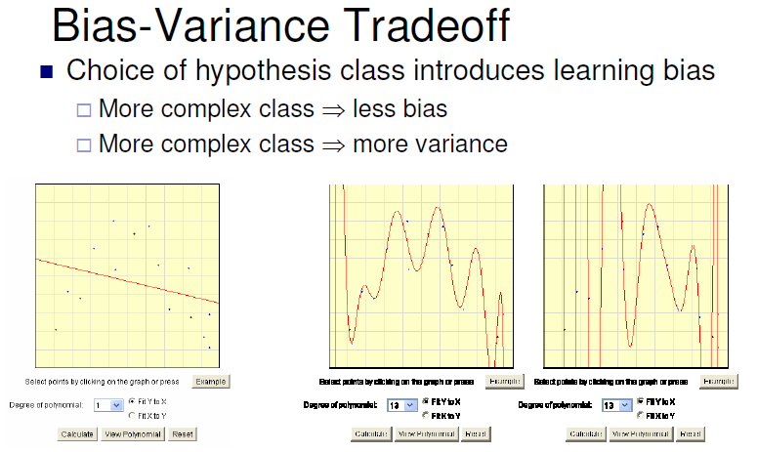



Slide 19
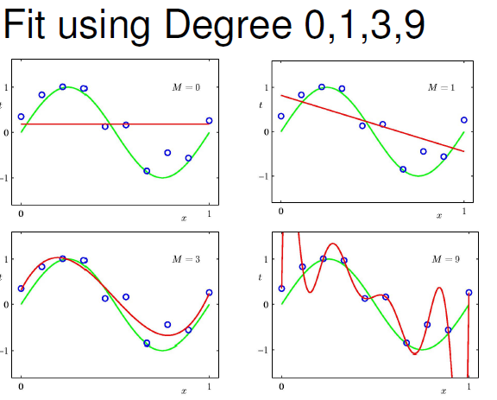


Slide 20
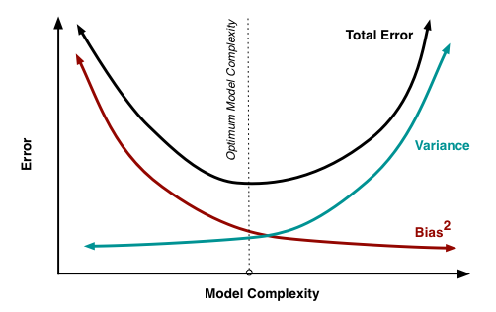

Total error = bias ^2 + Variance + irreducible error(noise)

Slide 21
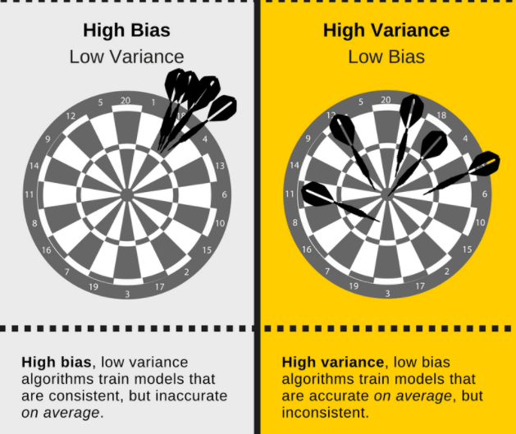


Slide 22
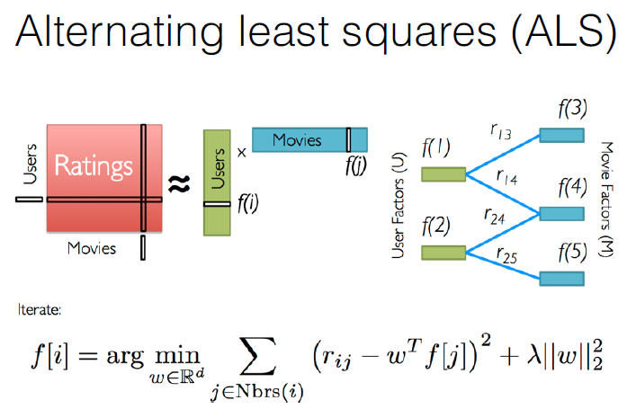


Slide 23
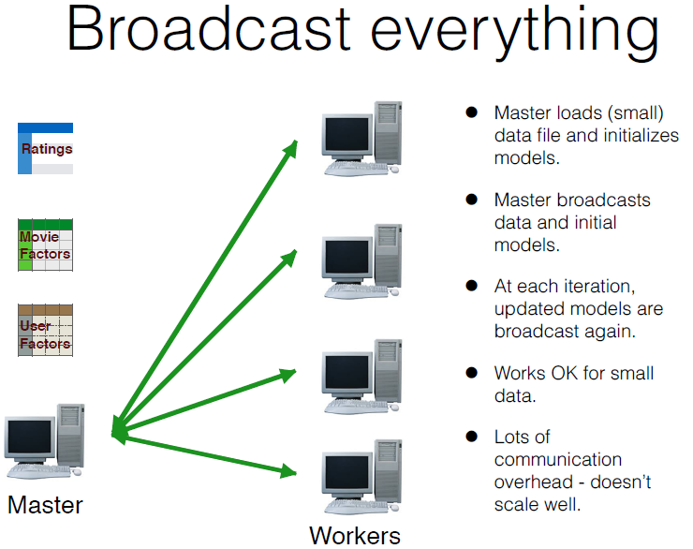


Slide 24
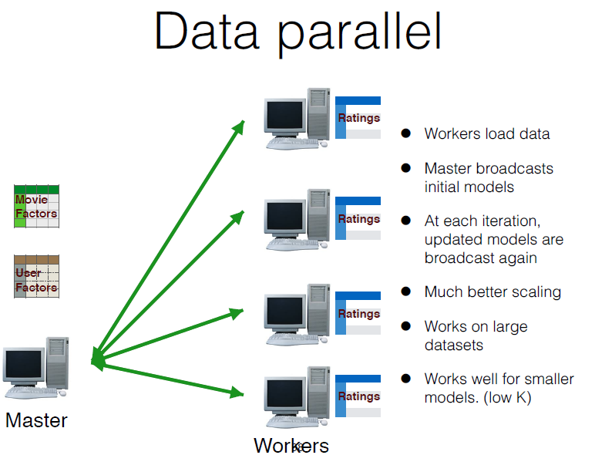


Slide 25
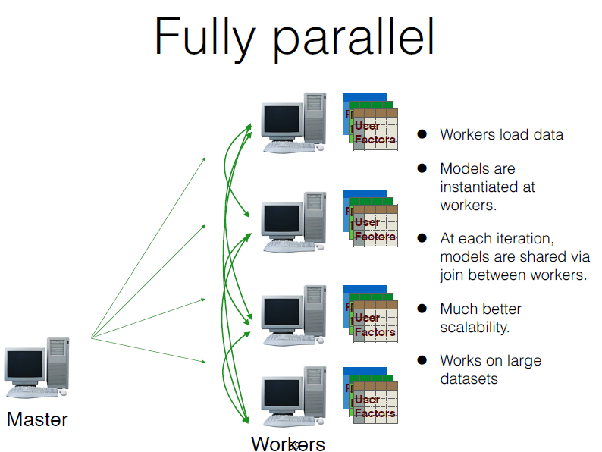


Slide 26
