Slide 1
MapReduce
Mohd Hasnain

Slide 2
How MapReduce Works? - Classic MapReduce
Four independent entities:
The client, which submits the MapReduce job.
The jobtracker, which coordinates the job run. The jobtracker is a Java application whose main class is JobTracker.
The tasktrackers, which run the tasks that the job has been split into. Tasktrackers are Java applications whose main class is TaskTracker.
The distributed filesystem (normally HDFS), which is used for sharing job files between the other entities.

Slide 3
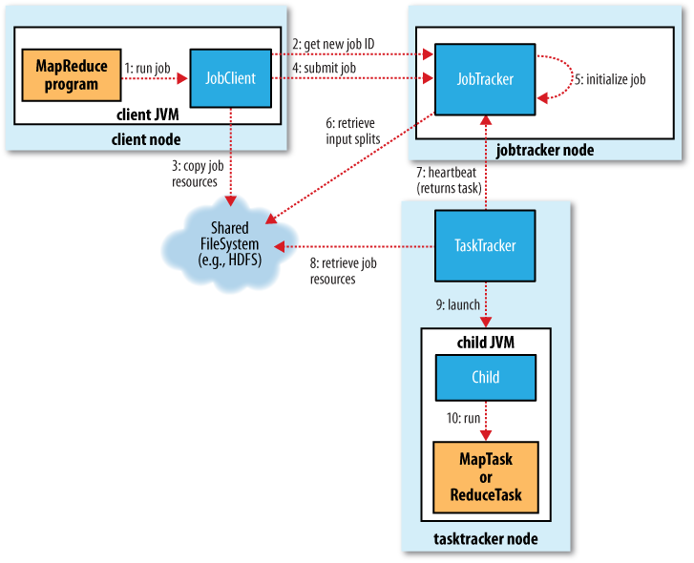

Slide 4
YARN - Yet Another Resource Negotiator
For very large clusters in the region of 4000 nodes and higher, the MapReduce system described in the previous section begins to hit scalability bottlenecks, so in 2010 a group at Yahoo! began to design the next generation of MapReduce
YARN meets the scalability shortcomings of “classic” MapReduce by splitting the responsibilities of the jobtracker into separate entities.
The jobtracker takes care of both job scheduling (matching tasks with tasktrackers) and task progress monitoring (keeping track of tasks and restarting failed or slow tasks, and doing task bookkeeping such as maintaining counter totals).
YARN separates these two roles into two independent daemons: a resource manager to manage the use of resources across the cluster, and an application master to manage the lifecycle of applications running on the cluster.
The idea is that an application master negotiates with the resource manager for cluster resources—described in terms of a number of containers each with a certain memory limit—then runs applicationspecific processes in those containers. The containers are overseen by node managers running on cluster nodes, which ensure that the application does not use more resources than it has been allocated

Slide 5
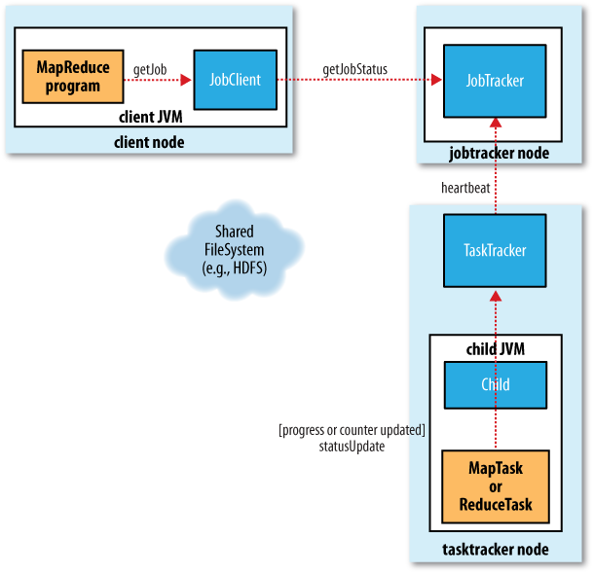
How status updates are propagated through the Classic system

Slide 6
MapReduce on YARN involves more entities than classic MapReduce. They are:
The client, which submits the MapReduce job.
The YARN resource manager, which coordinates the allocation of compute resources on the cluster.
The YARN node managers, which launch and monitor the compute containers on machines in the cluster.
The MapReduce application master, which coordinates the tasks running the MapReduce job. The application master and the MapReduce tasks run in containers that are scheduled by the resource manager, and managed by the node managers.
The distributed filesystem (normally HDFS), which is used for sharing job files between the other entities.

Slide 7
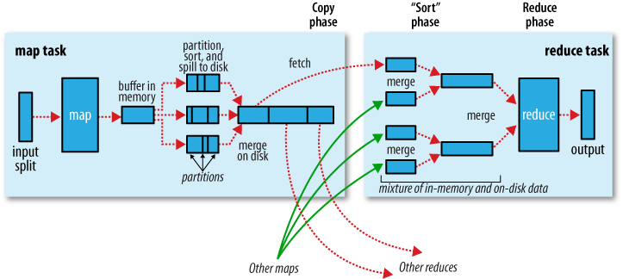
Shuffle and sort in MapReduce

Slide 8
The map and reduce functions
map: (K1, V1) → list(K2, V2)
reduce: (K2, list(V2)) → list(K3, V3)
In general, the map input key and value types (K1 and V1) are different from the map output types (K2 and V2). However, the reduce input must have the same types as the map output, although the reduce output types may be different again (K3 and V3).

Slide 9
A MapReduce program consists of the following 3 parts :
Driver
Mapper
Reducer

Slide 10
MAPPING LISTS
The first phase of a MapReduce program is called mapping. A list of data elements are provided, one at a time, to a function called the Mapper, which transforms each element individually to an output data element.
REDUCING LISTS
Reducing lets you aggregate values together. A reducer function receives an iterator of input values from an input list. It then combines these values together, returning a single output value.

Slide 11
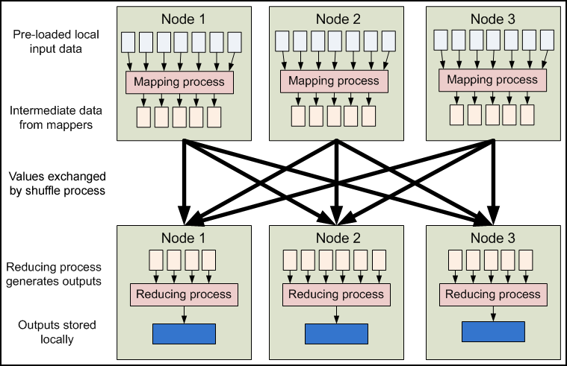
MapReduce Data Flow

Slide 12
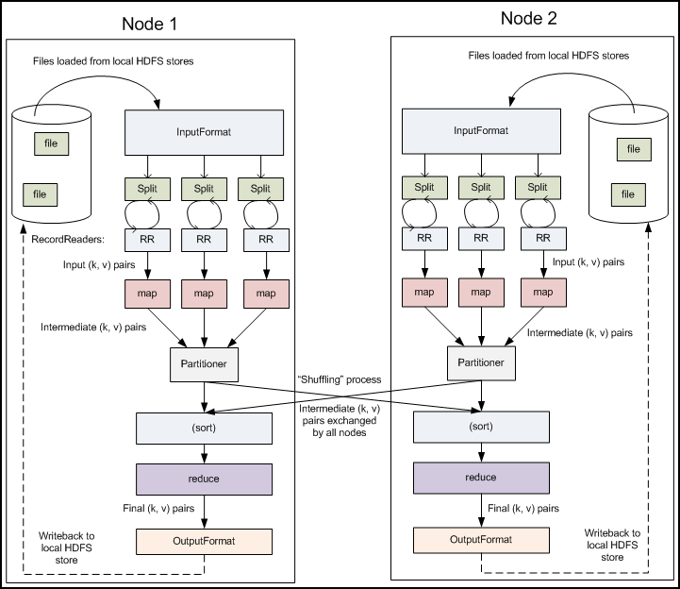

Slide 13
RecordReader
The InputSplit has defined a slice of work, but does not describe how to access it. TheRecordReader class actually loads the data from its source and converts it into (key, value) pairs suitable for reading by the Mapper. The RecordReader instance is defined by the InputFormat. The default InputFormat,TextInputFormat, provides a LineRecordReader, which treats each line of the input file as a new value. The key associated with each line is its byte offset in the file. The RecordReader is invoke repeatedly on the input until the entire InputSplit has been consumed. Each invocation of the RecordReader leads to another call to themap() method of the Mapper.

Slide 14
Driver
The Driver code runs on the client machine and is responsible for building the configuration of the job and submitting it to the Hadoop Cluster. The Driver code will contain the main() method that accepts arguments from the command line.
Some of the common libraries that are included for the Driver class :
import org.apache.hadoop.fs.Path;
import org.apache.hadoop.io.*;
import org.apache.hadoop.mapred.*;
The next step the Driver program should do is to configure the Job that needs to be submitted to the cluster. To do this we create an object of type JobConf and pass the name of the Driver class. The JobConf class allows you to configure the different properties for the Mapper, Combiner, Partitioner, Reducer, InputFormat and OutputFormat.

Slide 15
public class MyDriver{
public static void main(String[] args) throws Exception {
// Create the JobConf object
JobConf conf = new JobConf(MyDriver.class);
// Set the name of the Job
conf.setJobName(“SampleJobName”);
// Set the output Key type for the Mapper
conf.setMapOutputKeyClass(Text.class);
// Set the output Value type for the Mapper
conf.setMapOutputValueClass(IntWritable.class);
// Set the output Key type for the Reducer
conf.setOutputKeyClass(Text.class);
// Set the output Value type for the Reducer
conf.setOutputValueClass(IntWritable.class);
// Set the Mapper Class
conf.setMapperClass(MyMapper.class);
// Set the Reducer Class
conf.setReducerClass(Reducer.class);
// Set the format of the input that will be provided to the program
conf.setInputFormat(TextInputFormat.class);
// Set the format of the output for the program
conf.setOutputFormat(TextOutputFormat.class);
// Set the location from where the Mapper will read the input
FileInputFormat.setInputPaths(conf, new Path(args[0]));
// Set the location where the Reducer will write the output
FileOutputFormat.setOutputPath(conf, new Path(args[1]));
// Run the job on the cluster
JobClient.runJob(conf);
}
}

Slide 16
Mapper
The Mapper code reads the input files as <Key,Value> pairs and emits key value pairs. The Mapper class extends MapReduceBase and implements the Mapper interface. The Mapper interface expects four generics, which define the types of the input and output key/value pairs. The first two parameters define the input key and value types, the second two define the output key and value types.
Some of the common libraries that are included for the Mapper class :
import java.io.IOException;
import java.util.*;
import org.apache.hadoop.io.*;
import org.apache.hadoop.mapred.*;
The map() function accepts the key, value, OutputCollector and an Reporter object. The OutputCollector is resposible for writing the intermediate data generated by the Mapper.

Slide 17
Sample
public class MyMapper extends MapReduceBase implements Mapper<LongWritable, Text, Text, IntWritable>{
public void map(LongWritable key, Text value, OutputCollector<Text, IntWritable>
output, Reporter reporter) throws IOException {
output.collect(key,value);
}
}
}

Slide 18
Reducer
The Reducer code reads the outputs generated by the different mappers as <Key,Value> pairs and emits key value pairs. The Reducer class extends MapReduceBase and implements the Reducer interface. The Reducer interface expects four generics, which define the types of the input and output key/value pairs. The first two parameters define the intermediate key and value types, the second two define the final output key and value types. The keys are WritableComparables, the values are Writables.
Some of the common libraries that are included for the Reducer class :
import java.io.IOException;
import java.util.*;
import org.apache.hadoop.io.*;
import org.apache.hadoop.mapred.*;
The reduce() function accepts the key, an iterator , OutputCollector and an Reporter object. The OutputCollector is resposible for writing the final output result.

Slide 19
Sample
public class MyReducer extends MapReduceBase implements Reducer<Text,IntWritable,Text,IntWritable> {
@Override
public void reduce(Text key, Iterator<IntWritable> values,
OutputCollector<Text, IntWritable> output, Reporter reporter) throws IOException{
output.collect(key,value);
}
}
}

Slide 20
Word counting using MapReduce - Hello,World program for MapReduce
For this example let us consider the following input:
she sells sea shells on the sea shore
Mapper for Word Count
Reducer for Word Count
Driver for Word Count

Slide 21
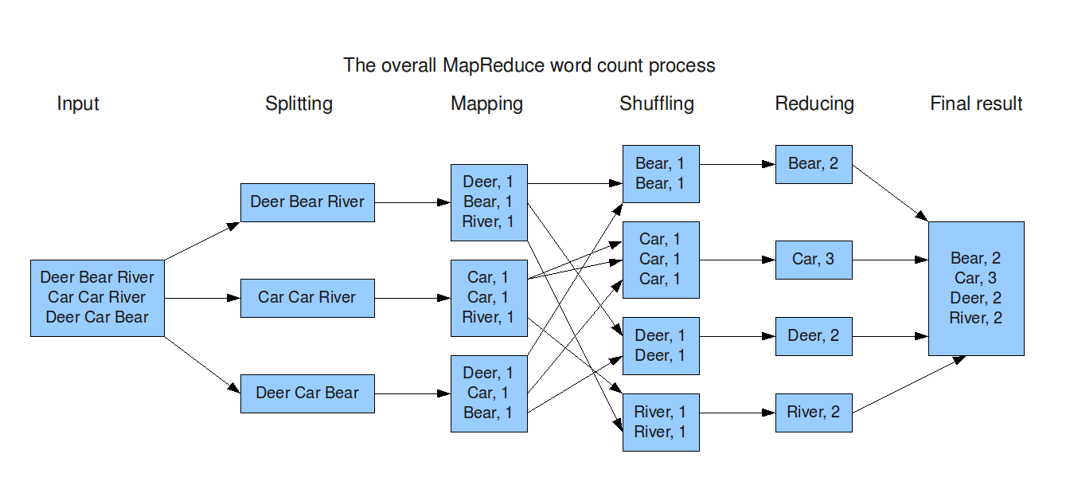
DATA FLOW

Slide 22
package wordcount;
import java.io.*;
import java.util.*;
import org.apache.hadoop.io.*;
import org.apache.hadoop.mapred.*;
public class WordCountMapper extends MapReduceBase implements Mapper<LongWritable, Text, Text, IntWritable>{
public void map(LongWritable key, Text value, OutputCollector<Text, IntWritable> output, Reporter reporter) throws IOException {
StringTokenizer st = new StringTokenizer(value.toString().toLowerCase());
while(st.hasMoreTokens()) {
output.collect(new Text(st.nextToken()), new IntWritable(1));
}
}
}

Slide 23
Map o/p
When the Mapper receives this line each and every word of the sentence is broken down into <key, value> pairs.
So, for the input line the following <key, value> pairs will be generated:
<she,1>
<sells,1>
<sea,1>
<shells,1>
<on,1>
<the,1>
<sea,1>
<shore,1>

Slide 24
package wordcount;
import java.io.*;
import java.util.*;
import org.apache.hadoop.io.*;
import org.apache.hadoop.mapred.*;
public class WordCountReducer extends MapReduceBase implements Reducer<Text, IntWritable, Text, IntWritable>{
public void reduce(Text key, Iterator<IntWritable> values, OutputCollector<Text,IntWritable> output, Reporter reporter) throws IOException {
int count = 0;
while(values.hasNext()) {
count += values.next().get();
}
output.collect(key, new IntWritable(count));
}
}

Slide 25
Reducer O/P
The reducer receives all the key value pairs for in the sorted order of the key. As you can see above the reduce method takes in all <key, value> pairs and increments a counter for values with the same key and emits it out. So the output of the reducer will be as follows:
<on, 1>
<sea, 2>
<sells, 1>
<she, 1>
<shells, 1>
<shore, 1>
<the, 1>

Slide 26
package wordcount;
import java.io.*;
import org.apache.hadoop.fs.*;
import org.apache.hadoop.io.*;
import org.apache.hadoop.mapred.*;
import org.apache.hadoop.util.*;
import org.apache.hadoop.conf.*;
public class WordCount extends Configured implements Tool{
public int run(String[] args) throws IOException{
JobConf conf = new JobConf(WordCount.class);
conf.setJobName("wordcount");
conf.setOutputKeyClass(Text.class);
conf.setOutputValueClass(IntWritable.class);
conf.setMapperClass(WordCountMapper.class);
conf.setReducerClass(WordCountReducer.class);
conf.setInputFormat(TextInputFormat.class);
conf.setOutputFormat(TextOutputFormat.class);
FileInputFormat.setInputPaths(conf, new Path(args[0]));
FileOutputFormat.setOutputPath(conf, new Path(args[1]));
JobClient.runJob(conf);
return 0;
}
public static void main(String[] args) throws Exception {
int exitCode = ToolRunner.run(new WordCount(), args);
System.exit(exitCode);
}
}

Slide 27
LISTING AND KILLING JOBS:
It is possible to submit jobs to a Hadoop cluster which malfunction and send themselves into infinite loops or other problematic states. In this case, you will want to manually kill the job you have started.
The following command, run in the Hadoop installation directory on a Hadoop cluster, will list all the current jobs:
$ bin/hadoop job -list
This will produce output that looks something like:
1 jobs currently running JobId State StartTime UserName job_200808111901_0001 1 1218506470390 aaron
You can use this job id to kill the job; the command is:
$ bin/hadoop job -kill jobid
Substitute the "job_2008..." from the -list command for jobid.

