Slide 1

Lambda Architecture to the rescue!

Slide 2

Sample Use Case
Hunting a Hunter
Anomaly for attack- Predict potential threats
Offline and Online streaming
Hashtags analysis
Airline data
Movie Recommendations - Netflix
Price prediction
Human mobility analytics
……….many
ML on Final data
  Training Models based on pattern of historical data
  Incremental Updating Models

Slide 3

Streaming Data
- unstructured or semi structured
Transection logs messages
User activity records
System ops and metrics data
One m/c can generate > 2 TB per day
Tracking million of devices
1 million write per second on logs
High % of write and low % read
TTL

Slide 4

Strategies
- fast, Cheap, Scale
Data locality
Partition for scale
Replicate for resiliency
Fault tolerance
Share nothing - Isolation
Data lineage and reprocessing in run time
Parallelism
Skew
Memory management

Slide 5
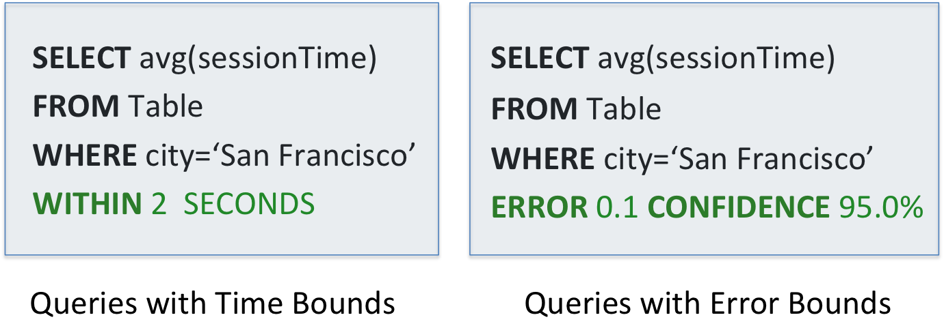

BlinkDB
- We don't have to look far to look back
- Approximate Queries
- Queries with Bounded Errors and Bounded Response Times on Very Large Data

Slide 6

lambda Architecture
Nathan Marz designed this generic architecture addressing common requirements for big data based on his experience working on distributed data processing systems at Twitter.
Data-processing architecture designed to handle massive quantities of data by taking advantage of both batch- and stream-processing methods.
Immutable system of records are captured and fed into a batch and a stream processing system in parallel

Slide 7

3 Components
Batch layer that provides the following functionality
  managing the master dataset, an immutable, append-only set of raw data
  pre-computing arbitrary query functions, called batch views.
Serving layer—This layer indexes the batch views so that they can be queried in ad hoc with low latency.
Speed layer—This layer accommodates all requests that are subject to low latency requirements. Using fast and incremental algorithms, the speed layer deals with recent data only.

Slide 8
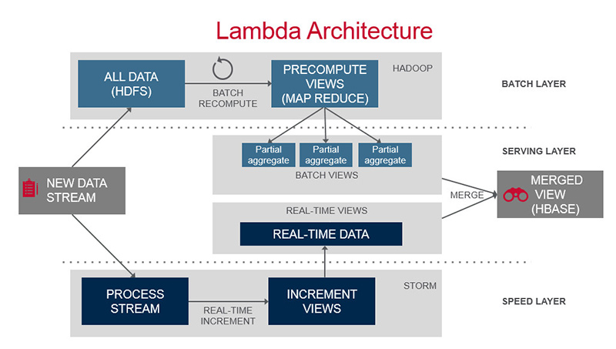


Slide 9
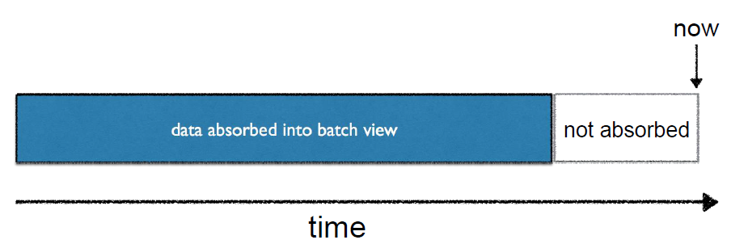

Lambda Architecture
- Compensate Batch
- Immutable Data + Views

Slide 10

Batch Layer
Data in HDFS
MapReduce to create Views and feed to Serving layer
Serving Layer
NoSQL (Hbase/Cassandra)
Querying using low latency – SparkSQL, Impala, Drill
Speed Layer
Apache Storm, Spark, Kafka, Flume

Slide 11
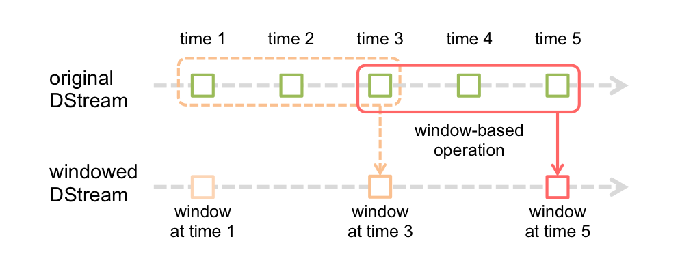

Incremental window

Slide 12

Challenges
Narrow and Wide data
Code changes at runtime
Distributed data consistency
Data ordering
Complex compute algorithm
Data lose
Bullet-proof your data
Not a stream, a flood
Dual System, dual code
  performing analytical computations and queries on dual system
  implementing transformation logic twice
Why dual system?
  Unified system for batch and streaming
  Real time processing
How to merge historical data in stream?

Slide 13

Scala/Spark
HDFS – MapReduce - Pig
Hbase/Cassandra
SparkSQL
Hive – Batch Query
Kafka
Zookepper
Flume

Slide 14

Why Apache Cassandra?
Extremely fast, Scalable
Always ON
No Single point of failure
Survive regional outage
Easy to operate
Automatic
Configurable
Flexible for modeling, ML and real time data
Huge community
Spark Cassandra connector

Slide 15

Why Kafka?
General purpose Pub/Sub messaging sys
RT pipeline
better throughput
Reduce back pressure
Good in handling spikes - shock absorber
built-in partitioning, replication, and fault-tolerance
Very Scalable
Add large number of consumers without affecting performance and without down time

Slide 16

Why Flume?
Kafka not specifically designed for Hadoop
Hadoop ecosystem is just be one of its possible consumers.
Flume is a distributed, reliable, and available system for efficiently collecting, aggregating, and moving large amounts of data from many different sources to a centralized data store, such as HDFS or HBase.
It is more tightly integrated with Hadoop ecosystem.
flume HDFS sink –better security
Flume Interceptor as preprocessing
Adding more consumers to Flume means changing the topology of Flume pipeline design, replicating the channel to deliver the messages to a new sink. – Scalability effects

Slide 17

Use both Kafka and Flume
Flume in CDH 5.2 starts to accept data from Kafka via the KafkaSource and push to Kafka using the KafkaSink.
Flafka

