Slide 1
Pig
Mohd Hasnain(345346)

Slide 2
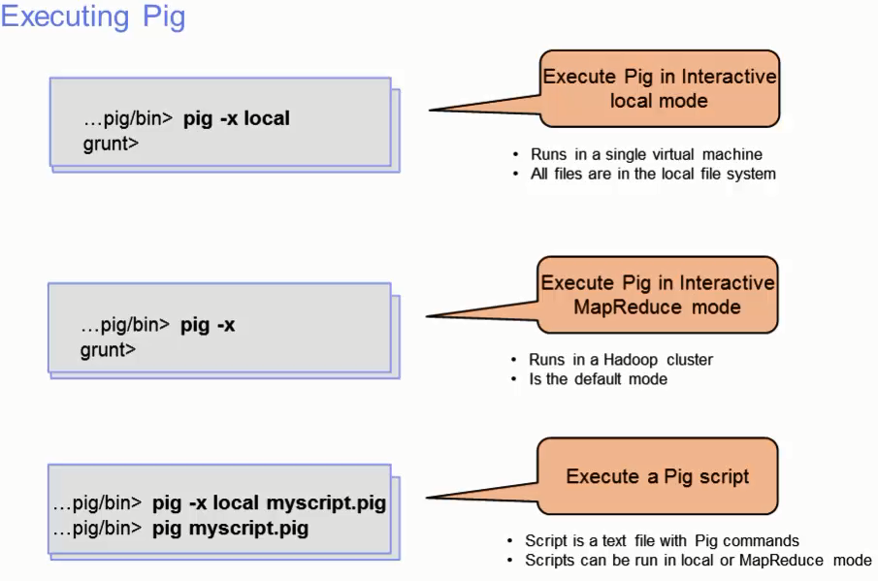

Slide 3
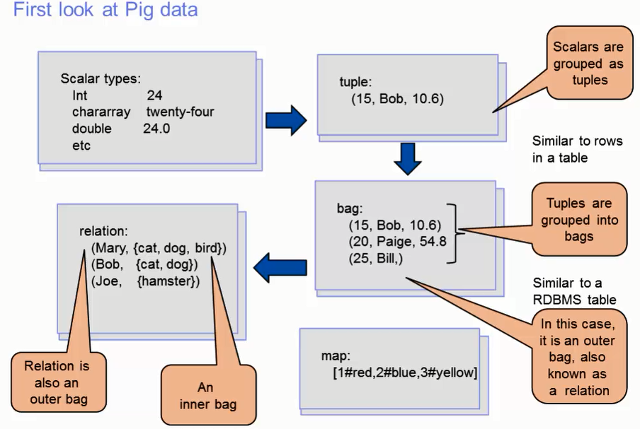

Slide 4
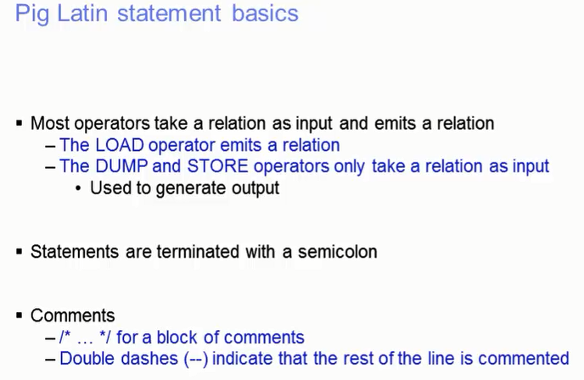

Slide 5
Thank you ☺

