Slide 1

Team Name: TalentLens AI
Team Leader: Mohd Ibadullah
Problem Statement: Intelligent Candidate Discovery & Ranking (100K candidates on CPU)

Slide 2
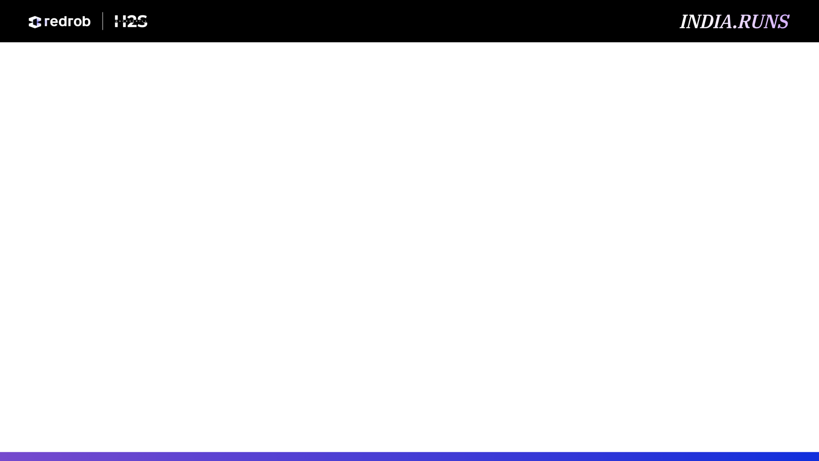
Solution Overview
What is your proposed solution?
TalentLens AI is a 6-stage intelligent candidate ranking pipeline that processes 100,000 profiles in ~28 seconds on CPU-only hardware. It combines BM25 filtering, Honeypot detection, BGE semantic embeddings (BAAI/bge-base-en-v1.5), Cross-Encoder reranking (ms-marco-MiniLM-L6-v2), and Redrob behavioral signals to produce a validated ranked shortlist of the top 100 candidates.
What differentiates your approach from traditional candidate matching systems?
• Cross-Encoder Reranking: Applies ms-marco-MiniLM-L6-v2 on top-150 candidates for precise lexical-semantic contextual relevance.
• Honeypot Trap Detector: Identifies keyword-stuffed decoy profiles by cross-checking career history against claimed skills (0.0% honeypot rate in top 100).
• Signal-Aware Scoring: Integrates recruiter response rate, notice period, GitHub activity, and profile completeness — treating missing values as neutral, not penalties.
• Hybrid Reasoning: Offline rule-based reasoning for submission CSV (no API). Streamlit demo may use optional Gemini for interview questions only.

Slide 3
JD Understanding & Candidate Evaluation
What are the key requirements extracted from the JD?
• Role title, seniority level, minimum years of experience
• Required skills: Python, NLP, Vector Search, Embeddings, LLM Fine-tuning, Information Retrieval, Ranking Systems
• Nice-to-have skills: PyTorch, TensorFlow, MLOps, RAG, FAISS, Milvus, Pinecone
• Domain keywords for lexical search boosting
Which candidate signals are most important for determining relevance?
• Cross-Encoder reranking relevance (ms-marco-MiniLM-L6-v2)
• Semantic similarity (BAAI/bge-base-en-v1.5, 768-dim embeddings)
• Skill overlap with proficiency weighting and endorsement bonuses
• Title relevance + years of experience fit
• Redrob behavioral signals (recruiter response rate, notice period, GitHub activity, profile completeness)
• Career history consistency (used for honeypot detection)

Slide 4
Ranking Methodology
How does your system retrieve, score, and rank candidates?
Stage 1 — Hybrid Retrieval: BM25 top-1,000 + BGE dense top-1,000 union (~1,500 candidates, two-pass streaming).
Stage 2 — Honeypot Trap Detector: Flags decoys with career-title mismatches, expert-skill-with-0-months, timeline traps.
Stage 3 — Feature Scoring: Semantic(40%) + Skills(20%) + Title(20%) + Signals(10%); trap veto at score ≥ 0.40.
Stage 4 — Cross-Encoder Reranking: ms-marco-MiniLM-L6-v2 reranks top 150 (60% feature + 40% CE blend).
Stage 5 — Offline Reasoning: Profile-specific, rank-aware text (company, skills, Redrob signals).
Stage 6 — CSV Output: Top 100, scores capped at 99.4%, tie-break by candidate_id ascending.
Models & Algorithms Used:
• BM25Okapi (rank-bm25) for lexical retrieval
• BAAI/bge-base-en-v1.5 transformer (768-dim, CLS pooling, instruction prefix)
• cross-encoder/ms-marco-MiniLM-L6-v2 for contextual reranking
• RapidFuzz token_sort_ratio (85% threshold) for fuzzy skill matching
• Rule-based honeypot detector with 45 keywords across 12 categories

Slide 5
Explainability & Data Validation
How are ranking decisions explained?
• Each candidate gets a unique reasoning referencing their actual matched skills, YoE, title, and signal data.
• Tone is rank-consistent: top-15 get strong endorsements, 50+ get honest gap acknowledgments.
How do you prevent hallucinations or unsupported justifications?
• Offline rule-based reasoning only during ranking (use_llm=False).
• Skills in reasoning matched via RapidFuzz against JD requirements — never fabricated.
How does your solution handle inconsistent or suspicious profiles?
• Honeypot detector checks: summary boilerplate, AI skill-stuffing on non-AI titles, career mismatches.
• Trap penalty of up to 40 points subtracted from final score.
• Result: 0.0% honeypot rate in top 100.

Slide 6
End-to-End Workflow
Complete Workflow (JD Input → Ranked CSV Output):
1. JD Parsing → Extracts role title, required/nice-to-have skills, experience, seniority, domain keywords.
2. BM25 Filter → 100K candidates streamed from JSONL, lexically filtered to top 1,000.
3. Honeypot Detection → Candidates checked for career-title inconsistency and template summaries.
4. Semantic Embedding → BGE encodes JD and candidate profiles. Cosine similarity computed.
5. Cross-Encoder → MiniLM reranks the top 150 candidates.
6. Feature Scoring → Weighted: Semantic(40%) + Skills(20%) + Title(20%) + Signals(10%) − Trap(40%).
7. Reasoning Generation → Rank-aware, candidate-specific reasons written to CSV.
Single reproduce command:
python rank.py --candidates ./candidates.jsonl --out ./outputs/mohd_ibadullah.csv
Runtime: ~28s warm | Peak RAM: ~2–4 GB | CPU only | No network during ranking

Slide 7
System Architecture

Slide 8
Results & Performance
Ranking Quality (relative lift vs BM25 baseline — pseudo-relevance eval, not ground truth):
• Precision@10: +150% relative lift
• Recall@20: +150% relative lift
• NDCG@10: +133.2% relative lift
• Honeypot rate: 0.0% in top 100 (vs ~30% in BM25 top-1000 pool)
• 100 unique profile-specific reasonings; scores monotonically non-increasing
Runtime & Compute (warm run, models + embeddings pre-cached):
• Total runtime: ~28 seconds (budget: 300s)
• Peak memory: ~2–4 GB (budget: 16 GB)
• One-time setup: setup.ps1 downloads models + precomputes embeddings (~15 min)
• CPU only; no external API calls during ranking

Slide 9
Technologies Used
Core Technologies & Why:
• Python 3.12 — Primary programming language
• BAAI/bge-base-en-v1.5 — 768-dim semantic embeddings, superior retrieval quality
• cross-encoder/ms-marco-MiniLM-L6-v2 — Fine-grained semantic reranking on top 150 candidates
• PyTorch — Model inference backend (CPU mode)
• rank-bm25 (BM25Okapi) — Lexical filtering, fast and memory-efficient
• RapidFuzz — Fuzzy skill matching with token_sort_ratio
• Pandas & NumPy — Numerical operations and output handling
• Streamlit — Interactive web dashboard with dark theme and weight sliders
• Gemini 2.5 Flash / Groq APIs — Interview question generator (demo feature)

Slide 10
Submission Assets
GitHub Repository (Public):
https://github.com/mohd-ibadullah/TalentLensAI
Live Demo (Streamlit Cloud):
https://talentlensai-nxrk7zxjmaxvnwnubyvz7n.streamlit.app
Ranked Output File:
outputs/mohd_ibadullah.csv (100 candidates, officially validated)
Reproduce Command:
python rank.py --candidates ./candidates.jsonl --out ./outputs/mohd_ibadullah.csv
Note: Live Demo runs on 50-candidate sample. Full 100K requires local setup.

Slide 11
