Slide 1

Capstone Project
Predicting Diabetes Risk with Explainable AI
  SHAP & LIME explanations + Streamlit app for transparent screening
  Mohamed Makki – Capstone Project – December 2025

Slide 2
Problem Overview
Diabetes is a growing global health challenge.
Early identification prevents complications and reduces costs.
Many communities lack accessible, interpretable screening tools.
Black-box models limit trust and clinical adoption.

Slide 3
Research Question
Main Question:
How can we build a reliable, explainable, and accessible ML system to predict diabetes risk and convey severity?
Sub-questions:
- Which features most influence predictions?
- How well can models classify high-risk cases?
- How should explanations be visualized for non-
technical users?

Slide 4
Initial Goals
- Frame problem & research question
- Verify and clean dataset
- Build baseline + tuned models
- Implement XAI (SHAP)
- Deploy Streamlit application

Slide 5
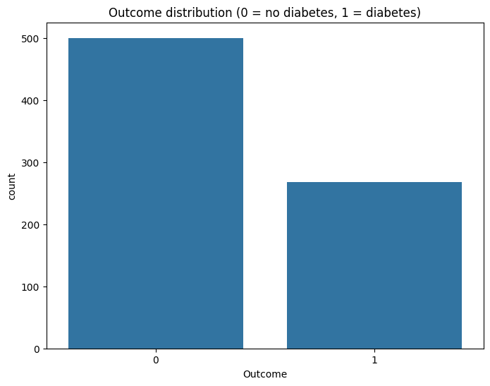
Dataset Overview
Source:
  Pima Indians Diabetes Dataset
Features:
  Pregnancies, Glucose, BloodPressure, SkinThickness, Insulin, BMI, DiabetesPedigree, Age
Target:
  Outcome (0 = No Diabetes, 1 = Diabetes)
Preprocessing:
  StandardScaler, train/test split

Slide 6
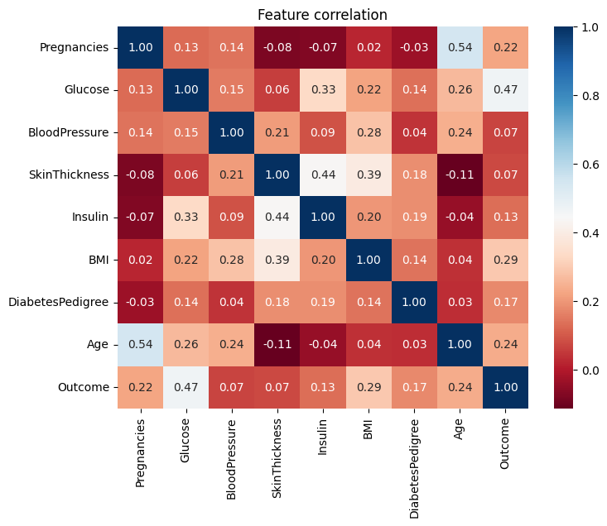
Feature Correlation
Glucose and BMI show strongest correlation with diabetes outcome.
Age and DiabetesPedigree moderately correlated.
BloodPressure and SkinThickness less predictive.

Slide 7
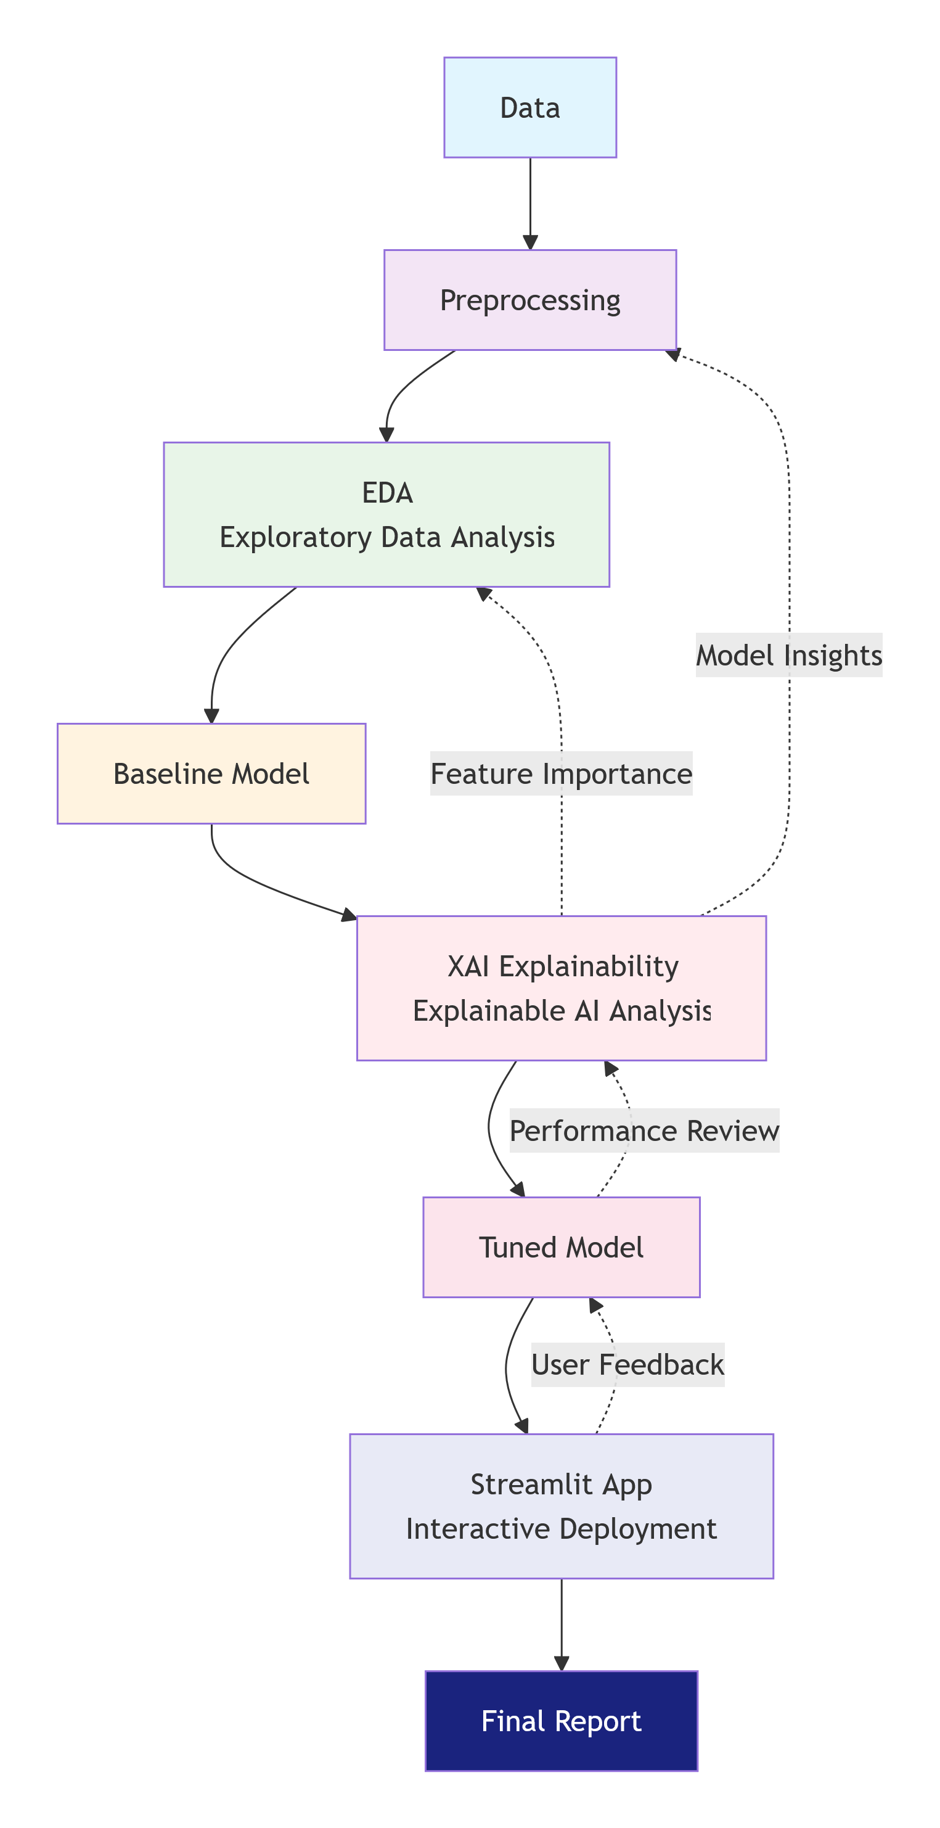
Modeling Pipeline
Data→ Preprocessing → EDA and Baseline Modeling → XAI →
Model Tuning → Evaluation →
Deployment (Streamlit App) →
final report / presentation
Models used: Logistic Regression, Random Forest, XGBoost
Tuning via RandomizedSearchCV

Slide 8
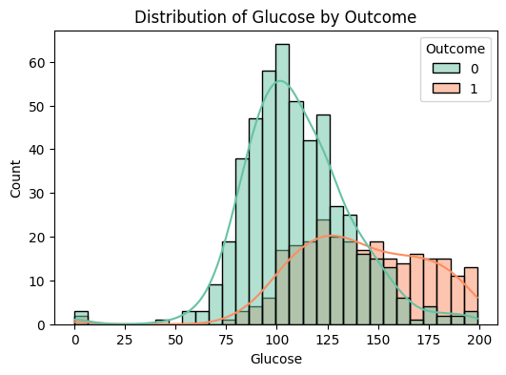
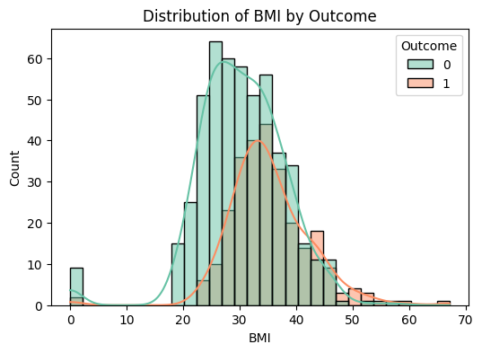
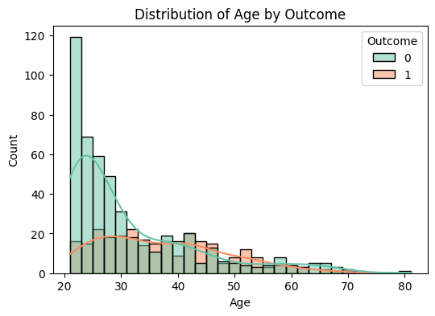
Exploratory Data Analysis
Glucose: Higher in diabetic cases
BMI: Broader and higher in diabetic cases
Age: Subtle differences, interacts with other features

Slide 9
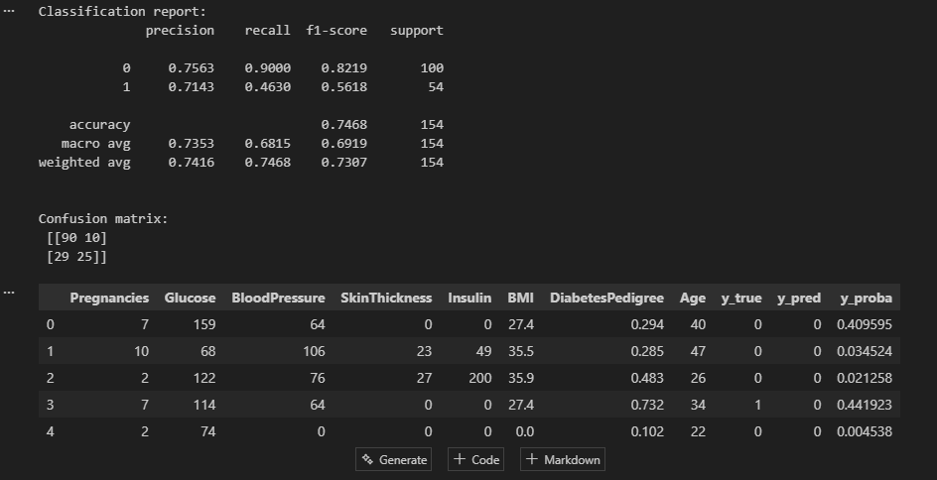
Model Performance Comparison
Model | Accuracy | Precision | Recall | F1 | ROC-AUC
Logistic Regression | 0.71 | 0.60 | 0.50 | 0.55 | 0.813
Random Forest | 0.75 | 0.61 | 0.76 | 0.68 | 0.824
XGBoost | 0.75 | 0.65 | 0.61 | 0.63 | 0.828
Confusion matrices show class-specific tradeoffs

Slide 10
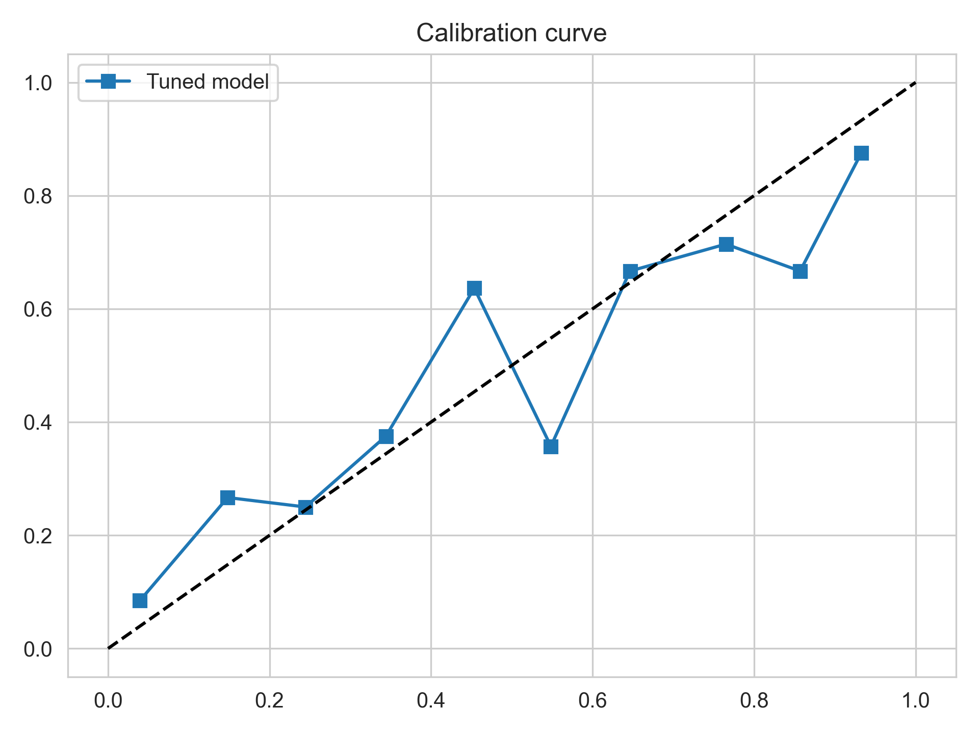
Calibration & Reliability
Calibrated probabilities align well with actual outcomes
Important for clinical decision-making

Slide 11
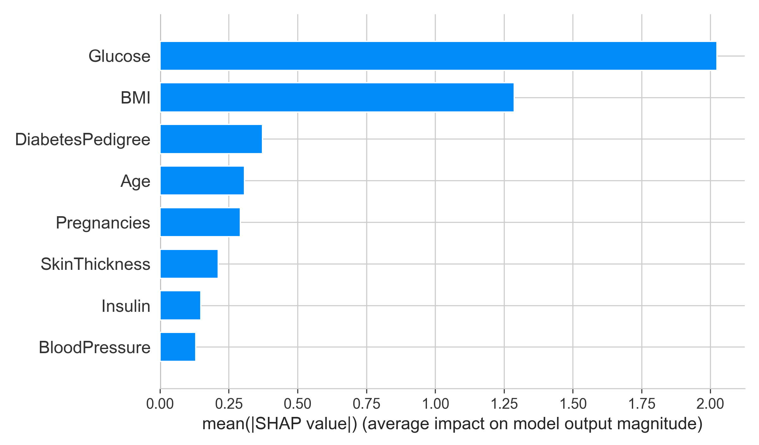
SHAP Global Explanations
Top features: Glucose, BMI, DiabetesPedigree, Age.
SHAP summary plot shows feature impact and direction

Slide 12
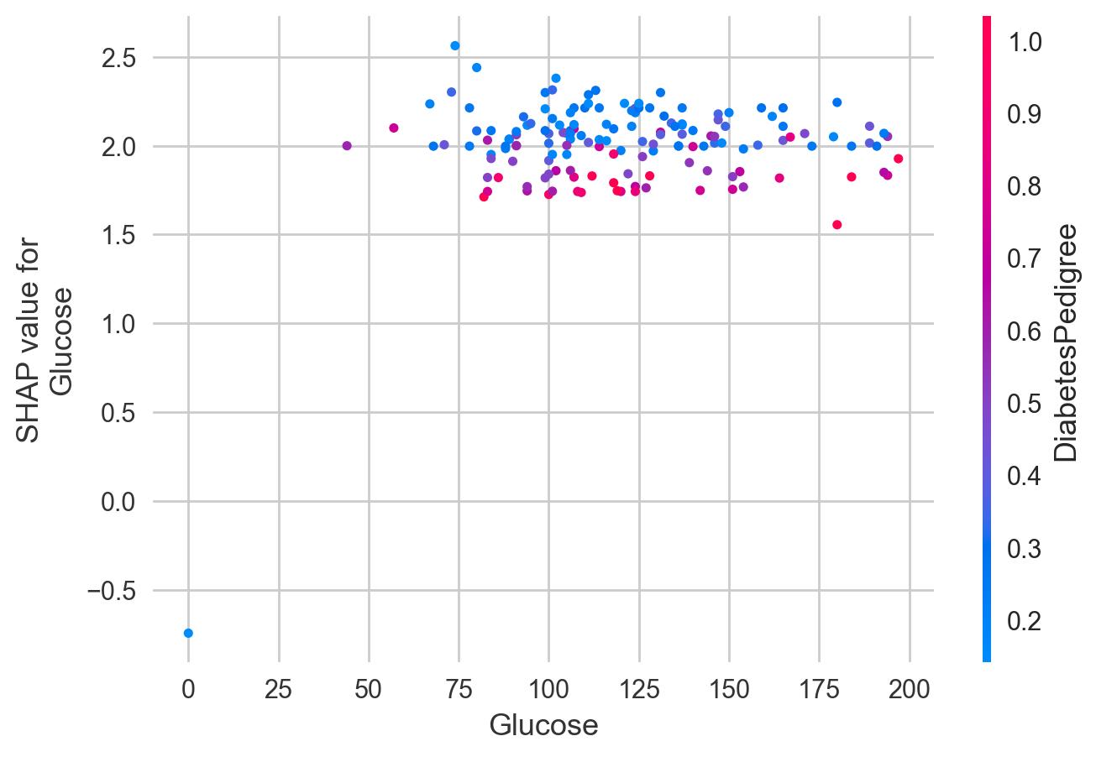
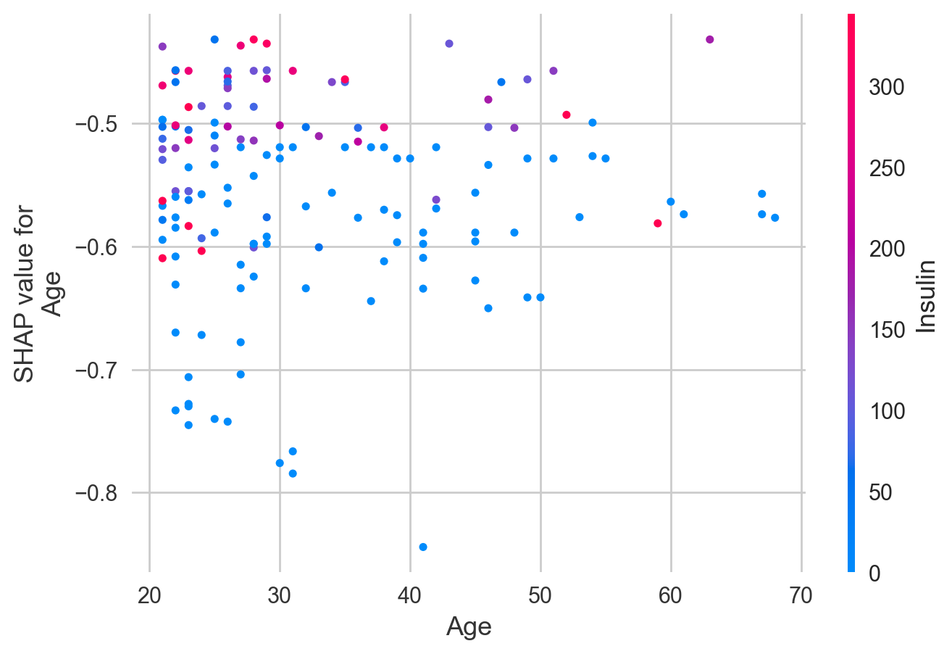
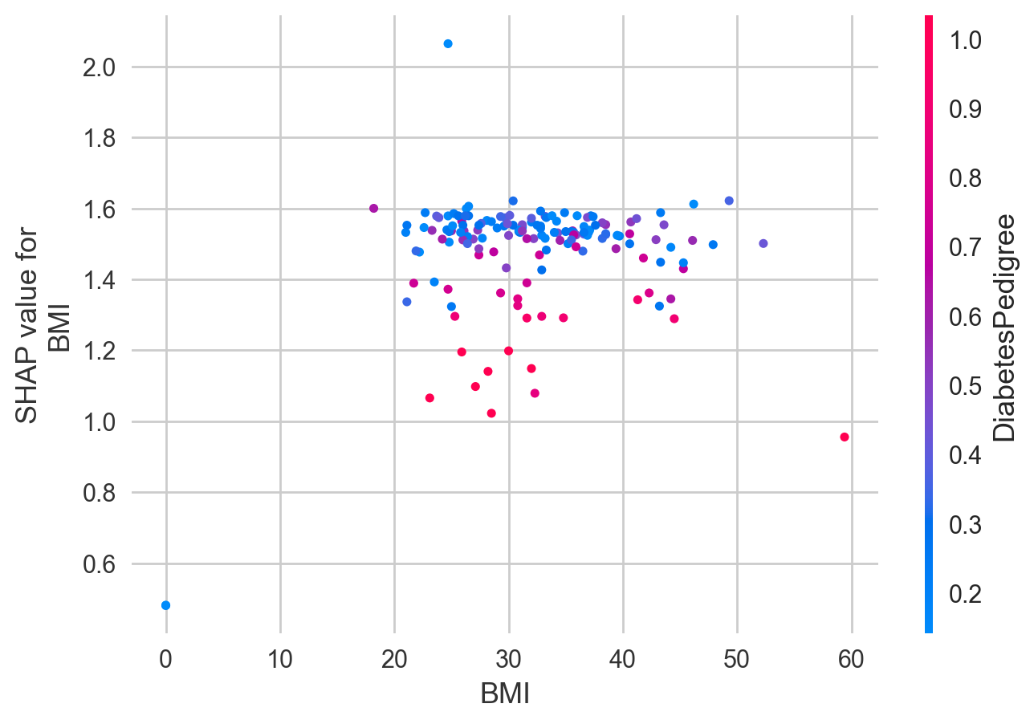
SHAP Feature Effects
Higher Glucose and BMI increase risk
Age and Pedigree interact with other features

Slide 13
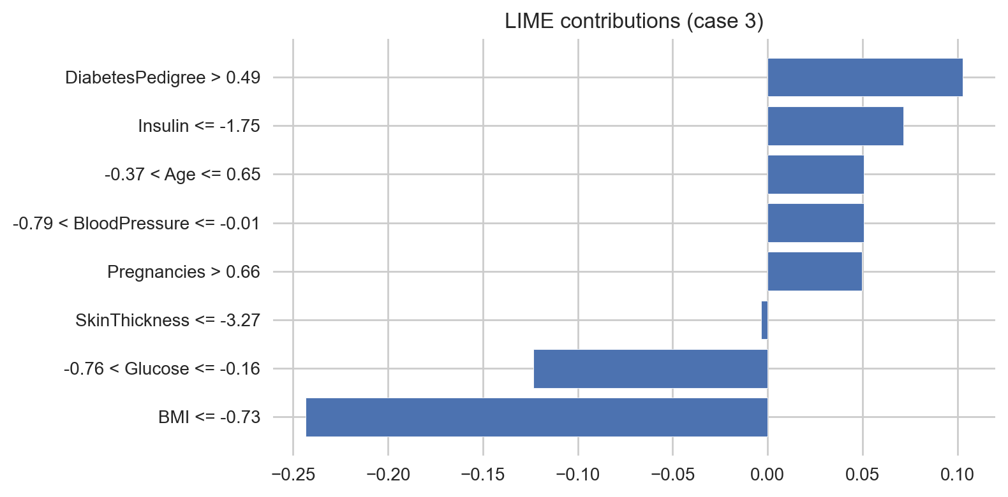
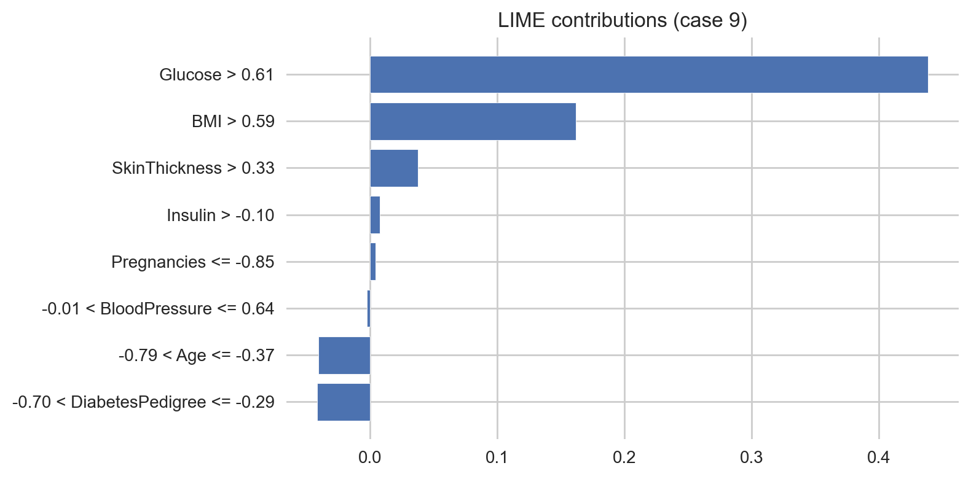
LIME Local Explanations
Case-level breakdown of prediction drivers
Case 3: BMI and Glucose lower risk; Pedigree and Insulin raise risk
Case 9: Glucose and BMI drive high-risk prediction

Slide 14
Streamlit App Demo
Input clinical values → Predict risk → Show explanations
Clear UI for non-specialists

Slide 15
Discussion & Limitations
Strengths: Good ROC-AUC, calibrated outputs, interpretable predictions
Limitations: Class imbalance, moderate recall, single dataset
Ethical notes: Transparency, fairness, clinical caution

Slide 16
Conclusion & Impact
Tuned models offer solid performance and interpretability
SHAP/LIME enhance trust and usability
Streamlit app supports scalable screening
Future work: external validation, fairness checks, multilingual UX

Slide 17
Acknowledgements & References
Mentors, collaborators, program cohort
Dataset: Pima Indians Diabetes
Libraries: scikit-learn, XGBoost, SHAP, LIME

Slide 18

Thank You
Questions?
Let’s discuss how explainable AI can support real-world healthcare?.

