Slide 2
Deploying ML Models using Azure Machine learning
Host & Speaker
Co-Host
Mohammed Raza Syed
(Beta MLSA)
Suniti
(Beta MLSA)

Slide 3
Topics to be covered :
Introduction to Azure Machine Learning
Steps to deploy an ML Model
How to find your Azure Subscription ID
QnA and Discussions

Slide 4
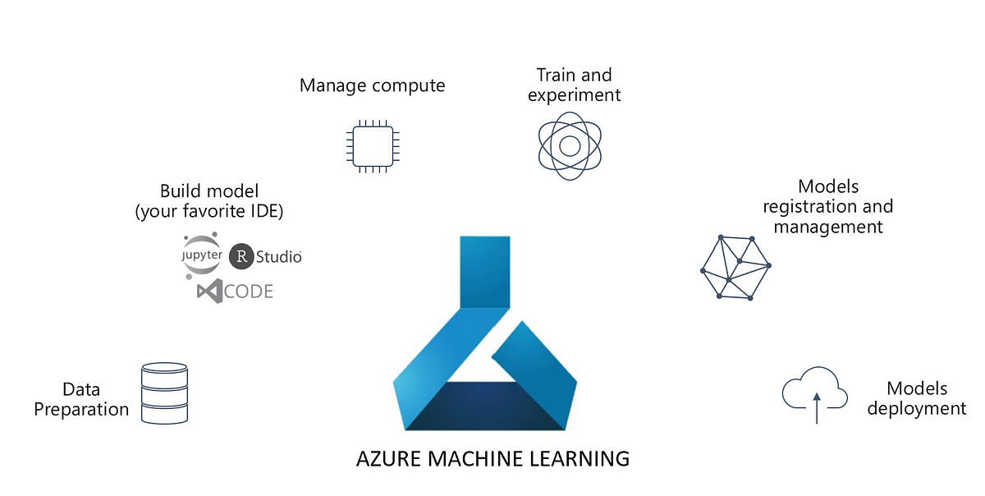

Slide 5
Introduction to Azure Machine Learning
Cloud-based environment for building, training, and deploying machine learning models.
Supports entire ML lifecycle from data preparation to model deployment and monitoring.
Offers automated machine learning (AutoML) for quick model development.
Facilitates collaboration with shared workspaces for data scientists and developers.
Integrates with popular tools like Jupyter Notebooks, Python, R, and Azure DevOps.
Scales resources up or down based on workload needs.
Enables MLOps practices for continuous integration and deployment (CI/CD) of ML models.
Ensures security and compliance with built-in security features.

Slide 6
Steps to Deploy an ML Model on Cloud
Train an ML Model
Create resource groups, workspaces, instances and deploy the Model
Test the Model using the deployed endpoint

Slide 7
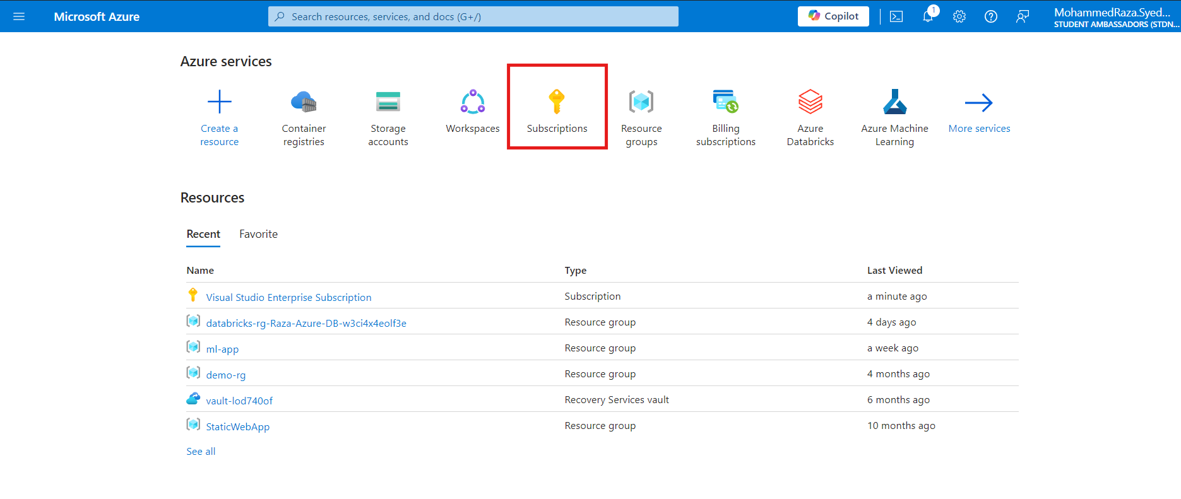
How to find your Azure Subscription ID

Slide 8
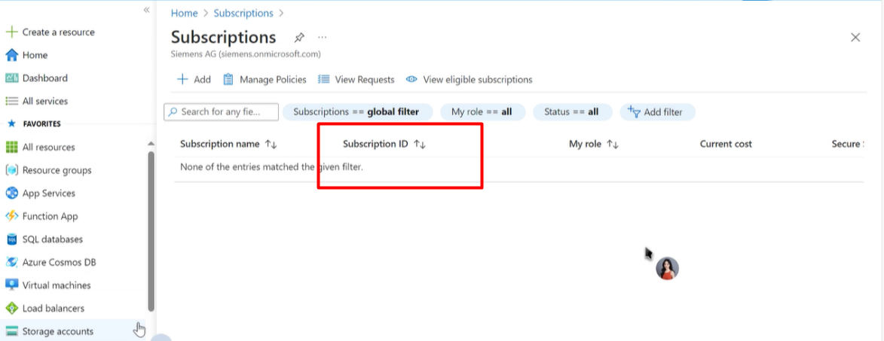

Slide 9
QnA and Discussions

