Slide 1


Exploratory Data Analysis
Gold Atlantis: Repaying the credit
Mohammed Abdul Shukoor Torture the data and it’ll confess to anything…

Slide 2
Problem Statement:
There are two types of risks associated with any loan request: - target:0 all other cases (client pays on time [Re-payer] ) - target:1 client with payment difficulties (defaulter)
Objective:
To analyze the patterns present in the data of gold atlantis in the order to ensure that the applicants can repay the credit. The analysis will help the firm provide loans to customers who have non-existent credit history but have a lower probability of becoming a defaulter.

Slide 3
Followings:
- Visualizations with insights:
* Univariate Analysis
* Bivariate Analysis
* Insights
* Conclusions
* Piece of Advice

Slide 4
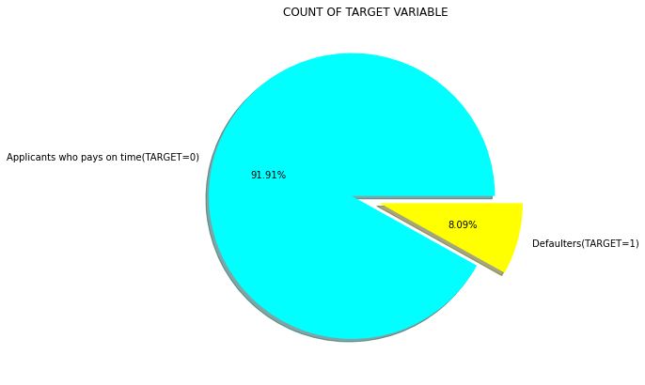
Proportion of Defaulters in the Data Set
Defaulters are 8.09% of total population.

Slide 5
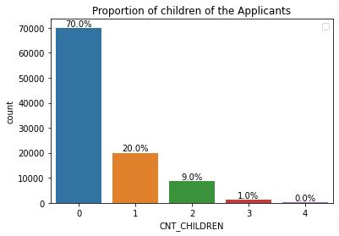
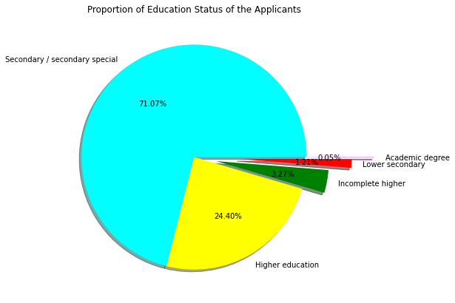
Proportion of Applicants having Children and their Educational Status: Most of the applicants do not have children Client who have more than 3 - 4 children may have a very high chance to be a defaulter. Higher the Education Level Less probability to be defaulter. Majority of clients have Secondary/secondary special education, followed by clients with Higher education. Very few clients have an academic degree

Slide 6
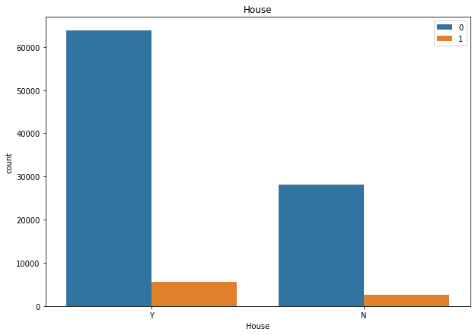
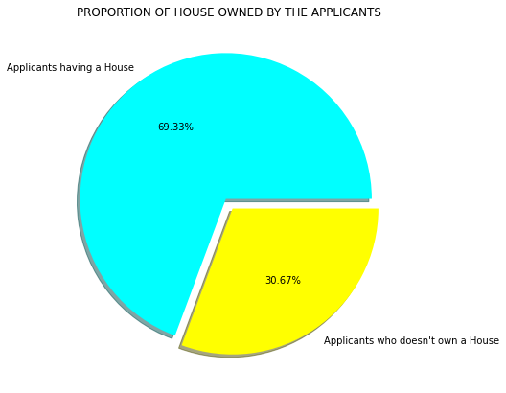
Proportion of Applicants owning a house & not!
Yes Applicant payment with respect to owning a house or flat considered…
Client with independent houses are more well off and may show a regular payment pattern,
whereas flat owning clients compared to the latter are may be inconsistent payers resulting in Defaulters.

Slide 7
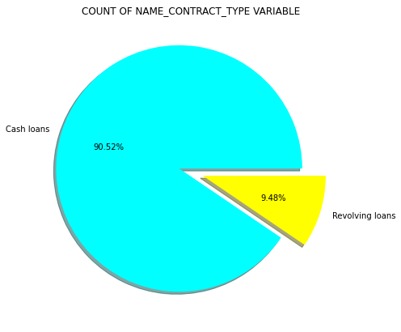
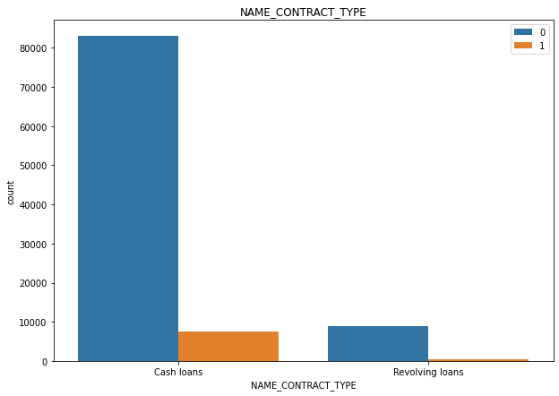
Target v/s Contract Type: Cash loans (90.52%) applicants are in high proportion compared to revolving loans(9.48%). cash loans have more defaulters with respect to the total clients of cash loans clients and having revolving loans have as well less defaulters with respect to the total clients of revolving loans .

Slide 8
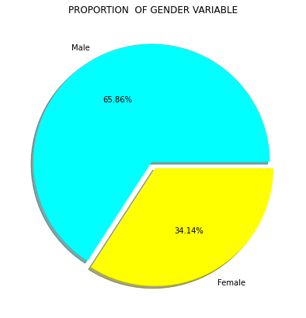
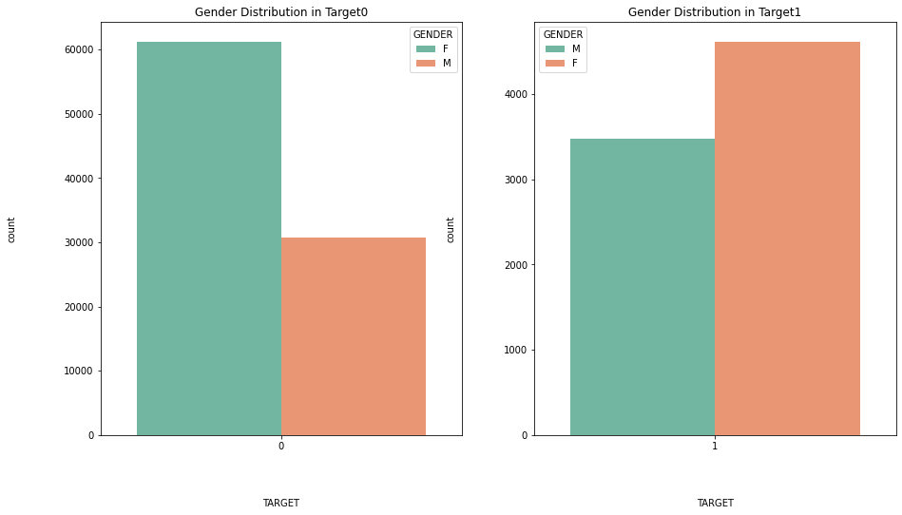
Target v/s Gender: Male (65.86%) applicants are in high proportion compared to Female(34.14%).

Slide 9
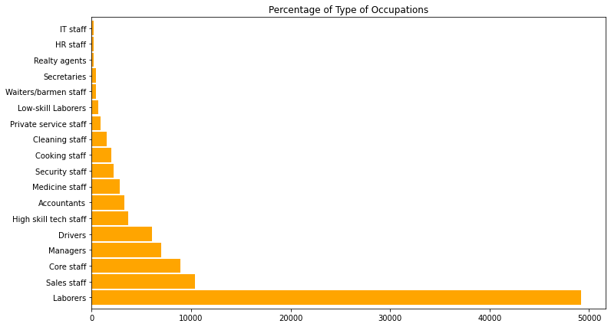
OCCUPATION_TYPE:

Slide 10
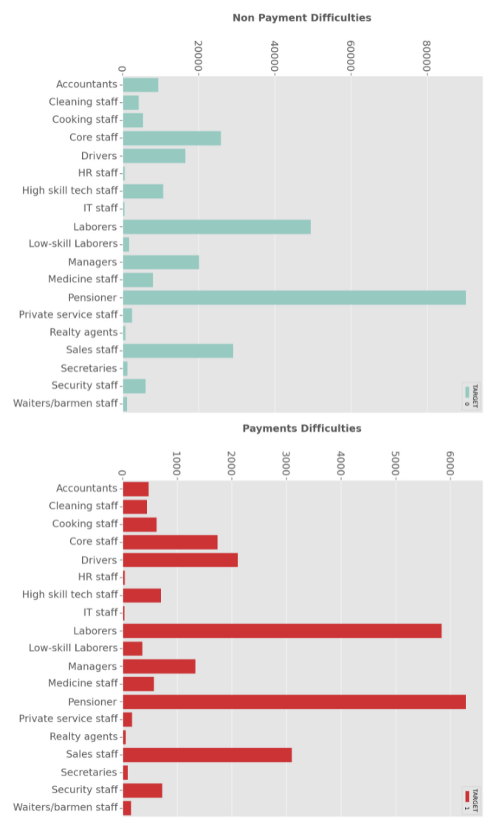
Target v/s Occupation Type:
Pensioners have applied the most for the loan in case of Defaulters and Non-Defaulters.
Pensioner being highest followed by laborers have high risk to default.

Slide 11
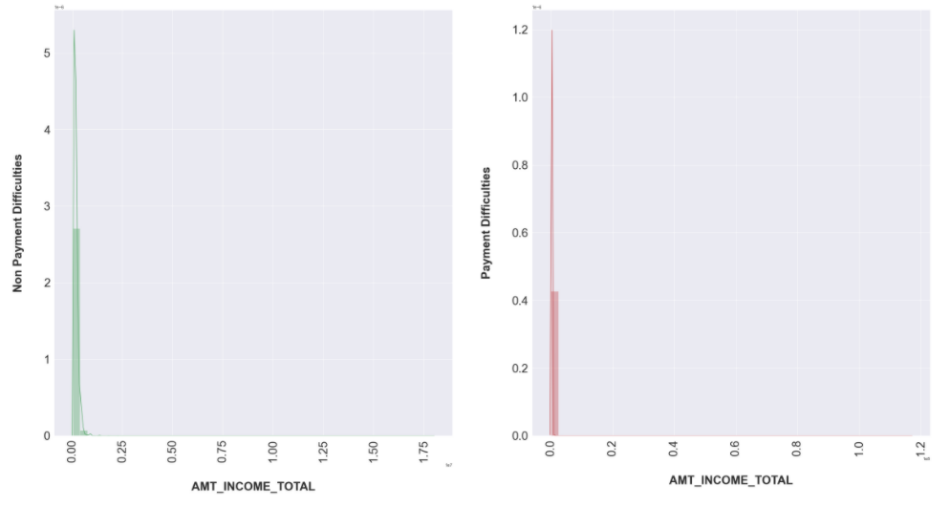
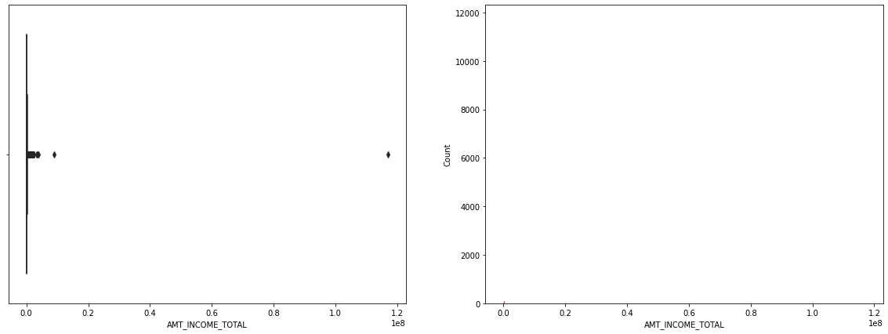
Amount of Total Income of the of both the Defaulters and Non_Defaulters:

Slide 12
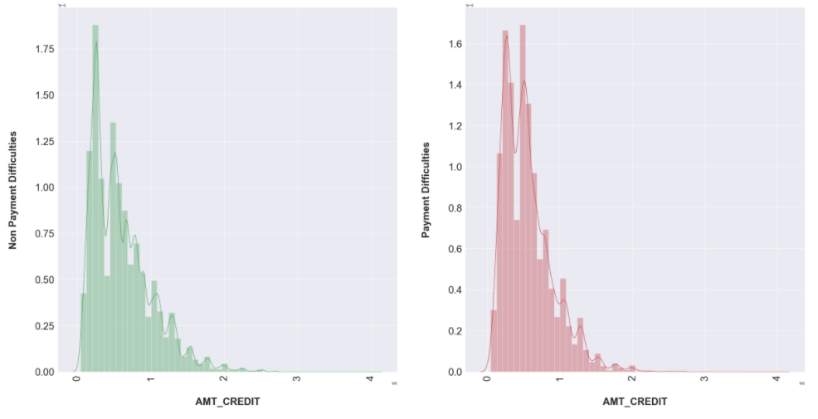
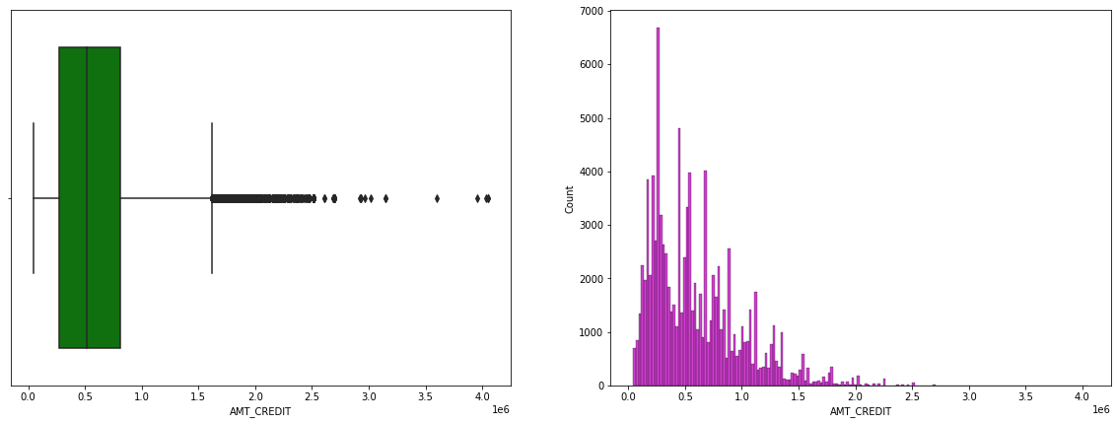
Amount of Credit of the of both the Defaulters and Non_Defaulters:

Slide 13
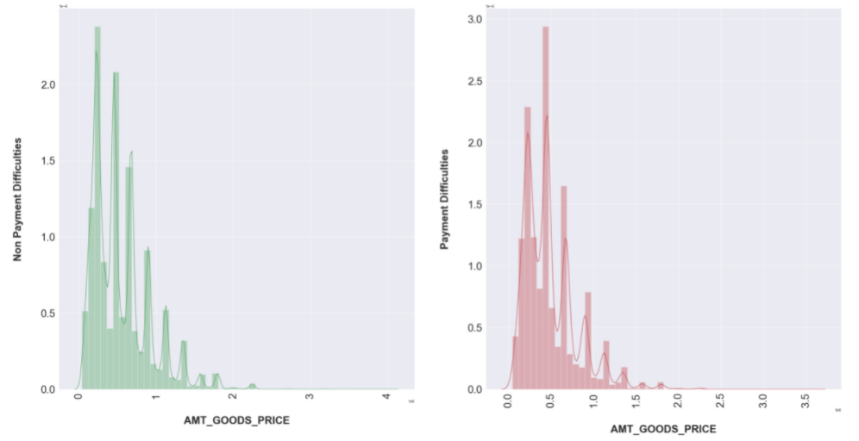
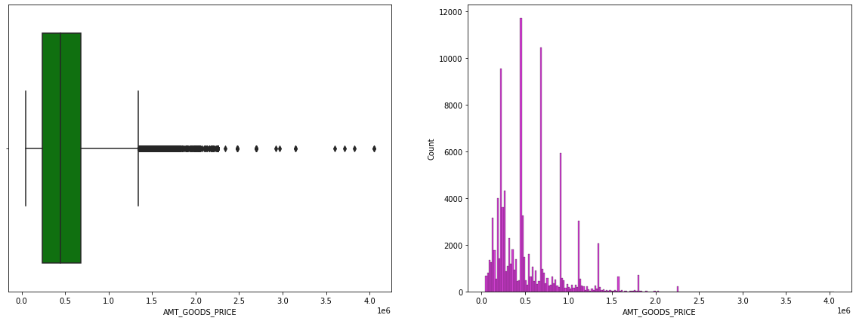
Amount of Goods Price of both the Defaulters and Non_Defaulters:

Slide 14
Analysis of the Amount of Total Income, Amount of Credit, Amount of Goods Price of the Applicants:
People with target one has largely staggered income as compared to target zero. Dist. plot clearly shows that the shape in Income total, Credit and Good Price is similar for Target 0 and similar for Target 1.
The plots are also highlighting that people who have difficulty in paying back loans with respect to their income, loan amount, price of goods against which loan is procured.
Dist. plot highlights the curve shape which is wider for Target 1 in comparison to Target 0 which is narrower with well-defined edges.

Slide 15
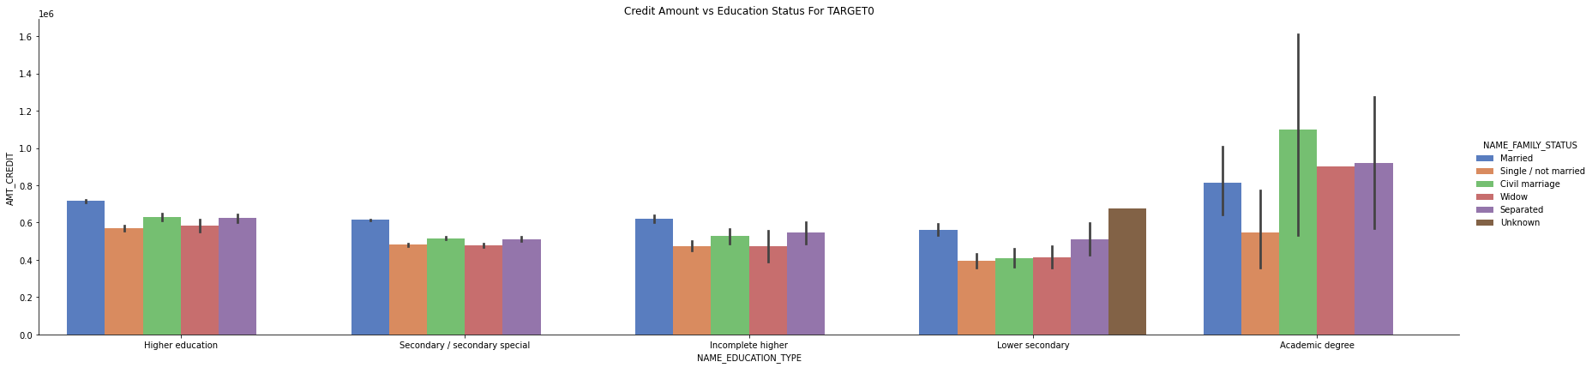
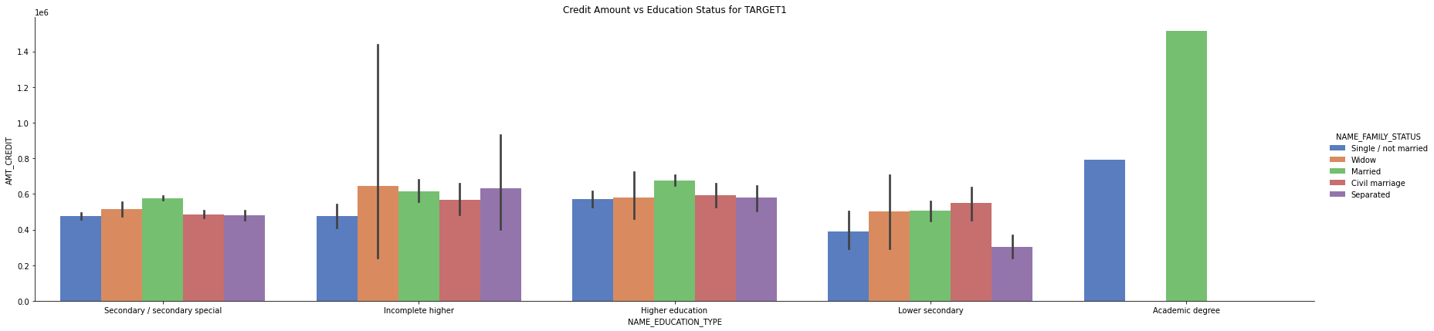
Family v/s Education v/s credit wrt Target:

Slide 16
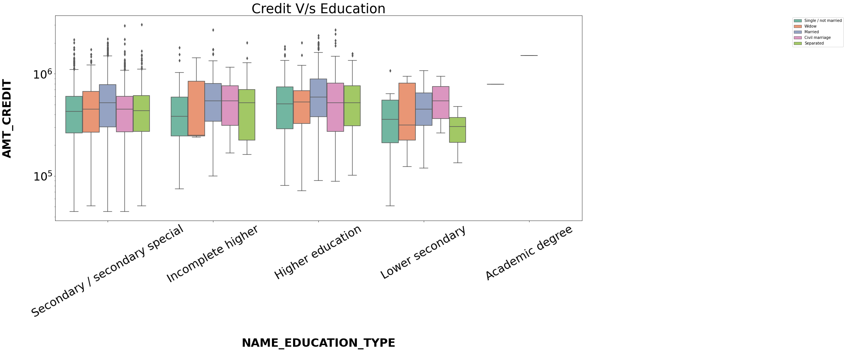
Family v/s Education v/s credit wrt Target: for immersive analysis

Slide 17
CONCLUSION:
we have extensively covered pre-processing steps required to analyze data as well as Null value imputation methods
We have also covered step by step analyzing techniques such as Univariate analysis, Bivariate analysis, Multivariate analysis, etc.
https://CIMA_Analytics.com/credit-repay-exploratory-data-analysis-8f5f266b2426

Slide 18
Factors whether an Applicant will be a Repayer:
* Gender-wise, as Male is in higher proportion so their may be chances of Males to be defaulter in majority.
* Students and Businessman have very least defaulters.
* Applicants whom income statement is above 7,00,000 are less likely to be defaulter.
* People with zero to two children tend to repay the loans.

Slide 19
Factors whether an applicant may be a Defaulter:
* Male is in higher proportion so they are at relatively defaulter rate.
* People who have civil marriage or who are single defaulters in majority.
* People with lower and secondary education.
* Can avoid low-skilled labours or labourers for higher amount of loan as thier defaulter rate is high.
* Applicants who are having children 3 or more than 3 are also defaulters and also applicants having children more than 5 are defaulters and thier applications can to be rejected.
* When the credit amount is beyond 3 lacs there is an increase in defaulters.

Slide 20
Factors to mitigate default risk with respect to business loss is, to grant loan on some conditions of high interest rate:
* High no. of loans applications are from the category of people who live in rented houses and big families and hence offering the loan would mitigate the loss if any default.
* People who get loan for 3-6 Lakhs tend to default more than others and hence having higher interest specifically for this credit range would be ideal.
* Applicants who have 4 - 8 children has a very high defaulters proportion and thus higher interest rate can be imposed.
* Since majority of the applicants have Income less than 3 Lacs and have high probability to be in default, they could be offered loan with higher interest.

Slide 21
Piece of Advice:
Limit often granting loans (Revolving loans) to new accounts or applicants.
Even one documentation applicants are also granted the loans which is not appropriate to practice, grant loans after proper verification of the associated documents according to the type of loan applied.

Slide 22
Thank You.
Mohammed Abdul Shukoor. Torture the data and it’ll confess to anything…

