Slide 1
Healthcare Analytics
for Doctor Visits
Mehak Abid
B.Tech. CSE | Jamia Hamdard
VOIS × AICTE TIRTC DIY Project
1

Slide 2

PROBLEM STATEMENT
Analyze patient visit data to identify which groups visit doctors more frequently. Explore how illness, health status, and chronic conditions relate to visit patterns. Provide data-driven insights to help hospital management improve healthcare services.
2

Slide 3
Project Description
Python-based exploratory analysis of demographic, health, financial and chronic-condition data.
5,190 records · 13 original columns
0 missing values · 5,190 unique record IDs
Workflow: load, quality-check and preprocess; univariate, bivariate and multivariate analysis; correlations and pattern interpretation.
“Unnamed: 0” is a record identifier, excluded from analysis.
3

Slide 4

WHO ARE THE END USERS?
Healthcare Analysts — Explore dataset patterns.
Students & Educators — Learn analysis and visualization.
Healthcare Researchers — Study factors associated with doctor visits.
Data-Driven Decision Makers — Review patterns for further analysis.
4

Slide 5

Technology Used
Programming & Environment: Python · Google Colab
Data Analysis: Pandas · NumPy
Data Visualization: Matplotlib · Seaborn
Analysis Techniques: Univariate · Bivariate · Multivariate
Grouped Statistics · Correlation Analysis · Load → Clean → Analyze → Visualize → Interpret
5

Slide 6
Results & Key Insights
Observed associations · 5,190 records
Doctor visits
Summary statistics
Gender
Average visits
Correlation with visits
Reduced activity
Illness
Health
Age
Income
0.419
0.224
0.193
0.125
-0.077
Female · 0.362
Mean 0.302
Median 0
Maximum 9
Male · 0.236
Reduced activity: strongest correlation among numerical variables analyzed.
Illness score 0 → 5: average visits 0.079 → 0.814.
Long-term chronic condition: Yes 0.603 vs No 0.262.
These relationships describe associations, not causation.
10/3/2026
6

Slide 7
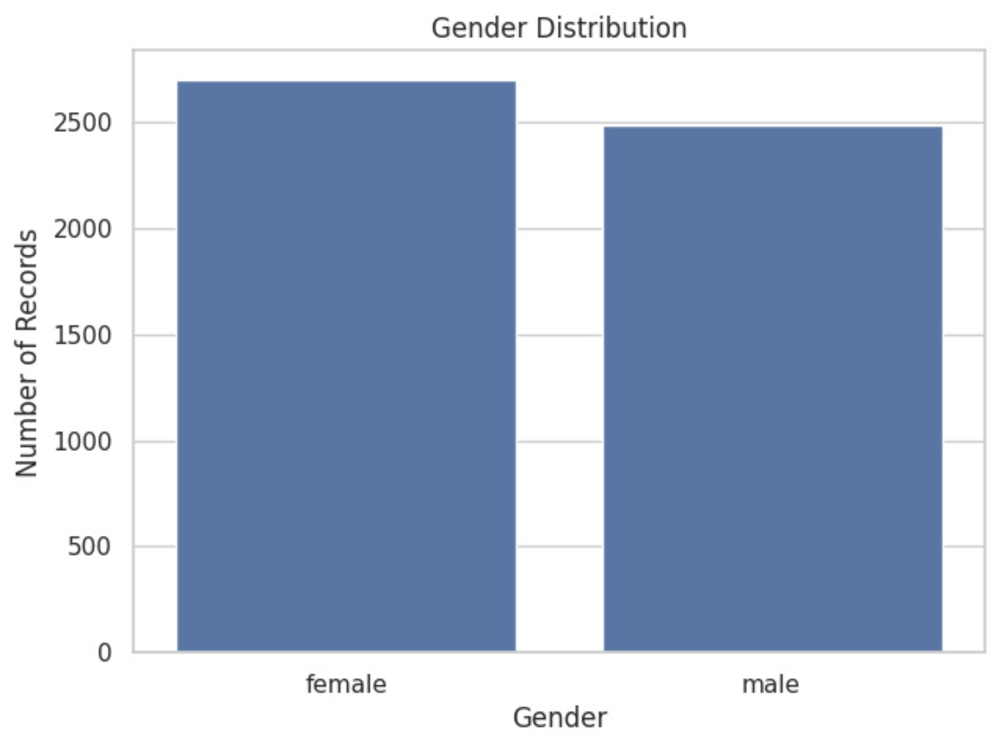
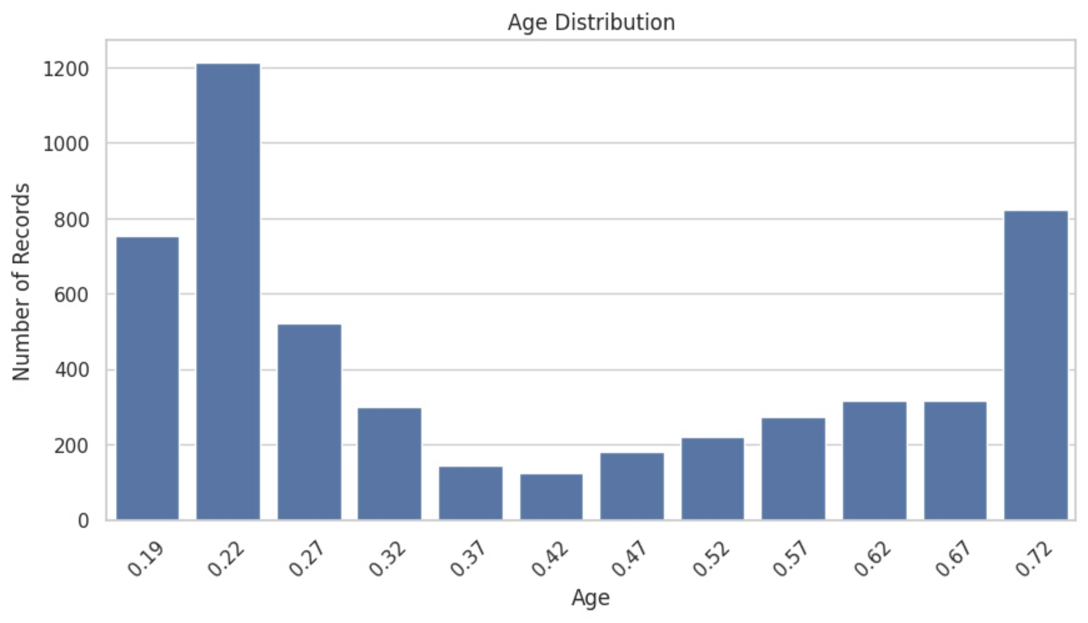

Results

Slide 8
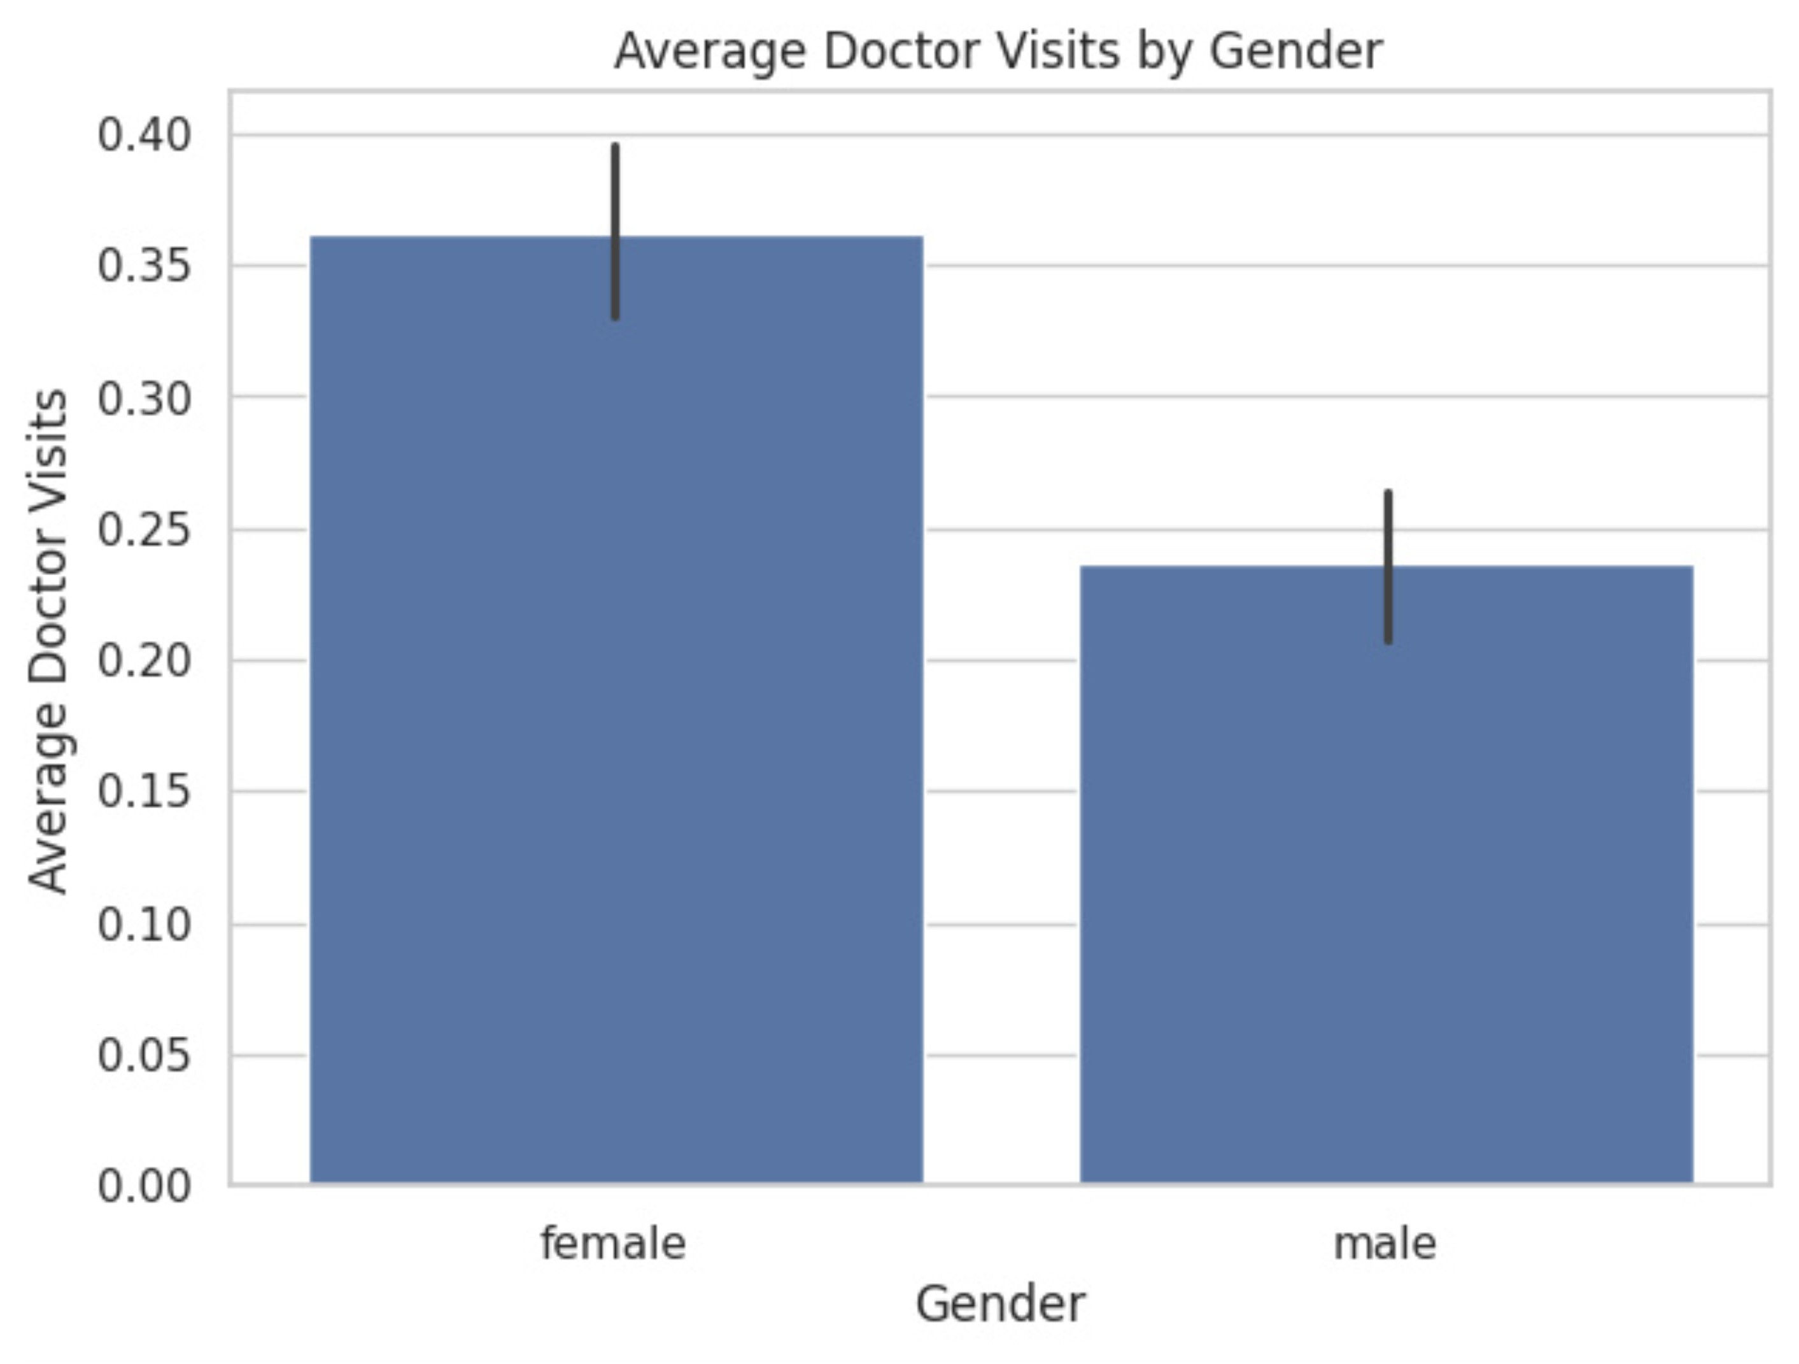
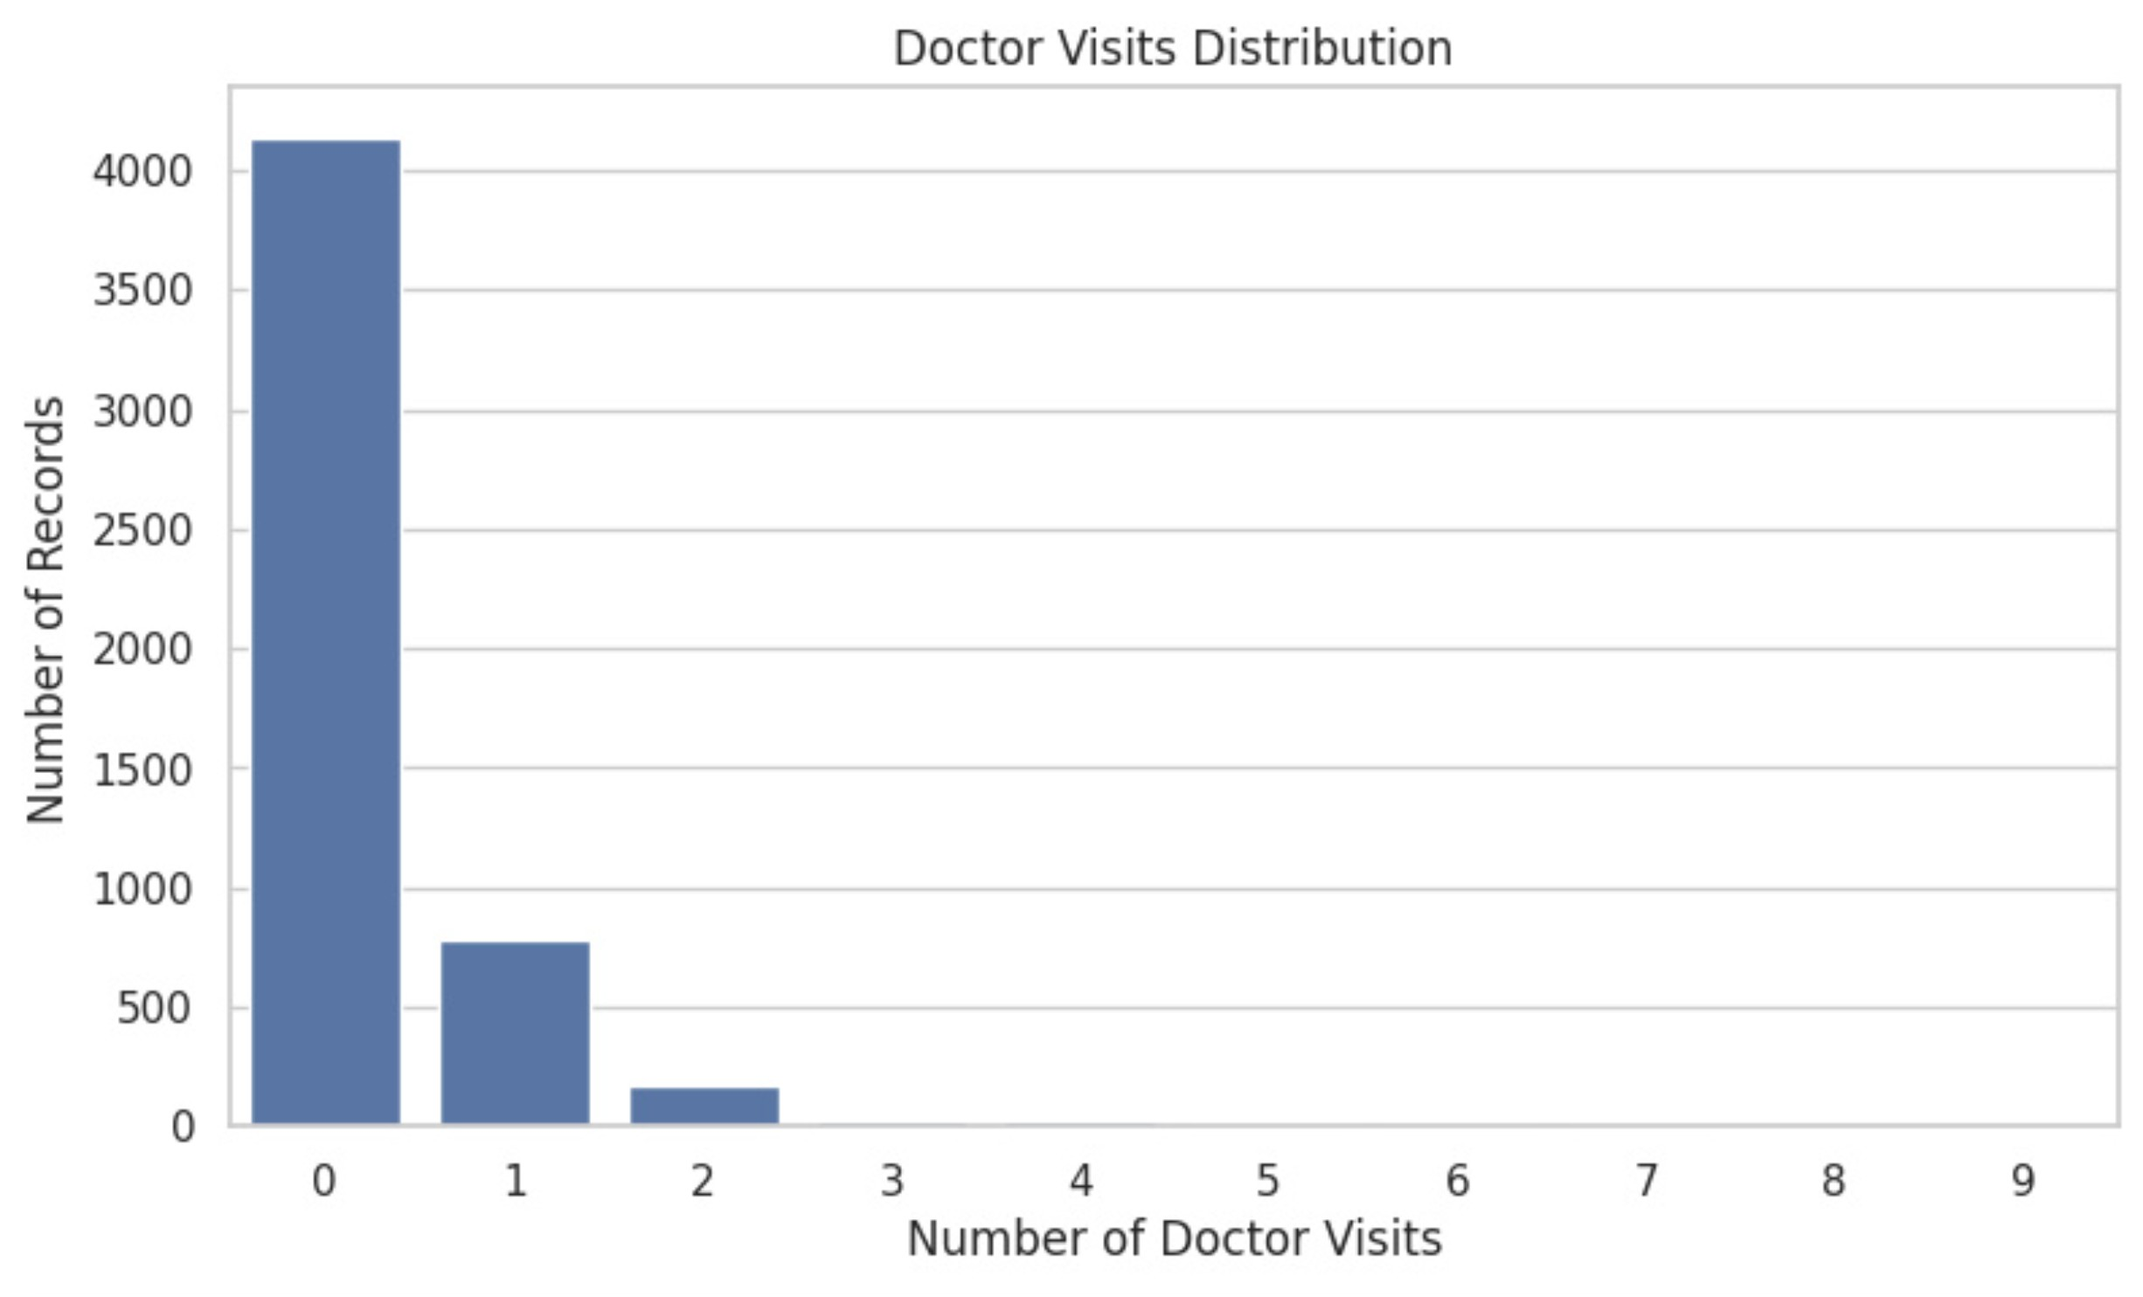
Results

Slide 9
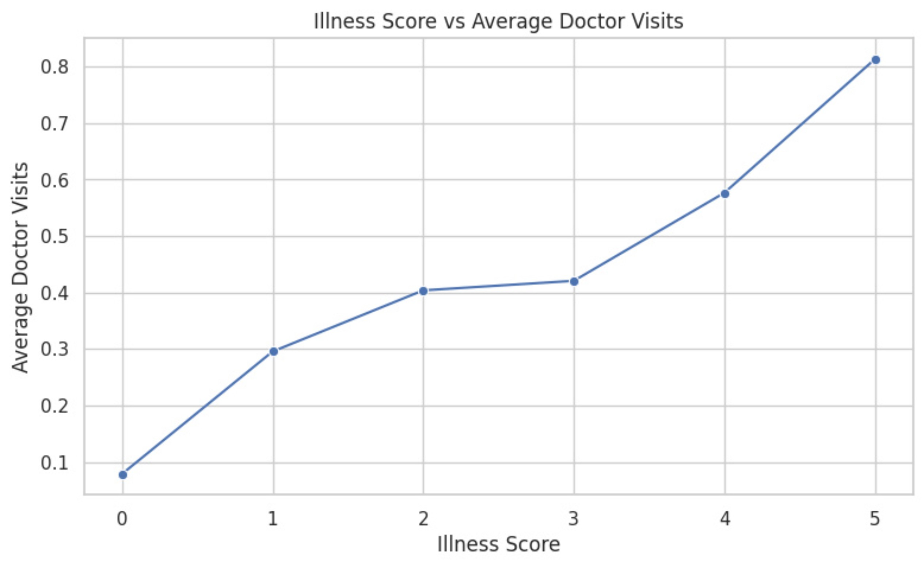
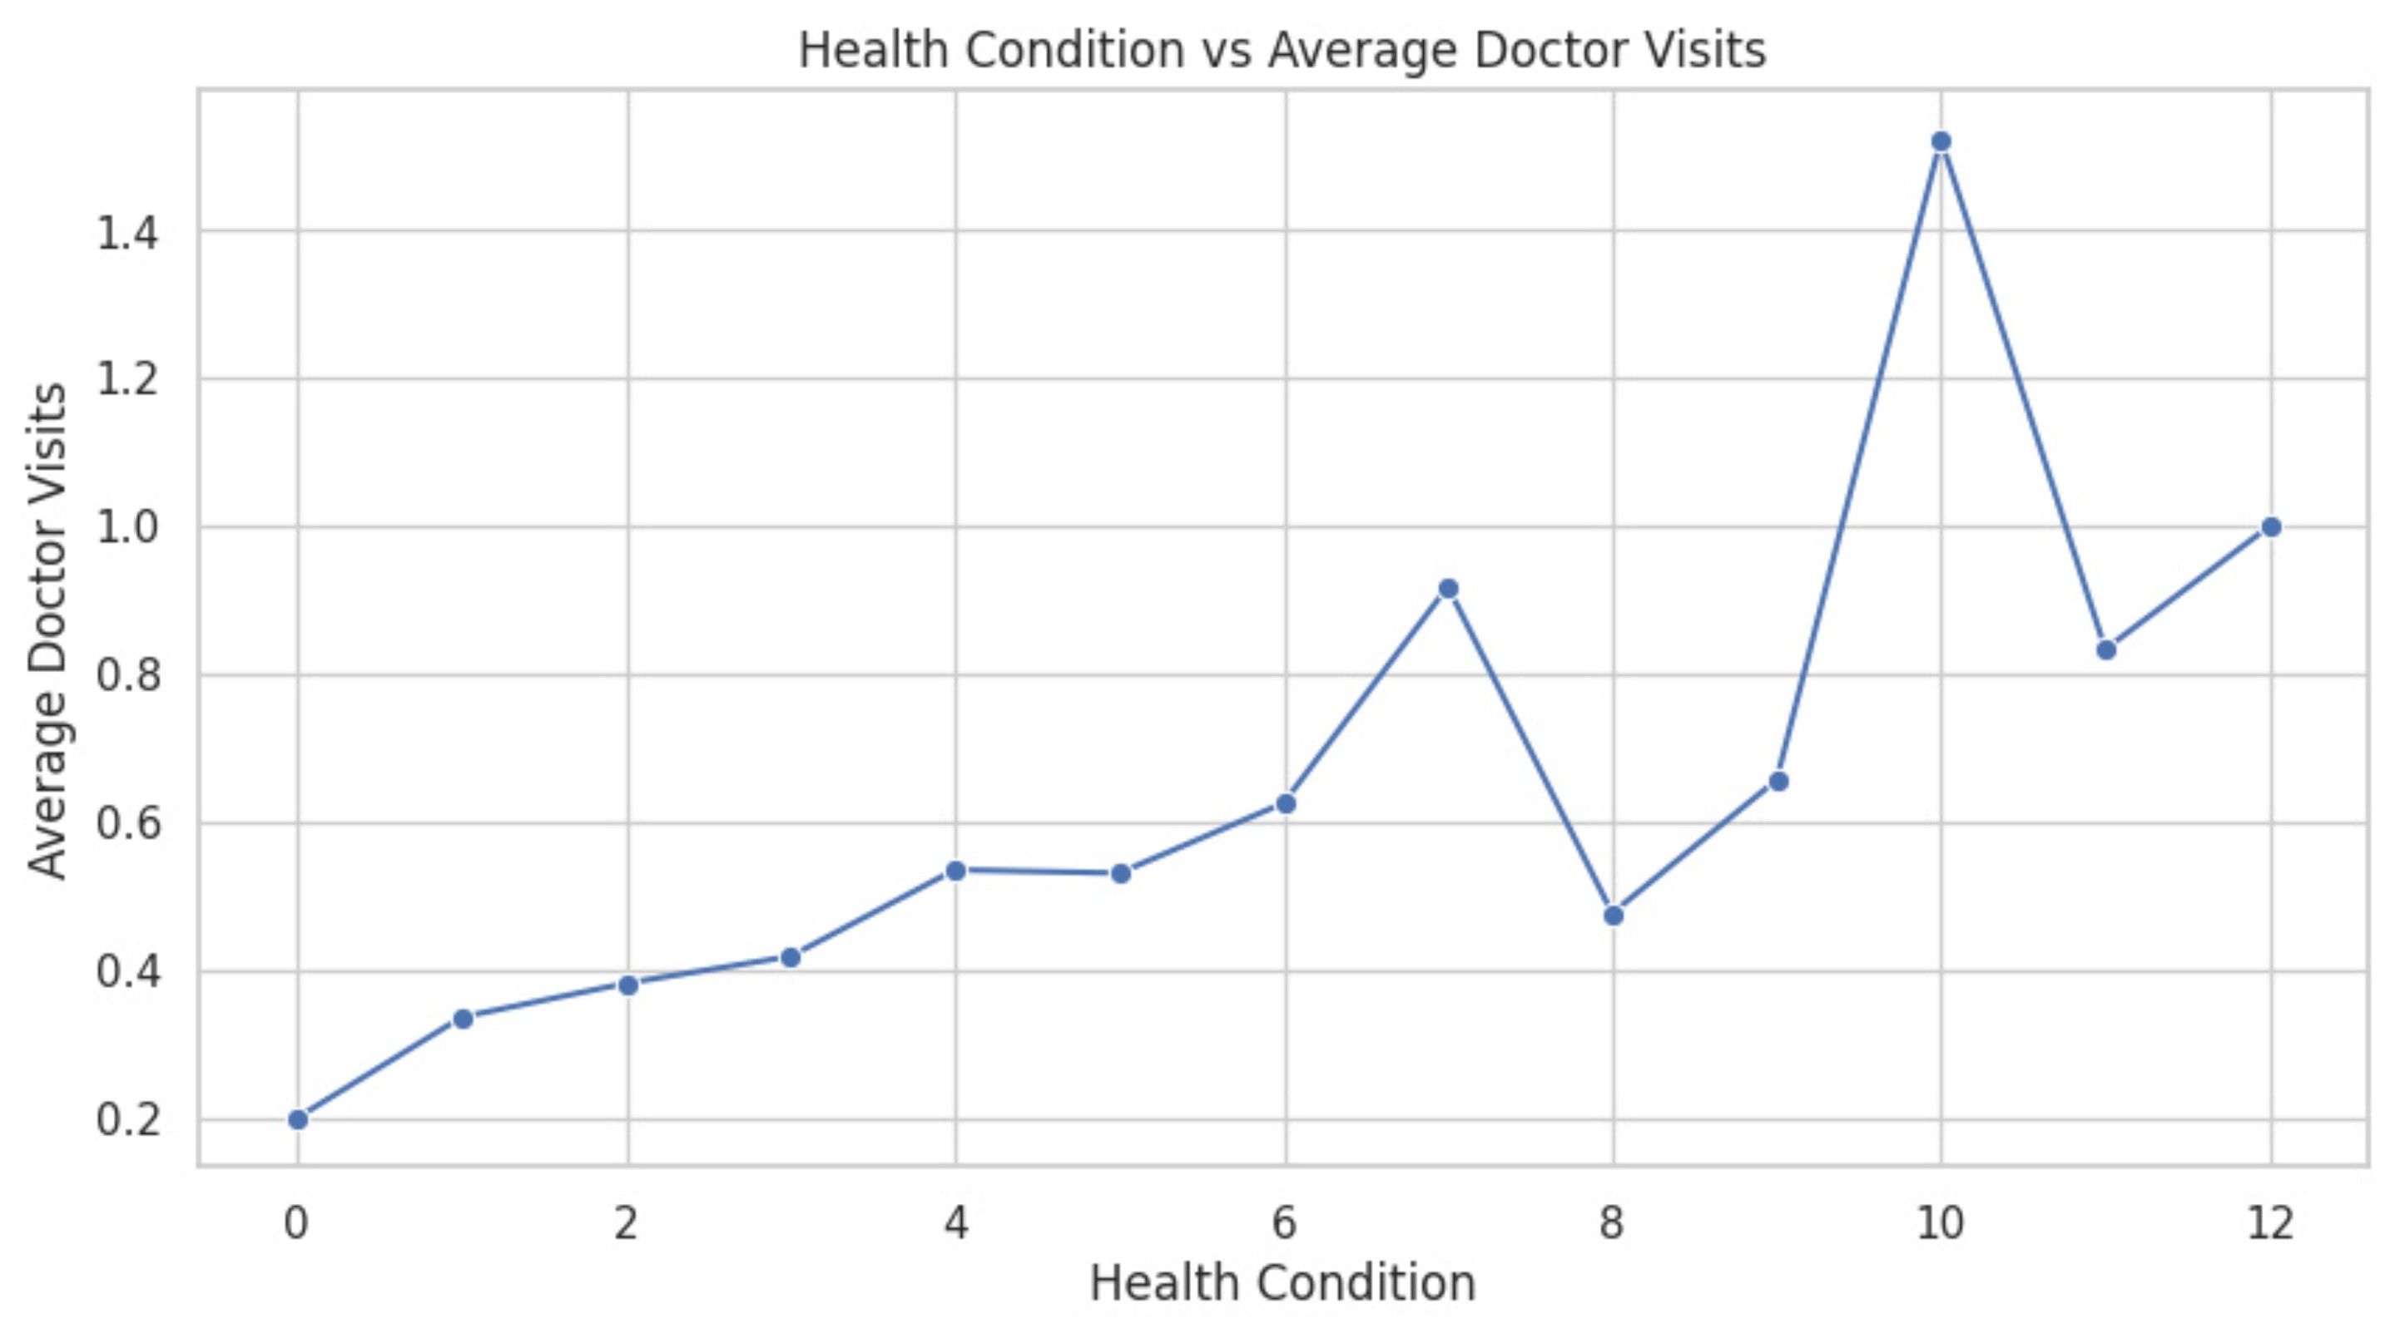
Results

Slide 10
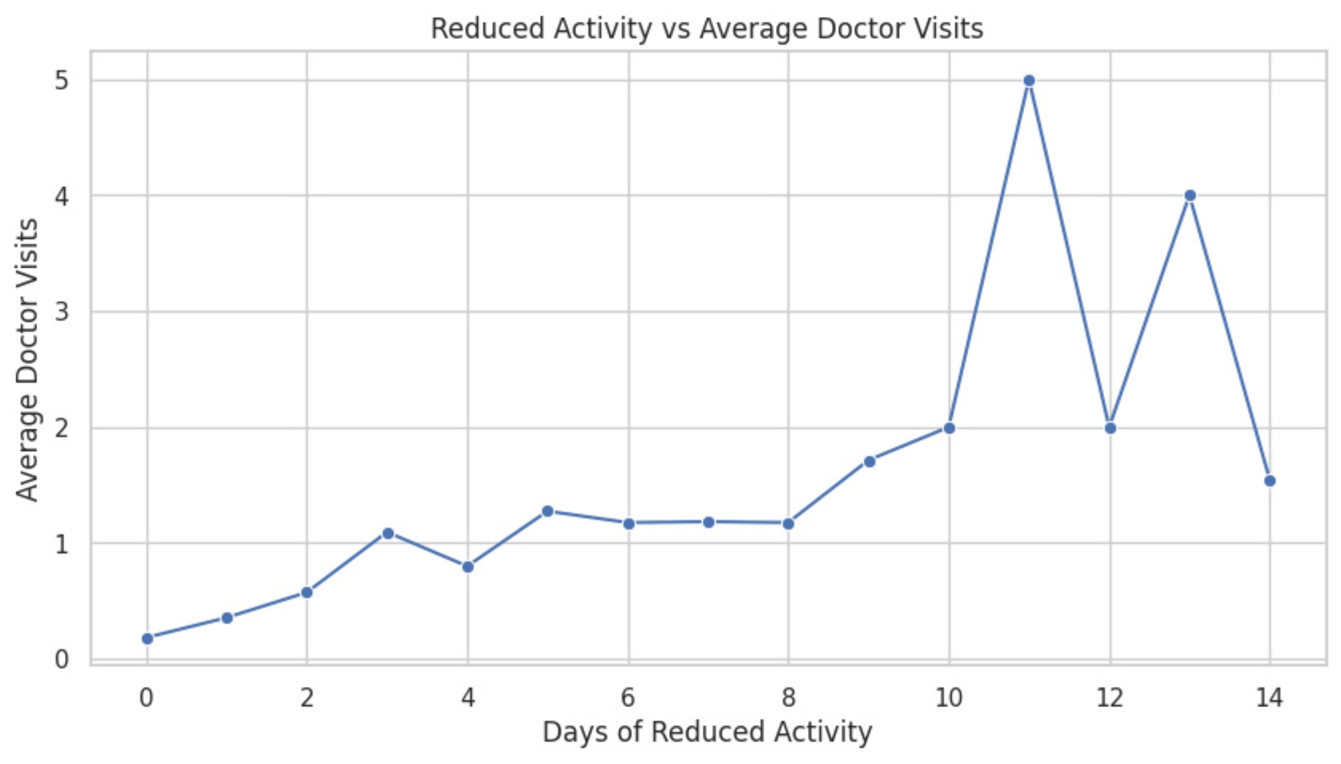
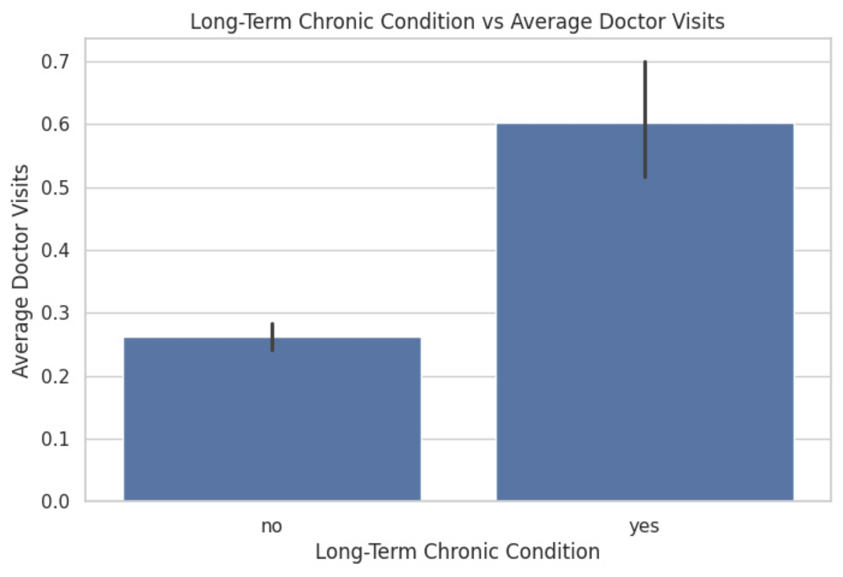
Results

Slide 11
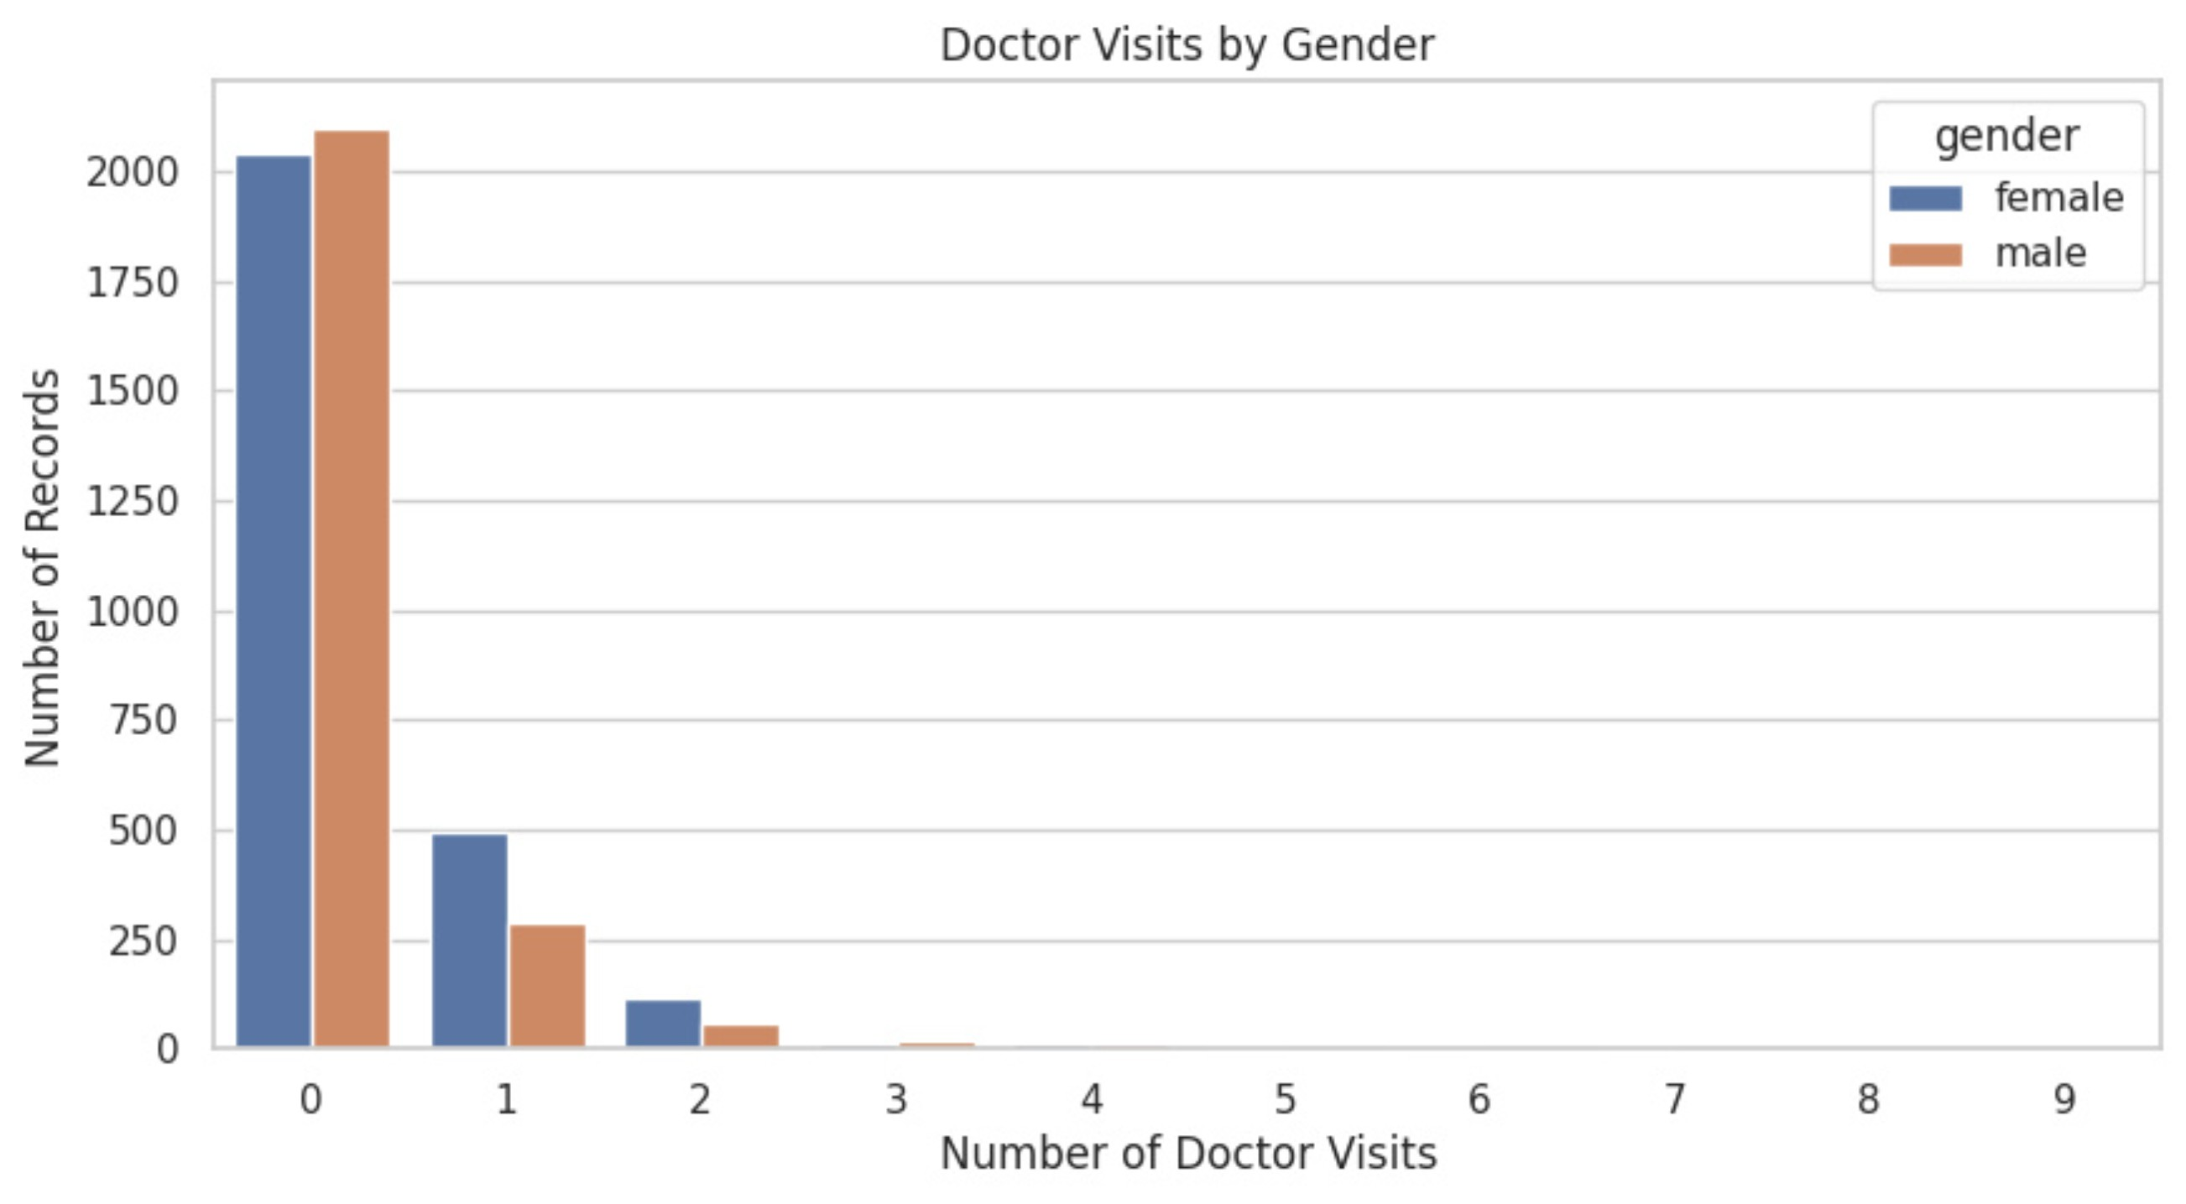
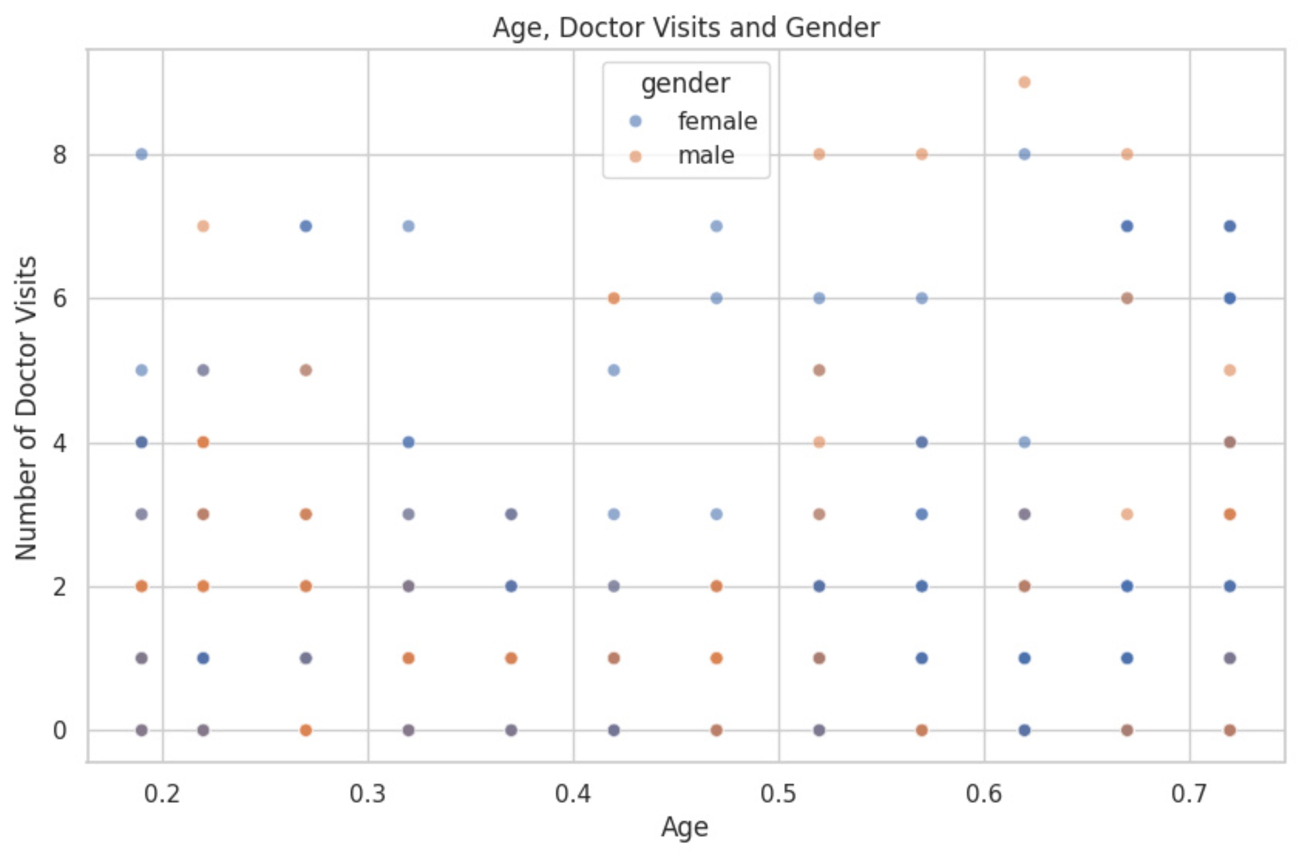
Results

Slide 12
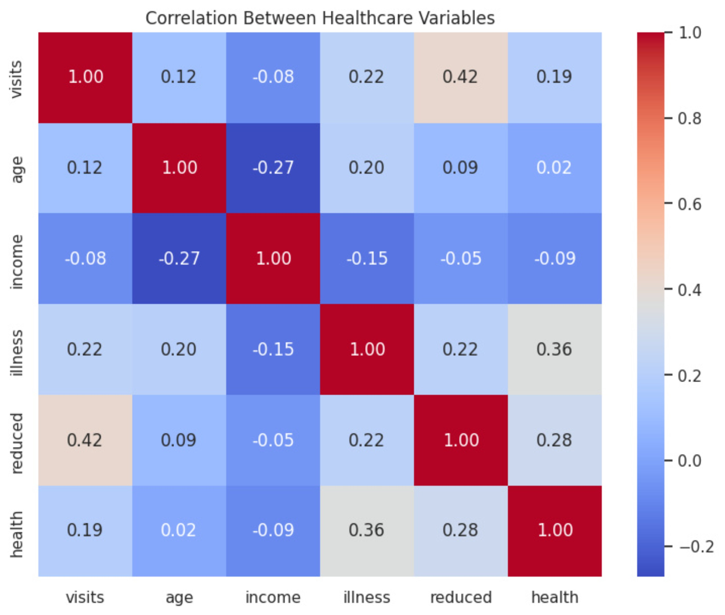
Results

Slide 13
Conclusion / Thank You
Across 5,190 records, reduced activity had the strongest positive correlation with doctor visits. Illness score and chronic-condition status showed differences in average visits. Gender averages differed; age had a weaker positive relationship, and income a weak negative relationship. Interpretation: These observed associations do not establish causation.
Mehak Abid
B.Tech. CSE
Jamia Hamdard
VOIS × AICTE
TIRTC DIY Project
7

