Slide 1

Presentation On Speech Emotion Recognition
Presented By: Group No-41
Mohd Abuzar Ansari
Khushal Babbar
Saksham Modgil
Mankhush kumar

Slide 2
Problem Statement
Problem:
Emotion recognition from speech plays a critical role in human-computer interaction. However, manually analyzing emotions is subjective, time-consuming, and inefficient.
Challenges:
Variability in Speech Patterns: People express emotions differently through variations in pitch, speed, and accent.
Noise Interference: Real-world environments introduce noise, affecting emotion detection accuracy.
Real-Time Processing: Developing a system that detects emotions instantly without lag is technically challenging.
Importance:
Understanding emotions can enhance AI systems for customer support, virtual assistants, healthcare, and education, creating more empathetic and responsive technology.

Slide 3
Objective
Goal:
Build an emotion detection system that automatically identifies emotions from speech in real-time, leveraging deep learning techniques.
Key Objectives:
Accurately classify emotions such as anger, happiness, sadness, fear, and neutrality from speech recordings.
Implement a model to process speech signals and extract key features.
Provide an interactive UI for real-time emotion detection.
Desired Outcome:
An efficient, user-friendly tool that delivers accurate, real-time emotion predictions from speech data.

Slide 4
Requirements
Hardware Requirements
intel i5 or higher
can also be AMD Ryzen 5000 or above
8gb ram
Hard disk 100gb
GPU GT1050 or above
SSD is more beneficial
microsoft compatible keyboard and mouse
Software Requirements
Operating System Windows 7 or later
IDE used : Anaconda
Software kit : python

Slide 5
System Architecture
Architecture Overview: The system is divided into several key components:
Audio Input Module:
Captures user speech via a microphone or pre-recorded audio file.
Preprocessing Module:
Converts audio signals into mel-spectrograms (a visual representation of sound) for feature extraction.
CNN-Based Emotion Detection Model:
Classifies the emotion by analyzing the mel-spectrogram through a trained CNN model.
UI Module:
Displays the detected emotion
System Flow:
Audio input →Feature extraction → CNN-based classification →Emotion output

Slide 6
Dataset
Dataset | Files | Emotions | Speaker Info | Key Features/Use Case
TESS | 2800 | Angry, Disgust, Fear, Happy, Neutral, Pleasant Surprise, Sad | 2 female speakers (26 and 64 years old) | Focuses on isolated words, useful for emotion detection in short audio
RAVDESS | 1440 | Neutral, Calm, Happy, Sad, Angry, Fearful, Disgust, Surprised | 24 actors (12 male, 12 female) | Speech and song, suitable for emotional tone detection in both modes
SAVEE | 480 | Neutral, Happy, Sad, Angry, Fearful, Disgust, Surprise | 4 male speakers | Emotional speech dataset focused on male voices
CREMA-D | 7442 | Angry, Disgust, Fear, Happy, Neutral, Sad | 91 actors (48 male, 43 female) | Emotions are also labeled with intensity (low, medium, high), providing more nuanced data

Slide 7
Preprocessing
Steps in Preprocessing:
Audio Cleaning and Trimming:
Removed silences and unnecessary parts of the audio clips. Ensured all audio is normalized in volume.
Mel-Spectrogram Conversion:
Why Mel-Spectrogram? It captures time and frequency features crucial for understanding speech.
Converted audio to mel-spectrograms (matrix of frequency vs. time), which is input to the model.
Data Augmentation:
Applied pitch shifting, time-stretching, and noise addition to expand the dataset and improve generalization.
Normalization:
All mel-spectrograms normalized to the range [0, 1] for consistent input to the model.

Slide 8
Model Architecture
Model Structure:
Input Layer: The input shape is (None, 178, 1), meaning the model expects sequences with 178 timesteps and 1 feature per timestep.
Convolutional Layers (Conv1D):
The model uses multiple 1D convolutional layers (Conv1D), which are typically employed for processing sequential or time-series data. In this case, it processes sequences with shape (None, 178, 1), where the sequence length is 178 and the data has 1 feature per timestep.
Residual Connections:
Skip connections (Add layers) to help train deeper networks.
Average-Pooling Layers:
Reduces sequence length while preserving feature information..
Fully Connected (Dense) Layers:
These layers act as the decision-making layers to classify emotions based on learned features.
Output Layer:
Softmax activation function for multi-class classification. The output gives a probability distribution over the possible emotion categories.

Slide 9
Modules
1. Audio Module:
Input audio from the user
2. Feature Extraction Module:
Converts the recorded audio into features in real-time.
3. CNN Prediction Module:
Uses the CNN model (‘emotion-recognition.keras’) to predict the emotion from the extracted features.
4. UI Module:
Built using Streamlit allows the user to upload audio, see the detected emotion

Slide 10
Training and optimization
Training Process:
Batch Size: 32.
Epochs: 500 (with early stopping to prevent overfitting).
Loss Function: Categorical Cross-Entropy (for multi-class classification).
Optimizer: Adam optimizer (adaptive learning rate adjustment).
Model Optimization Techniques:
Learning Rate Scheduling: Dynamically adjusted the learning rate to ensure efficient convergence.
Early Stopping: Stopped training when the validation loss plateaued.
Data Augmentation: Increased the robustness of the model by augmenting the dataset.
Performance:
Training Accuracy: 99.87%
Validation Accuracy: 76.18%
Test Accuracy: 74.82%

Slide 11
Result
Confusion Matrix:
Display a confusion matrix to show how well the model performs for each emotion. Highlight areas of strong and weak classification.

Slide 12
UI And Real Time Detection
User Interface (UI):
The interface, built using Streamlit, allows users to:
Record Audio: Using a simple “Record” button.
See Detected Emotion: Display the predicted emotion after processing the recorded audio.
Real-Time Detection:
Response Time: Model takes ~2-3 seconds to process audio and display the emotion.
Example: Demonstrate a sample interaction where a user speaks, and the UI instantly shows the detected emotion as "Happy" or "Angry."

Slide 13
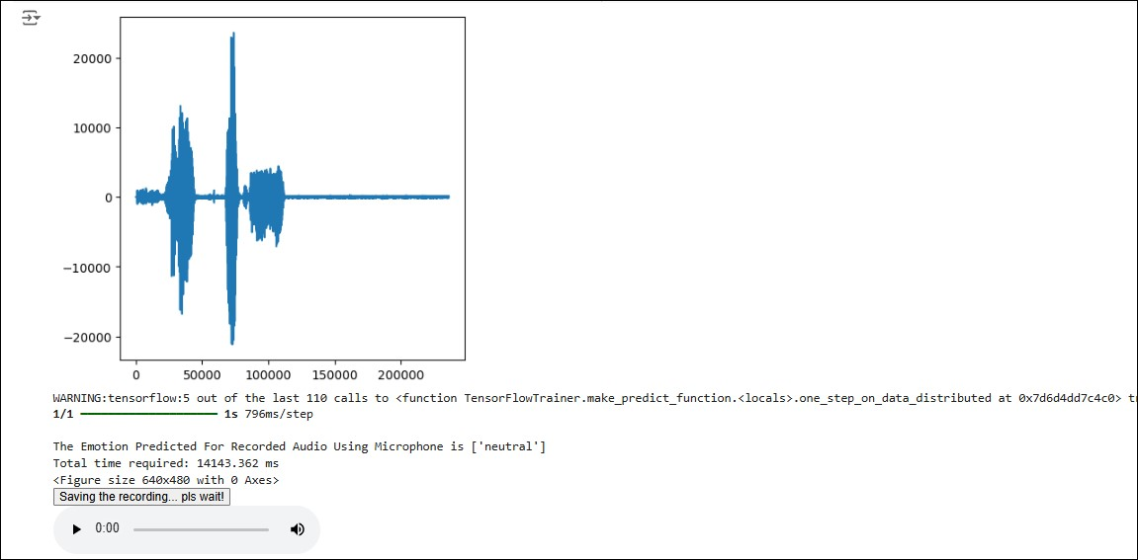
Snapshot

Slide 14
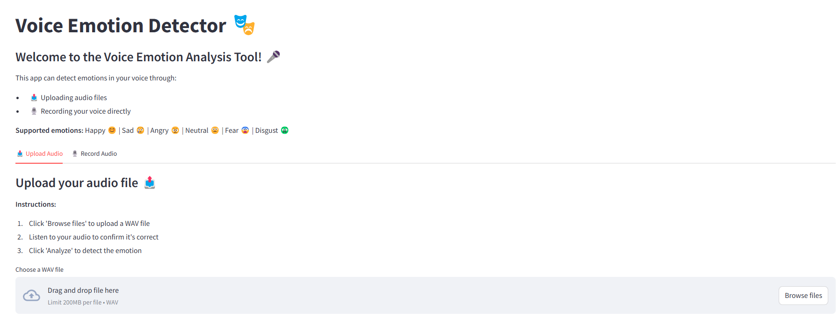
Snapshot

Slide 15
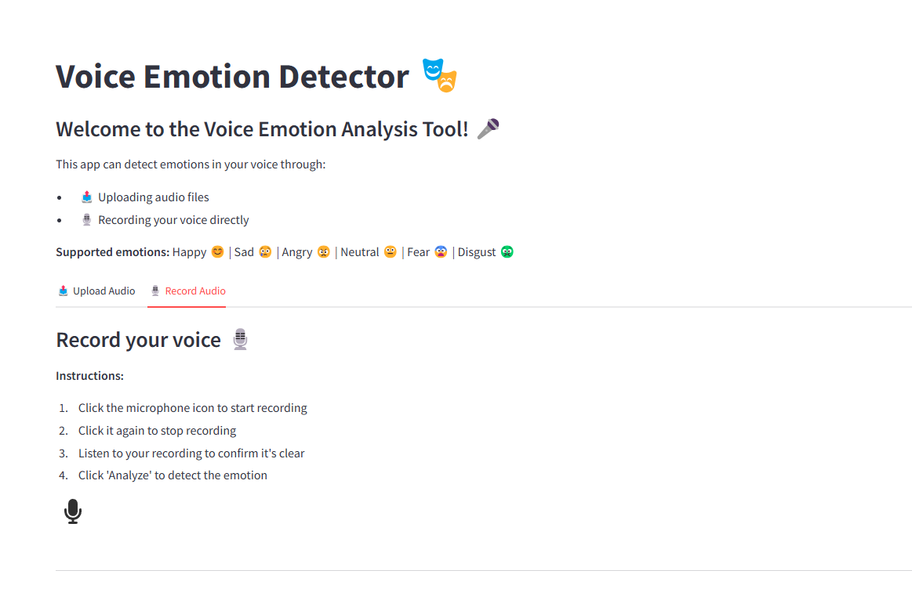
Snapshot

Slide 16
CHALLENGES
1. Variability in Speech Patterns:
Different accents, tones, and speech speeds affect how emotions are perceived by the model.
2. Background Noise Sensitivity:
Real-world environments often include noise, which can interfere with emotion detection accuracy.
3. Limited Dataset for Certain Emotions:
Emotions like disgust and fear are underrepresented in datasets, making it difficult for the model to learn these classes effectively.

Slide 17
Conclusion
Summary of Achievements:
Successfully implemented a CNN-based system for real-time emotion detection using speech.
Achieved an accuracy of 75% on validation data, with a user-friendly UI for real-time prediction.
Key Takeaways:
Audio preprocessing and CNN models can effectively classify emotions from speech.
A simple UI makes it accessible for users to interact with the system.

Slide 18
Future Improvments
1. Enhanced Noise Filtering:
Incorporate advanced noise reduction techniques to make the model robust against real-world environments.
2. Expanded Dataset:
Increase the size and diversity of the dataset by including speech samples from multiple languages and cultures.
3. Fine-Tuning:
Fine-tune the model using transfer learning or by adding additional layers to improve emotion detection for subtle emotions like fear and disgust.

Slide 19
Future Scope
1. Customer Service Automation:
Integrate emotion detection into customer support systems to enhance user interaction by identifying customer emotions in real time.
2. Healthcare Applications:
Emotion detection in therapy sessions to assist in tracking patients’ emotional progress and mental health.
3. Smart Assistants:
Integrate emotion detection in virtual assistants like Alexa or Siri to make them more empathetic and responsive to users’ emotional states.

Slide 20
………Thank you………

