Slide 1

Introduction to Seaborn
What is Seaborn?
Importing Seaborn
A Python data visualization library
Built on top of Matplotlib
High-level interface for attractive statistical plots
Widely used in Data Analysis, Data Science and EDA
Works especially well with Pandas DataFrames
import seaborn as sns
seaborn → library name
sns → commonly used alias
Basic Structure
sns.plot_function(
data=data,
x='column_name',
y='column_name'
)
data → DataFrame x → X-axis column y → Y-axis column
Data
→
Seaborn
→
Plot
→
Insights

Slide 2
Understand Your Data Before Choosing a Plot
“Before creating a visualization, we need to understand what type of data we have.”
Numerical | Categorical
Age | Gender
Salary | Department
Revenue | Product Category
Price | City
Quantity | Payment Method
1. Numerical Data
2. Categorical Data
Numbers used for measurements or quantities; continuous or discrete.
Groups, labels, or categories.
Age, Salary, Price, Revenue, Height, Temperature, Marks
Gender, Department, Product Category, City, Payment Method
Age → 25, 31, 42
Salary → 25000, 40000, 55000
Gender → Male, Female
Category → Electronics, Clothing, Furniture
Key idea: The type of data determines which visualization will be most useful.

Slide 3
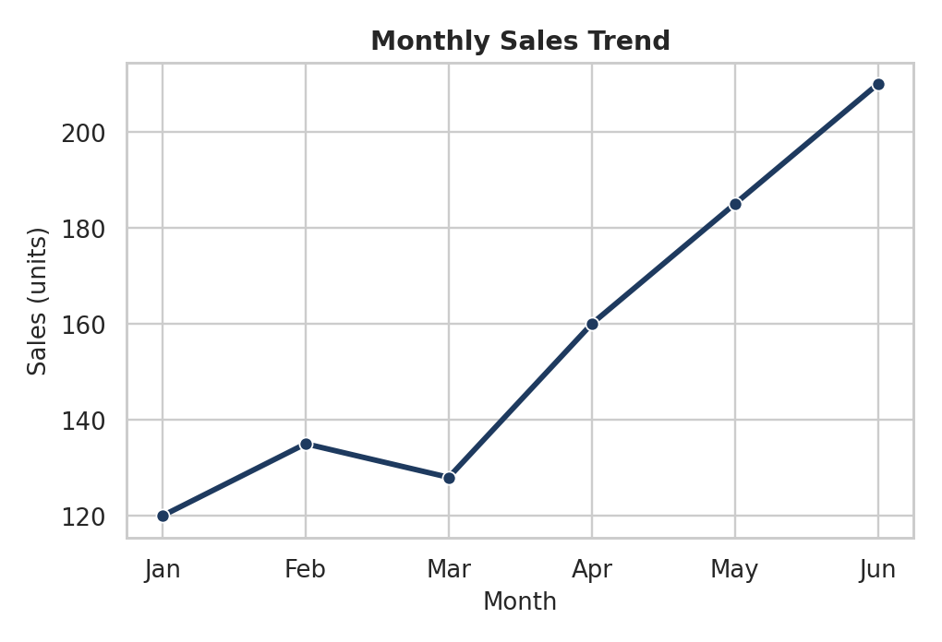
Line Plot
Data type: Numerical (ordered: time, date, sequence)
Show trends over time
Track increases and decreases
Compare trends between groups
sns.lineplot(
data=data,
x='month',
y='sales'
)
x → ordered / continuous variable
y → numerical variable; points are connected to show a trend
Best for: Trends, time series, and continuous changes.

Slide 4
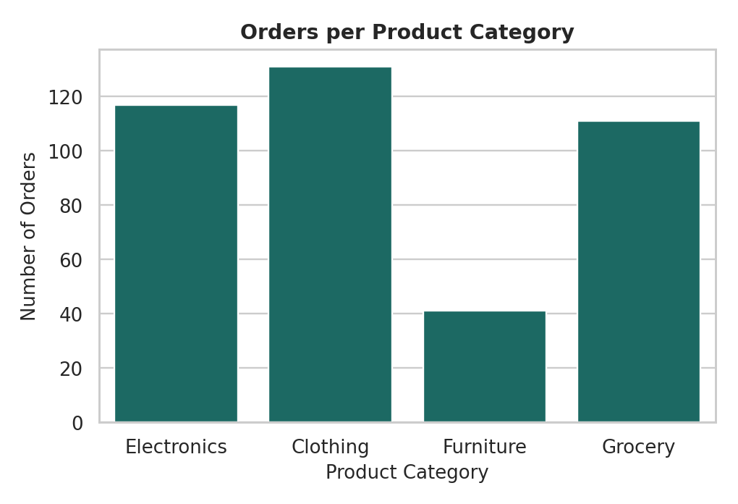
Count Plot
Data type: Categorical
Shows how many observations fall in each category
Great first look at a categorical column
sns.countplot(
data=data,
x='category'
)
x → categorical variable
Y-axis is calculated automatically: the count of each category
Best for: Frequency / count of categorical values.

Slide 5
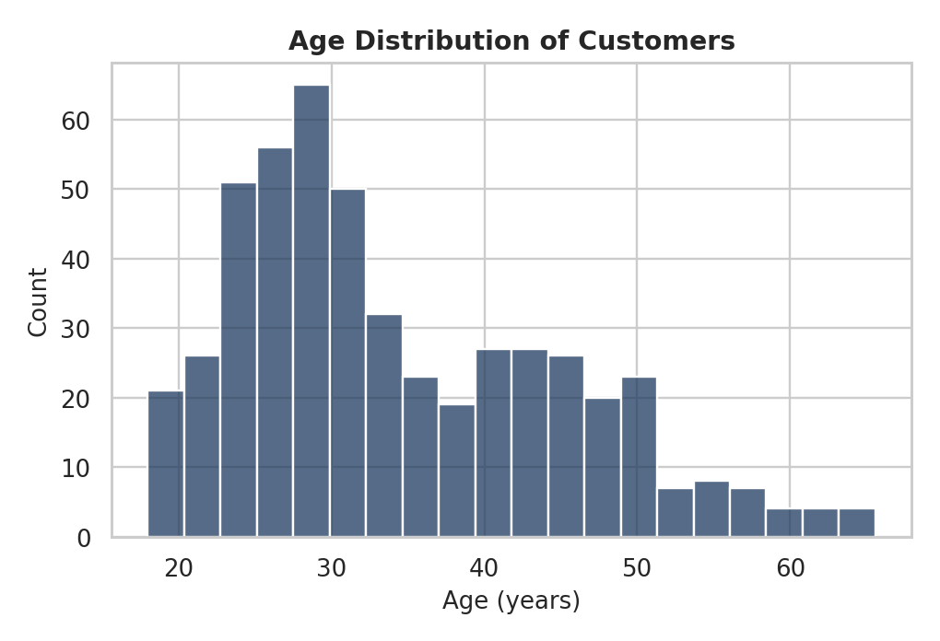
Histogram
Data type: Numerical
Understand the distribution of numerical data
See where values concentrate and how they spread
Detect possible skewness
sns.histplot(
data=data,
x='age',
bins=20
)
Values are grouped into bins (ranges)
bins → number of intervals; Y-axis → observations per bin
Best for: Distribution and frequency of numerical data.

Slide 6
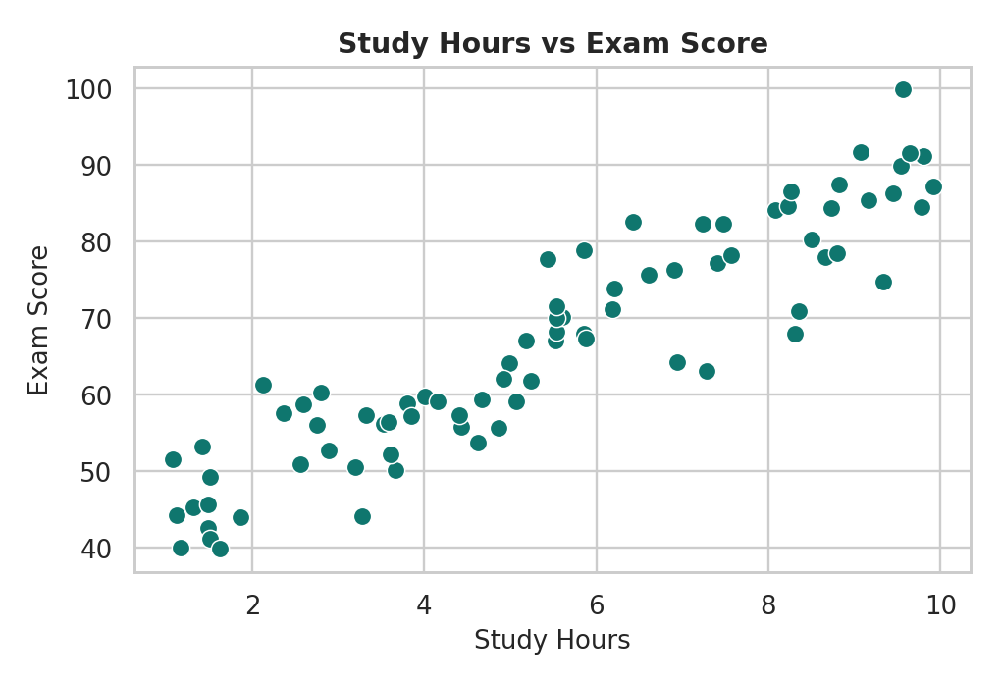
Scatter Plot
Data type: Numerical + Numerical
Find relationships and patterns
Detect clusters and outliers
See whether variables move together
sns.scatterplot(
data=data,
x='study_hours',
y='score'
)
Each dot is one observation
x and y should generally both be numerical
Best for: Relationship between two numerical variables.

Slide 7
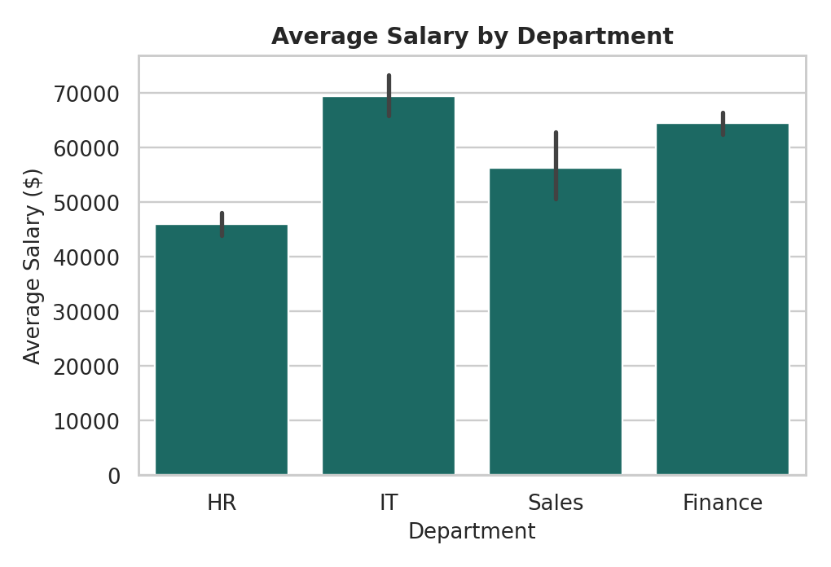
Bar Plot
Data type: Categorical + Numerical
Compare numerical values across categories
Compare averages or other aggregates
sns.barplot(
data=data,
x='department',
y='salary'
)
Shows one aggregated value per category
By default Seaborn estimates the mean (thin line = confidence interval)
Best for: Comparing numerical summaries across categories.

Slide 8
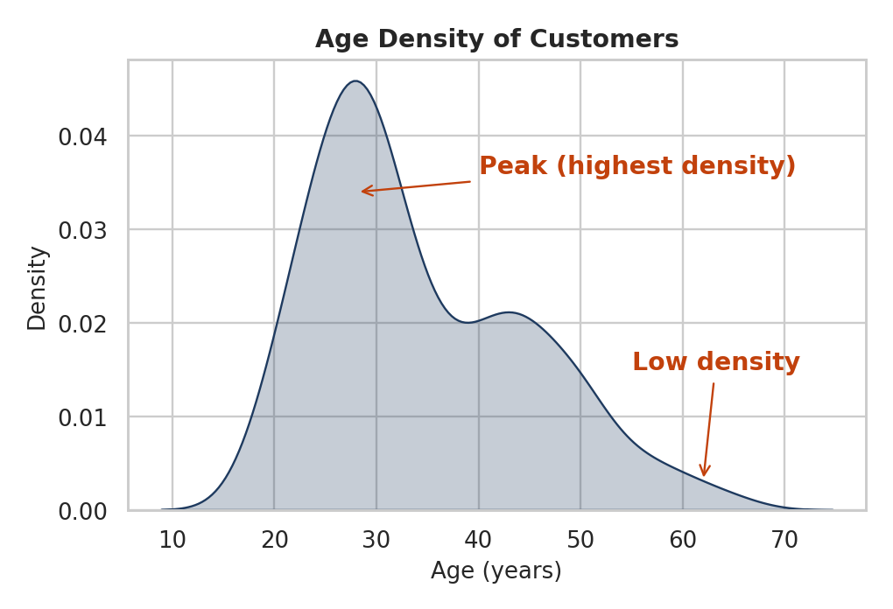
KDE Plot (Kernel Density Estimate)
Data type: Numerical
Understand the shape of a distribution
Spot peaks and low-density regions
Compare distributions
sns.kdeplot(
data=data,
x='age'
)
KDE draws a smooth curve of the estimated distribution
Higher curve → more observations concentrated there
Best for: Smooth distribution analysis.

Slide 9
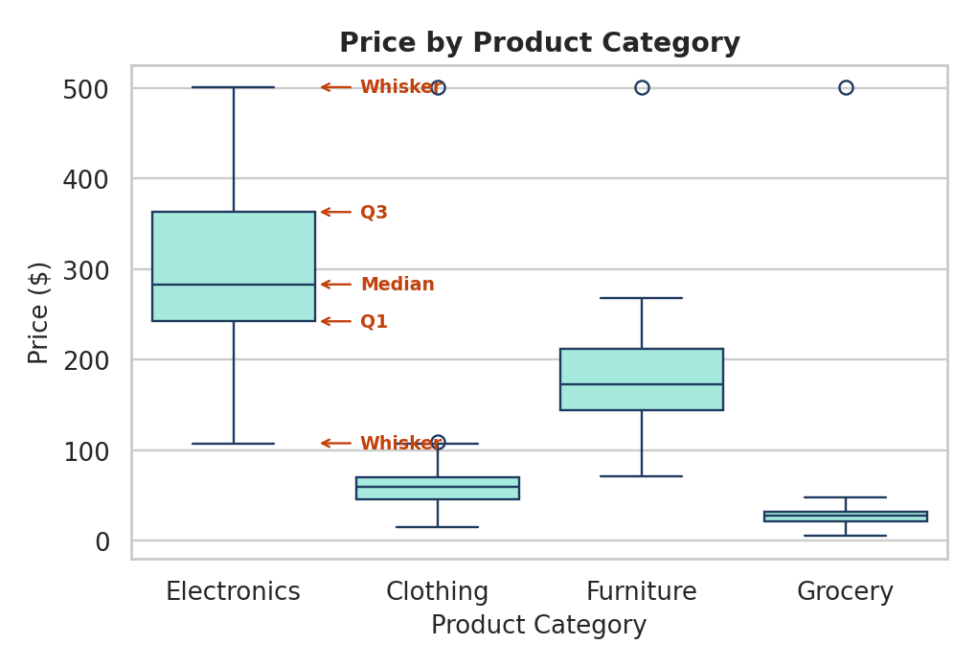
Box Plot
Data type: Numerical (+ optional categorical grouping)
Summarize distribution: Q1, median (Q2), Q3
Whiskers show range; IQR = Q3 − Q1
Detect outliers and compare groups
sns.boxplot(
data=data,
x='category',
y='price'
)
Box = middle 50% of data (IQR)
Points beyond the whiskers are potential outliers
Best for: Distribution, spread, comparison, and outlier detection.

Slide 10
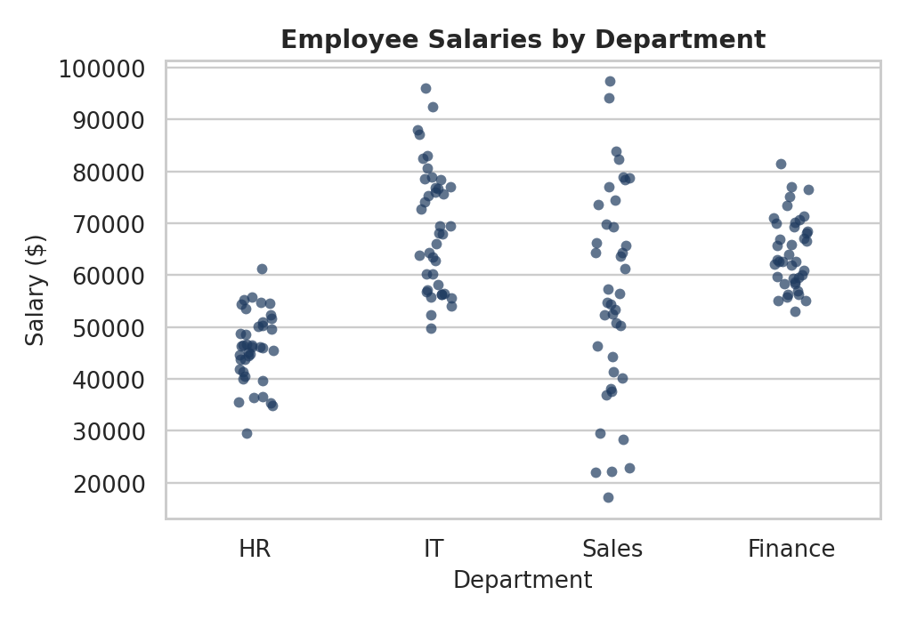
Strip Plot
Data type: Categorical + Numerical
Show individual observations
See spread within each category
Identify clusters and potential outliers
sns.stripplot(
data=data,
x='department',
y='salary'
)
Unlike a bar plot, it shows every individual observation
Points may overlap when values are close
Best for: Individual data points across categories.

Slide 11
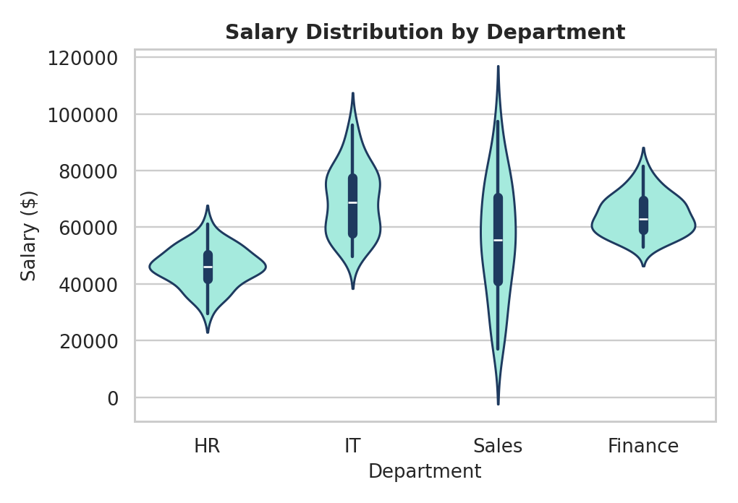
Violin Plot
Data type: Categorical + Numerical
Combines ideas from a box plot and a KDE plot
Shows distribution, density, and spread
Compare differences between categories
sns.violinplot(
data=data,
x='department',
y='salary'
)
Wider part of the violin → more observations at that value
Inner box shows median and quartiles
Best for: Comparing distributions and density across categories.

Slide 12
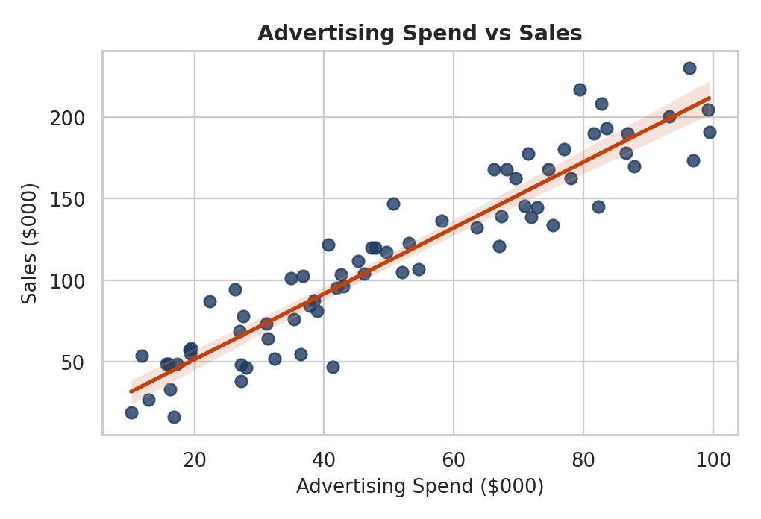
Regression Plot
Data type: Numerical + Numerical
Understand the relationship between two variables
See the direction of the relationship
Visualize a fitted trend line
sns.regplot(
data=data,
x='advertising_spend',
y='sales'
)
Dots → actual observations; line → estimated regression
Shaded region → confidence interval
Best for: Relationships and trends between numerical variables.

Slide 13
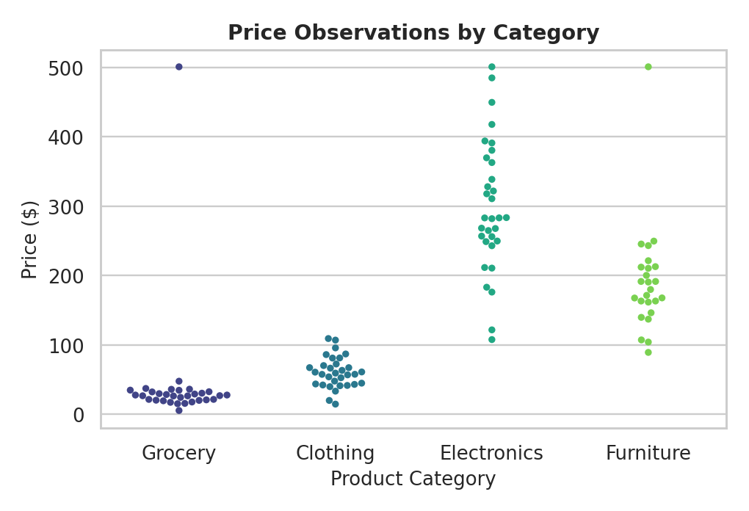
Swarm Plot
Data type: Categorical + Numerical
Show individual observations
Compare distributions between categories
See concentration without heavy overlap
sns.swarmplot(
data=data,
x='category',
y='price'
)
Points are positioned so they do not overlap unnecessarily
Wider swarm → more observations at that value
Best for: Detailed comparison of individual observations across categories.

Slide 14
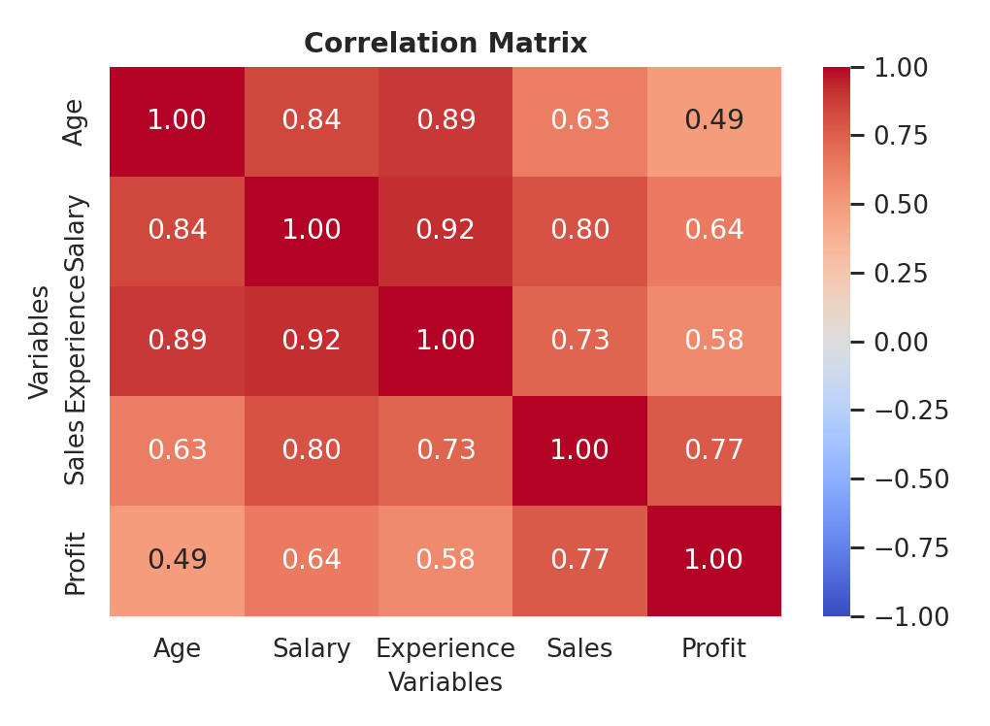
Heatmap
Data type: Matrix of numerical values (e.g., correlations)
Quickly spot high and low values
Visualize correlation between many variables
sns.heatmap(
data.corr(),
annot=True
)
data.corr() → correlation between numerical variables; annot=True → show values in cells
+1 strong positive | 0 little/no linear | −1 strong negative
Best for: Matrix-based comparisons and correlation analysis.

Slide 15
Which Plot Should I Use?
Goal | Recommended Plot
Show a trend over time | Line Plot
Count categories | Count Plot
Understand numerical distribution | Histogram
Relationship between two numerical variables | Scatter Plot
Smooth numerical distribution | KDE Plot
Distribution + outliers | Box Plot
Goal | Recommended Plot
Compare values across categories | Bar Plot
Show individual observations | Strip Plot
Compare distributions and density | Violin Plot
Show relationship + trend line | Regression Plot
Individual observations, reduced overlap | Swarm Plot
Compare many values in a matrix | Heatmap
Key Takeaway: “Choose the plot based on the type of data and the question you want to answer.”
Understand Data
→
Identify Data Type
→
Define Your Question
→
Choose the Right Plot
→
Analyze the Insight

