Slide 1

AI-Powered Student Attention Monitoring System
Real-time engagement detection using facial-landmark feature engineering and a trained ML classifier — built with Computer Vision & Machine Learning.

Slide 2


The Problem: Attention is Invisible
Silent Disengagement
A student can look at a screen while mentally checked out — teachers have no objective signal to catch it.
Doesn't Scale
One instructor cannot continuously track eye contact, blinking, or posture for every student, every second.
Too Late to Act
Fatigue and distraction are usually noticed only after grades slip — not in the moment when it matters.

Slide 3




Project Goals
Capture Behaviour in Real Time
Engineer Domain-Informed Features
Run MediaPipe Face Landmarker on a live webcam feed, frame by frame.
Convert raw landmarks into EAR, MAR, head pose, and gaze-direction signals.
Classify Attention Automatically
Make It Observable
Map features to Distracted / Passive / Highly Attentive using a trained ML model.
Log every session to SQLite and expose it through a live analytics dashboard.

Slide 4

End-to-End Pipeline Architecture
Webcam Feed
Face Landmarker
Feature Engineering
ML Prediction
Every frame travels through this deterministic pipeline — from raw pixels to a logged attention classification — in near real time.

Slide 5



Computer Vision: Landmarks → Behavioural Signals
EAR — Eye Aspect Ratio
MAR — Mouth Aspect Ratio
Head Pose (Pitch / Yaw / Roll)
Geometric ratio on 6 eye-contour points. Drops sharply on a blink, driving fatigue detection.
Same idea applied to 8 mouth-contour points. A sustained spike flags a yawn.
cv2.solvePnP on 6 stable landmarks estimates 3D orientation to catch "looking away."
Gaze Direction
Iris landmarks normalized between eye corners to classify left / center / right.

Slide 6
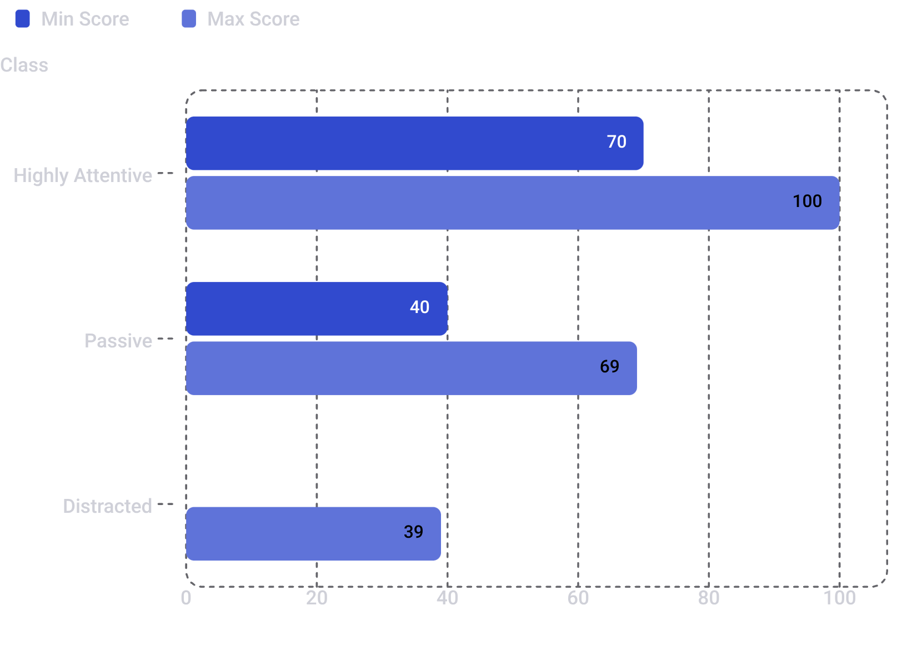
Scoring & Classification Logic
Each behavioural signal is normalized to 0–1, weighted, and summed into one transparent attention score (0–100) — no black box.
🟢 Highly Attentive
🟡 Passive
Score ≥ 70 — student is engaged, eyes forward, minimal yawning or distraction signals.
Score 40–69 — partial engagement detected; attention is present but inconsistent.
🔴 Distracted
Score < 40 — significant disengagement signals; candidate for an immediate alert.

Slide 7
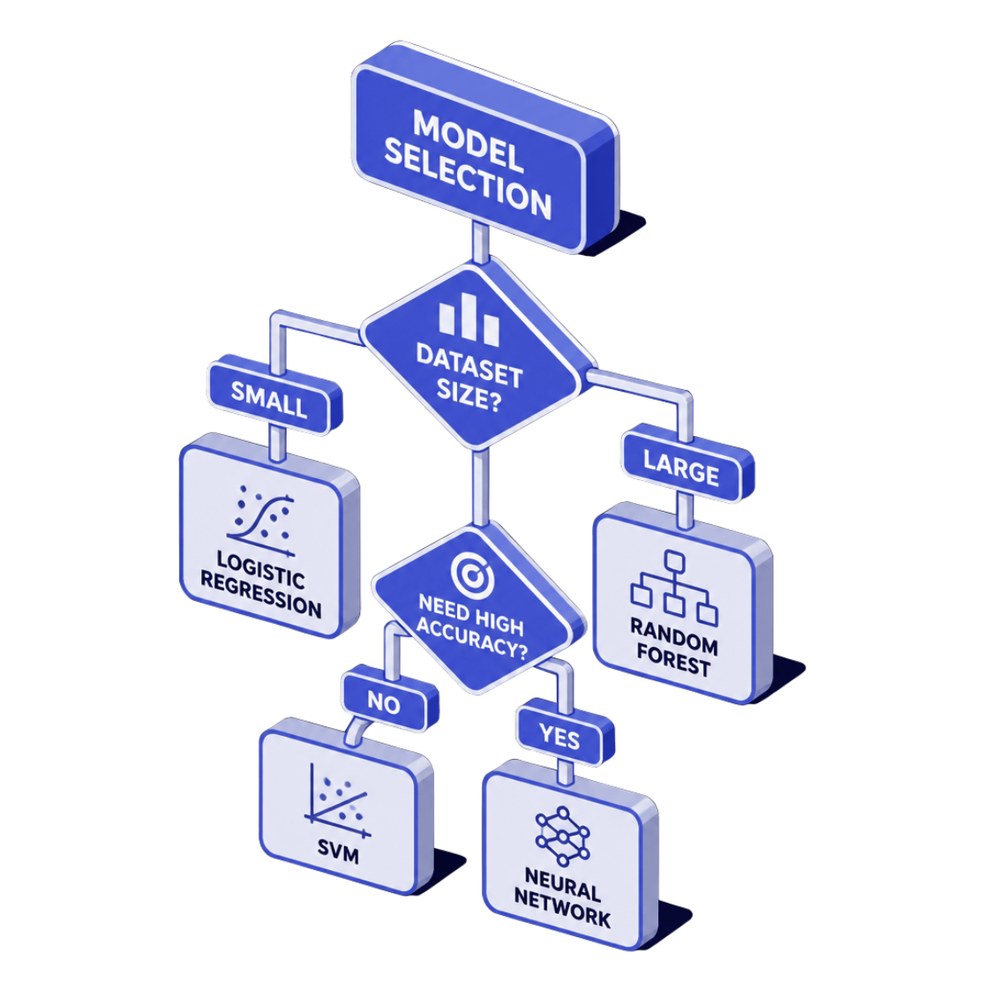
Machine Learning: Auto-Selecting the Best Classifier
Training Setup
1
Synthetic Bootstrap Dataset
2
10 Engineered Features
3
Two Candidates Benchmarked
EAR, MAR, blink rate, yawn count, pitch, yaw, roll, gaze score, face presence, session duration.
600 domain-informed samples per class so the system predicts from the very first run.
Random Forest vs. Logistic Regression evaluated on the same held-out test split.
4
Auto-Selection at Runtime
Whichever model scores the higher weighted F1 is serialized with joblib and loaded live.

Slide 8

What's Next: Future Scope
Classroom-Scale Monitoring
Extend from a single face to multiple simultaneous students tracked within one frame.
Temporal Deep Learning
Explore CNN/LSTM models over feature sequences instead of single-frame classification.
Teacher-Facing Alerts
Push live low-attention alerts and export session summaries directly into an LMS.

