Slide 1
Quantifying Market Sentiment and Its Impact on Stock Prices An In-depth Analysis
MADE Project
Mohammad Ahmed

Slide 2
Agenda
01. Introduction
02. Motivation
Exploring the relationship between market sentiments and stock prices.
Influence of Social Media and News Sentiments
03. Methodology
04. Data Sources
05. In-dept Analysis
Data Pipeline, Exploratory & Statistical analysis
Stock Price Data & News Datasets
Financial Metrics and Technical Indicators
January 17, 2024

Slide 3

Introduction
Exploring the relationship between market sentiments and stock prices.
Seeks to determine the extent to which social media and news sentiments affect stock prices.
January 17, 2024

Slide 4

Motivation
Recognizes the growing impact of sentiments on social media and news platforms in shaping stock market dynamics.
Highlights the need to understand the correlation between market sentiments and stock prices for effective investment strategies in a digitally interconnected financial landscape.
January 17, 2024

Slide 5
Methodology – Pipeline
Kaggle Dataset Download
SQLite Migration
Utilizes the Kaggle API to download datasets related to stock exchange data and news articles.
Creates an SQLite engine and migrates data to appropriate tables with specified rules
Dataset Preprocessing
Overall Pipeline
Renames columns, handles datetime formats, and filters data to focus on the relevant time period (e.g., 2021).
Calls functions sequentially to ensure a streamlined process from dataset download to SQLite migration.
January 17, 2024

Slide 6
Methodology - Analysis
Statistical Analysis and Modeling
SQLite Data Retrieval
Executes SQL queries or utilizes Pandas to fetch relevant datasets for analysis.
Applies modeling techniques to further explore correlations and relationships within the data.
Exploratory Data Analysis (EDA)
Real-World Trading Scenarios
Creates visualizations and summary statistics to identify patterns and trends.
Explores the practical applicability of the insights gained in real-world
January 17, 2024

Slide 7
Data Sources
Stock Price Data
News Data
We sourced daily price data for global stock exchanges, including indexes from the United States, China, Canada, Germany, Japan, and more. This data was obtained from Kaggle, and it encompasses several decades of historical data from Yahoo Finance.
Two datasets from Kaggle were utilized for news sentiment analysis. The first dataset contains news headlines published over nineteen years by the Australian Broadcasting Corporation (ABC). The second dataset collects RSS feeds from BBC News using a self-updating mechanism.
ABC News Data
BBC News Data
January 17, 2024

Slide 8

Analysis

Slide 9
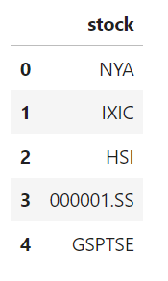
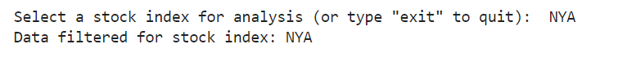
Initial Configuration
Generating a list of Stock Index
Stock Index selection
January 17, 2024

Slide 10
Derived Columns for Advanced Analysis
Daily Returns
Log Return
Moving Averages
This column represents the percentage change in the stock's closing price from one day to the next.
Formula:
Daily Return = (Closeₜ - Closeₜ₋₁) / Closeₜ₋₁
Logarithmic returns are often used in financial analysis and can be more appropriate for certain calculations.
Formula:
Log Return = ln(Closeₜ / Closeₜ₋₁)
Moving averages smooth out price data to identify trends over a specified period.
Common types include the Simple Moving Average (SMA) and Exponential Moving Aveo4 log returns.
January 17, 2024

Slide 11
Derived Columns for Advanced Analysis
Relative Strength Index (RSI)
Moving Average Convergence Divergence (MACD)
Aggregate Sentiment Scores
RSI is a momentum oscillator that measures the speed and change of price movements.
It ranges from 0 to 100 and is used to identify overbought or ov5rsold conditions.
MACD is a trend-following momentum indicator that shows the relationship between two moving averages.
It consists of the MACD line, sigcating overbought or oversold conditions.
Sentiment scores are aggregated by date to provide a holistic view of market sentiment over time.
January 17, 2024

Slide 12
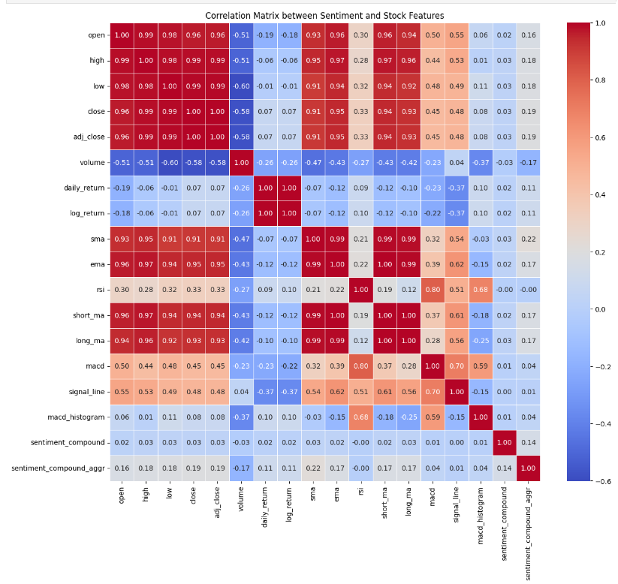
Correlation Matrix between Sentiment and Stock Features

Slide 13
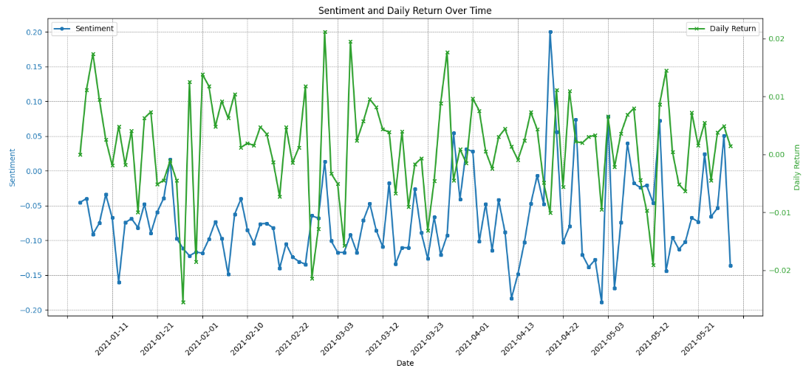
Sentiment and Daily Return Over Time
January 17, 2024

Slide 14
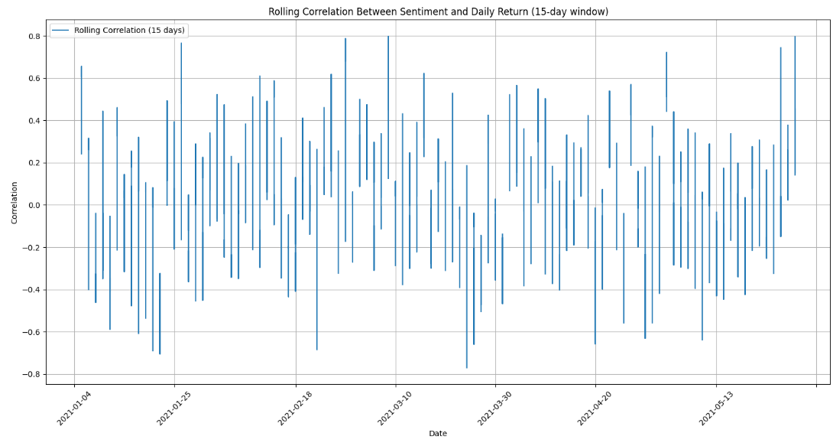
Rolling Correlation Between Sentiment and Daily Return
January 17, 2024

Slide 15
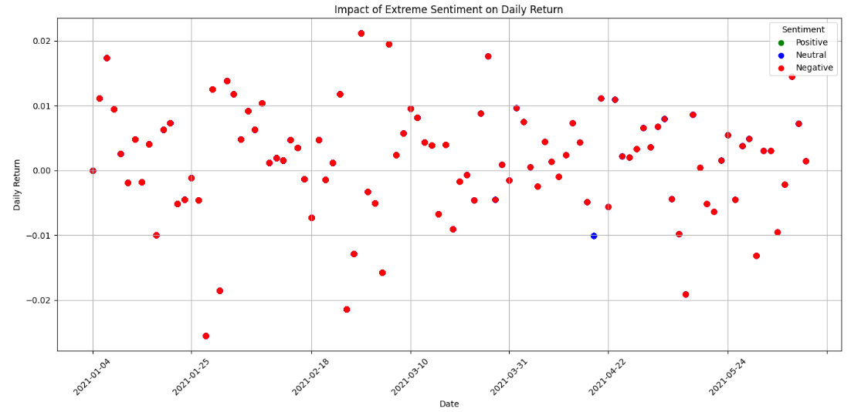
Impact of Extreme Sentiment on Daily Return
January 17, 2024

Slide 16
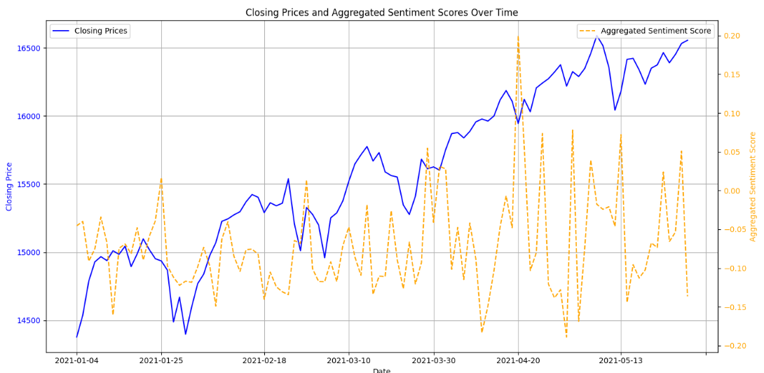
Closing Prices and Aggregated Sentiment Scores Over Time
January 17, 2024

Slide 17
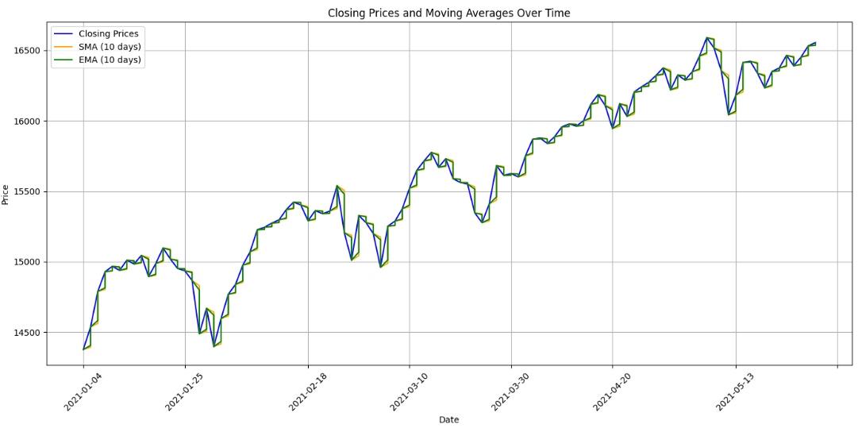
Closing Prices and Moving Averages Over Time
January 17, 2024

Slide 18
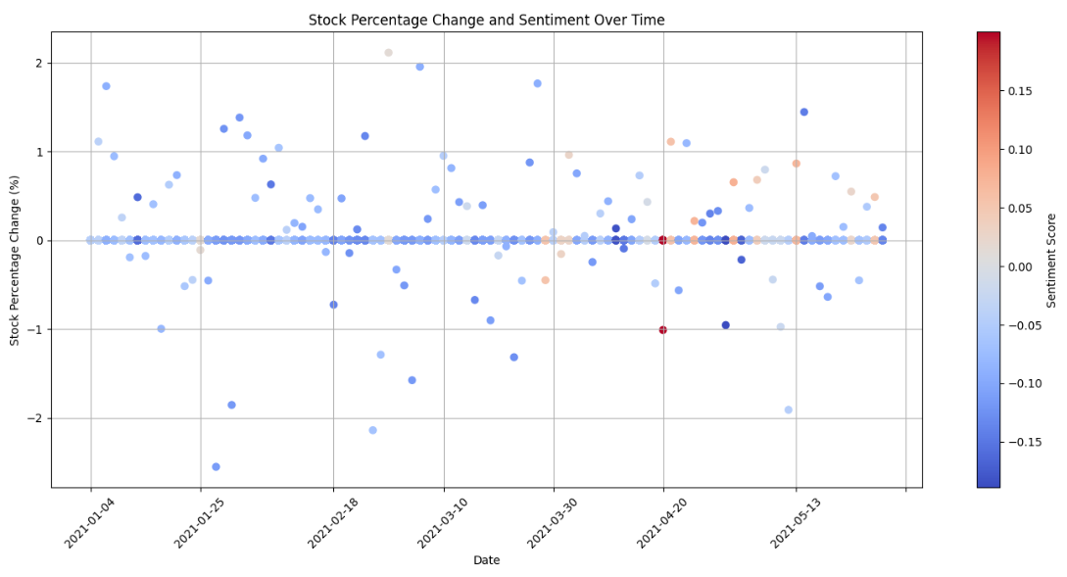
Stock Percentage Change and Sentiment Over Time
January 17, 2024

Slide 19
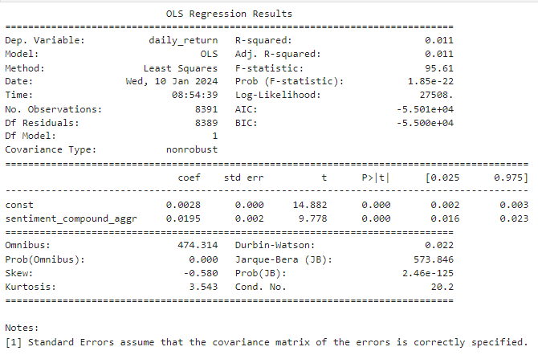
OLS Regression Results

Slide 20
Conclusion
News Sentiment Analysis
Examined the influence of news sentiments on stock prices using 2021 data.
Key Findings
Statistical Insight
High sentiment scores positively affect market dynamics; low scores correlate with downturns.
OLS regression shows a modest but significant link between sentiment scores and stock returns.
January 17, 2024

Slide 21

Thank you
Mohammad Ahmed
mohammad.ahmed@fau.de

