Slide 1

MTA Turnstile Data Analysis for Cleaning Services
By: Mohammed Abduldaim

Slide 2
BMS Janitorial Services
BMS is a janitorial and cleaning services provider based in New York. The company has entered a contract with MTA to handle the subway station janitorial and cleaning tasks. So they have approached me to analyze the stations traffic to figure out the best time of day to perform the cleaning services for the stations.

Slide 3
Problem Description
BMS is responsible for cleaning the stations however they only perform their services once a day. So, they would like to find the busiest time of day and start operating afterward.
This would allow BMS to target the optimal time of day to perform and ensure client satisfaction which can assist their growth in the industry and becoming more reputable.

Slide 4
Data Set
The MTA data set contain information pertaining the turnstile gate for every station. Spanning over a decade, the data records every entry and exist for each gate cumulatively every four hours. It also includes the gate id, where it's station date and time of records and more.
The sample I've chosen is 3 month long (MAY – August) 2021, as it is the newest set of data.
The data has 2513079 rows and 11 columns

Slide 5
Data Set
C/A: Control Area
UNIT: Remote Unit for a station
SCP: Subunit Channel Position represents a specific address for a device
STATION: Represents the station name the device is located at
DIVISION: Represents the Line originally the station belonged to BMT, IRT, or IND
DATE_TIME Represents the date and time
ENTRIES_DIFF: Total entries
EXITS_DIFF: Total EXITS
TOTAL: total traffic per turnstile

Slide 6
Assumptions
Sample: I've chosen the to look at the top, lowest and a random station total traffic believing they would be good representees of all stations
Traffic: I decided not to use the entries count and calculated the total traffic using the entries and exits count

Slide 7
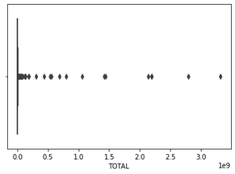
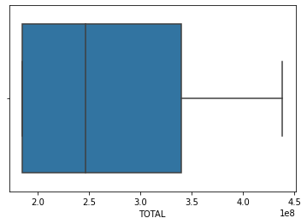
Challenge
Missing values: out of 2513202 row of data only 53 row had missing values, given their small number I assumed it would be safe to drop them rather than correct or transform them in any way
Outliers: keep only the ones that are within +0.5 to –0.5 standard deviations
Before
After

Slide 8
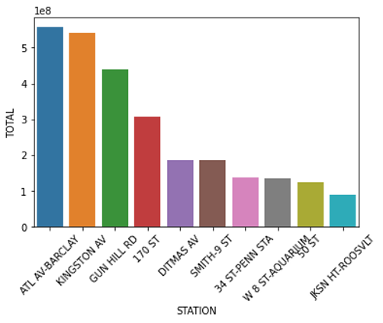
Findings
Stations
I decided to take one of the top few and the same for the lowest stations and randomly chosen on of from the middle
Sample:
Gun Hill RD, Ditmas AV, 50 ST

Slide 9
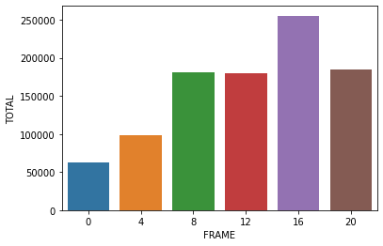
Findings
Top station: Gun Hill
Observation: most traffic starts at 8 AM and peaks at 4 PM and the least traffic is between 12 AM and 8 AM

Slide 10
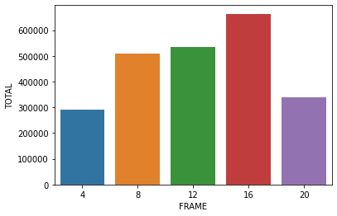
Findings
Low station: 50 ST
Observation: we can see a similar pattern to the Gunhill chart
also, there are no entries recorded for the 12 AM time frame I assume that’s due to the station not operating after 8 PM

Slide 11
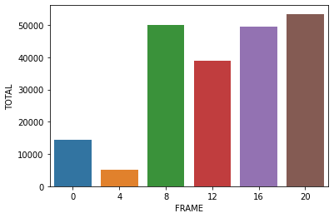
Findings
random station: Ditmas
Observation: the station has a somewhat different pattern
However, the low traffic time frames are similar

Slide 12
conclusion
The company can benifet by operating after 8 pm or before the traffic at 8 AM

