Slide 1

Human Face Recognition Attendance System (FRAS)
Final Project Presentation · 2026 Optimization
Mohammed Bilal K
Adhik S
Reg No: U03EC23S0178
Reg No: U03EC23S0104
Saugandh R K Pal
Reg No: U03EC23S0152

Slide 2
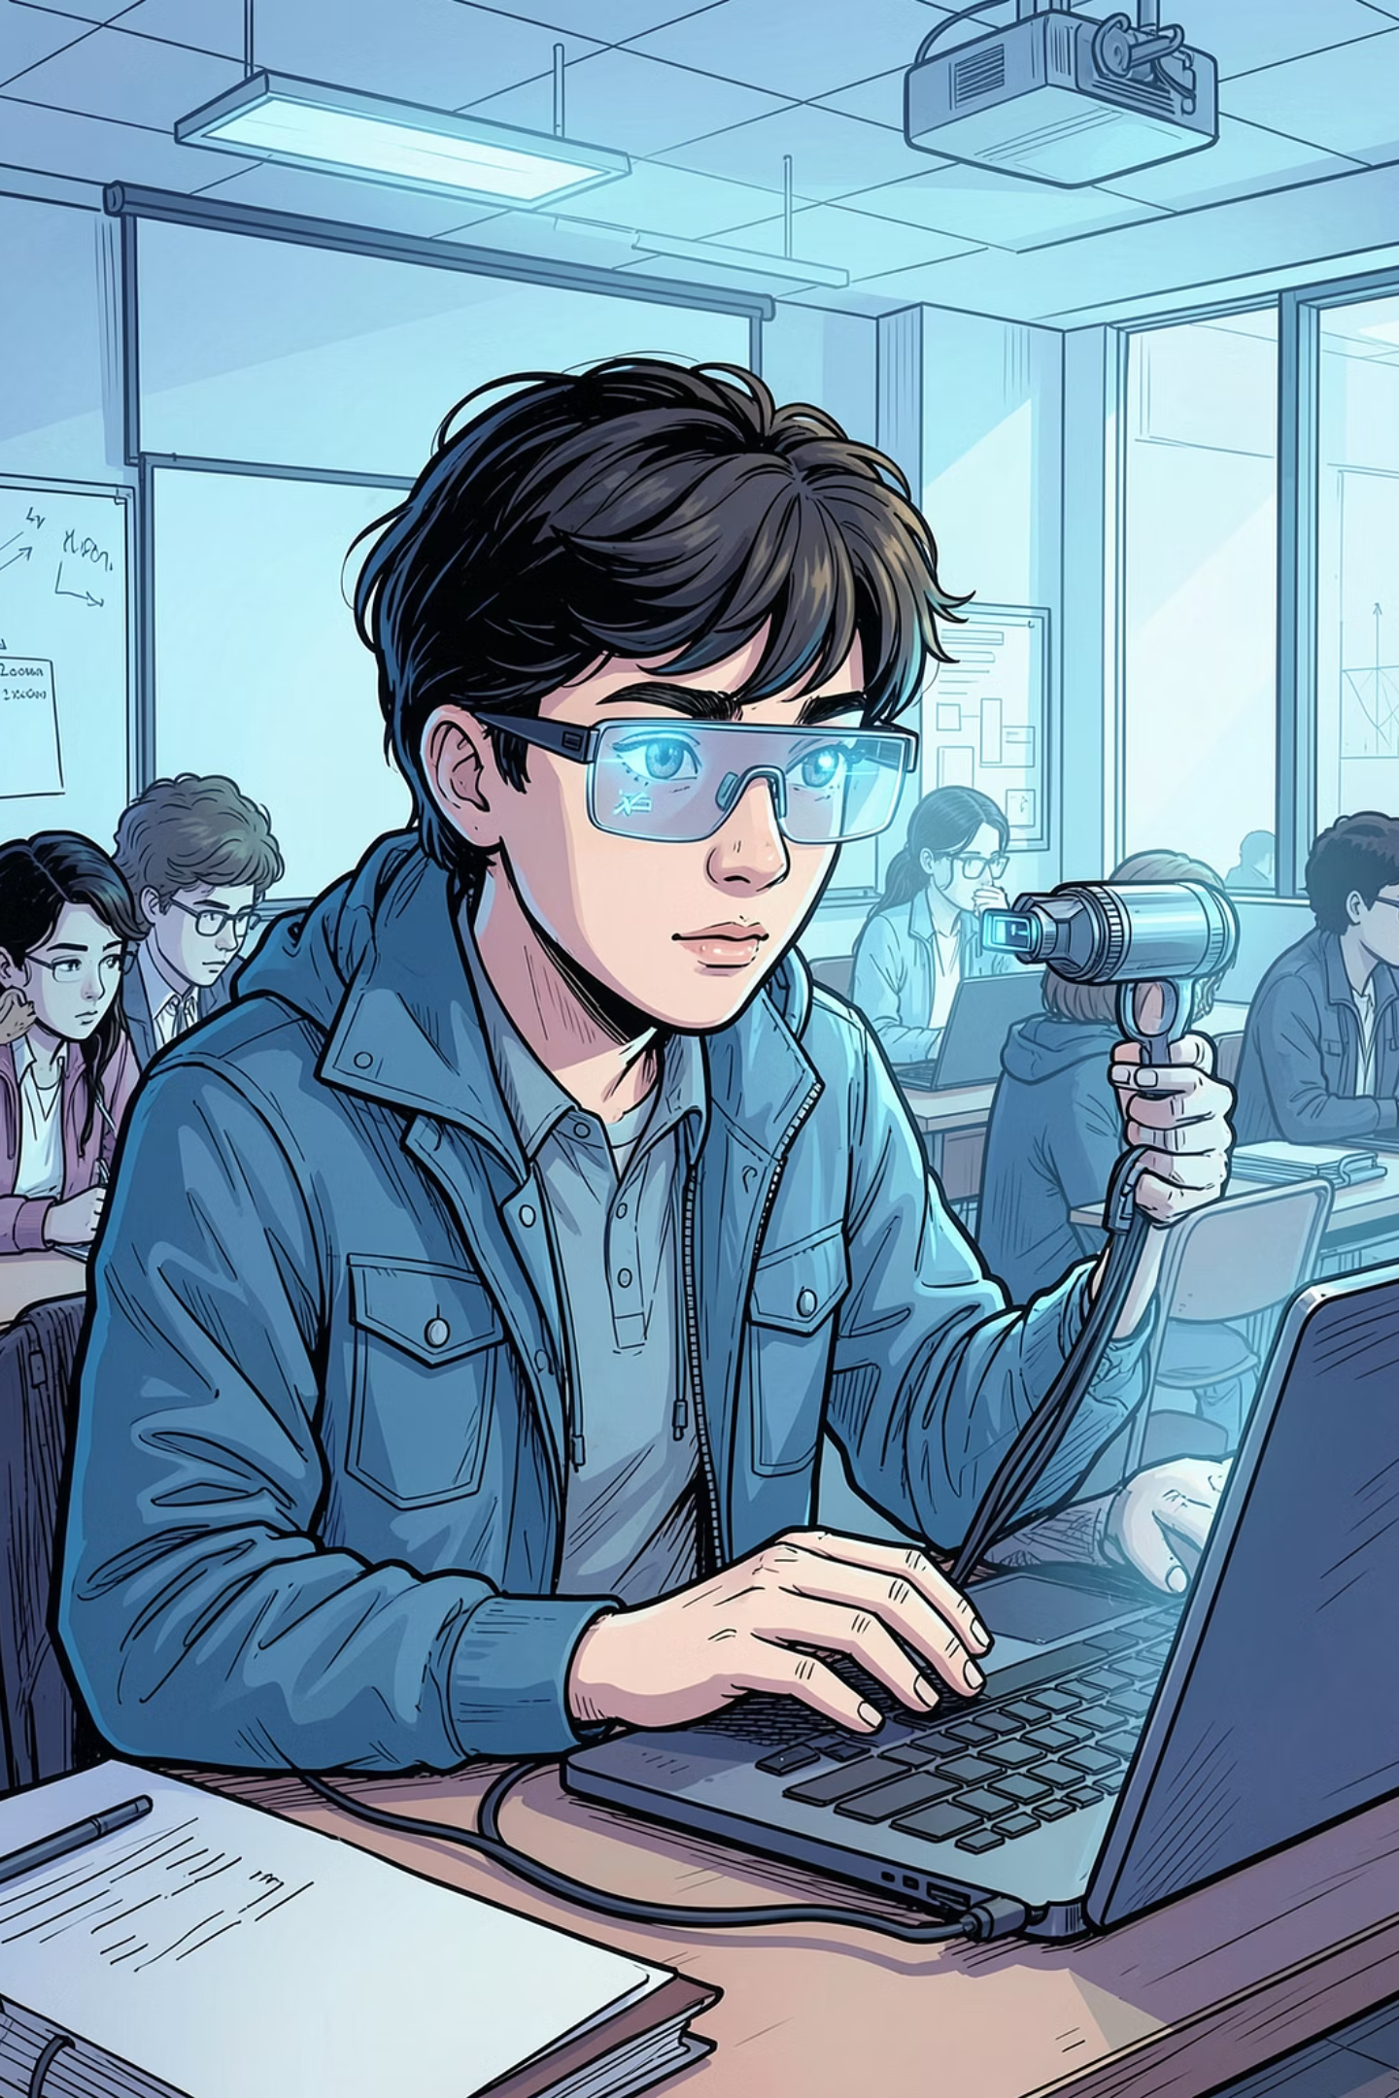

Introduction & Objective
FRAS is a computer-vision-based attendance system that recognizes student faces in real-time and automatically matches them against a local database — eliminating manual roll calls entirely.
The Concept
A Python-driven system using a standard laptop webcam to detect, process, and identify faces — logging attendance automatically with zero manual input from lecturers or administrators.
Primary Goal
To provide lecturers and administrators with an authentic, automated, and tamper-proof method to track student attendance and manage absenteeism seamlessly — reducing human error and proxy attendance.

Slide 3

SYSTEM ARCHITECTURE
Plan of Work: Image Processing Pipeline
FRAS operates through a structured five-stage pipeline — from raw image capture through to a confirmed attendance record. Each stage processes and refines data before passing it to the next, ensuring accurate and reliable face matching.
Image Capture
Recognition
Pre-processing
This end-to-end workflow executes in real-time on standard hardware, with each stage building on the previous to transform a raw webcam frame into a verified attendance entry.

Slide 4

Core Technology & Features
Development Stack
What is a "Feature"?
Language: Python 3 — chosen for its rich ecosystem of computer vision libraries including OpenCV, NumPy, and face_recognition
IDE: PyCharm — a professional-grade environment offering integrated debugging, version control, and project management
Vision Library: OpenCV — for real-time frame capture, image preprocessing, and face detection
Recognition Engine: face_recognition library built on dlib's deep learning models
In computer vision, a feature is an inherent, measurable data point within an image — such as pixel intensity values, edge gradients, corner points, or geometric shapes. FRAS combines thousands of these micro-features to build a unique facial signature.
These signatures allow the algorithm to distinguish human faces from background objects and differentiate one individual from another — even under varying lighting or minor pose changes.
Features are the fundamental building blocks that enable automated identity verification without any manual input.

Slide 5

CRITICAL COMPARISON
2019 Legacy vs. 2026 Optimized Implementation
Our 2026 optimization represents a fundamental architectural shift — from hardware-dependent to fully software-driven. The table below highlights the key improvements achieved through modern laptop computing power.
Dimension
2019 Legacy System
2026 Optimized System
Hardware Approach
External components: Raspberry Pi, HD Webcam, SD Card
Zero External Hardware — runs 100% on existing laptop with built-in webcam
Total Hardware Budget
₹5,500
₹0 — Fully Software-Driven
Computing Power
Limited by slow Raspberry Pi CPU and low RAM; heavy computations restricted
Modern laptop CPU/GPU for smooth, real-time local execution
Setup Complexity
Weeks of physical assembly, wiring, and component configuration
Instant deployment — plug-and-play capability from day one
The 2026 optimization eliminates all hardware costs and setup overhead, making FRAS deployable on any standard laptop immediately.

Slide 6
Project Timeline & Lean Workflow
The 2026 implementation follows a streamlined 11-week software-only development cycle, structured into four focused phases. Each phase builds directly on the previous, ensuring a logical progression from research through to a fully tested, deployable system.
Phase 1 — 3 Weeks
1
Image Processing Research & Algorithm Learning
Studying face detection algorithms, OpenCV fundamentals, and feature extraction techniques to establish the theoretical foundation.
2
Phase 2 — 3 Weeks
System Code Development & Database Training
Writing core Python modules, building the local face database, and training the recognition model with sample datasets.
Phase 3 — 2 Weeks
3
Camera Calibration & Interface Integration
Calibrating the built-in webcam, refining the user interface, and integrating all system modules into a unified application.
4
Phase 4 — 3 Weeks
System Optimization & Final Testing
Performance tuning, accuracy benchmarking, edge-case testing, and final documentation for project submission.

Slide 7
Interface & User Menu
FRAS features a clean, menu-driven command-line interface designed for ease of use by lecturers and administrators. The six-option welcome menu guides users through the complete attendance workflow — from initial hardware checks to automated email notifications.
FRAS Welcome Menu
How It Works
Select an option to proceed:
Each menu option corresponds to a discrete stage in the attendance workflow. Lecturers can register new students, run recognition sessions, and notify absent students — all from a single unified interface.
[1] Check Camera — Verify webcam connectivity and preview live feed
[2] Capture Faces — Register new student faces into the database
[3] Train Images — Process and encode captured images for recognition
[4] Recognize & Attendance — Run live recognition and log attendance
[5] Auto Mail — Trigger automated absentee notification emails
[6] Quit — Exit the application safely
Non-Technical
Modular
No coding knowledge required to operate
Each function operates independently

Slide 8
Result Analysis & Limitations
1,200+
80-81%
₹0
Facial Images
Recognition Accuracy
Hardware Cost
Total images evaluated and used to train the local recognition database
Real-time face identification accuracy achieved under controlled conditions
Total expenditure on external hardware — fully software-driven on existing laptop
What We Achieved
Current Limitations
With a dataset exceeding 1,200 facial images, the system consistently identifies registered students in real-time with an accuracy rate of 80–81% — a strong baseline for a local, non-neural implementation running on standard hardware.
Distance Constraint: Recognition performance degrades beyond the optimal range of the built-in webcam
Lighting Sensitivity: Accuracy fluctuates under poor or inconsistent ambient lighting conditions
Dataset Ceiling: Local, non-neural datasets have inherent scalability limits compared to deep learning models

Slide 9
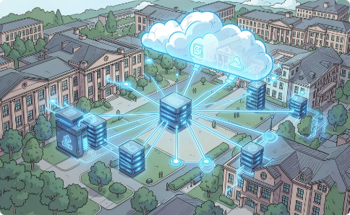

Future Scope & Upgrades
FRAS has a clear roadmap for evolution — from a local laptop application to a scalable, enterprise-grade attendance platform. Two major upgrades are planned to push accuracy and deployment capability significantly further.
Cloud Integration
Deep Learning Integration (CNN)
Transition the local application into an online, web-based platform capable of scaling deployment across entire universities, factories, or corporate workplaces. A cloud-hosted database would enable centralized attendance management, remote access for administrators, and real-time synchronization across multiple locations simultaneously.
Upgrade the current local feature-extraction code to a Convolutional Neural Network (CNN) model. This would dramatically expand the scalable dataset size and push real-time recognition accuracy metrics toward 99.9% — matching industry-standard biometric systems used in enterprise security and identity verification.

Slide 10
Conclusion & Q&A
"FRAS demonstrates that a fully functional, real-time face recognition attendance system can be built at zero hardware cost — leveraging modern laptop computing power and open-source Python libraries to deliver a practical, tamper-proof solution for academic environments."
Key Achievements
Thank You
Zero external hardware — 100% software-driven
Real-time face recognition at 80–81% accuracy
Trained on 1,200+ facial images
Modular, user-friendly command-line interface
Automated absentee email notifications
Full cost optimization from ₹5,500 to ₹0
We appreciate the time and attention of the examination panel. We are happy to address any questions regarding the system architecture, implementation decisions, results, or future roadmap.
Mohammed Bilal K · U03EC23S0178
Adhik S · U03EC23S0104
Soughand R K Pal · U03EC23S0152
OPEN FOR QUESTIONS

