Slide 1
UIT 43 File Export And Managements System

Slide 2
MySQL
Auto Sync
Realtime-Sync
Default
Verify Data

Slide 3
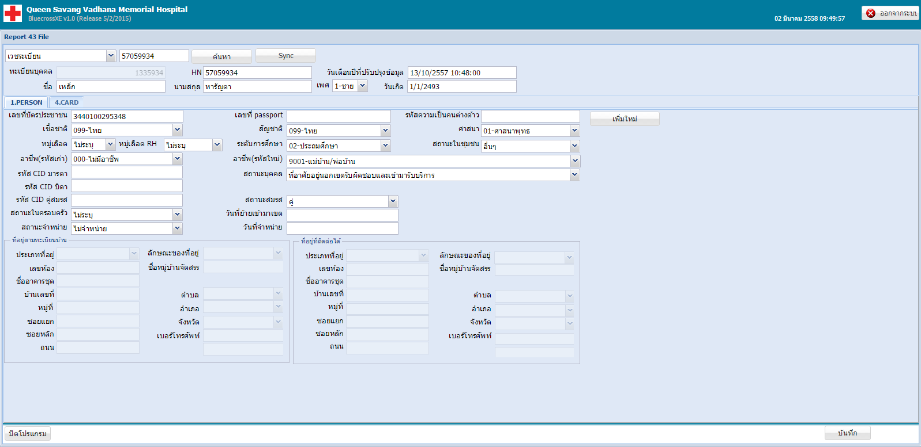

Slide 4
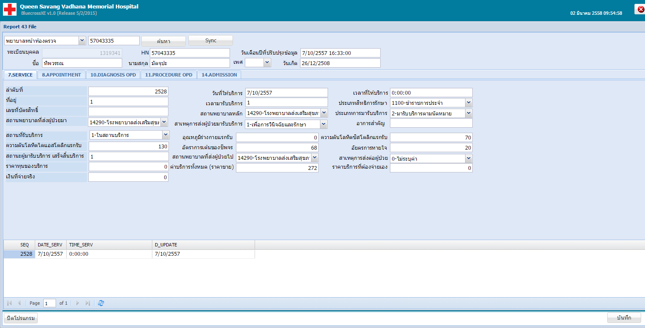

Slide 5
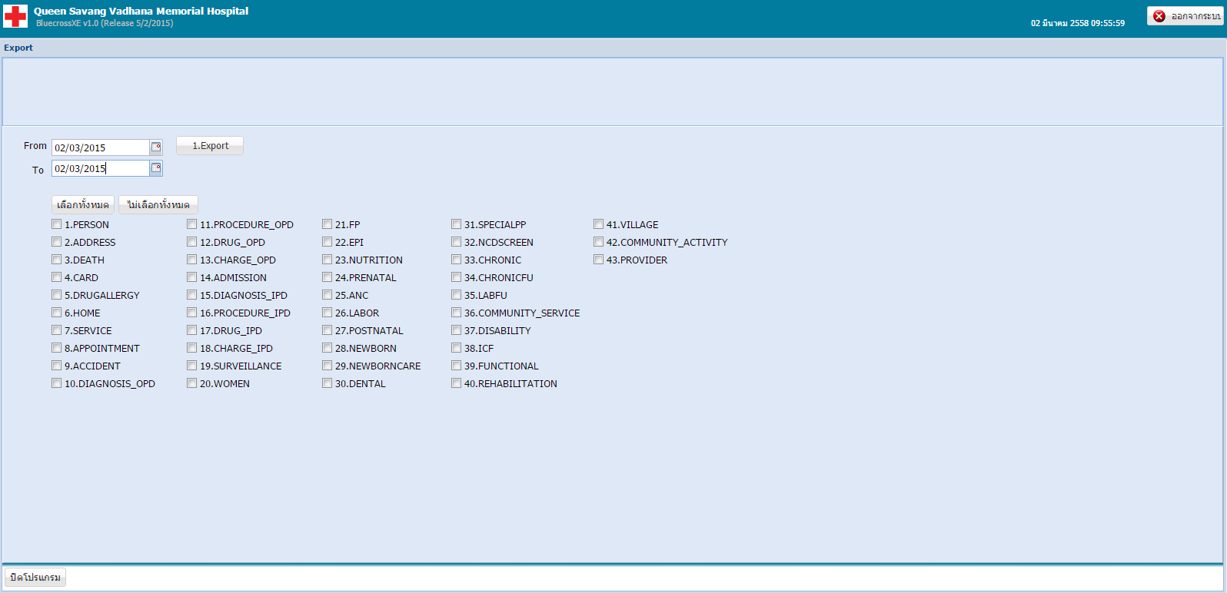

Slide 6
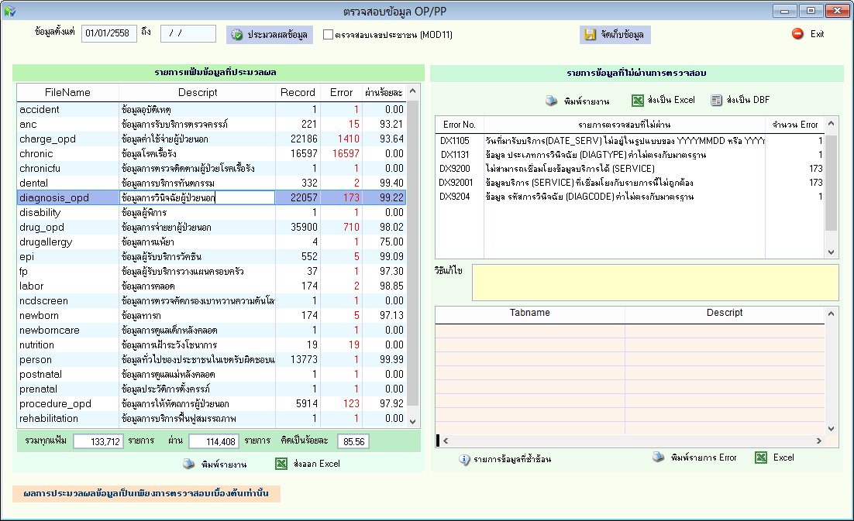

Slide 7
