Slide 1

HEALTHCARE ANALYTICS
📊 3 Dashboard Modules
🏥 Network Scale
Executive Healthcare Performance & Strategic Insights Dashboard
Executive Overview · Hospital Operations · Strategic Intelligence
39.9K Hospitals · 40.3K Doctors · 55.5K Patients
💰 Total Revenue
$1,417.4M across all healthcare facilities
Operational Efficiency, Patient Trends, Revenue Intelligence & Clinical Outcomes Analysis
A comprehensive, data-driven executive briefing synthesizing hospital operations, patient flow, financial performance, and clinical outcomes across the healthcare network.
PRESENTER: MOHD FAIJ
Healthcare Report

Slide 2







PROJECT OVERVIEW
Project Overview & Business Objectives
1
Core Business Goals
Improve Operational Efficiency
2
Identify bottlenecks in patient flow and resource utilization across the hospital network.
3
1
Executive Healthcare Overview
Analyze Patient Admissions & Track Revenue
Top-level KPI monitoring across all hospitals — revenue, patient volumes, doctor capacity, and emergency admission rates in a single executive view.
Understand admission patterns and correlate them with revenue generation and billing performance.
Identify Clinical Risks & Optimize Emergency Care
2
Hospital Operations & Patient Flow
Surface high-risk clinical patterns and reduce emergency admission pressure through proactive planning.
Deep-dive analysis of admission types, monthly trends, demographic segmentation, and disease burden to optimize resource allocation and care delivery.
Analytics Workflow
3
Healthcare Intelligence & Strategic Insights
Strategic Insights
Raw Healthcare Data
KPI Analysis
Dashboard Creation
Decision Making
Compute revenue, volumes, capacity
Identify trends and improvement areas
Financial performance by insurance provider, clinical outcome analysis, and predictive insights to drive long-term strategic planning and decision-making.
Patient records, claims, device feeds
Executive view for hospitals
Allocate resources and set priorities

Slide 3




KPI SUMMARY
KPI Performance Summary
$1.4B
39.9K
Total Revenue
Total Hospitals
$1,417.4M generated across all facilities and patient segments
Network-wide hospital count supporting national healthcare delivery
40.3K
55.5K
Total Doctors
Total Patients
Active physicians across all specialties and departments
Cumulative patient admissions driving high utilization rates
32.9%
$25.5K
Emergency Admissions
Avg. Billing Amount
Share of total admissions classified as emergency cases
Average billed per patient, consistently high across hospitals
📈 Revenue Growth: High patient volume of 55.5K generated strong overall revenue growth of $1.4B across the network.
🚨 Operational Pressure: Emergency admissions at 32.9% created significant strain on hospital resources and staffing.
💳 Billing Stability: Average billing of $25.5K remained consistently high across all hospital types and patient categories.

Slide 4

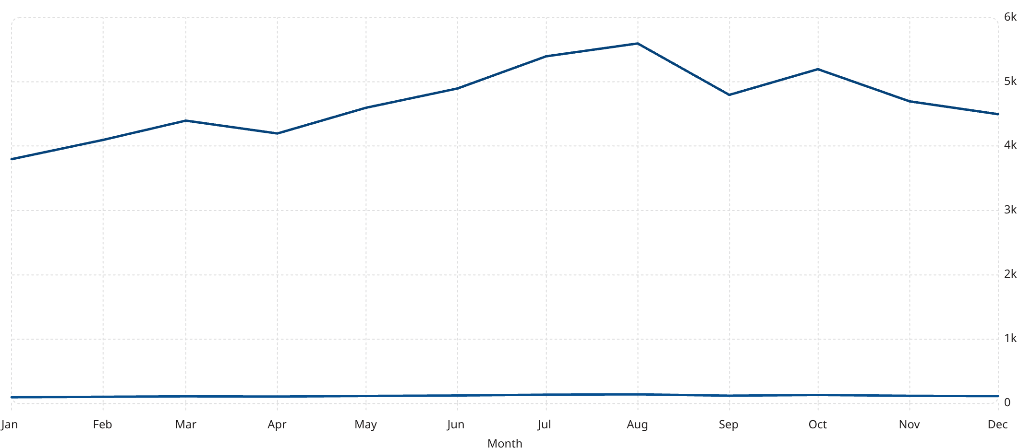
REVENUE TRENDS
Monthly Revenue & Patient Trend Analysis
Revenue (M)
Patient Count
Executive Insights
📊 Revenue–Admissions Correlation
Revenue strongly correlates with patient admissions — months with higher patient volumes consistently produced proportional revenue increases.
🌡️ Seasonal Demand Spikes
Seasonal spikes in July–August and October increased hospital utilization, creating resource and staffing pressure across the network.
📈 Stable Monthly Growth
Dual-axis trend analysis showing patient volume (count) vs. revenue ($M) January–December. Peak utilization observed in July, August, and October driven by seasonal healthcare demand surges.
Stable monthly growth trajectory indicates strong, consistent healthcare demand and a resilient patient pipeline throughout the year.

Slide 5

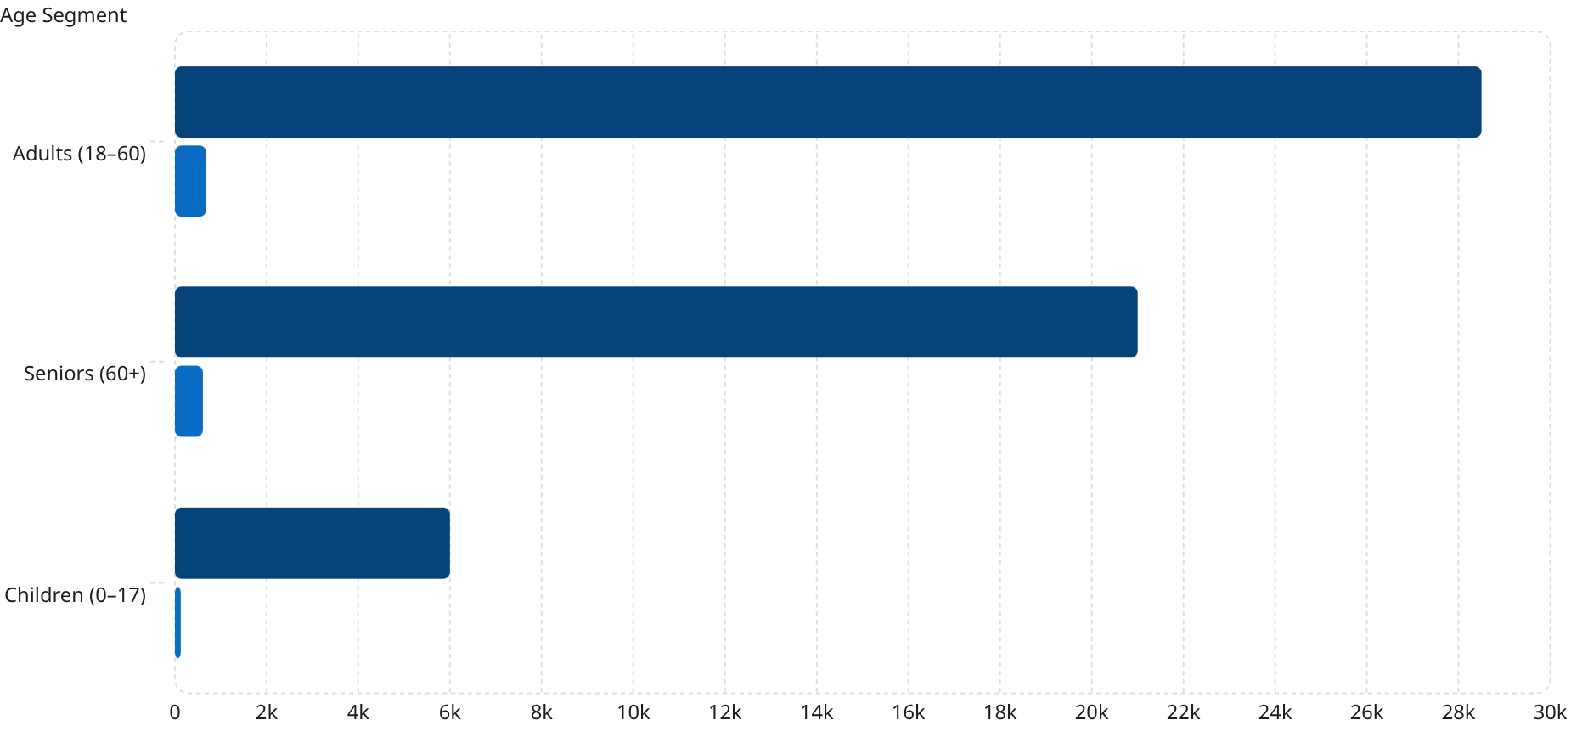
DEMOGRAPHICS
Patient Demographics & Age Analysis
Patient Volume
Revenue Contribution (M)
Demographic Key Findings
28.5k
🧑 Adult Segment
👴 Senior Segment
680
Adults generated the highest patient volume at 28.5K, representing over 51% of total admissions and the largest revenue contributor at $680M.
Seniors at 21K patients contributed significantly to healthcare costs, averaging higher billing amounts due to complex, chronic care needs.
21k
610
6k
127
👶 Child Segment
Patient volume and revenue contribution segmented by age group. Adults lead in volume while Seniors drive disproportionately high healthcare costs.
The child segment remained comparatively low at 6K patients, contributing $127M — indicating lower acute care utilization in pediatric populations.

Slide 6

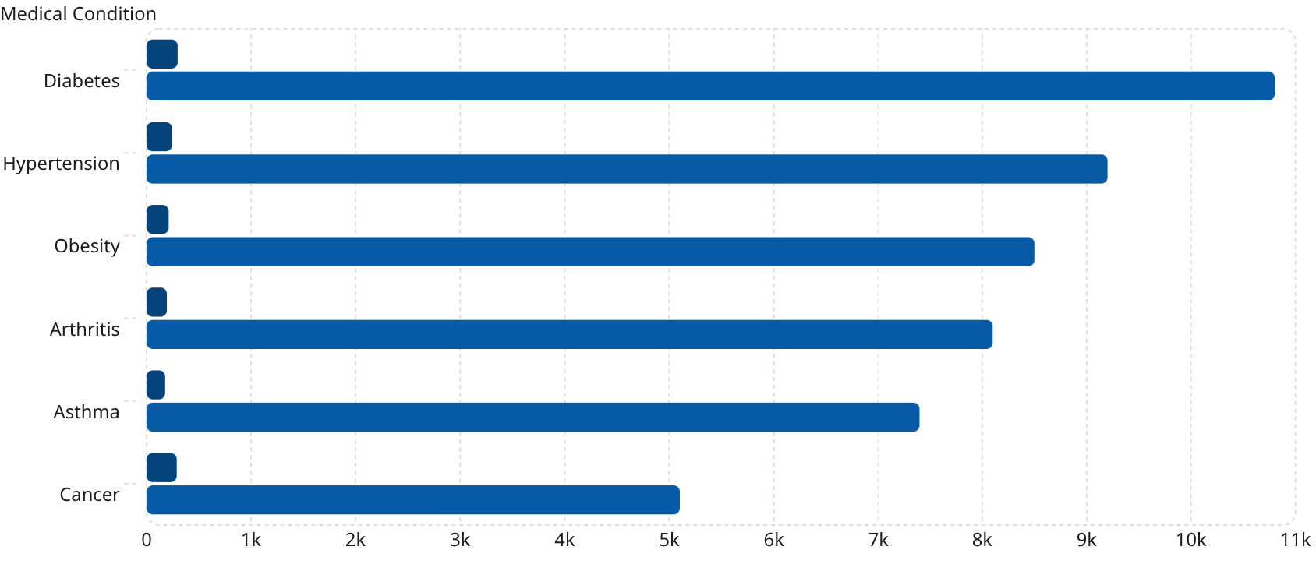



DISEASE ANALYSIS
Medical Condition & Disease Burden Analysis
Revenue Contribution by Condition ($M)
Strategic Clinical Insights
Revenue ($M)
Patient Volume
Diabetes — Highest Revenue Driver
Diabetes generated the highest overall revenue at $298M, driven by high patient volume of 10.8K and ongoing chronic care management requirements.
Chronic Diseases Dominate Admissions
Diabetes, hypertension, obesity, and arthritis collectively accounted for the majority of all healthcare admissions, reflecting a chronic disease epidemic.
Disease burden comparison showing revenue and patient volume across six major chronic and acute conditions. Cancer yields high revenue per patient despite lower volume.
Obesity & Hypertension — Long-Term Load
Obesity and hypertension together contribute $457M in revenue and increased long-term operational load through recurring admissions and complex care pathways.

Slide 7


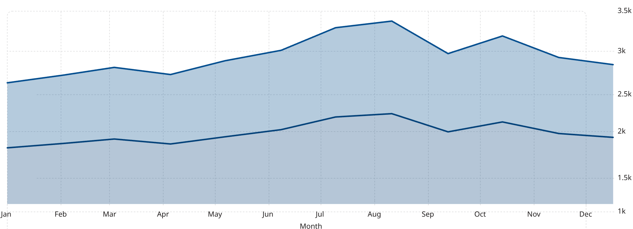

EMERGENCY OPERATIONS
Emergency Admission & Operational Pressure Analysis
Admission Type Distribution
Monthly Emergency Admission Trend
Urgent Admissions
Emergency Admissions
Emergency·32.92%
·32.92%
·
Urgent·38.14%
·38.14%
·
Elective·28.94%
·28.94%
·
Emergency admissions represent 32.92% of all hospital admissions, placing significant pressure on operational capacity and clinical staffing.
🚨 Operational Alert: Emergency admission rate of 32.92% exceeds recommended sustainable thresholds for most hospital networks.
Emergency cases significantly increased hospital workload
Balanced elective admissions improved revenue stability
Peak emergency volumes in July–August coincide with peak total admissions, creating compounded staffing and bed management challenges.
Elective admissions at 28.94% maintained a predictable revenue floor, partially offsetting volatility from emergency and urgent care surges.

Slide 8

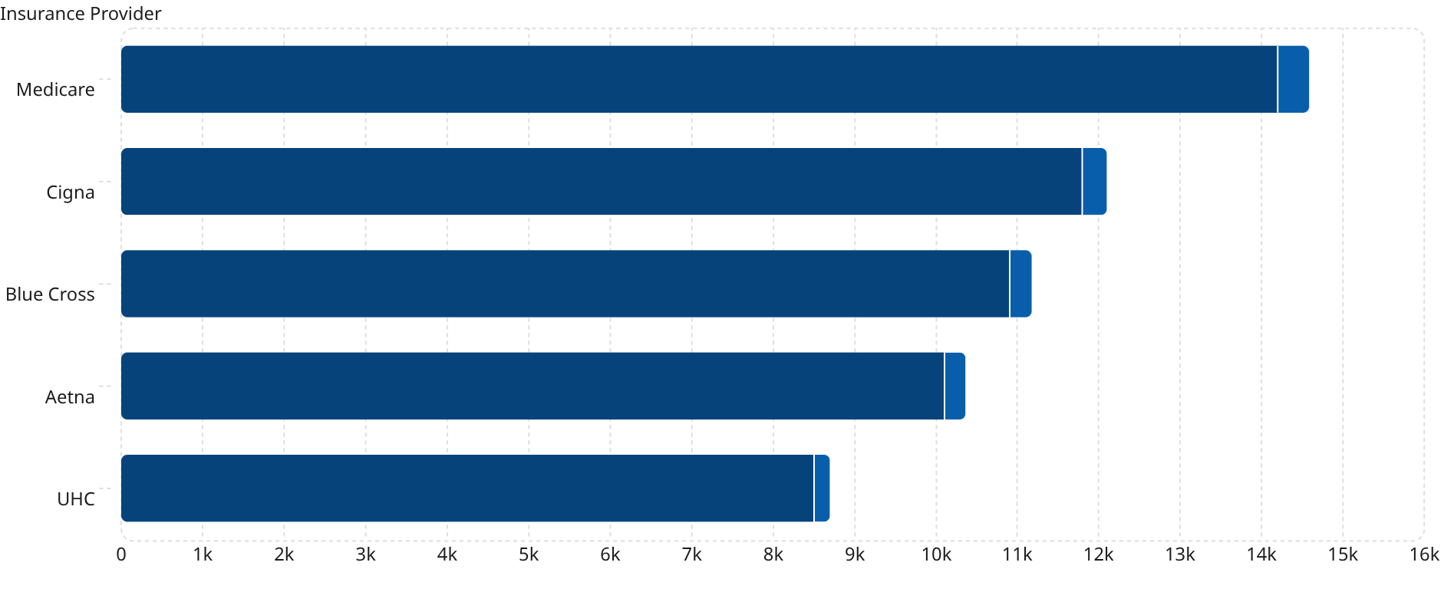



FINANCIAL INTELLIGENCE
Insurance Provider & Revenue Driver Analysis
Revenue & Patient Volume by Insurance Provider
Financial Intelligence Insights
Patient Volume
Revenue ($M)
Medicare — Highest Billing Volume
Medicare patients generated the highest billing volume at $385M, representing 14.2K patients and reflecting the high-cost nature of senior healthcare services.
Insurance Segmentation & Revenue Stability
Diversified coverage across five major providers — Medicare, Cigna, Blue Cross, Aetna, and UHC — influenced overall revenue stability and reduced single-payer dependency.
Balanced Provider Mix Reduces Risk
Insurance provider comparison across patient volume and revenue contribution. Medicare leads across both dimensions, reflecting the dominance of senior-aged patients in the network.
The balanced insurance provider distribution ensures no single payer represents a critical concentration risk, reducing financial dependency and improving long-term stability.

Slide 9

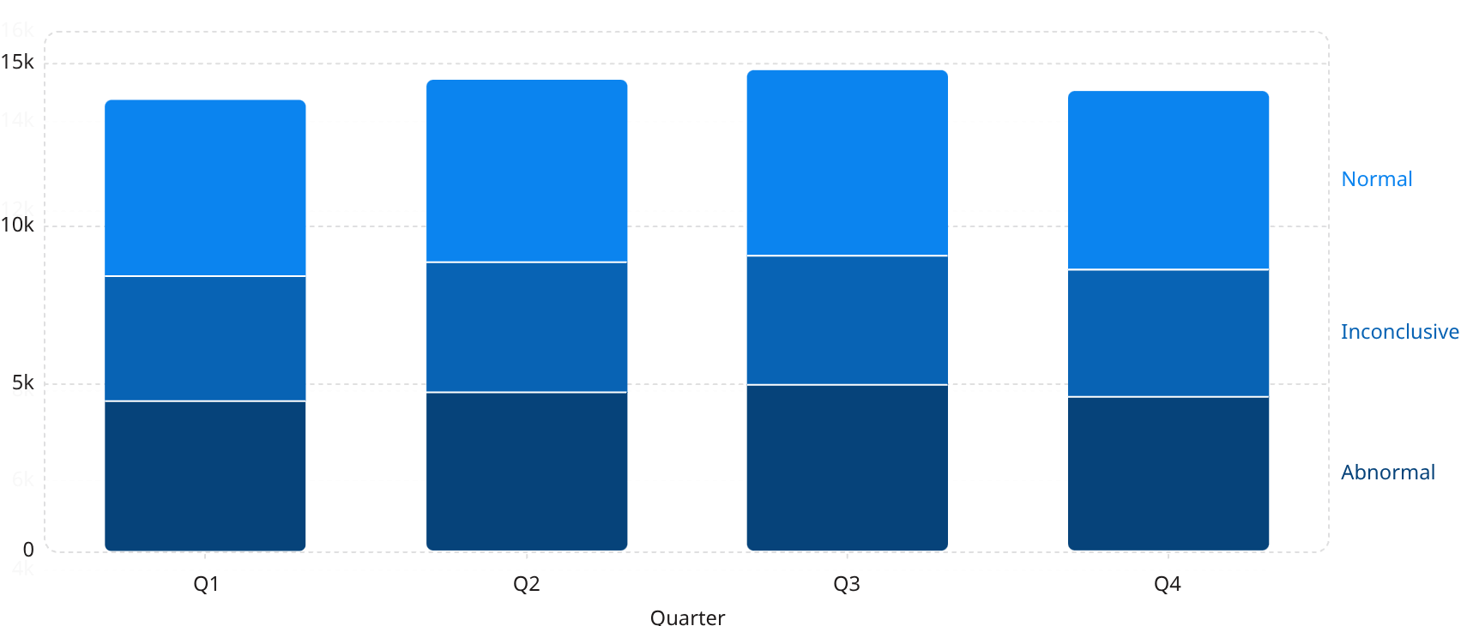

CLINICAL OUTCOMES
Clinical Outcomes & Test Result Analysis
Diagnostic Test Result Distribution
Clinical Analytics Insights
🔬 High Abnormal Results = Elevated Clinical Burden
💰 Diagnostic Complexity Raised Operational Costs
With approximately 33.5% of all test results classified as abnormal, hospitals face sustained clinical burden from diagnosis complexity, follow-up requirements, and specialist referrals.
Inconclusive results — averaging 27% quarterly — require repeat testing and extended diagnostic pathways, directly raising operational and laboratory costs across facilities.
🛡️ Preventive Care Could Reduce Future Admissions
Structured preventive healthcare strategies targeting high-risk patient cohorts may significantly reduce future abnormal outcomes and associated emergency admission rates.
Quarterly breakdown of test results across abnormal, inconclusive, and normal categories. Abnormal results consistently represent approximately 33.5% of all diagnostic outcomes.
⚠️ Clinical Risk Alert: Abnormal test rate of ~33.5% signals elevated clinical burden and increased demand for specialist intervention and follow-up care.

Slide 10

STRATEGIC RECOMMENDATIONS
Strategic Recommendations & Executive Conclusion
🔍 Key Findings
🚀 Strategic Recommendations
01
02
Emergency Admissions — Operational Pressure
Diabetes — Highest Revenue Contributor
Improve Emergency Response Infrastructure
Increase Preventive Healthcare Programs
Emergency admissions at 32.92% drove significant operational strain across hospital networks, requiring urgent capacity investment.
Diabetes generated the highest revenue at $298M and represents the single largest disease burden across the patient population.
Invest in emergency department capacity, triage protocols, and real-time bed management systems to reduce bottlenecks.
Launch targeted prevention programs for diabetes, hypertension, and obesity to reduce chronic disease admissions and long-term costs.
03
04
Senior Patients — Elevated Healthcare Costs
Clinical Abnormalities — Treatment Complexity
Optimize Staffing During High-Demand Months
Enhance Insurance Partnerships & Use Predictive Analytics
Senior patients at 21K volume contributed disproportionately to overall healthcare costs through complex, multi-condition care needs.
Abnormal test results at ~33.5% highlighted significant diagnostic and treatment complexity across all major care departments.
Use seasonal trend data (July, August, October peaks) to pre-position staffing resources and prevent utilization-driven quality degradation.
Strengthen multi-payer relationships to diversify revenue and deploy predictive models for proactive hospital capacity planning.
📌 Executive Conclusion: This healthcare analytics initiative establishes a foundation for data-driven decision-making across the network. By addressing emergency capacity, chronic disease burden, and clinical outcomes systematically, the organization is positioned for sustainable performance improvement. The future scope includes real-time predictive dashboards, AI-driven clinical risk scoring, and dynamic insurance revenue optimization.

