Slide 1
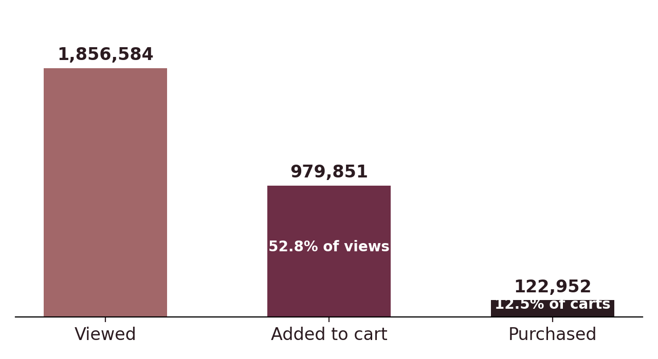
THE PROBLEM
Customers fill baskets.
Almost none check out.
979,851 items were added to a cart in October 2019.
857,000 of them were never bought.
1.86M items viewed → 0.98M carted → 0.12M purchased
7.2×
More value sits in abandoned baskets than the shop actually earned
REES46 cosmetics shop · October 2019 · 3.88M events · 399,366 users
Notes:
Opening line: this shop does not have a traffic problem. It has a checkout problem. Half of everything viewed gets carted - that is healthy intent. Then seven out of eight of those baskets are abandoned. The 7.2x figure sizes the problem; it is not a recovery target, because some carting is browsing.

Slide 2
APPROACH
I followed every basket item to its ending.
1
2
3
4
4.1M raw events
Cleaned to 3.9M
Modelled six tables
One row per basket item
Every view, cart, removal and purchase logged by the shop.
Removed duplicate tracking fires, sessionless events and zero prices. 94.6% retained.
Rebuilt a flat event log into a star schema linking users, sessions, products and baskets.
Each of 979,851 items tagged: purchased, removed, or silently abandoned.
The distinction that matters: an item taken back out of a basket is a rejection. An item left behind is a disappearance. Most analyses report one blended number and miss that these need different fixes.
Notes:
Keep this to one line if asked: I took the raw event log, cleaned it, modelled it into a star schema, and reduced it to one row per basket item so every item had exactly one ending. The key judgement call was splitting abandonment into removed versus silent.

Slide 3
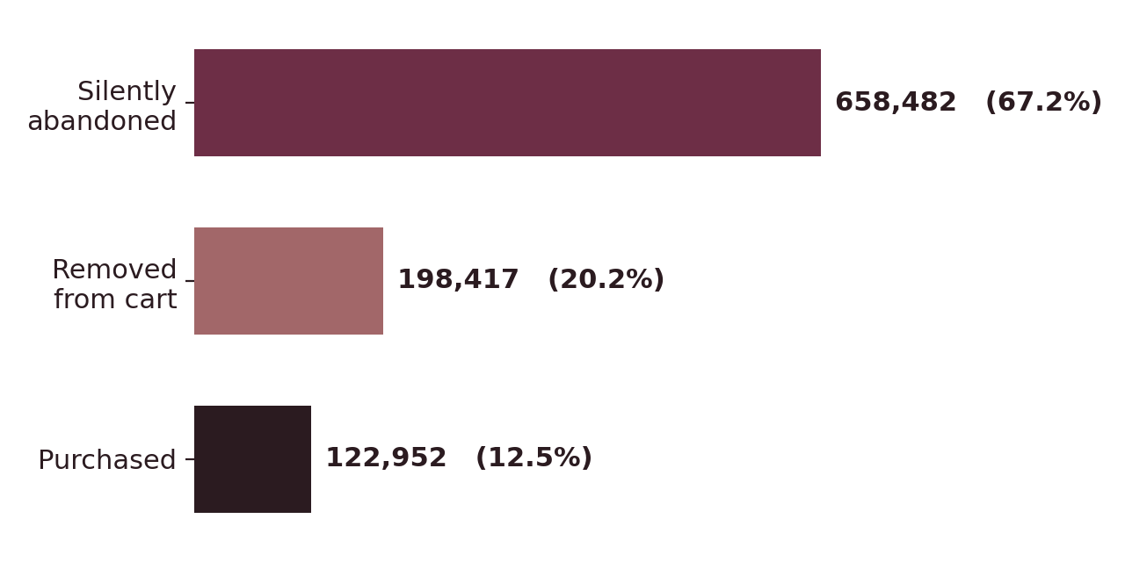
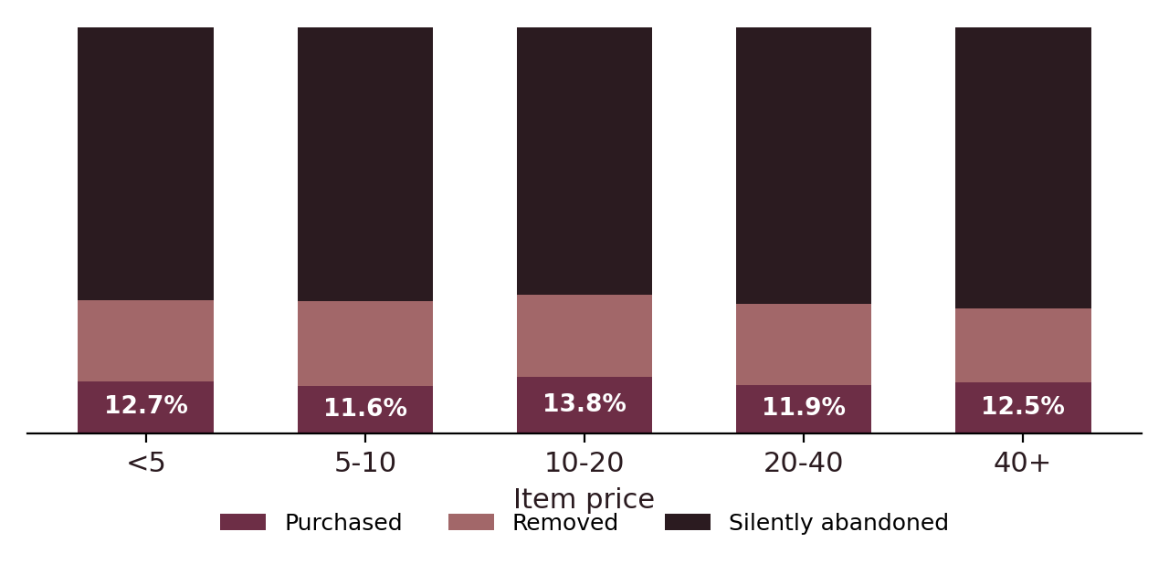
FINDINGS
Three findings — and one popular theory that failed
1 · They forget, they don't refuse
2 · Price is not the reason
Silent abandonment is 3.3× active rejection. Two thirds of items are never revisited at all.
Abandonment stays between 87.3% and 88.4% across a 10× price range. Tested and rejected.
3 · They don't come back. Only 9.7% of new visitors return the following week near identical across all four October cohorts. The abandoned basket and the lost customer are largely the same event.
Notes:
Finding 2 is the one to lead with if challenged. I expected price to drive abandonment. It does not - the spread is 1.1 points across a 10x range and it is not even monotonic. That rules out discounting, which is the intervention most people reach for first. I also tested first-visit versus returning visits and time of day; neither held up. Both are in the appendix of the written findings.

Slide 4
RECOMMENDATION
Remind them. Don't discount them.
Basket-recovery messaging
Addresses Finding 1
1
Target the 658,482 silently abandoned items not the 198,417 that were actively removed. These customers never rejected anything; they left and did not return.
IF 1–5%
RECOVERED
+5.6%
to
+27.8%
on realised
revenue
2
Baskets that survive the session
Addresses Finding 3
With a 9.7% week-one return rate, a persistent basket is the only remaining link to a customer who will otherwise never be seen again.
3
Do not cut prices
Addresses Finding 2
Abandonment is flat across a 10× price range. A discount sacrifices margin against a factor the data shows is not driving the behaviour.
Impact is a sensitivity, not a forecast it assumes a 1 to 5% recovery rate on the 3.55M of value in silently abandoned baskets. Slide 5 tests that assumption.
Notes:
Be careful with the impact range. Say: this is a sensitivity, not a projection. I have assumed a 1 to 5 percent recovery rate because I have no basis in this data to claim a specific one - that is exactly what the test on the next slide is for. If someone pushes, concede immediately that the true figure could be lower.

Slide 5
NEXT STEPS
Test it before believing it.
Split
Send
Measure
Guard
Randomly halve the silent-abandonment cohort.
One half receives a basket reminder within 24 hours. The other receives nothing.
Purchase rate on abandoned items within 7 days.
Watch the unsubscribe rate. A recovered basket is not worth a lost customer.
What this analysis cannot tell you
One month of data — no seasonality, and week-one return is a short window for a category people restock monthly.
Carting is not intent. Some baskets were never meant to convert, so abandonment overstates lost sales by an unmeasurable amount.
Bot filtering was conservative — 0.26% of sessions flagged. Likely an undercount.
Notes:
Closing line: the finding I am most confident in is that this is a memory problem, not a price problem. The finding I am least confident in is the size of the opportunity. That is why the first thing I would do is run the test, not roll out the fix.

