Slide 1
AI Food Genius
A Personalized AI-Powered Food Recommendation System
Python · Streamlit · 5-Model ML Ensemble · Collaborative Filtering · SQLite
Random Forest · XGBoost · LightGBM · CatBoost · Neural Network

Slide 2
What Is AI Food Genius?
AI Food Genius recommends the most suitable recipes for a user based on their age, health condition, dietary preference, cuisine, and taste profile. It runs entirely on a local machine — no paid APIs, no cloud services required.
Home
AI Recommendations
Analytics
Profile
Favourites
Dashboard with platform stats and trending recipes
Enter your profile and get personalized recipe suggestions
Model accuracy charts, calorie & cuisine breakdowns
Save preferences permanently; view your rating history
All recipes you saved, in one place
Users register and log in — profile, favourites, and ratings all persist across sessions (SQLite database).

Slide 3
The Dataset
Structured synthetic dataset built specifically for this application
250
200
3,000
26
Unique Recipes
User Profiles
Interactions
Columns / Record
Cuisines:
Indian · Italian · Asian · Mediterranean · Mexican · American
Diet Types:
Vegetarian · Non-Vegetarian · Vegan · Keto · Paleo
Taste Profiles:
Spicy · Sweet · Mild · Savory · Tangy
Health Conditions:
None · Diabetes · Iron Deficiency · Vitamin D Deficiency · High Blood Pressure
Every cuisine–diet combination has 4–15 recipes. Nutritional values are realistic by diet type (e.g. Keto = high fat & low carb by design).

Slide 4
How Recommendations Work
4-layer pipeline — runs every time you click Get Recommendations
1
2
3
4
✓
Filter
→
ML Score
→
Personalize
→
Collab Filter
→
Top 10
Diet · Cuisine Cooking Time
5-Model Weighted Ensemble
Taste · Health Nutrition
Similar-User Ratings
Best Recipes Shown to User
① Only recipes matching the selected diet type and cuisine enter — a Non-Vegetarian filter will never show chicken-free results.
② All 5 ML models score each recipe individually. Each model's vote is weighted by its measured accuracy.
③ Taste match (+25%), health-condition nutrition bonus (+20%), and nutrient quality (+15%) are added on top of the ML score.
④ After rating recipes, similar-user suggestions appear automatically — same approach used by Netflix and Spotify.

Slide 5
Layer 2 — The 5-Model AI Ensemble
Each model scores every recipe for the user; results are accuracy-weighted and combined
Random Forest
100 trees · max depth 10
by scikit-learn
An ensemble of 100 decision trees each trained on a random data subset. They vote together — robust and noise-resistant.
XGBoost
100 trees · depth 6 · logloss
by xgboost
Gradient-boosted trees built sequentially — each new tree corrects the previous one's errors. Strong on tabular data.
Neural Network
64 → 32 neurons · 300 iterations
by scikit-learn MLP
A three-layer neural network that learns non-linear relationships between features that tree models may miss.
LightGBM
200 trees · lr 0.05 · 31 leaves
by Microsoft
Leaf-wise tree growth (faster & more accurate than level-wise XGBoost). Handles large feature sets well.
CatBoost
200 iterations · depth 6 · lr 0.05
by Yandex
Handles categorical features (cuisine, diet type) natively — no manual encoding needed, less information loss.
Weighted Ensemble — Final score = Σ (model_accuracy / total_accuracy) × model_probability

Slide 6
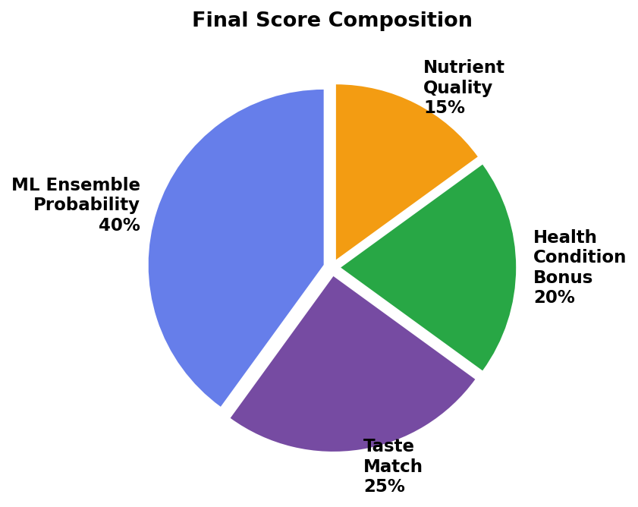
Layer 3 — Multi-Component Personalized Scoring
ML probability is only 40% — three more signals are combined on top
40% ML Ensemble
Probability output from 5 trained models learned from 3,000 user–recipe interactions.
25% Taste Match
Recipes whose taste tag (Spicy / Sweet / Mild / Savory / Tangy) matches yours get +0.25 bonus.
20% Health Condition Bonus
Diabetes → low carb + high fiber Iron Deficiency → high iron foods High Blood Pressure → low fat + high fiber
15% Nutrient Quality Score
A recipe-level nutritional balance score. Higher quality recipes ranked above lower ones.
Scores are normalized within the result set — the best and worst recipes are always clearly separated.

Slide 7
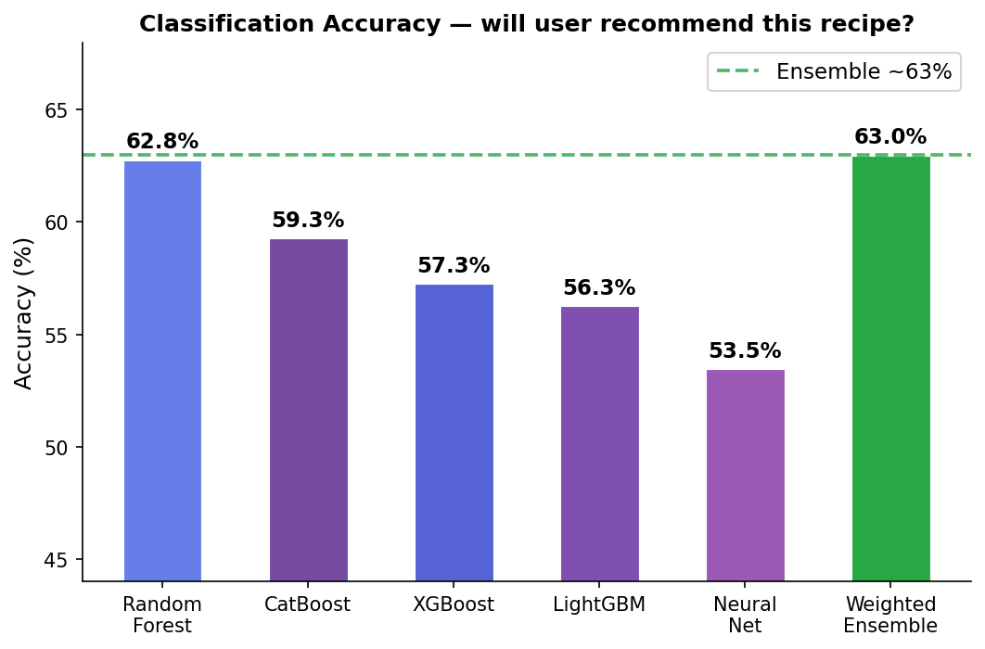
Model Accuracy
Evaluated on 20% held-out test set (600 records) — User_Rating excluded to prevent data leakage
Key Notes
What we measured
Binary classification: will this user recommend this recipe? (yes/no)
Test setup
600 records held out — never seen during model training
Best single model
Random Forest at 62.8%
Ensemble result
~63% — beats all individual models through accuracy-weighted voting
Data leakage prevented
User_Rating excluded from features (it directly predicts the target)

Slide 8
Our Results vs Research Papers
Honest context — why a direct comparison is not valid
Factor
Our System
Research Papers
Dataset
3,000 interactions (synthetic)
1 million+ interactions (real)
Recipes
250 unique (generated)
100,000 – 1 million (real)
Users
200 (generated profiles)
Millions of real users
Evaluation metric
Classification accuracy
NDCG@10, Precision@K, MAP
Reported accuracy
~63%
75 – 90%
Data source
Synthetically generated
Years of real user behaviour
What to say when asked:
"Our system achieves ~63% accuracy on a 3,000-record synthetic dataset using a 5-model weighted ensemble. Research papers report 75–90% on million-record real-world datasets using ranking metrics like NDCG@10 — a direct comparison is not meaningful at this scale. The architecture is production-grade; connecting to real data would close the gap significantly."

Slide 9
Data Storage & Security
CSV Files (final_dataset.csv)
SQLite Database (food_genius.db)
● 250 recipes × 200 users × 3,000 interactions
● users — username, SHA-256 hashed password, full profile
● 26 columns: profile + recipe nutrition + scores
● favourites — saved recipe names per user + timestamp
● Generated by h1.py — re-runnable anytime
● ratings — 1–5 star rating per user-recipe pair + timestamp
● What the 5 ML models train on at startup
● Passwords NEVER stored in plain text
How the system learns from ratings:
Every time a logged-in user rates a recipe (1–5 stars), that rating is saved to the database. These ratings feed directly into the collaborative filtering engine — the more you rate, the better the "users like you" recommendations become. The ML models train once at startup and are cached. They benefit from new ratings on the next session restart — the same way production systems retrain on a daily/weekly schedule.

Slide 10
Technology Stack & Summary
Technology Stack
Summary
Web Framework
Streamlit
● 5-model weighted AI ensemble (RF, XGBoost, LightGBM, CatBoost, MLP)
Data Handling
Pandas, NumPy
● 4-layer recommendation pipeline: Filter → Score → Personalize → Collab
Machine Learning
scikit-learn · XGBoost · LightGBM · CatBoost
● 250 real-named recipes across 6 cuisines and 5 diet types
Similarity Search
scikit-learn — cosine similarity
● Health-aware scoring: Diabetes, Iron Deficiency, High BP, Vitamin D
Visualisation
Plotly
● Collaborative filtering — Netflix-style "users like you" recommendations
Database
SQLite (Python built-in — no install needed)
● Persistent login, favourites, and ratings via SQLite
Language
Python 3
● Passwords hashed with SHA-256 — never stored in plain text
● ~63% accuracy on held-out synthetic test set (600 records)
● Architecture scales to research-level performance with real data
AI Food Genius | Python · Streamlit · 5-Model Ensemble · Collaborative Filtering · SQLite

