Slide 1



LivingCities
Giving a theory of living cities the memory to finally work
remember · recall · improve · forget
WeMakeDevs × Cognee Hackathon 2026 · Track 2: Best Use of Cognee Cloud
Notes:
Open with energy. 'Cities are dying inside — and nobody measures it. We built the tool that does.' One line, then move. This split image says it all: grey concrete city vs a living green one.

Slide 2




Cities are graded on money and traffic.
Never on life.
Can birds and insects
cross the city?
Is the soil alive
beneath the concrete?
Can everyone reach
real nature — not just the rich?
These questions have never had a real scorecard — until now.
02
Notes:
Slow down here. Ask the three questions rhetorically. The judges should feel the gap before you name the framework. This is your problem statement — the single most important 30 seconds.

Slide 3

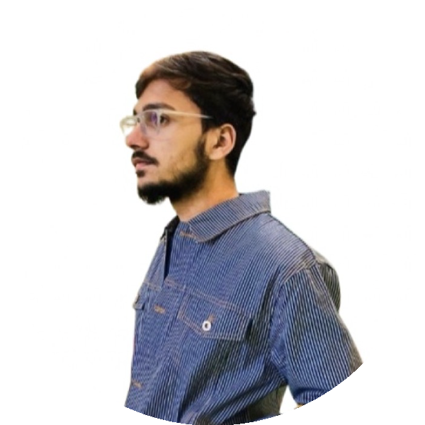
Team noName
The two halves this project needed: the researcher who wrote the framework, and the engineer who gave it a memory.
Safir Abbas
Faizan Khan
Architect
MSc Computer Science
B.Arch, GGSIPU Delhi
University of Geneva (UNIGE)
Author of the LCUI framework, from his B.Arch thesis. The domain expertise and five pillars this tool operationalizes and the expert-in-the-loop who corrects its judgments.
Built the AI system: Cognee memory pipeline, the scoring engine, and the product. Turned a paper framework into a working tool.
Domain expert + AI engineer — the pairing that makes this project uniquely defensible.
03
Notes:
Emphasize the pairing: Safir wrote the framework (rare — the author is on the team), Faizan built the AI. That combination is why the project is credible, not just an academic exercise or a generic hack.

Slide 4

The foundation: the LCUI
A published architecture dissertation that scores any city 0–100 on how well it supports life.
1
2
3
4
5
Ecological
Continuity
Multispecies
Infrastructure
Regenerative
Systems
Human–Nature
Equity
Governance
Can nature move
across the city?
Does it build
for animals too?
Does it renew
like an ecosystem?
Can everyone
reach nature?
Is it enforced,
not just written?
From
Fragile
Emerging
Transitional
Life-Responsive
Ecologically Rooted
From Safir Abbas's B.Arch thesis (GGSIPU Delhi). A real, published framework — the credibility this project stands on.
04
Notes:
This is where the dissertation enters — as foundation, not lecture. Name Safir as the author. Keep it to ~30 seconds: five pillars, a 0-100 scale, a real researcher. Then pivot hard to the gap.

Slide 5

But the framework couldn't be used.
"The data needed to apply this framework is unavailable, fragmented, or not routinely monitored… the index risks remaining an ethical manifesto rather than a replicable protocol."
from the dissertation's own conclusion
The data is scattered across dozens of documents no human can read and connect.
This is a memory problem.
05
Notes:
The most important slide. The gap IS your problem statement, and it's straight from the framework's own author. Land the last line hard: 'This is a memory problem.' — that's the entire justification for using Cognee.

Slide 6
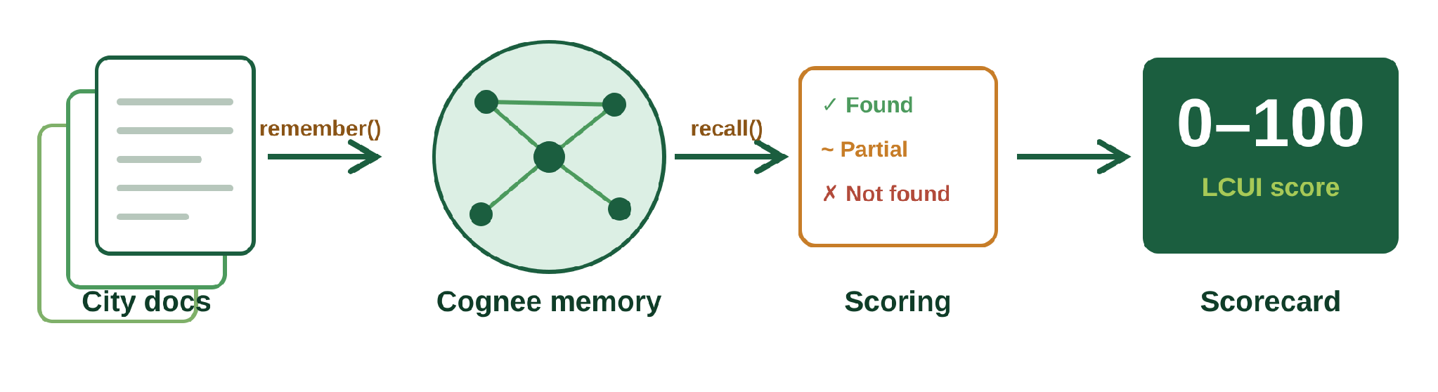
We gave the framework a memory.
LivingCities reads a city's documents into a knowledge graph, then scores it with a real quote behind every point.
1 remember()
2 recall()
3 Score
4 Scorecard
Read the city's PDFs into a knowledge graph
Ask each scoring question of that memory
Grade the evidence: found / partial / not found
0–100, with a quote behind every point
06
Notes:
The transition into the AI half. Walk the pipeline left to right in one sentence. From here on, the tool is the star.

Slide 7


A day in the work
Answered in seconds — with the real quote.
→
→
"…corridors biologiques protégés…"
Source: Biodiversity Strategy 2030
Stuck.
Asks Living Cities.
"Does Geneva even protect its ecological corridors? I'd have to read six documents…"
The city's whole memory, asked in one line.
07
Notes:
The relatable human moment. A real user hits a wall — days of reading — and the tool answers in one line with a cited quote. Keep it light; the character carries it.

Slide 8




Four memory functions. Everyone does real work.
remember()
recall()
Reads a city's PDFs & docs into a connected knowledge graph
Answers all 20 scoring questions — the engine of the scorecard
improve()
forget()
Learns permanently when the expert corrects a judgment
Prunes outdated policies so the score stays truthful
08
Notes:
The 'Best Use of Cognee' foundation. Stress: not one of these is decoration. recall() literally computes the score; forget() has a real-world meaning (repealed policy).

Slide 9


How the score is built
4 indicators
→ Pillar
5 pillars
→ Total
Found
Partial
Not found
1.0 pts
0.5 pts
0.0 pts
A worked example
Multispecies indicator | Verdict | Pts
Wildlife crossings | Not found | 0.0
Nesting / shelter | Partial | 0.5
Pollinator gardens | Found | 1.0
At-risk / lighting | Partial | 0.5
2.0 ÷ 4 × 100
50
Multispecies pillar score
Every point traces back to a real quote from a real document.
09
Notes:
Judges love seeing the actual mechanism. Walk the example: four indicators, add the points, divide by four, times 100 = 50. Then average five pillars for the total. Keep it concrete.

Slide 10
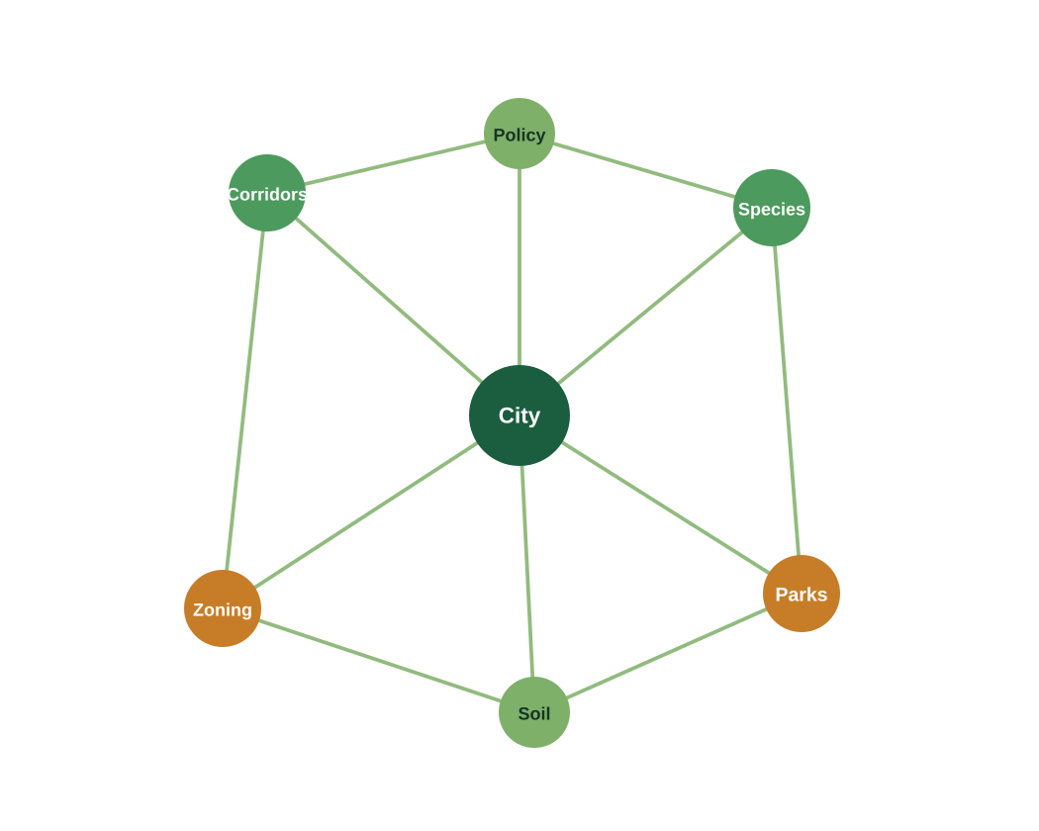
Why a graph, not a chatbot
Some questions can't be answered from one document.
"Is green space fairly distributed between rich and poor areas?"
Needs the parks map + demographics + transit — living in different documents.
A chatbot reads one document at a time and misses it.
Cognee connects the facts across documents — so recall() can join them.
This is the reason the project needs Cognee's hybrid graph-vector memory.
10
Notes:
Your headline 'Best Use of Cognee' argument. The multi-hop question is the killer. Say it plainly: a chatbot reads one doc at a time; the graph joins them.

Slide 11
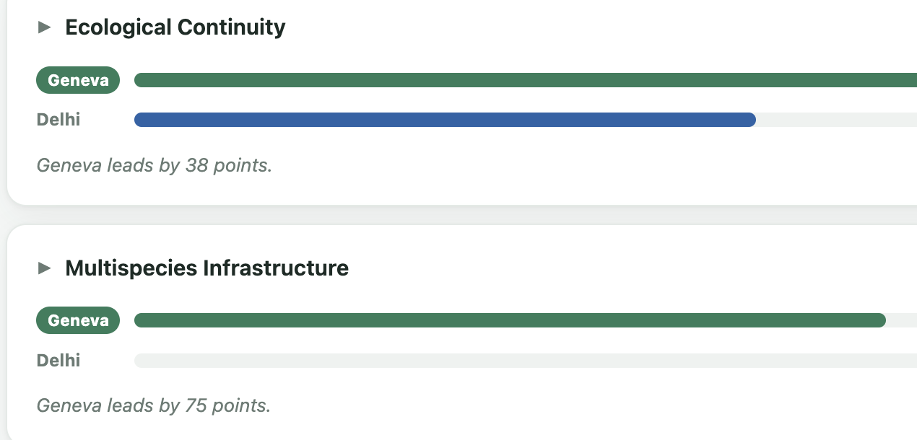
One framework. Any city.
Same code, same rubric — only the documents change. A comparison nobody had before.
G
D
Geneva
Delhi
Ecological Continuity
70
30
100
62
Multispecies Infra.
75
Life-Responsive
Emerging
0
out of 100
Regenerative Systems
75
12
The surprise
Human–Nature Equity
Live from the tool — try it: livingcities-app.netlify.app
Both cities tie at 25 on equity — even wealthy Geneva fails to give everyone fair access to nature.
25
25
Governance
75
Delhi's 0 on Multispecies means no evidence in its official documents for those four indicators — not that nothing exists.
50
Not "rich city wins everything" — a discriminating, evidence-backed picture. Same framework, any city.
11
Notes:
Geneva 70 (Life-Responsive) vs Delhi 30 (Emerging), a 40-point gap. But look pillar by pillar: Delhi leads nowhere outright yet holds real ecological continuity (62), while both cities tie at 25 on equity — proof the tool discriminates rather than favouring wealth. Same code, only the documents changed.

Slide 12



We don't blindly trust the AI
Careful testing caught real errors. We fixed them properly — and turned the review habit into a feature.
Verified quotes
Strict rubric
Real ingestion
Every evidence quote must appear word-for-word in the source — auto-checked, or flagged.
Judging tightened to grade against each criterion, not by feel.
Caught the memory storing paths, not content — fixed to read true text.
3 scoring errors caught across 40 indicator judgments — we fixed the pipeline, not the numbers. The same expert-review loop is the improve() feature we offer every user.
12
Notes:
Turns your biggest apparent weakness — imperfect scores — into a technical-excellence and honesty win. Judges trust teams that show their work.

Slide 13
Impact & fit
Who uses it
Criterion | How we win it
Impact | Makes a published framework usable
Creativity | Memory for a city-as-ecosystem
Technical | Verified quotes, clean design
Best use of Cognee | All 4 ops load-bearing
UX | One page, live, evidence-backed
Presentation | Told by the framework's author
Urban planners
Municipalities & NGOs
Researchers & journalists
Aligned with
SDG 11
SDG 13
SDG 15
Cities · Climate · Life on land
13
Notes:
Compact. Don't read the table aloud — let it sit as proof while you say the impact line: this makes a real framework usable, for real users, on real global goals.

Slide 14
Honest about the edges
Today's limits
What's next
Preliminary guidance, not a scientific certification
Can only credit what the documents actually say
improve() uses a fallback path on this cloud tenant
Auto-gather a city's official documents (human-verified)
Track a city's score over the years
The public 'living dashboard' the dissertation called for
14
Notes:
Calibration reads as maturity. State limits plainly, then pivot to the exciting future. The auto-gather + verified-source line shows you understand why you'd keep a human in the loop.

Slide 15



A framework its author couldn't use
is now a tool that remembers.
LivingCities reads a city's memory · scores its life · learns from experts · stays honest
Try it & explore
Live demo
livingcities-app.netlify.app
GitHub repo
github.com/<your-repo> (add link)
Demo video
<paste video link> (add link)
Scan for live demo
Best Use of Cognee Cloud · WeMakeDevs 2026 · Team noName · Built with AI assistance (disclosed)
Notes:
End on the story arc, then point them to the live app, repo, and video. The Netlify demo is the strongest CTA — a judge can use the real tool in one click. ADD the GitHub and video URLs before submitting.

