Slide 1

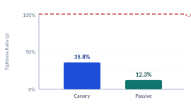
Measuring the Tightness Gap: Auditing DP-SGD Privacy Guarantees
Mohamad Faour · EECE 608 · First Draft
Experimental Pipeline
Tightness Ratio Results
Model: 2-layer MLP (784→64→10) on MNIST
Training: DP-SGD via Opacus, 1 epoch, LR = 0.15
Privacy: σ = 1.1, C = 1.0, δ = 10⁻⁵ | Acc: ~84% | Seeds: 3 training × 2 audit
Track 1 — Canary Stress Testing (Active)
Track 2 — Passive Auditing (Model-Only)
Evaluator inserts 32 crafted canaries into training set,
retrains DP-SGD model, scores inserted vs. held-out decoys.
3 strategies: random, improved, optimized pixel patches.
Best: ε_lower = 0.274, tightness ratio ρ = 35.8%
Conservative bounds via Wilson score confidence intervals.
Auditor queries released model on 128 examples
(64 members, 64 non-members). No access to training data.
4 scoring rules: prob margin, max prob, neg loss, fusion.
Best non-pathological: ε_lower = 0.095, ρ = 12.3%
Postfix corrections for score direction and member bias.
Challenges resolved:
seed propagation bug across runs · pathological bounds from small-sample artifacts · score direction misalignment in passive track
Status: pipeline validated end-to-end, first draft complete

