Slide 1



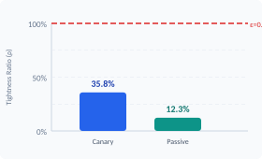


Measuring the Tightness Gap: Auditing DP-SGD Privacy Guarantees
Mohamad Faour · EECE 608 · Progress Report
Experimental Pipeline
Tightness Ratio Results
Model: 2-layer MLP (784→64→10) on MNIST
Training: DP-SGD via Opacus, 1 epoch, LR=0.15
Privacy: σ=1.1, C=1.0, δ=10⁻⁵ | Acc: ~84% | Seeds: 3×2
Track 1: Canary Stress Testing (Active Threat Model)
Track 2: Passive Auditing (Model-Only Threat Model)
• Insert 32 crafted canaries into training data, retrain, score membership
• 3 strategies tested: random, improved, optimized pixel patches
• Best result: ε_lower = 0.274 → ρ = 35.8%
• Wilson CI for conservative bound estimation
• Query model on 128 balanced member/non-member examples
• 4 scoring rules: prob margin, max prob, neg loss, fusion
• Best non-pathological: ε_lower = 0.095 → ρ = 12.3%
• Score direction & member-favoring corrections applied
Challenges resolved:
seed propagation bug · pathological small-sample bounds · score direction misalignment
Pipeline validated end-to-end

