Slide 1
↗
MyFinanceCoach
Intelligent Expense Tracking & Financial Analytics
Spring Boot
PostgreSQL
React
AI-Powered
Mini Project
A Personal Finance Intelligence Platform

Slide 2
The Problem with Normal Finance Apps
❌ Typical Finance Apps
✅ MyFinanceCoach
✗ Only shows what you spent
✓ Explains WHY you spend
✗ Warns AFTER overspending
✓ Warns BEFORE overspending
✗ Charts without explanation
→
✓ Explainable AI Insights
✗ No future predictions
✓ ML Expense Predictions
✗ No decision testing
✓ What-If Simulations
✗ Mutable, unreliable data
✓ Immutable financial ledger
"Google Maps for your money"

Slide 3
Tech Stack & Architecture
Frontend
Backend
Database
AI / ML
React + Vite
Spring Boot
PostgreSQL
SVM
Recharts
REST API
Immutable Ledger
Moving Averages
Tailwind CSS
JWT Security
ACID Compliance
Trend Analysis
JWT Auth
Python AI Module
Audit Logs
Receipt OCR
Architecture: Modular Monolith — ensures data integrity, simplicity, and financial-grade reliability

Slide 4
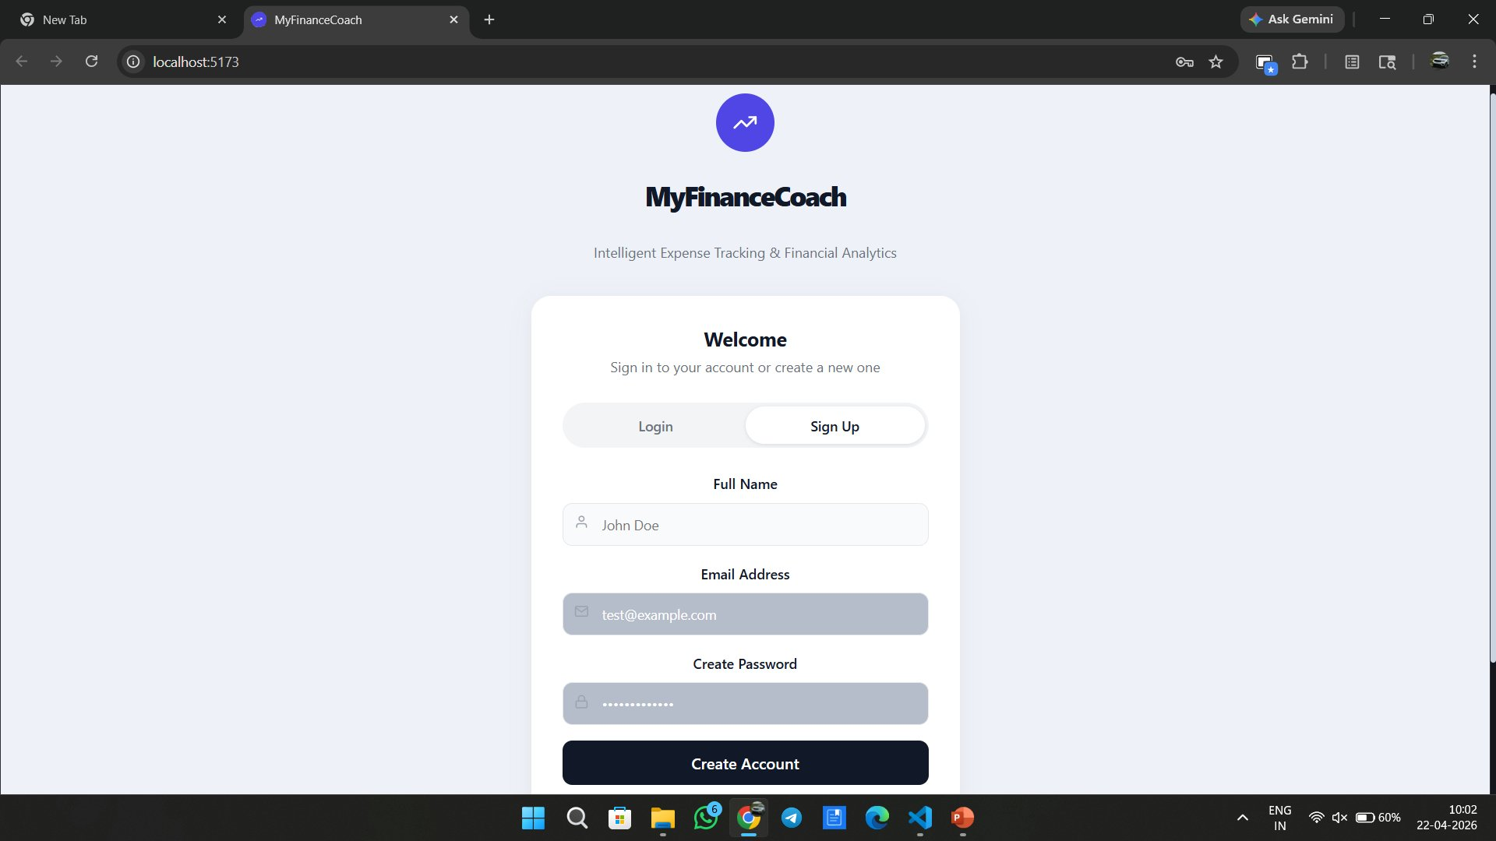
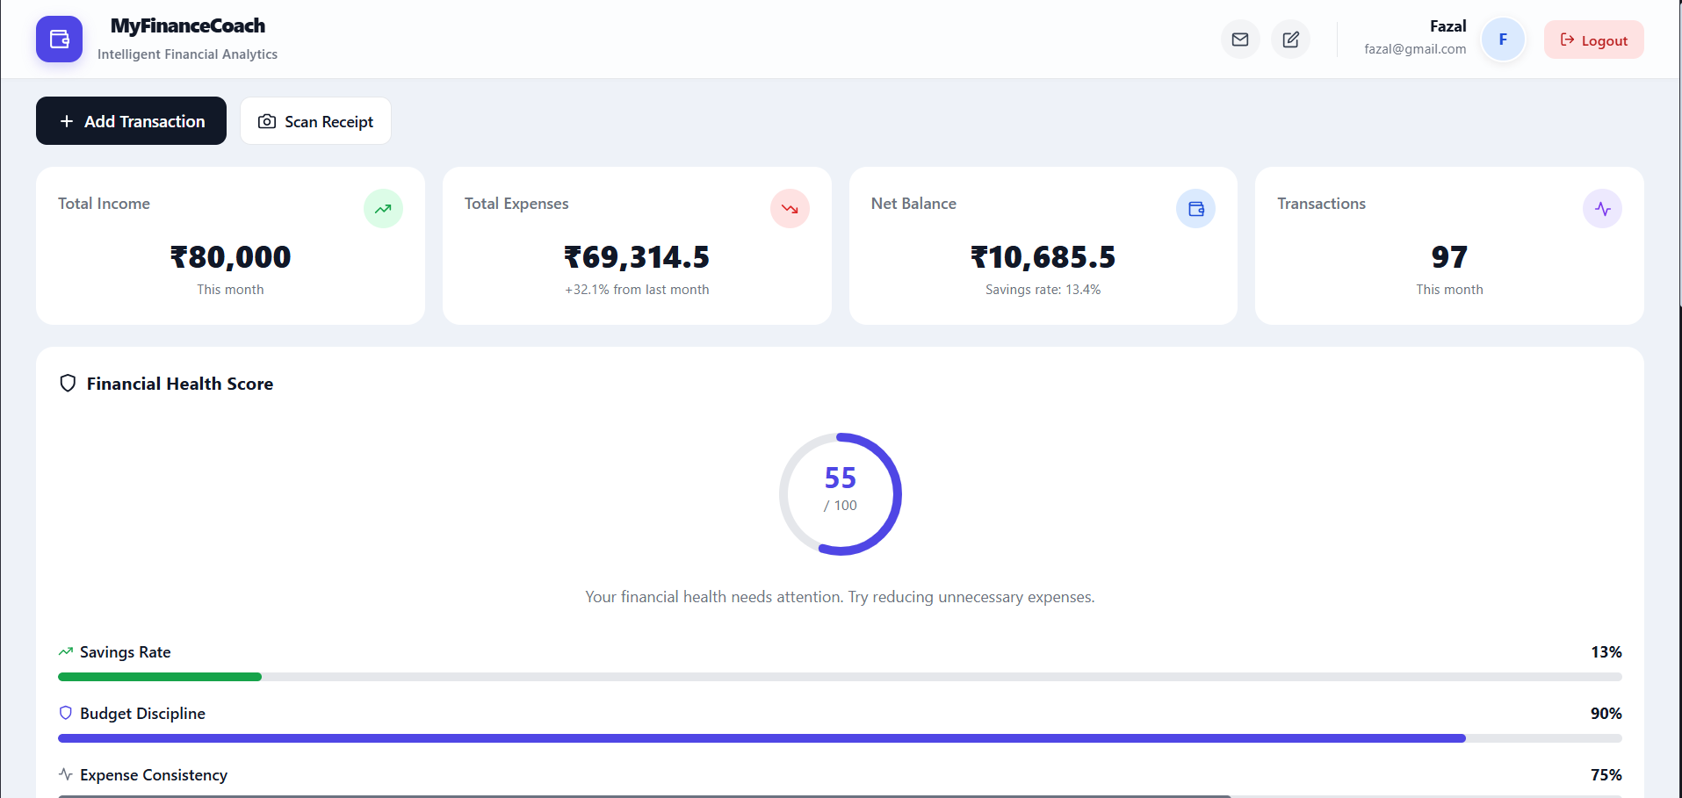
User Authentication & Dashboard
Login / Sign Up Screen
Main Dashboard
🔐
📊
💯
JWT-secured auth with encrypted passwords
Income, Expenses, Balance & Transactions overview
Financial Health Score visible at a glance

Slide 5
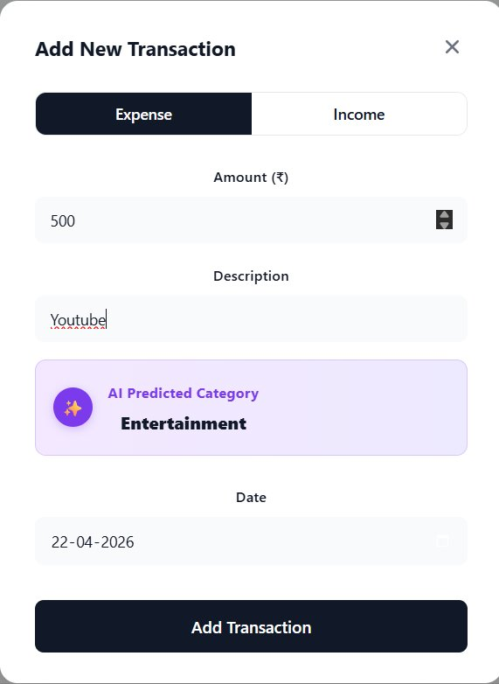
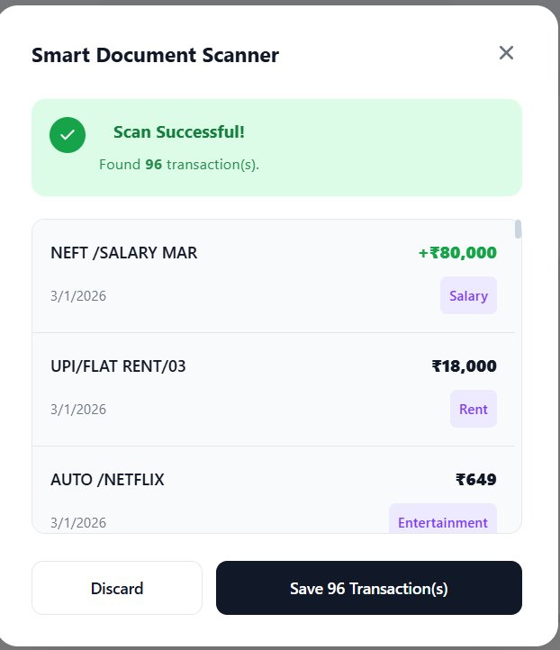
Transactions & AI-Powered Categorization
🤖 AI Category Prediction
Type "Youtube" → Predicts "Entertainment" instantly using ML Model
📷 Smart Document Scanner
Upload bank statement PDF or receipt photo → Auto-extract 96 transactions with categories
🔍 Search & Filter
Add Transaction + AI Category
Receipt Scan Result
Filter by category, type, or search by description

Slide 6
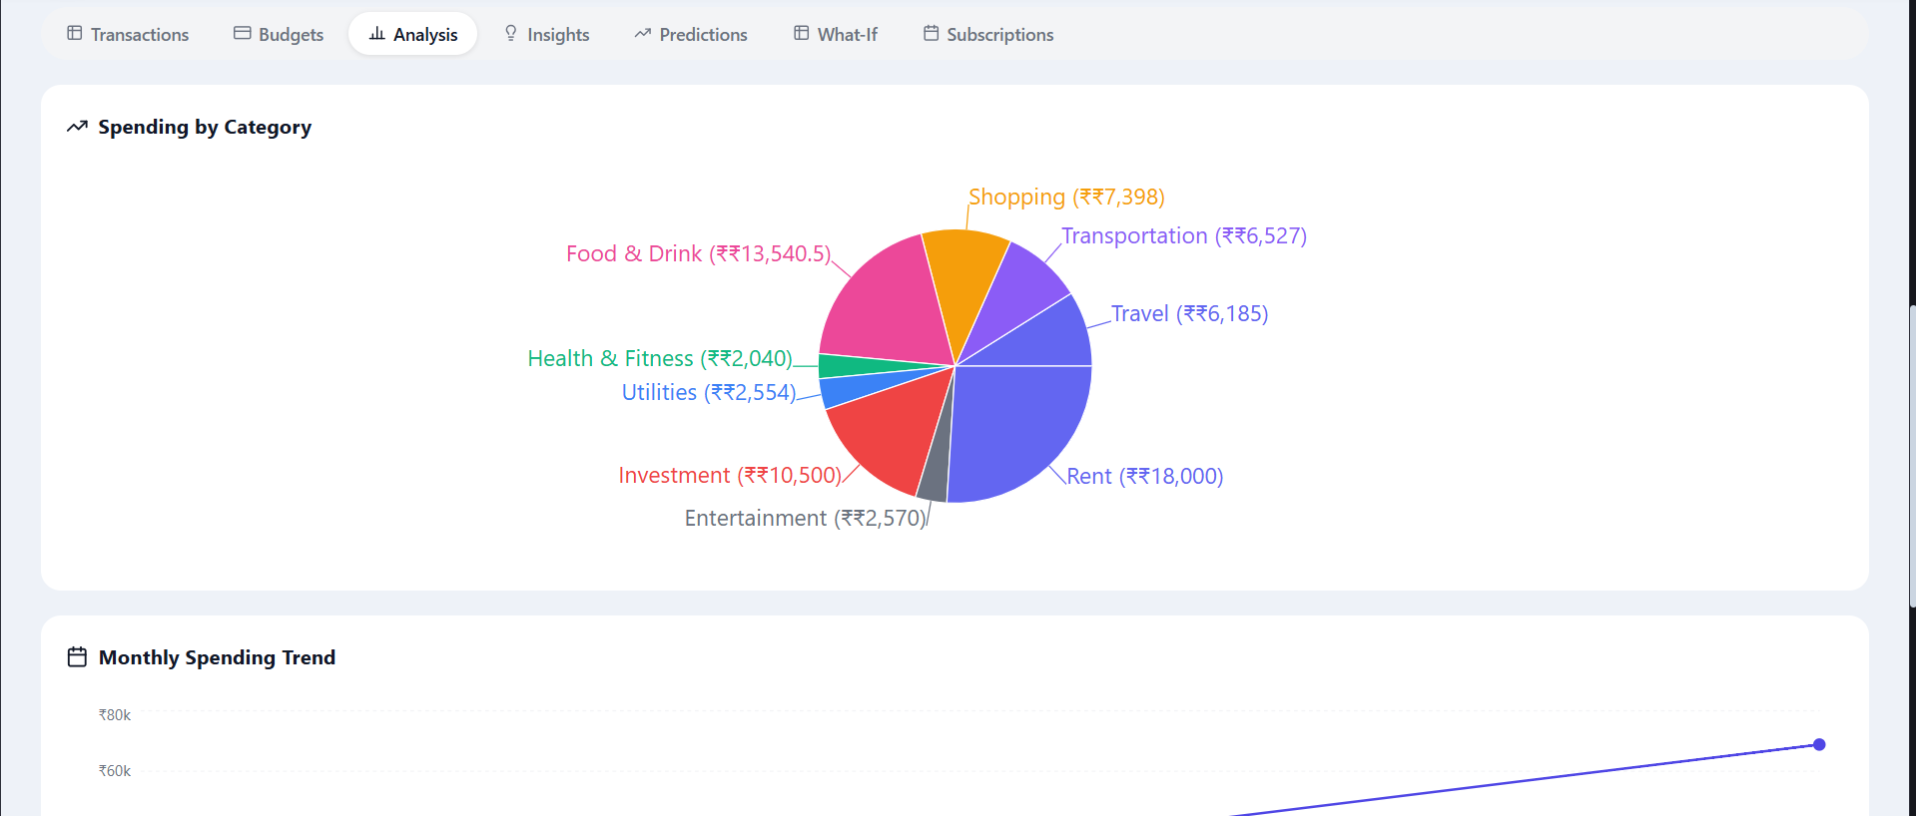
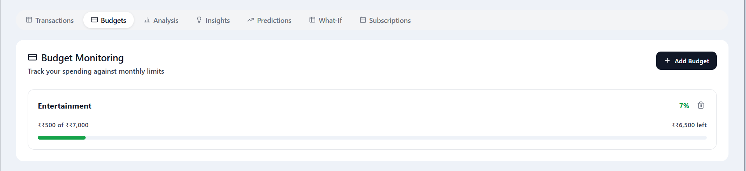
Budget Monitoring & Spending Analysis
Budget Monitoring
Spending by Category (Pie Chart)
₹7,000
7%
₹6,500
8 Cats
Entertainment Budget
Used (₹500 spent)
Remaining
Tracked Categories
⚡ Proactive Alerts: "At this pace, you'll exceed your food budget in 8 days." — Warns BEFORE the budget is crossed, not after.

Slide 7
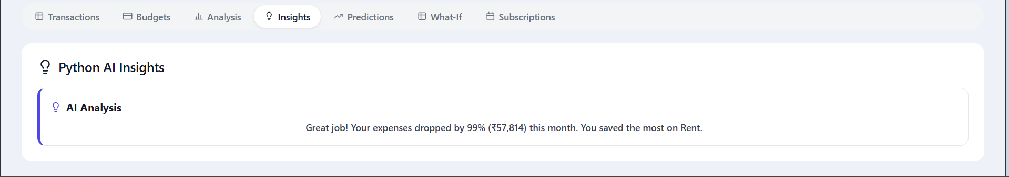
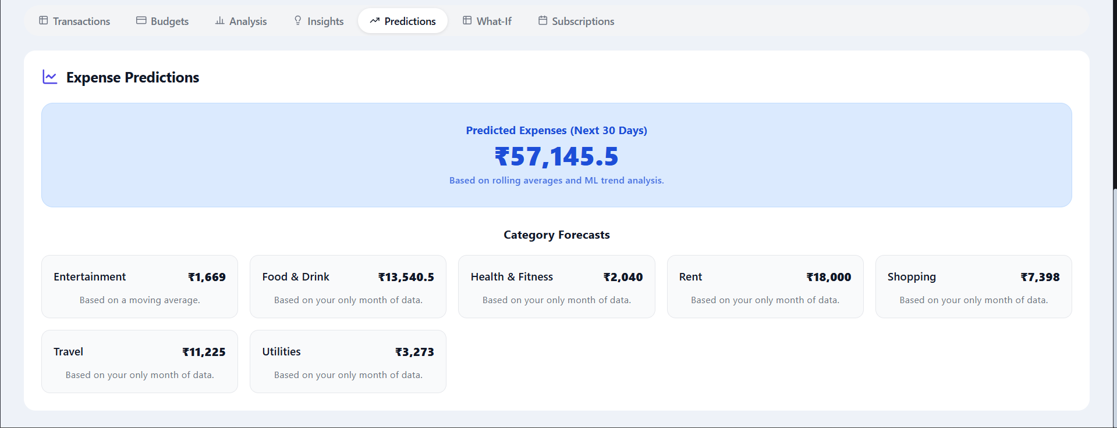
Python AI Insights & Expense Predictions
Python AI Insights Panel
💡 Sample AI Insight
"Expenses increased because food delivery orders rose 42% on weekends — 4 consecutive weekend orders above usual pattern."
Expense Predictions (Next 30 Days)
📈 Moving Average Forecasting
📐 ML Trend Analysis
🗂️ Category-wise Forecasts
🎯 ₹57,145 predicted next 30 days

Slide 8
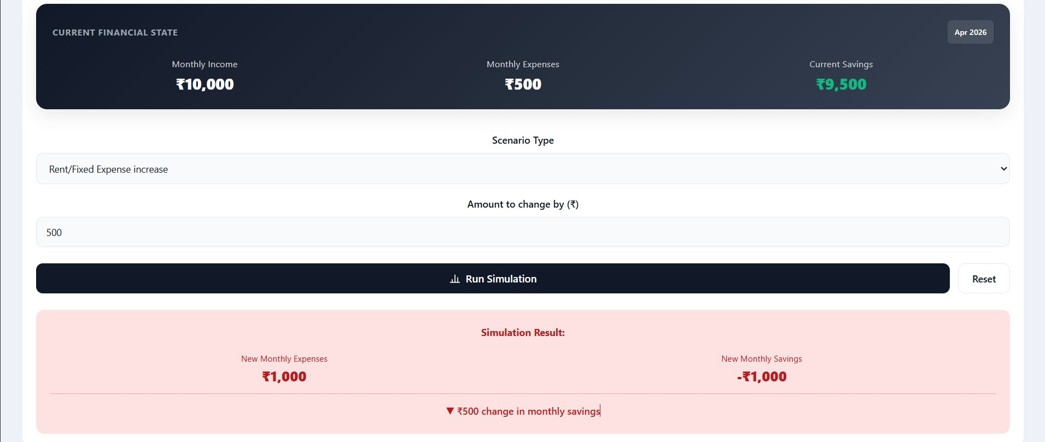
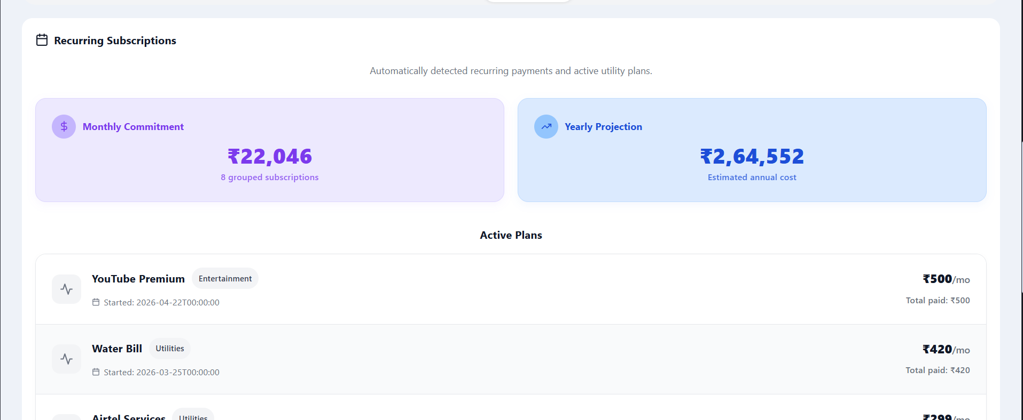
What-If Simulator & Subscription Management
Recurring Subscriptions
₹22,046/mo
₹2,64,552/yr
What-If Simulation
8 subscriptions
Yearly projection
🎯 Decision Intelligence: "If you reduce food by ₹2,000/month, save ₹24,000/year and reach emergency fund goal 3 months early." — No advice, just outcomes.

Slide 9
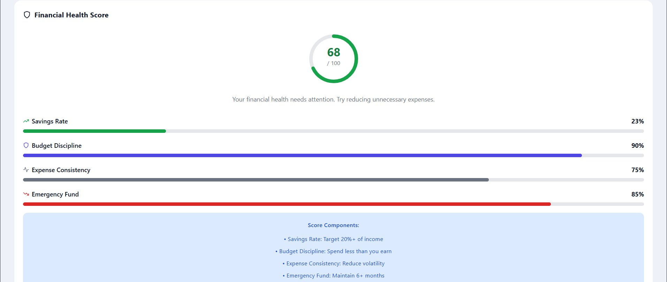
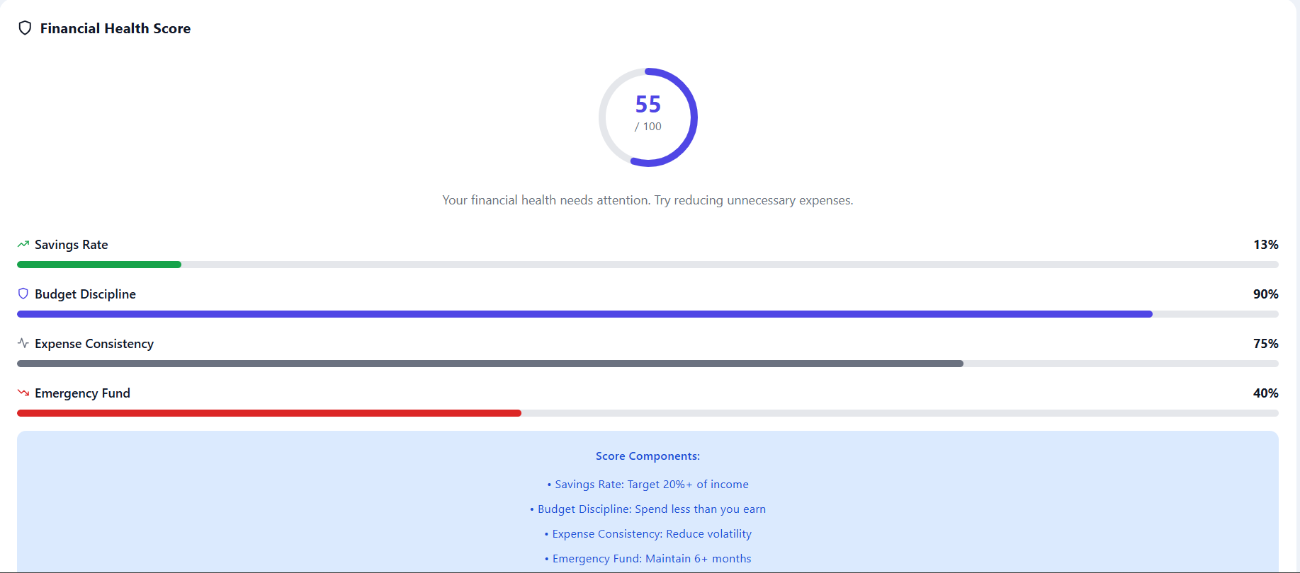
Financial Health Score — Explainable Intelligence
Score: 68 / 100 (Before)
Score: 55 / 100 (Different User)
Savings Rate
Budget Discipline
Expense Consistency
Emergency Fund
Target 20%+ of income
Spend less than you earn
Reduce volatility
Maintain 6+ months
Score is explainable — each component tells WHY it changed, not just what the number is.

Slide 10
12 Core Features at a Glance
🔐
User Auth & Security
💰
Income & Expense Tracking
🤖
Smart AI Categorization
🧠
Behavioral Analysis
#1
#2
#3
#4
⚡
Budget Monitoring & Alerts
📈
Expense Predictions (ML)
💯
Financial Health Score
🎯
What-If Simulations
#5
#6
#7
#8
💡
Explainable AI Insights
📊
Dashboard & Reports
🔄
Subscription Management
📷
Receipt OCR Scanner
#9
#10
#11
#12

Slide 11
How We Compare
Feature | Normal Finance App | MyFinanceCoach
Expense Tracking | ✅ | ✅
Budget Alerts | After overspend ❌ | Before overspend ✅
Insights | Charts only ❌ | Explained reasons ✅
Predictions | ❌ | ML-powered ✅
Decision Testing | ❌ | What-If Simulator ✅
Data Model | Mutable rows ❌ | Immutable ledger ✅
Receipt Scanning | ❌ | OCR-powered ✅
Health Score | ❌ | Explainable Score ✅
USP: Explainable Behavioral Intelligence — Not just tracking, but understanding and predicting.

Slide 12
MyFinanceCoach
More than an expense tracker — a financial decision-support system
🧠
⚡
🔮
🎯
Explainable AI Insights
Proactive Budget Warnings
ML Expense Predictions
What-If Decision Support
"Think of it like Google Maps for your money"
Built with: Spring Boot • PostgreSQL • React • Python ML
Thank You

