Slide 1
CLASSIFY DRIVER BEHAVIOUR USING SHALLOW & DEEP LEARNING METHODS
Brainstormers
[Govind Gupta(190346), Mohd. Irfan Mahir(18807425)]

Slide 2
Introduction
Due to the increasing number of vehicles and a vast transportation network globally, it is important to consider drivers’ and pedestrians’ safety. Most vehicle crashes in any country are due to distracted drivers, and these are usually the fatal ones.
Past writing recommends that a forceful driving style is one of the main sources of car crashes that can prompt passings, material misfortunes, and wounds.
It will be very difficult and cumbersome to handle these things manually, and hence, some alternate and more effective approaches will be very beneficial for all.
Many solutions regarding this issue have been proposed so far based on some machine learning approaches, mainly known as “Driver Behaviour Profiling”.

Slide 3
Introduction
Driver behaviour profiling is a procedure to categorise drivers as safe/risky at any point in time based on driving patterns, records, and other conditions. Hence, driver behaviour profiling tries to understand and improve driver behaviour.
Thus, the objective of our project is to identify the best algorithm to predict potentially risky driving using driver behaviour.

Slide 4
Driver Behaviour Overview
Driver behaviour sensing can be done using the cumulative response of three broad methods: vehicle control data, physiological data and visual data.
Vehicle control data is derived from the positioning, frequency, speed, and other vehicle properties.
Similarly, physiological data can be extracted from drivers’ health conditions, heart rate, e.t.c.
Whereas visual data can be examined using the videos and images of drivers by looking at the body posture, head positioning, facial expressions, e.t.c.
We will be using vehicle control data to identify driver behaviour for our project. Vehicle control data is found from smartphone sensors which are further converted and used to identify driver behaviour.

Slide 5
Methodology
Data
Dataset we have used has been collected using smartphone sensors. Experiment was performed in four different car trips of around 13 minutes each. Data consists of accelerometer reading, linear acceleration, magnetometer reading and gyroscope reading. Data consists of 7 different driving event types and number of sequences for each event. A total of 69 sequences were obtained.
Driving event type | # of samples
Aggressive breaking | 12
Aggressive acceleration | 12
Aggressive left turn | 11
Aggressive right turn | 11
Aggressive left lane change | 4
Aggressive right lane change | 5
Non-aggressive event | 14
Total | 69

Slide 6
Methodology
Pre-processing
We clumped together all the data files for each vehicle based on the sequences available in the label files.
We converted the time feature (from the start time of the device) from nanoseconds to centiseconds ( because data containing labels have a precision of centiseconds).
We have used MinMaxScaler to scale the features to a given range.

Slide 7
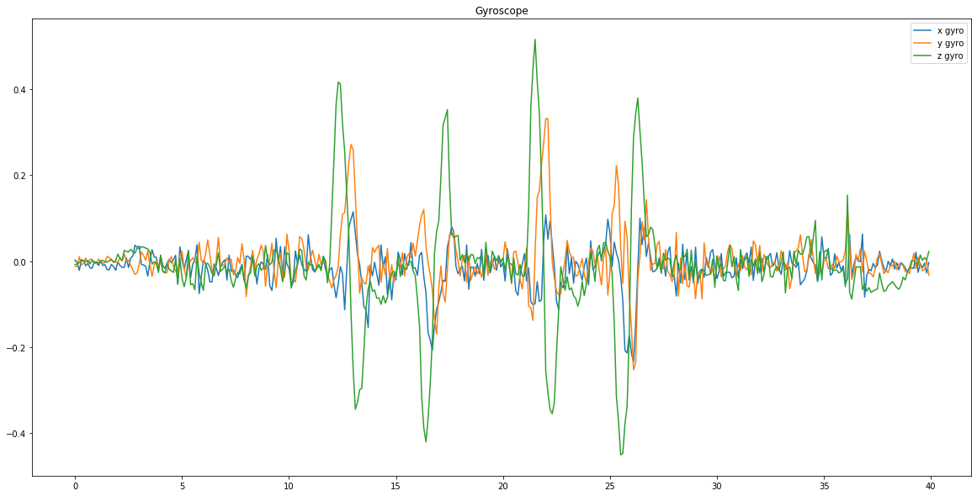
Methodology
Visualisation
We also visualised the data for vehicle 2 for first 40 seconds to observe the trends it is following.

Slide 8
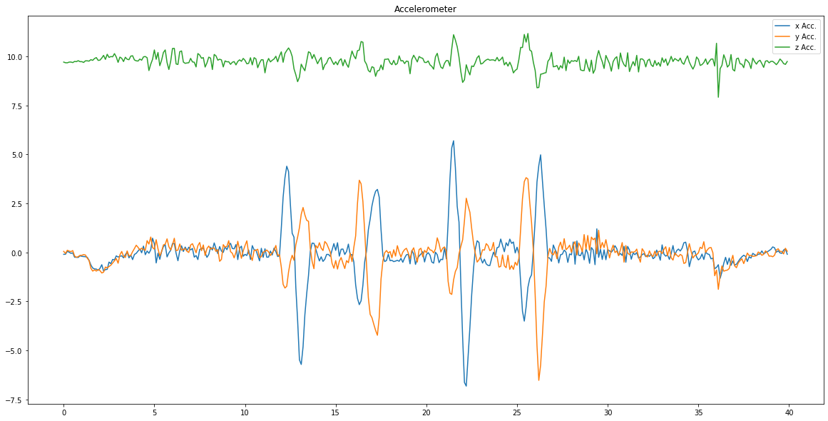
Methodology
Visualisation
The sudden change in x and y acceleration values shows aggressive left and right turns or aggressive left lane change and right lane change.

Slide 9
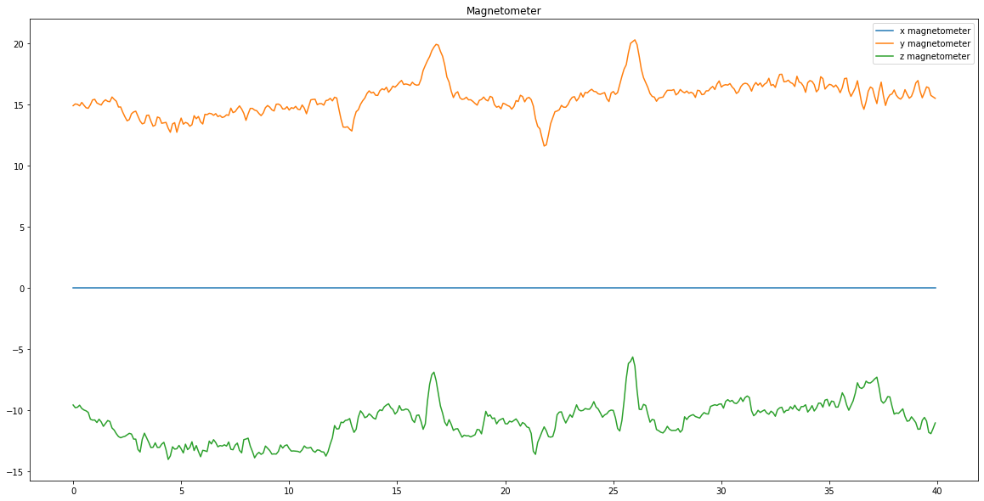
Methodology
Visualisation

Slide 10
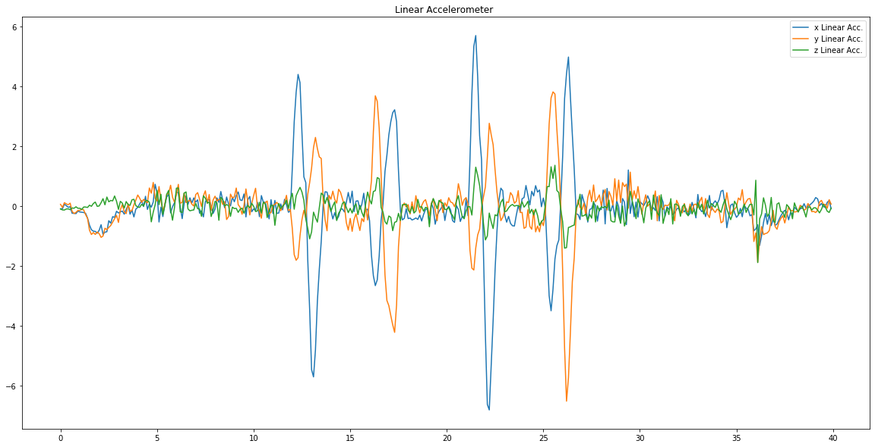
Methodology
Visualisation

Slide 11
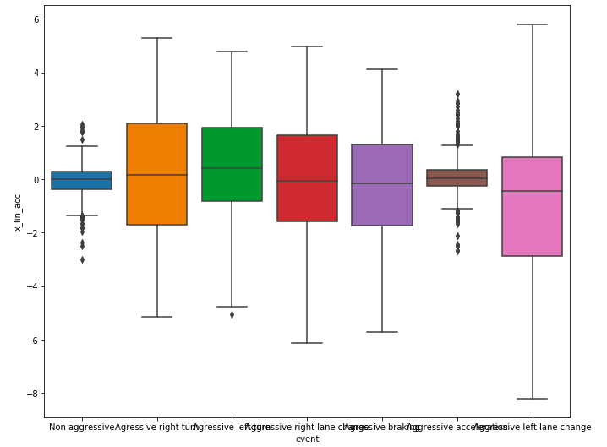
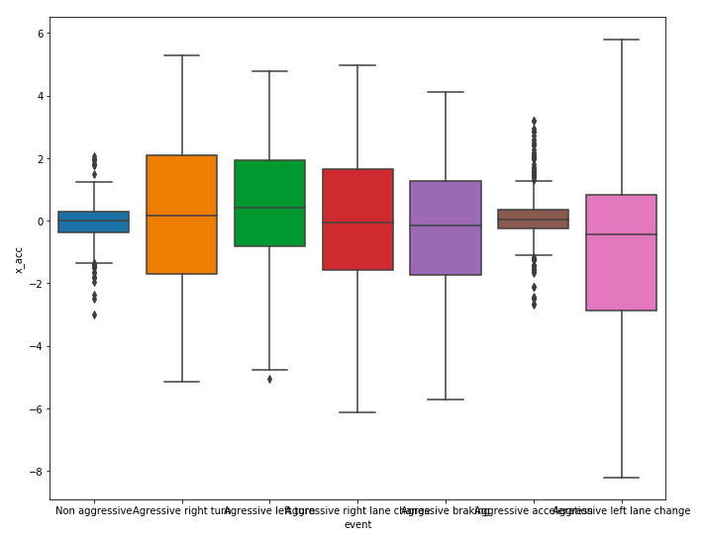
Methodology
Attribute generation
We used the sliding time window partition technique to generate more attributes from the data. We chose a time window of 0.5 seconds and then merged them to get the minimum, maximum, mean, and standard deviation for each attribute of each window. The data generated consists of 44 (3*3*4 + 1*2*4) attributes and 1 label class.
Fig.: boxplot showing x linear acceleration and x accelerometer values distribution

Slide 12
Methodology
Evaluation Assembly
The generated attribute vector datasets are further used to train, test and evaluate the performances of different MLAs (Machine Learning Algorithms). Thus, the best algorithm is identified. We used 70% data for training and the remaining for validation and testing of the different MLAs used. We used ANN, SVM, and RF on the generated dataset for classification accuracy and chose the best one. We used the Keras framework for the implementation of all the algorithms. We used different algorithm configurations and tried different parameters, no of layers, no of epochs e.t.c. to avoid the problem of overfitting and to get satisfactory results.

Slide 13
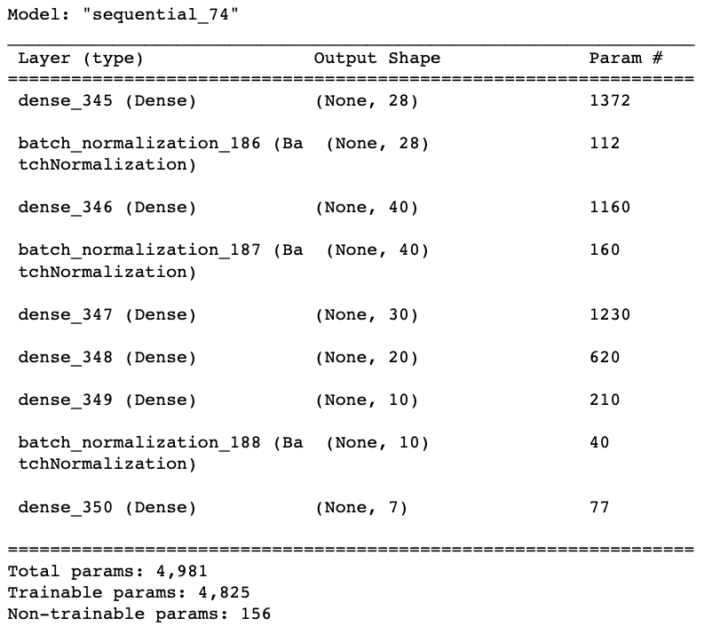
Results
ANN
We have used 5 hidden layers with batch normalization after 3 layers (chosen based on trial and error). The output layer consists of 7 neurons, with each giving the probability of output to be in any of the 7 classes.
Fig.: model summary of ANN

Slide 14
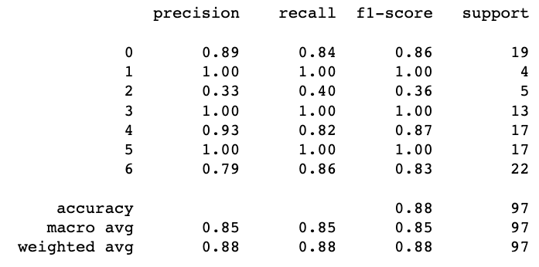
Results
We have got an accuracy of 0.88 using ANN.
Fig.: Classification report for ANN model

Slide 15
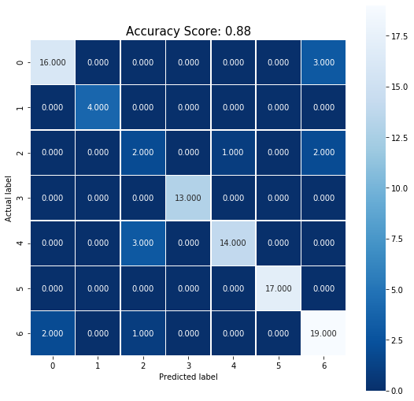
Results
Fig.: Confusion matrix using ANN

Slide 16
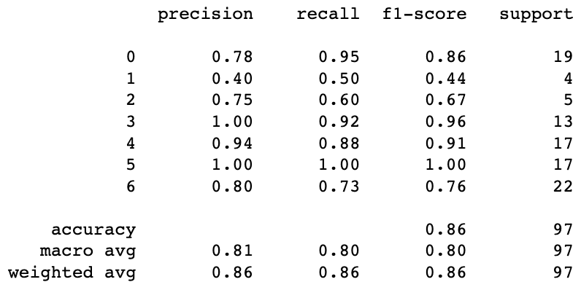
Results
SVM
In SVM we have used radial basis function (RBF) kernel as it gives better accuracy as compared to linear, poly and sigmoid kernels. The C and gamma values we used are 2.5 and 1.4 respectively (based on trial and error).
Fig.: Classification report for SVM model

Slide 17
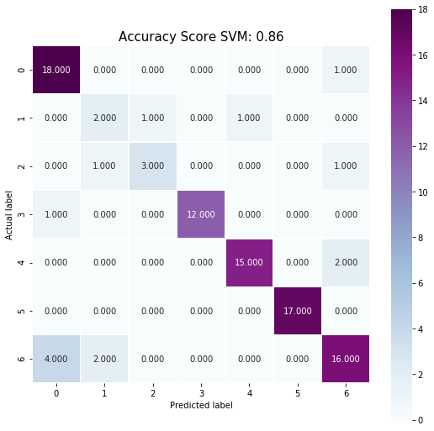
Results
Fig.: Confusion matrix using SVM

Slide 18
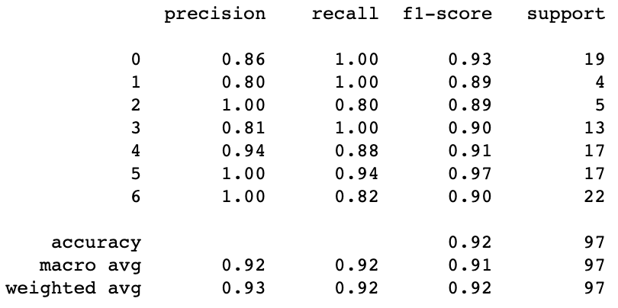
Results
RF
We have used Random Forest with a total of 100 estimators (trees) and each tree having a minimum depth of 10. The criterion used to measure the quality was “gini”. We have obtained an overall accuracy of 0.92 using RF.
Fig.: Classification report for RF model

Slide 19
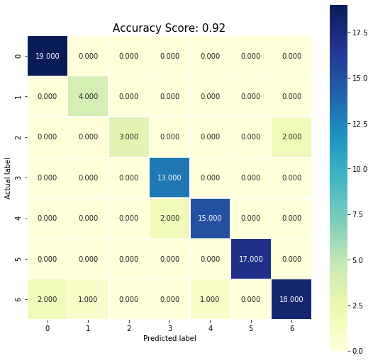
Results
Fig.: Confusion matrix using RF

Slide 20
Conclusion
In this project, we used ANN, SVM and RF to predict aggressive/ non-aggressive driver behaviour.
Out of three, best accuracy was shown by random forest with an accuracy score of .92.
Minimum accuracy was shown by SVM with an accuracy score of 0.86.
ANN gave accuracy score 0.88.

Slide 21
Future Works
Along with vehicle control data, physiological data and visual data can be also added in the dataset to more precisely predict driver behaviour.
More MLAs can be added to the evaluation assembly. This will help in increasing accuracy of the model.
For insurance telematics domain, a model for driver behaviour profile identification can be made to make car insurance cheaper by rewarding drivers with good driving scores same as credit score based on past driver behaviour, instead of only considering group-based statistics, e.g., age, gender, marital status, etc.

Slide 22
References
[1] Charles Marks, Arash Jahangiri, and Sahar Ghanipoor Machina, “Identifying and Labeling Potentially Risky Driving: A Multistage Process Using Real-World Driving Data,” Journal of Advanced Transportation Volume 2021, Article ID 8819094, 11 pages.
[2] Al-Hussein, W.A.; Por, L.Y.; Kiah, M.L.M.; Zaidan, B.B., "Driver Behavior Profiling and Recognition Using Deep-Learning Methods: In Accordance with Traffic Regulations and Experts Guidelines, " Int. J. Environ. Res. Public Health 2022, 19, 1470.
[3] Ghandour, R.; Potams, A.J.; Boulkaibet, I.; Neji, B.; Al Barakeh, Z., "Driver Behavior Classification System Analysis Using Machine Learning Methods, ". Appl. Sci. 2021, 11, 10562.

Slide 23
References
[4] Li, Z.; Zhang, K.; Chen, B.; Dong, Y.; Zhang, L., "Driver identification in intelligent vehicle systems using machine learning algorithms, " IET Intell. Transp. Syst. 2018, 13, 40–47
[5] Silva, I.; Eugenio Naranjo, J., "A systematic methodology to evaluate prediction models for driving style classification, " Sensors 2020, 20, 1692.
[6] Rohon Das; Pabitra Mohan Khilar, "Driver Behaviour Profiling in VANETs: Comparison of Ensemble Machine Learning Techniques, "978-1-7281-0419-5/19/, 2019.
[7] Ferreira, Jair Júnior et al. “Driver behavior profiling: An investigation with different smartphone sensorsand machine learning.” PloS one vol. 12,4 e0174959. 10 Apr. 2017

Slide 24
Contribution
Govind: Literature review of paper [1],[2],[3], proposal writing, Report compilation and editing, Data Visualisation, Presentation Writing and Compilation, Applying algorithms.
Irfan: Literature review of paper [4],[5],[6], paper selection, proposal writing, Data Preprocessing, Evaluation Assembly, Presentation Writing and Compilation, Applying algorithms.

Slide 25
ACKNOWLEDGMENT
We would like to express our special thanks of gratitude to our course instructor Dr. Pranamesh Chakraborty who gave us the golden opportunity to do this wonderful project on “Classify Driver Behaviour Using ML and DL Algorithms”, which also helped us in doing lot of research and we come to know about so many new things. We would also like to thank Nidhi and Dhanya for contributing in the initial parts of the project.

Slide 26
THANK YOU

