Slide 1

Exploring the Influence of Opinion Dynamics on Infectious Disease Spread
Mathematical Modeling, Simulation and Optimization
University of Koblenz
By:
Mohd Kashif Ansari (223201222)
Amirhossein Baharilashkari (220201606)
M Rashedul Hasnat (220202415)
Sidhant Makin (222202551)
Supervised By
Dr. Radomir Pestow

Slide 2
Contents
Introduction
SIR Model
SIR Model with Opinion Dynamics
Results
Conclusion
Further Research Topics
References
Appendix – I
Appendix - II

Slide 3
Introduction
The integration of Mathematics and Epidemiology plays a significant role in comprehending disease evolution.
In our project, we develop a modified SIR model that incorporates behavioral practices and captures the joint evolution of disease and opinions in a computationally tractable manner.
The enhanced model seeks to understand the interplay between the disease spread and opinion dynamics.
We demonstrate how individuals transition between states (susceptible, infected, & recovered) and adapt opinions through interactions, highlighting the impact on disease dynamics.

Slide 4
SIR Model
Model Overview
The SIR model is a mathematical representation used in epidemiology to forecast the spread of infectious diseases within a population.
Three Compartments
Susceptible (S): Individuals who can be infected.
Infected (I): Individuals who are currently infected and can spread the disease.
Recovered (R): Individuals who have recovered and are immune.
Parameters and Population Dynamics
The model assumes a constant total population (N = S + I + R) and is governed by the infection rate (β) and recovery rate (γ).

Slide 5
SIR Model With Opinion Dynamics
This extended SIR model simulates virus spread across different opinion groups, capturing the impact on each group within the population.
Unlike the traditional SIR model with a homogeneous population and three compartments (S, I, R), this model divides the population into opinion groups on the level of Cautiousness.
The total population (N) is given by
N = S(t) + I(t) + R(t),
With opinions array q, where negative sign indicates cautiousness and magnitude indicates the degree of cautiousness, higher magnitudes correspond to lower infection chances.
q = [ - q1, - q2 , - q3 , ……., - qn ]

Slide 6
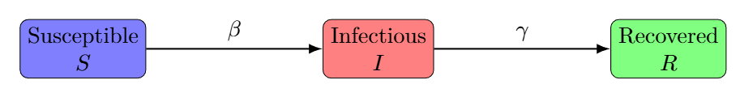
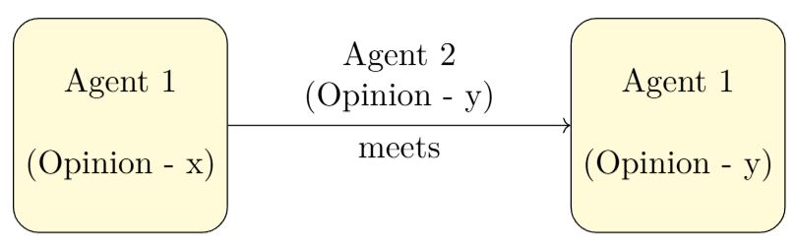
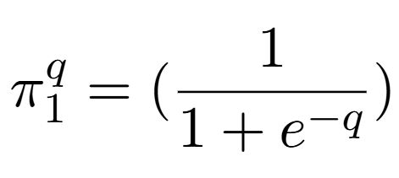
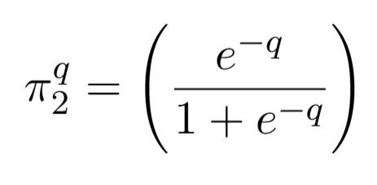
Modeling Assumptions
One-Way Flow: Population flows from Susceptible to Infected to Recovered, achieving immunity after recovery.
Opinion Adaption: When individuals interact, the first agent adopts the opinion of the second agent.
Actions (∏1,∏2): Two action are defined as ∏1 – Doing Nothing, ∏2- Full Protection. Their affect can be calculated by:
,

Slide 7
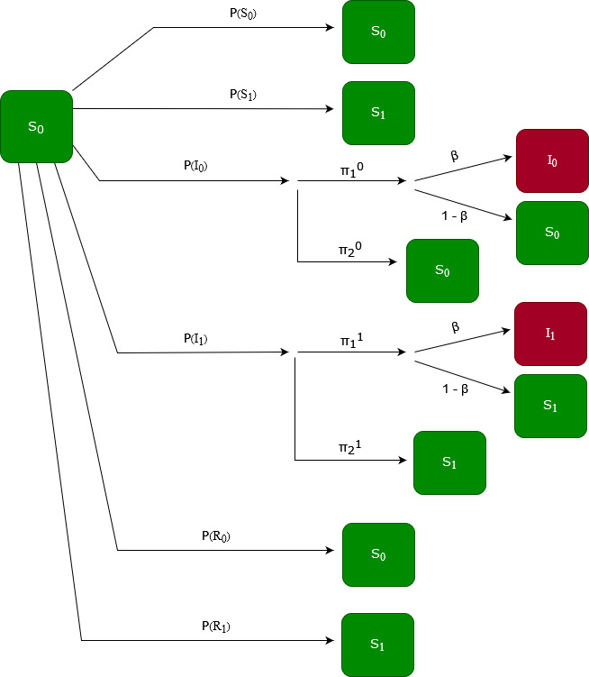
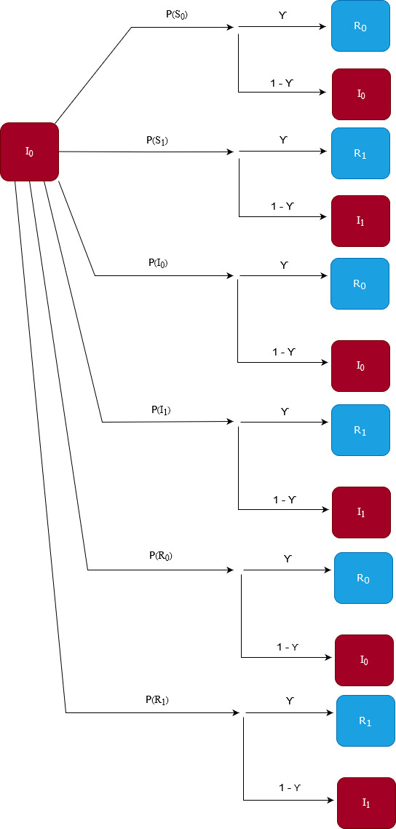
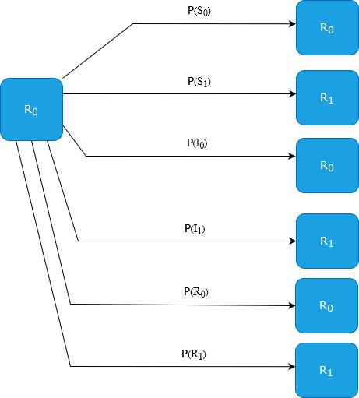
Interaction Patterns
Interactions Patterns for S I R compartments with Opinion 0 & 1

Slide 8
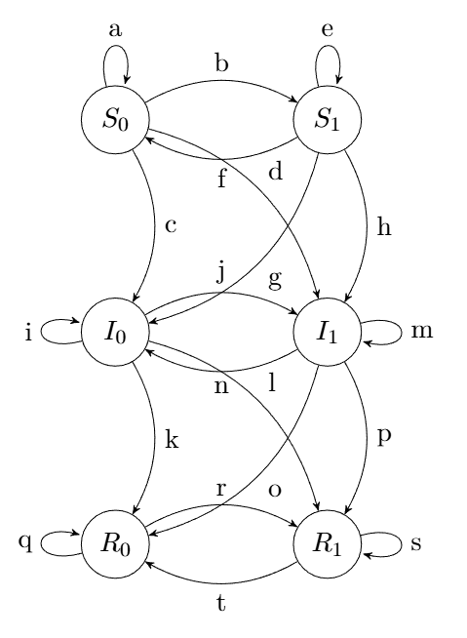
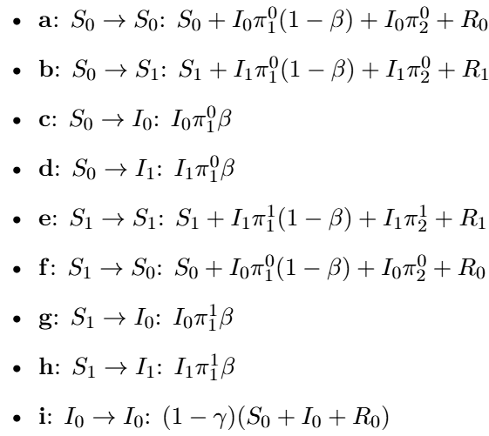
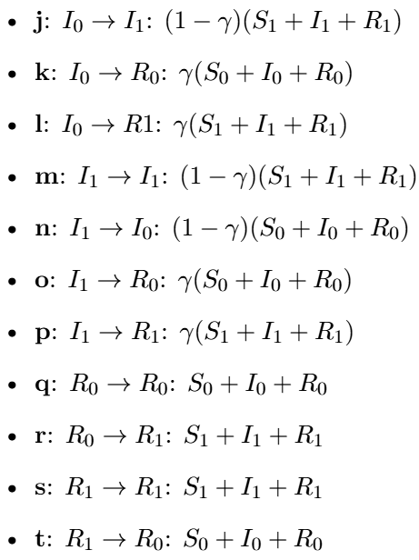
Markov Chain
Transition Probabilities:

Slide 9
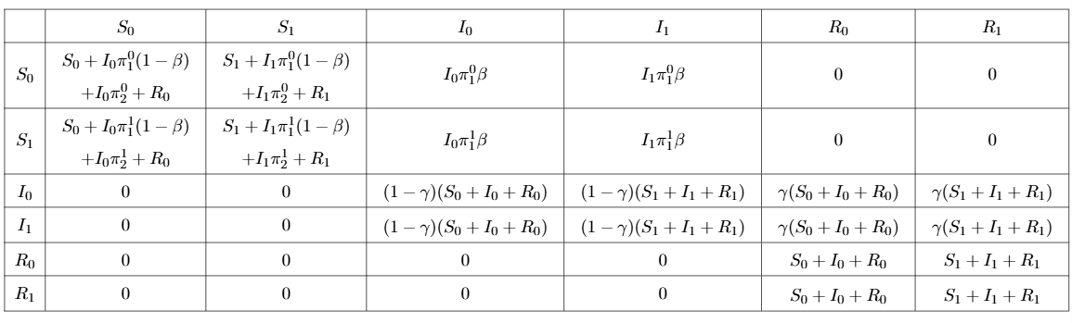
Transition Matrix
Markov chain yields the following Transition matrix (For Opinion 0 & 1):

Slide 10
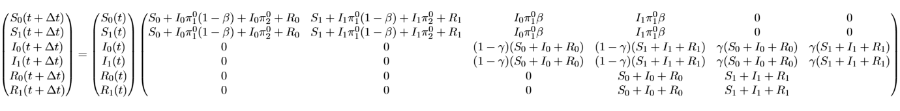
System of Equations
Transition Matrix yields the following System of Equations (For Opinion 0 & 1):
T
T

Slide 11
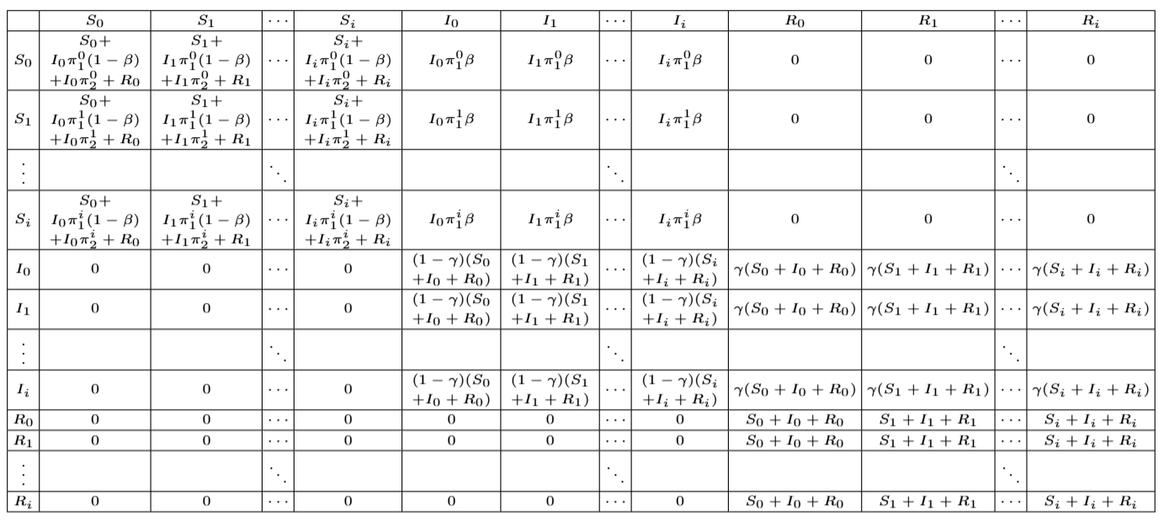
Transition Matrix For i opinions

Slide 12
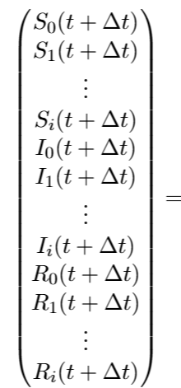
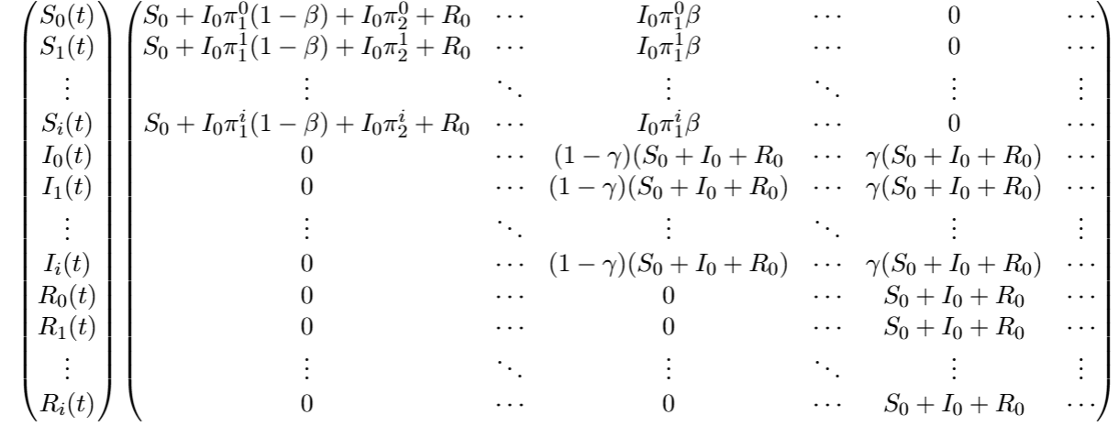
System of Equations for i opinions
T
T

Slide 13
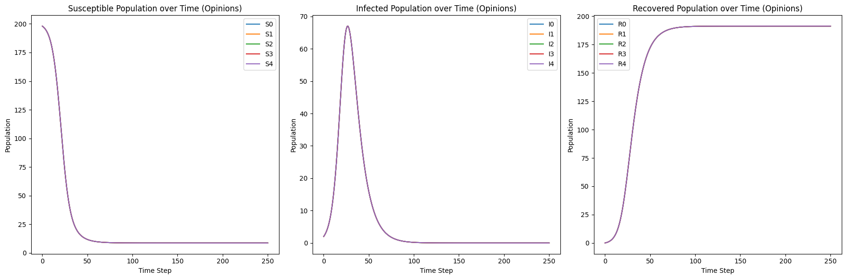
Results
Dynamics of Susceptible, Infected, and Recovered of different Opinion groups
Assumed Values
n (opinions) = 5
N (Population) = 1000
β = 0.7, γ = 0.1
Divided population equally among all opinions:
S0 = S1 = … = S4 = 198
I0 = I1 = … = I4 = 2
R0 = R1 = … = R4 = 0
Then we can observe that all opinion groups behave equally towards infection. resulting, the S, I, and R curves for all opinion groups overlaps each other. Which is strange, right? This happened because of No Dominating Opinion and equal population among all opinions (which are very trivial).

Slide 14
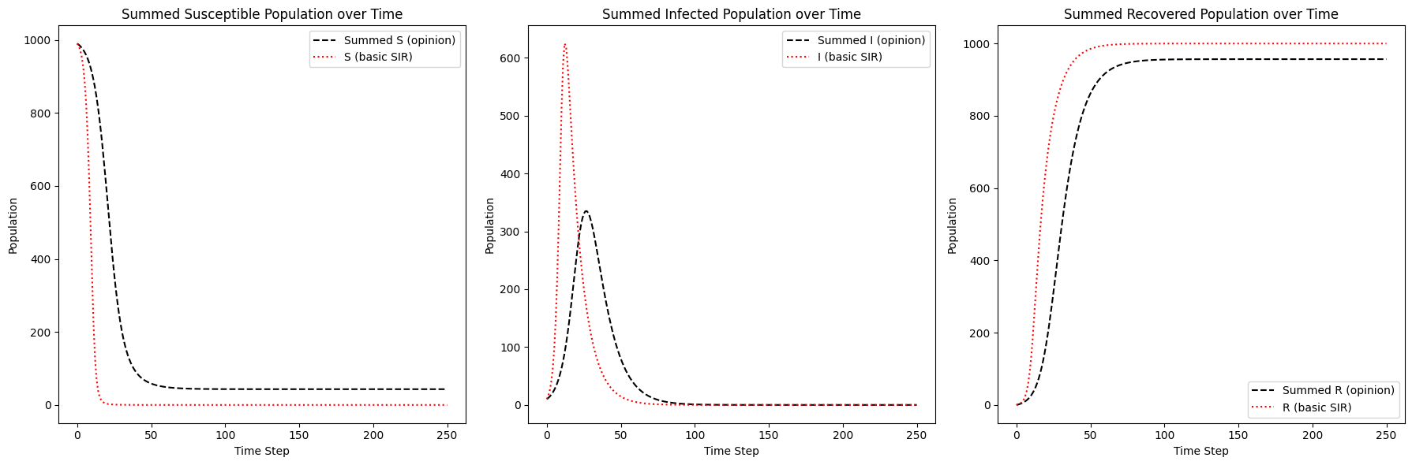
Results
Dynamics of Basic and aggregated (Summed of Opinion) SIR
We can observe, despite the trivial conditions the aggregated model damps the spread of infection than the Basic SIR model.

Slide 15
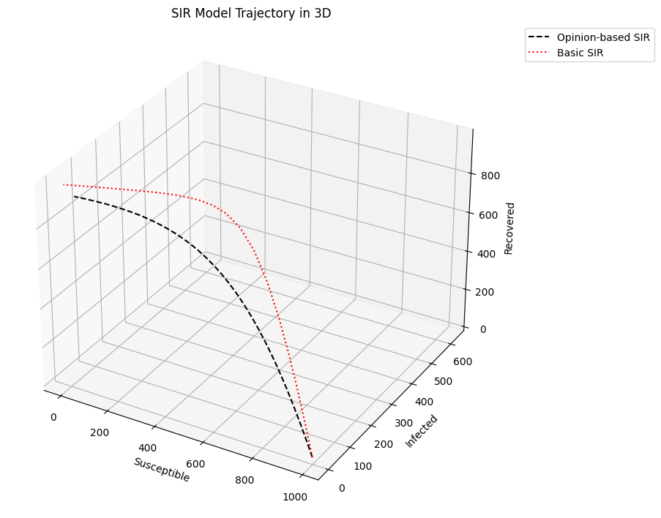
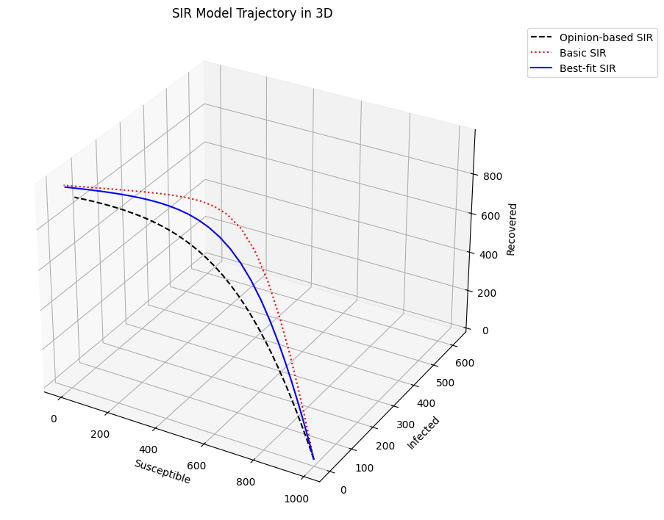
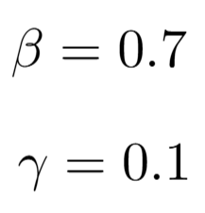
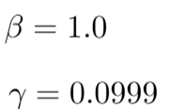
Results
Dynamics of Basic ,aggregated , and Fitted SIR in 3D Space
We can observe, that the fitted curve between Basic and Aggregated Opinion based SIR Model. For,
has
in order to the aggregated model to perform as bad as no opinion model, the β should be greater than one.

Slide 16
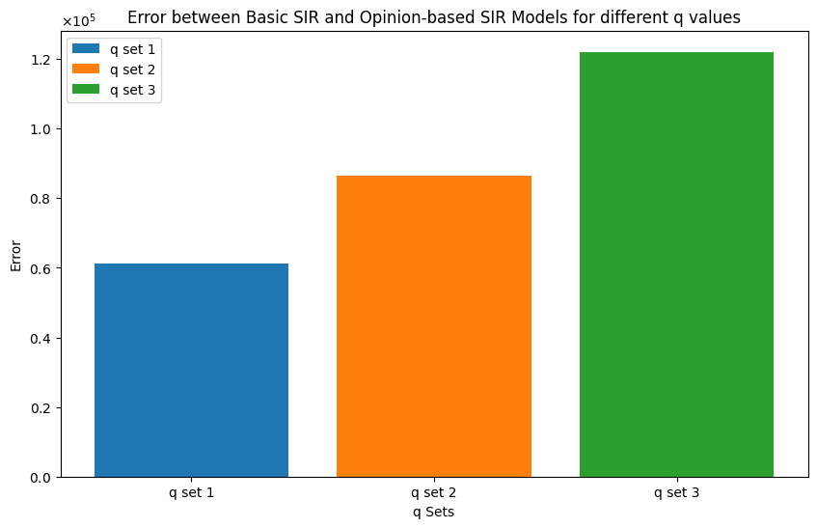
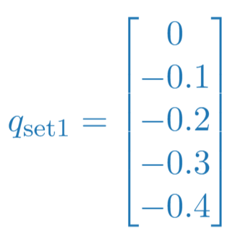
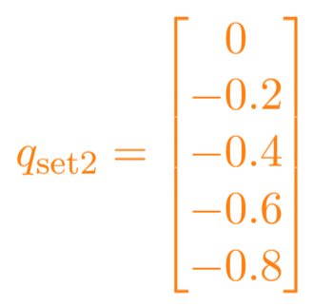
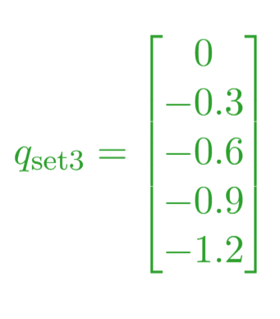
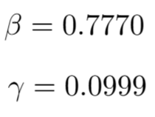
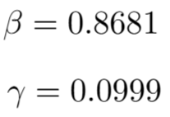
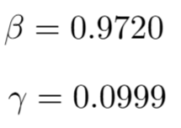
Results
Error Estimations for Varying q (sets) – Implying Different Sections of Society
Medical
Professionals
Non-Med
Professionals
For, β = 0.35, γ = 0.1
Optimized values for each q(set) are:
Students
This result indicates that the population with higher opinions can withstand higher infection rate (optimized β ) than population with no Opinion dynamics.

Slide 17
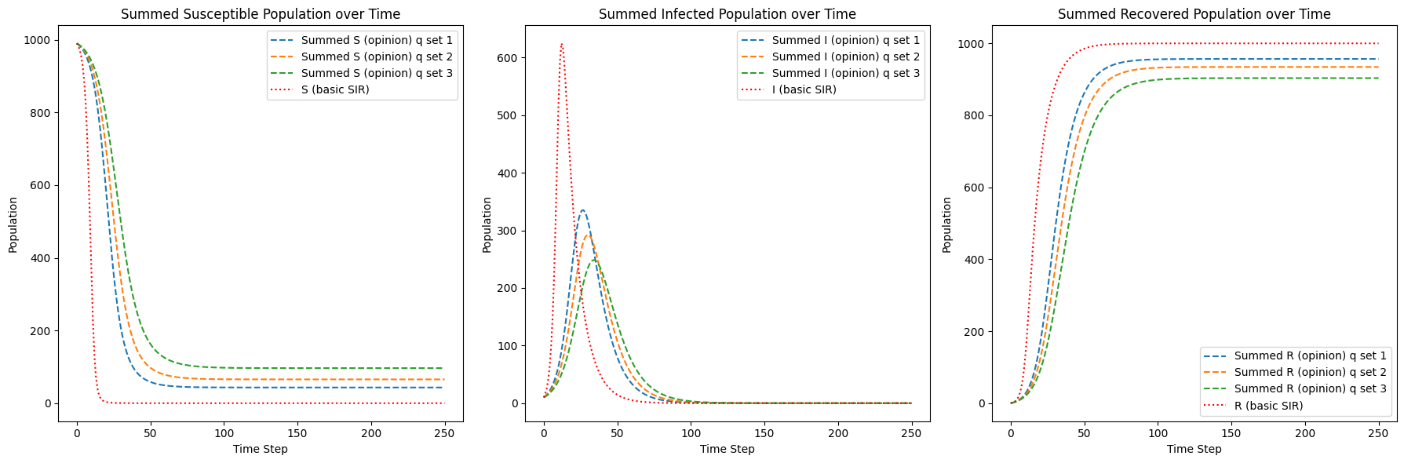
Results
Dynamics for Varying q (sets)
This result indicates:
Reduced Peak Intensity: Higher opinion group correlates with a lower peak in infection rates.
Extended Timeframe: The peak occur later for groups with higher opinion.

Slide 18
Conclusion
The Opinion-based Model effectively captures the dynamics of infectious disease spread across different opinions in population.
The model Reduces Infection Spread, therby Increasing public opinion (cautiousness) significantly decreases infection rates.
The model has potential applications for a wide range of infectious diseases, offering valuable insights for public health.
By continuously adapting and refining the model, we can gain deeper insights into disease control and optimize public health interventions for future outbreaks.

Slide 19
Further Potential Research Topics
Impact of Population Size on Opinion Dynamics : Investigate how different population sizes for each opinion influence the overall dynamics of disease spread and opinion shifts.
Dynamics of Adapting Opinions Under Dominance : Explore how the presence of dominant opinions can lead to different adaptation mechanisms for other opinions, resulting in significant changes in disease spread patterns.
Modeling Disease Spread with SIS Framework : Analyze the dynamics of disease spread assuming a Susceptible-Infectious-Susceptible (SIS) model, and how opinion dynamics integrate within this framework.
Utilizing SoftMax Functions for Opinion Calculation : Evaluate the impact of using different SoftMax functions to calculate opinion strengths and transitions, and how these influence the spread of infectious diseases.

Slide 20
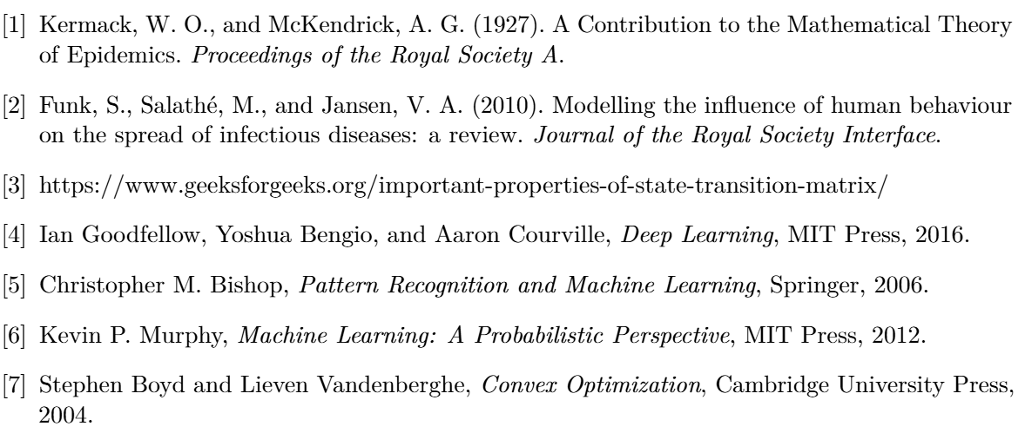
References

Slide 21
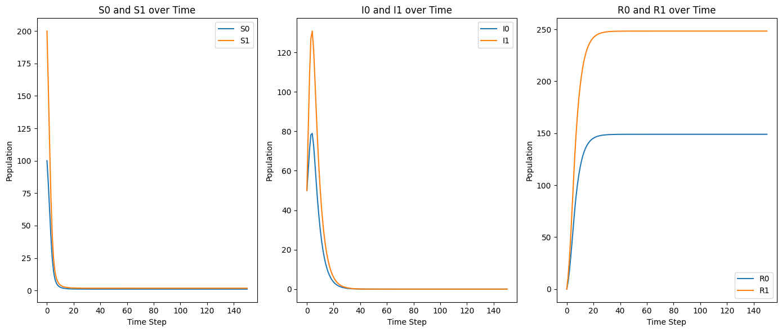
Appendix - I
In the above simulation, we assumed the population is divided equally among all Opinions. By adjusting this assumption, we can observe(for opinions 0 & 1):
Initially,
S0
S1
I0
I1
R0
R1
100
200
50
50
0
0
=
For, β = 0.8, γ = 0.2
At End,
S0
S1
I0
I1
R0
R1
1
2
0
0
149
248
=
The result Implies that disease spread dynamics differ when the population sizes of Opinions vary.

Slide 22
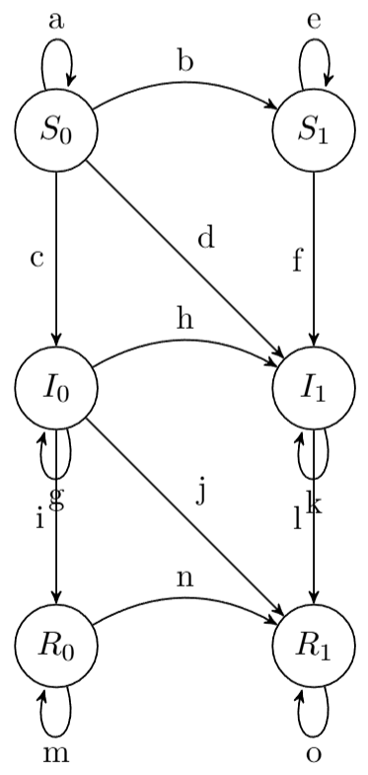
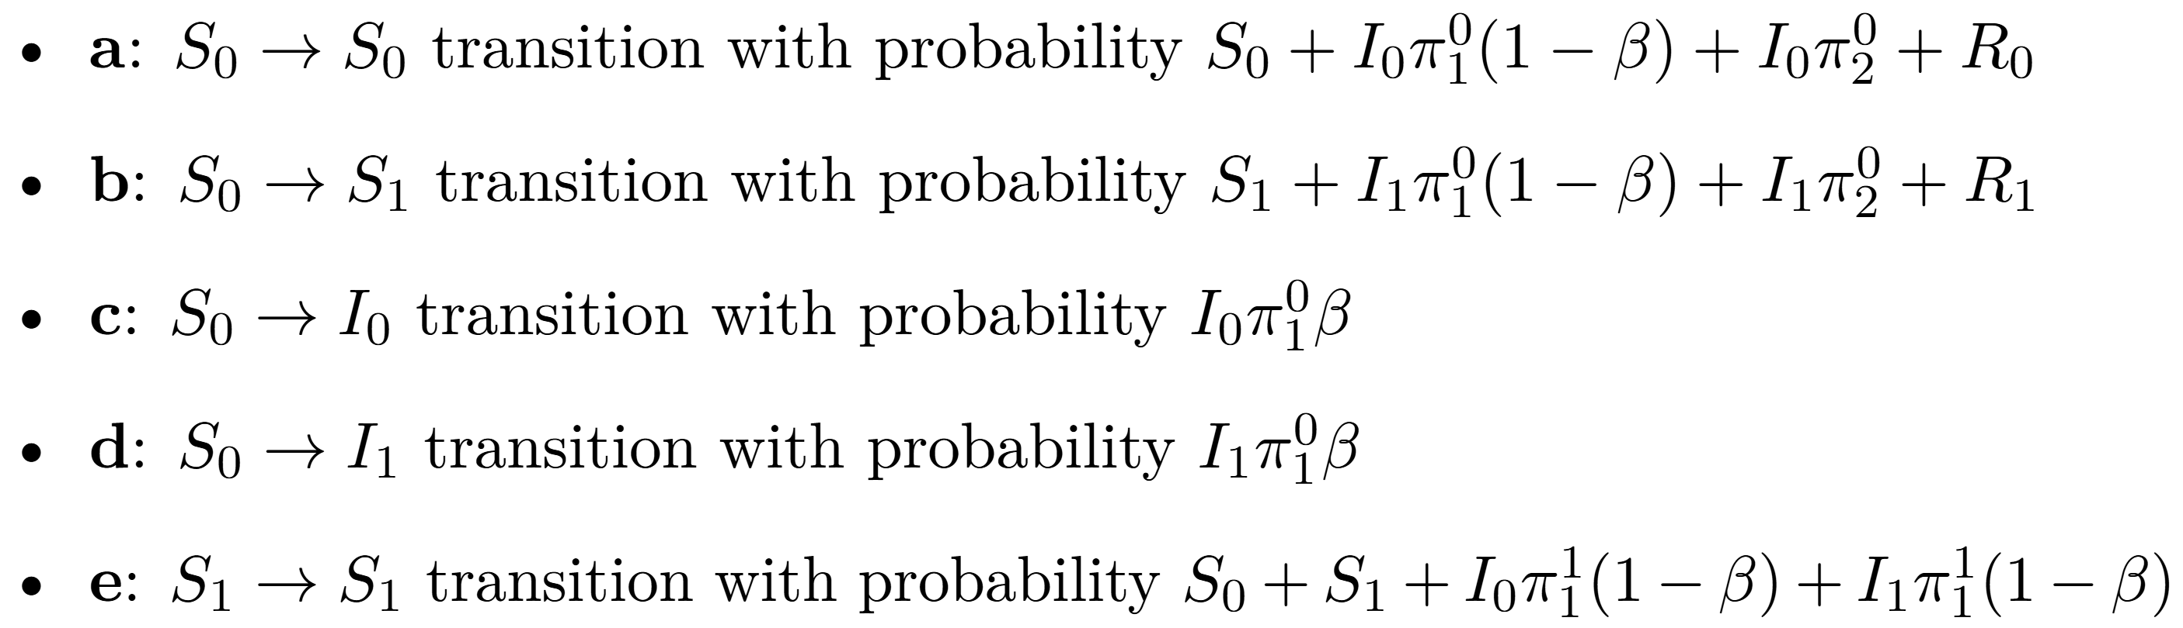
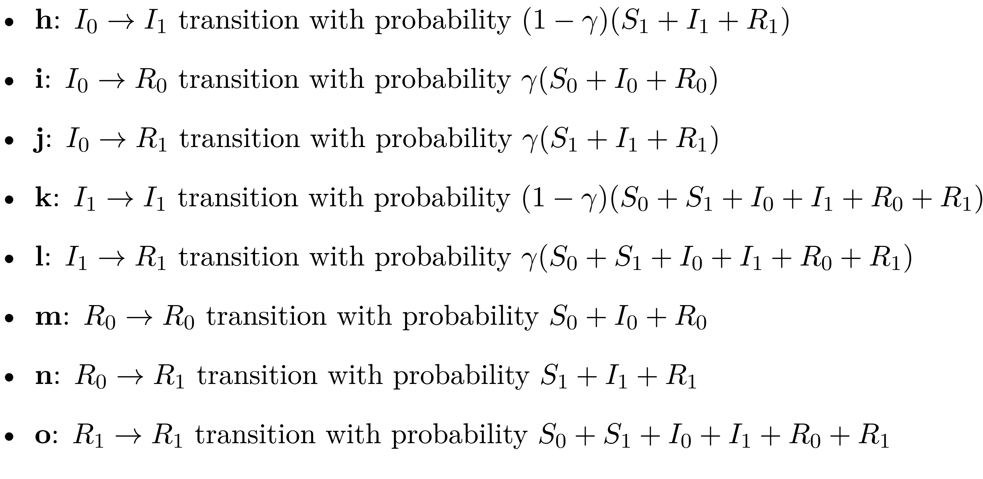
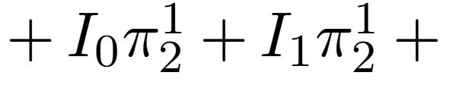
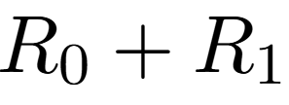
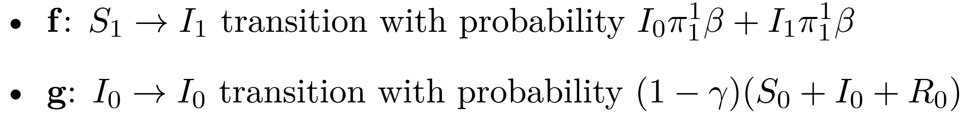
Appendix - II
In the above model, we assumed that when agent 1 meets the agent 2 ,agent 1 adopts agent2’s opinion. However, what if there is dominance in the opinion dynamics? Here, we assumed that agent with a higher opinion will not adopt a lower opinion. By adjusting this assumption, we can observe (for opinions 0 & 1):
Markov Chain
Transition Probabilities:

Slide 23
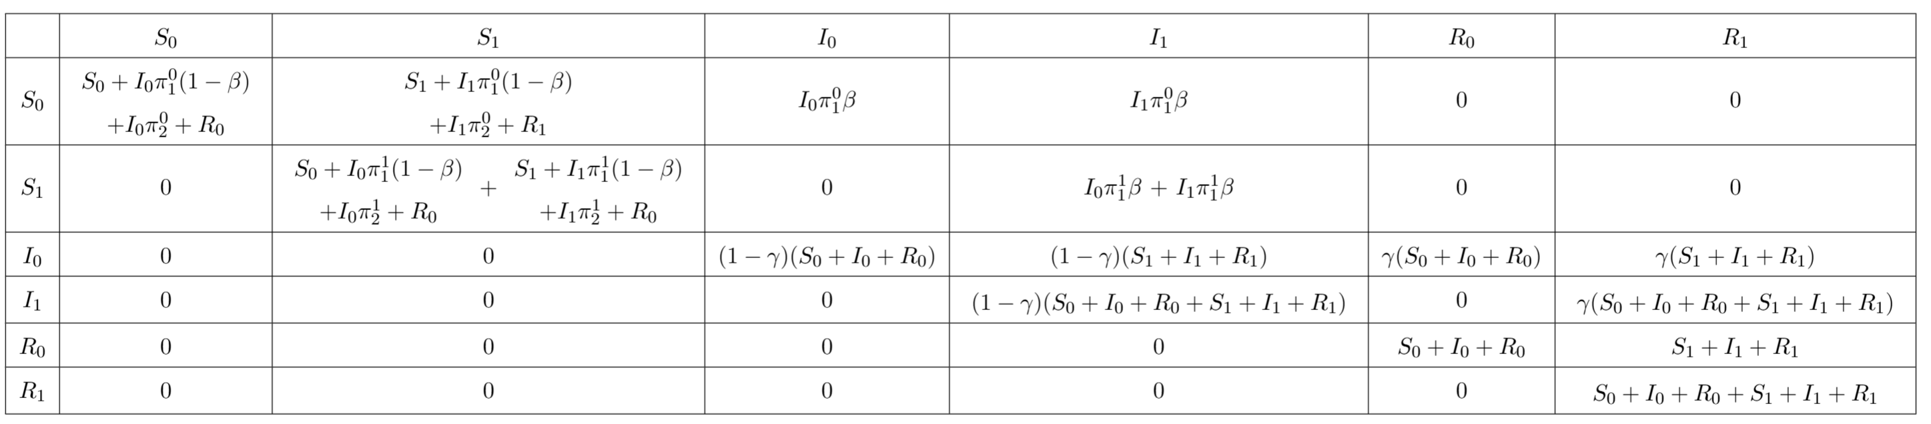
Appendix - II
Transition Matrix :
System of Equations :
T
T

Slide 24
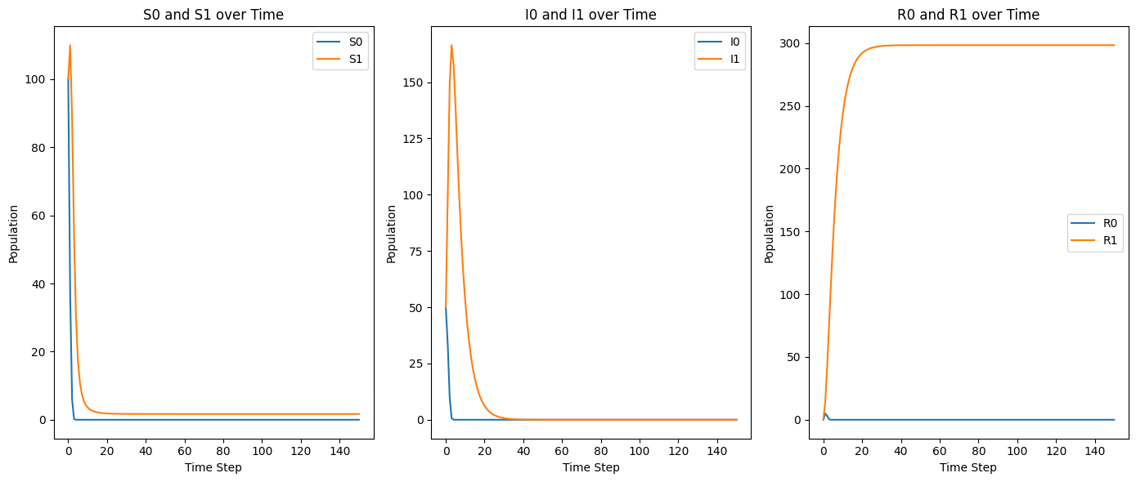
Appendix - II
Result
Initially,
S0
S1
I0
I1
R0
R1
100
100
50
50
0
0
=
For, β = 0.8, γ = 0.2
At End,
S0
S1
I0
I1
R0
R1
0
2
0
0
0
298
=
The result Implies that due to the dominating opinion, the lower opinion vanishes completely.

