Slide 1

STOCK MARKET ANALYSIS
MOHD laraib momin

Slide 2
Aim
Method for Investors and Traders to make Buying and Selling Decisions. Fundamental share Market Analysis is about using Real data to evaluate a Stock’s value.
Analysis that allows trading firms to analyze large patterns of stock market data and loop For possible permutations to increase returns and reduce risk.
Performing the Financial Analysis on Historic Stock Market Data such as calculating various risks, returns, etc.

Slide 4









TOOLS Used:

Slide 5
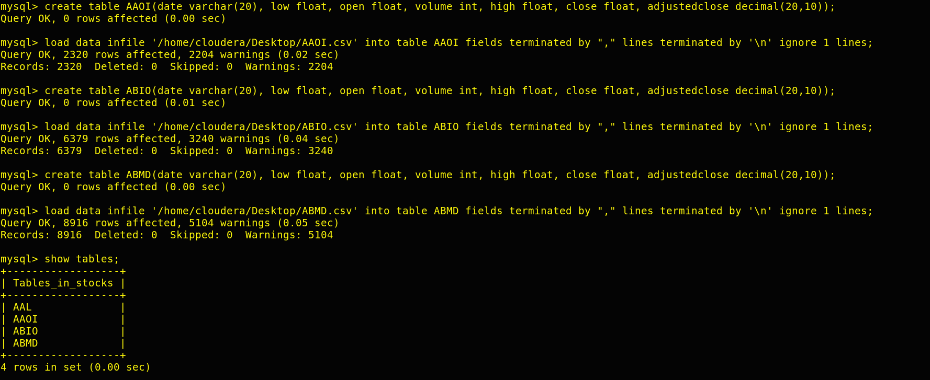
Steps :
Step 1: Transferred the csv file from C:\Users\Admin\Downloads to /home/cloudera/Desktop/
Step 2: Created a directory on Hadoop by using hadoop fs -mkdir wallmartproject
Step 3: Created a database called stocks then created all 4 tables and removed their headers.
load data infile '/home/cloudera/Desktop/ABMD.csv' into table ABMD fields terminated by "," lines terminated by '\n' ignore 1 lines;

Slide 6
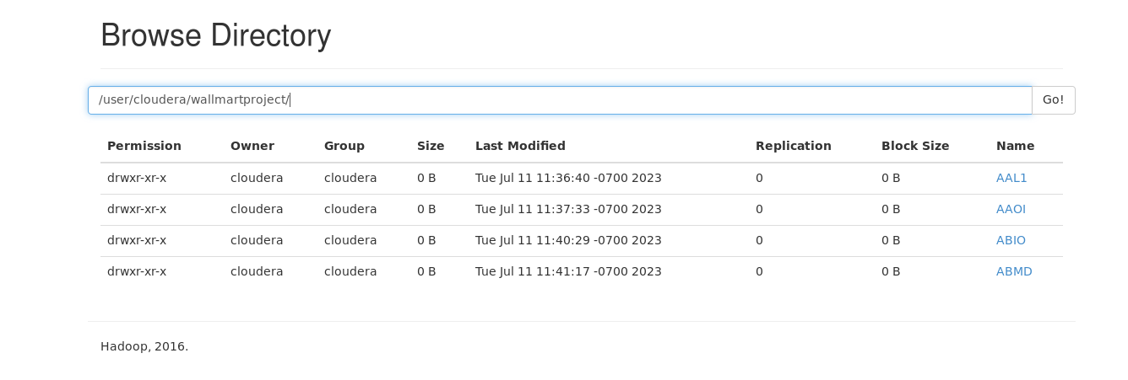
Steps cont.…
Step 4: I have transferred all these tables to Hadoop from mysql.
Command:
sqoop import-all-tables --connect jdbc:mysql://localhost:3306/stocks --username root -password cloudera --warehouse-dir /user/cloudera/wallmartproject/ -m 1

Slide 7
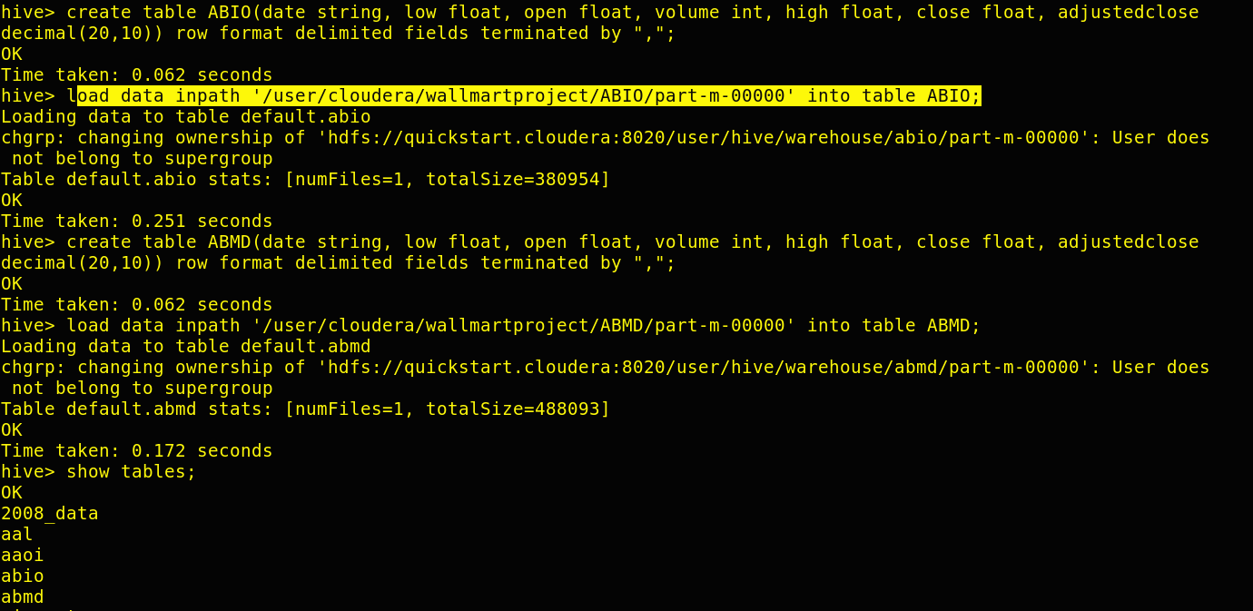
Steps cont.…
Step 5: Loading hdfs data into hive tables
Here we have to create all the tables and load the data by using command:
Create table command:
create table ABIO(date string, low float, open float, volume int, high float, close float, adjustedclose decimal(20,10)) row format delimited fields terminated by ",";
Loading data from hdfs to hive table command:
load data inpath '/user/cloudera/wallmartproject/ABIO/part-m-00000' into table ABIO;

Slide 8
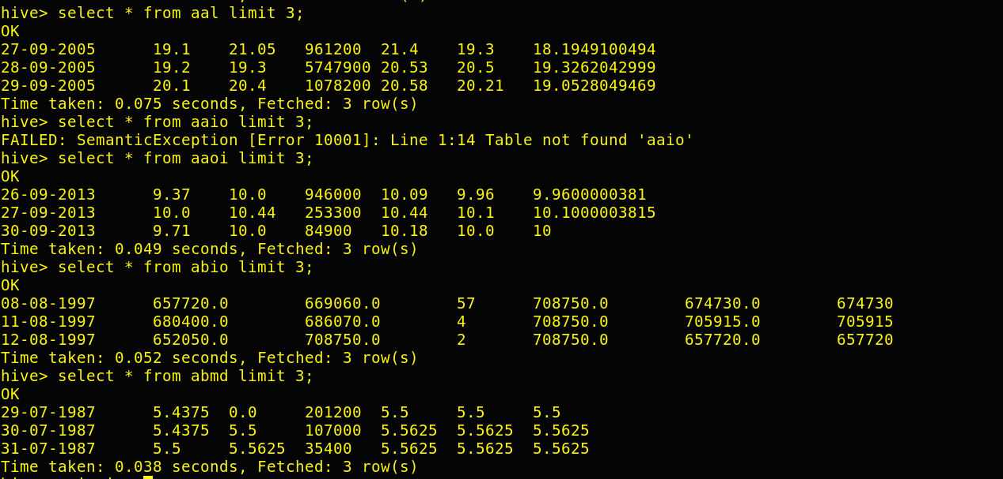
displaying 3 records from each hive table:

Slide 9
Steps cont.…
Step 6: After running the HIVE query I have made an external table in a new directory /user/cloudera/projectresult for each result and stored the result in that table. External table creation query and insert query is given below in each question
Step 7: After making external table and inserting data into that table, I have made same number of tables in mysql in a new database with name project_result and exported the data to there by using sqoop query:
Eg:
sqoop export --connect jdbc:mysql://localhost:3306/project_result --username root --password cloudera --table scenario3_ext_abmd --export-dir /user/cloudera/projectresult/scenario3_ext_abmd/000000-0 --input-fields-terminated-by ','

Slide 10
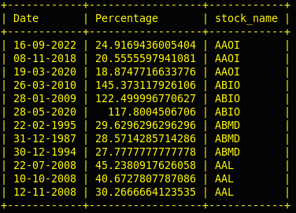
Hive Scenario1: Write a Hive query to identify the top three dates that experienced the largest percentage change in stock price (from open to close) for every stock.
select date, (abs(close-open)/open)*100 as per from aal/aaoi/abio/abmd order by per desc limit 3;

Slide 11
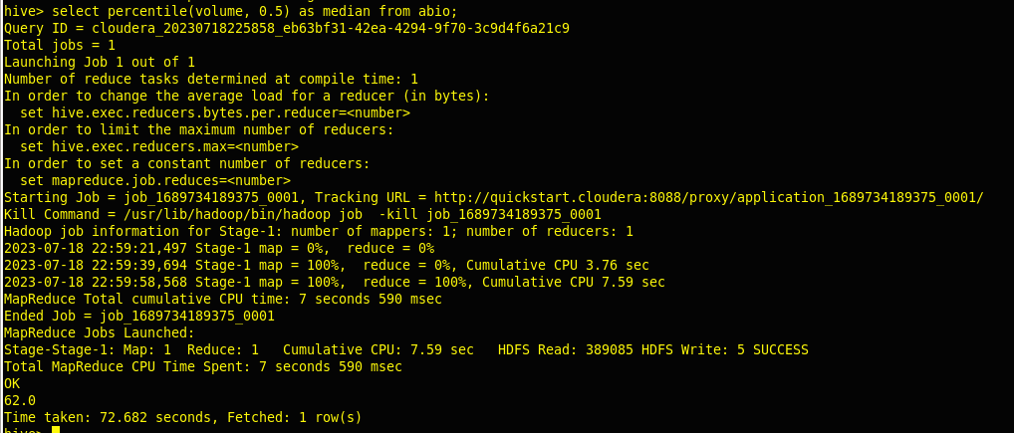
Hive Scenario 7: Find the median of volume for ABIO.
select percentile(volume, 0.5) as median from abio;

Slide 12
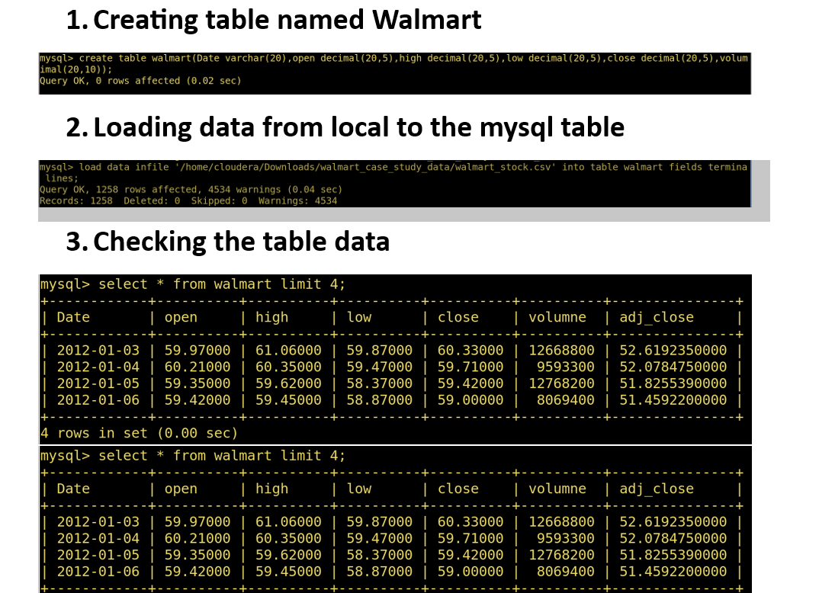
LOADING DATA FROM LOCAL SYSTEM TO MYSQL

Slide 13
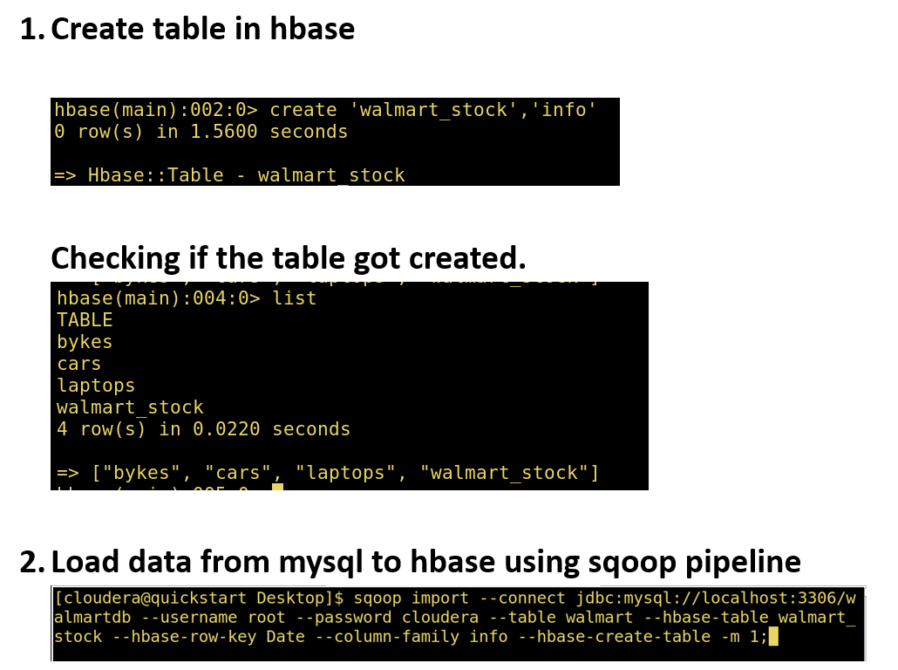
Loading data into HBase :

Slide 14
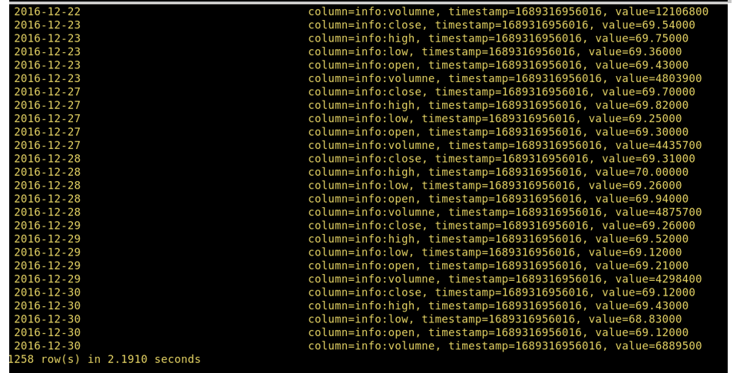
HBase SCENARIO : PRINT OUT FIRST 5 COLUMNS

Slide 15
SPARK PIPELINE:

Slide 16
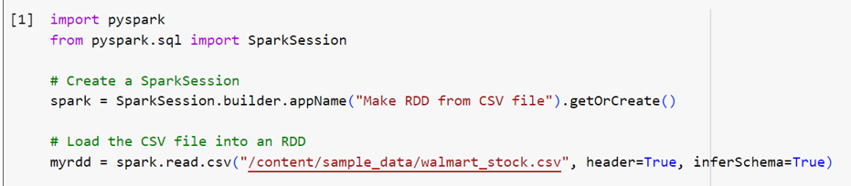
PYSPARK & Spark SQL SCENARIOs:
Scenario 2: There are too many decimal places for mean and stddev in the describe() data frame. Format the numbers to just show up to two decimal places.

Slide 17
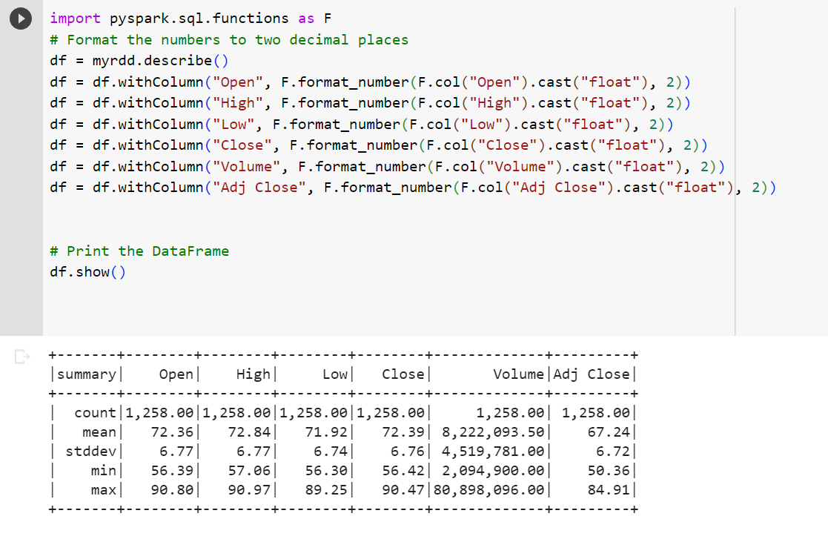

Slide 18
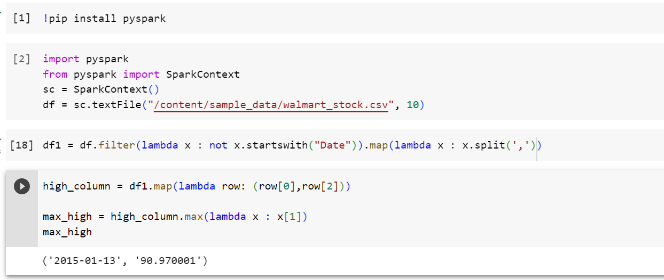
Scenario 4: What day had the Peak High in Price?

Slide 19
Directed Acyclic Graph (DAG) : A DAG, or directed acyclic graph, is a data structure that represents a sequence of operations. In the context of Spark, a DAG represents a sequence of Spark jobs.
There will be 3 DAGs created in my code.
The first DAG will be created when the df DataFrame is created.
The second DAG will be created when the df1 DataFrame is created.
The third DAG will be created when the max_high RDD is created.
The code creates three Spark jobs:
The first job reads the CSV file into a DataFrame.
The second job filters the DataFrame to remove the header row.
The third job finds the maximum value in the high column.
Each of these jobs creates a DAG. The DAGs are created in a sequential order, with the first job creating the first DAG, the second job creating the second DAG, and so on.

Slide 20
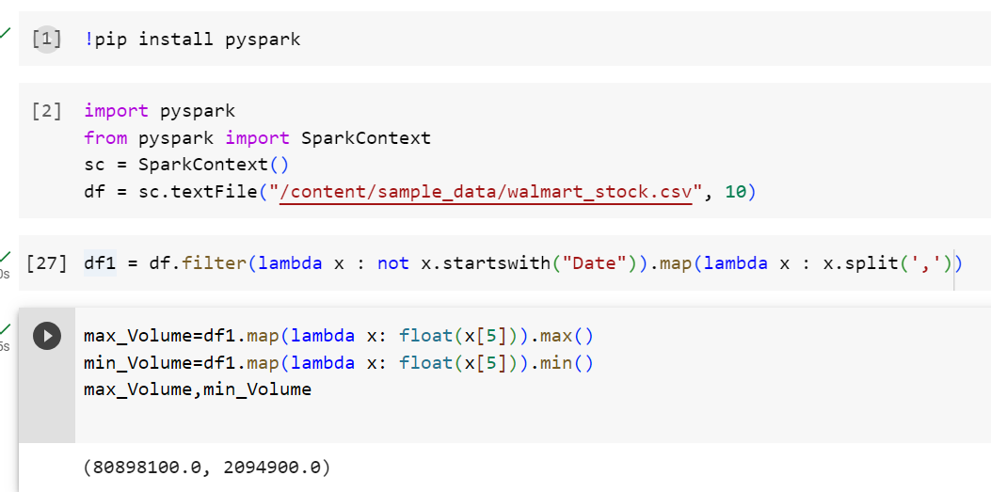
Scenario 6: What is the max and min of the Volume column?
In my code snippet, 10 is passed as the minPartitions parameter, indicating that I want the resulting RDD to have a minimum of 10 partitions. This parameter helps in parallelizing the read operation and achieving better performance when processing large datasets.

Slide 21
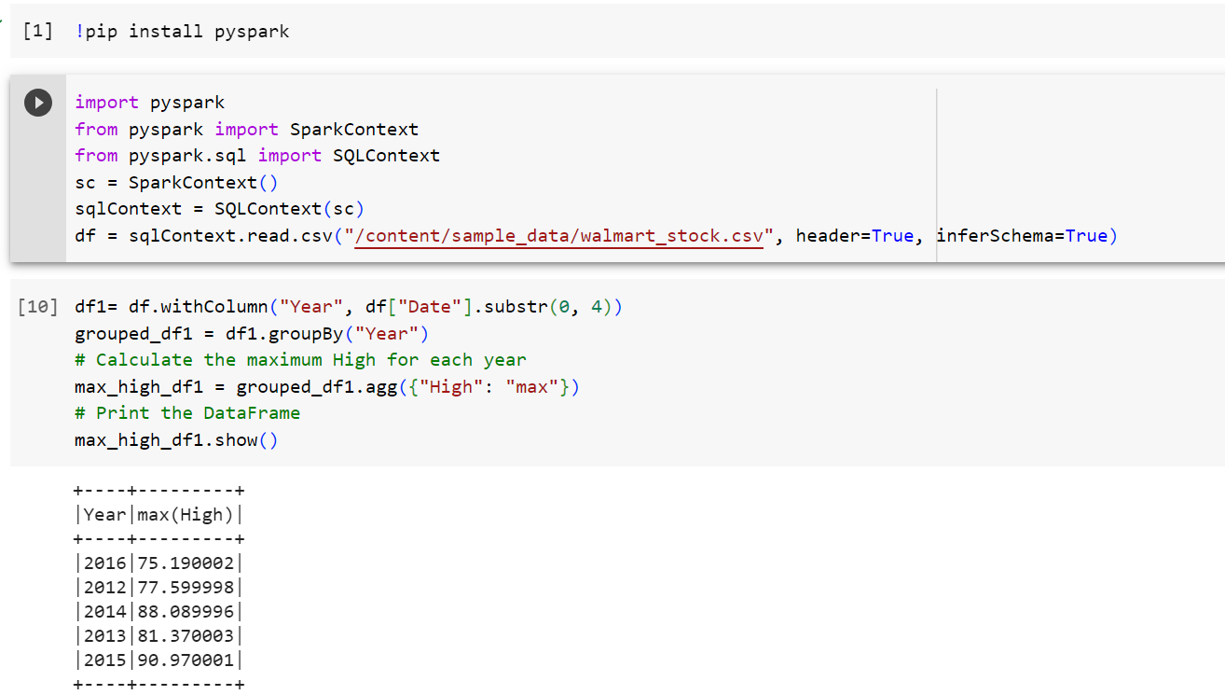
Scenario 9: What is the max High per year?

Slide 22
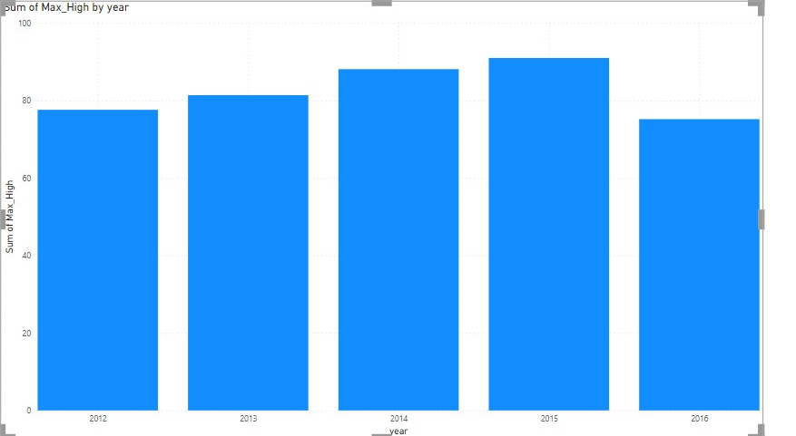
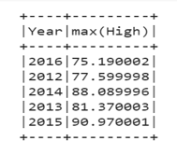
Visualization Scenario 9:

Slide 23
Insight:
Potential Growth: In general, if we consider the highest "High" value recorded for each year, there is an upward trend from 2012 (77.59) to 2015 (90.97). This suggests potential growth in the stock's value during this period.
Factors Influencing the Decline: Several factors can contribute to the decline of a stock's high value. These factors can include changes in market conditions, economic indicators, company-specific news, industry trends, competition, or shifts in investor sentiment. Additional information beyond the dataset is required to pinpoint the specific factors impacting Walmart stock in 2016.

Slide 24
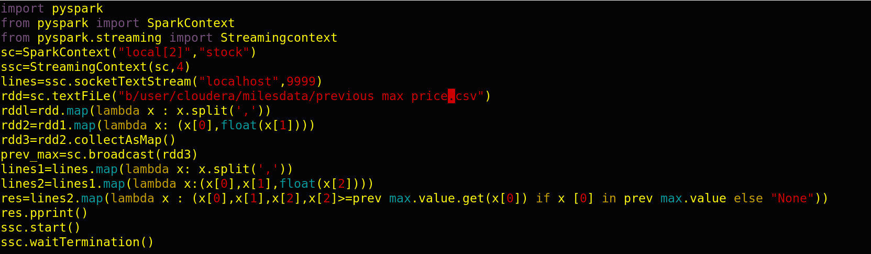
Spark streaming scenario: We have NYSE stock data set. One file has the maximum stock price of the previous day consisting of stock symbol of the company and the previous max price. The other is streaming data each record of which consists of the stock symbol, time stamp in HH:MM:SS format and the current stock price.

Slide 25
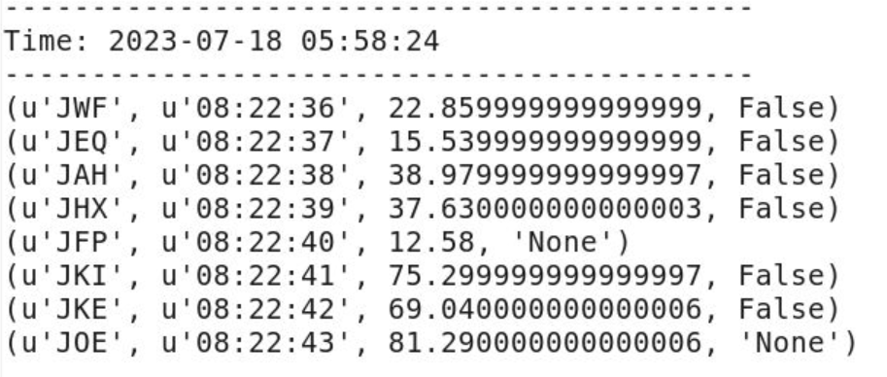
output

Slide 26

Acknowledgement
"I would like to express my deepest gratitude and appreciation to my trainer DE Expert Venkata S Billa.
Their unwavering dedication, expertise, and support throughout my training journey have been instrumental in my personal and professional growth. His guidance and encouragement have inspired me to push my limits. I am incredibly fortunate to have had such an amazing trainer who truly invested in my success. Thank you for your passion, patience, and unwavering commitment to my development. I am forever grateful for the impact you've had on my life."

Slide 27
THANK YOU

