Slide 1



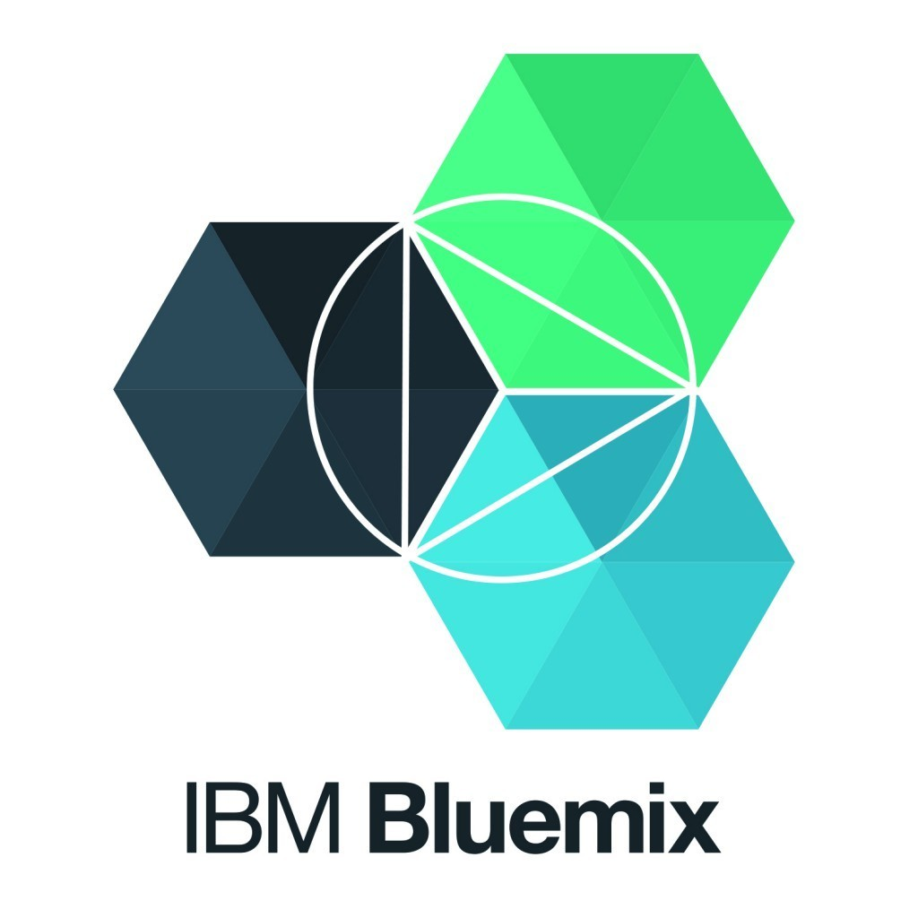
Blockchain Interoperability Technical Architecture Experiment # 1
Blockchain Explorer
G R P C
R
E S T I
N T
FrontEnd Server
R
E S T I N T
Client
WebApp1
REST Server
Client
WebApp2….
Client
WebApp2
Blockchain Explorer
Bi-Directional Data Flow

