Slide 1
AI Food Donation Assistant
SDG - SDG 2: Zero Hunger
Intern Name: Mohammed Abdul Rahman
University: JNTUH University College of Engineering Palair
AICTE Student ID: STU6976153e7cc851769346366
Internship Program: 1M1B AI for Sustainability Virtual Internship
Internship Domain: Artificial Intelligence & Sustainability
Project Title: AI Food Donation Assistant
SDG: SDG 2 – Zero Hunger
Tools Used: Python, Streamlit, Pandas
Duration: 6 Weeks

Slide 2
Problem Statement SDG – SDG 2:Zero Hunger
Food waste and hunger exist simultaneously in many communities. This project aims to help donors share surplus food efficiently and support NGOs and volunteers in reaching people in need.

Slide 3
Proposed Solution
A Streamlit-based application that records food donations, organizes data, allows filtering of donations, and displays donation statistics.

Slide 4
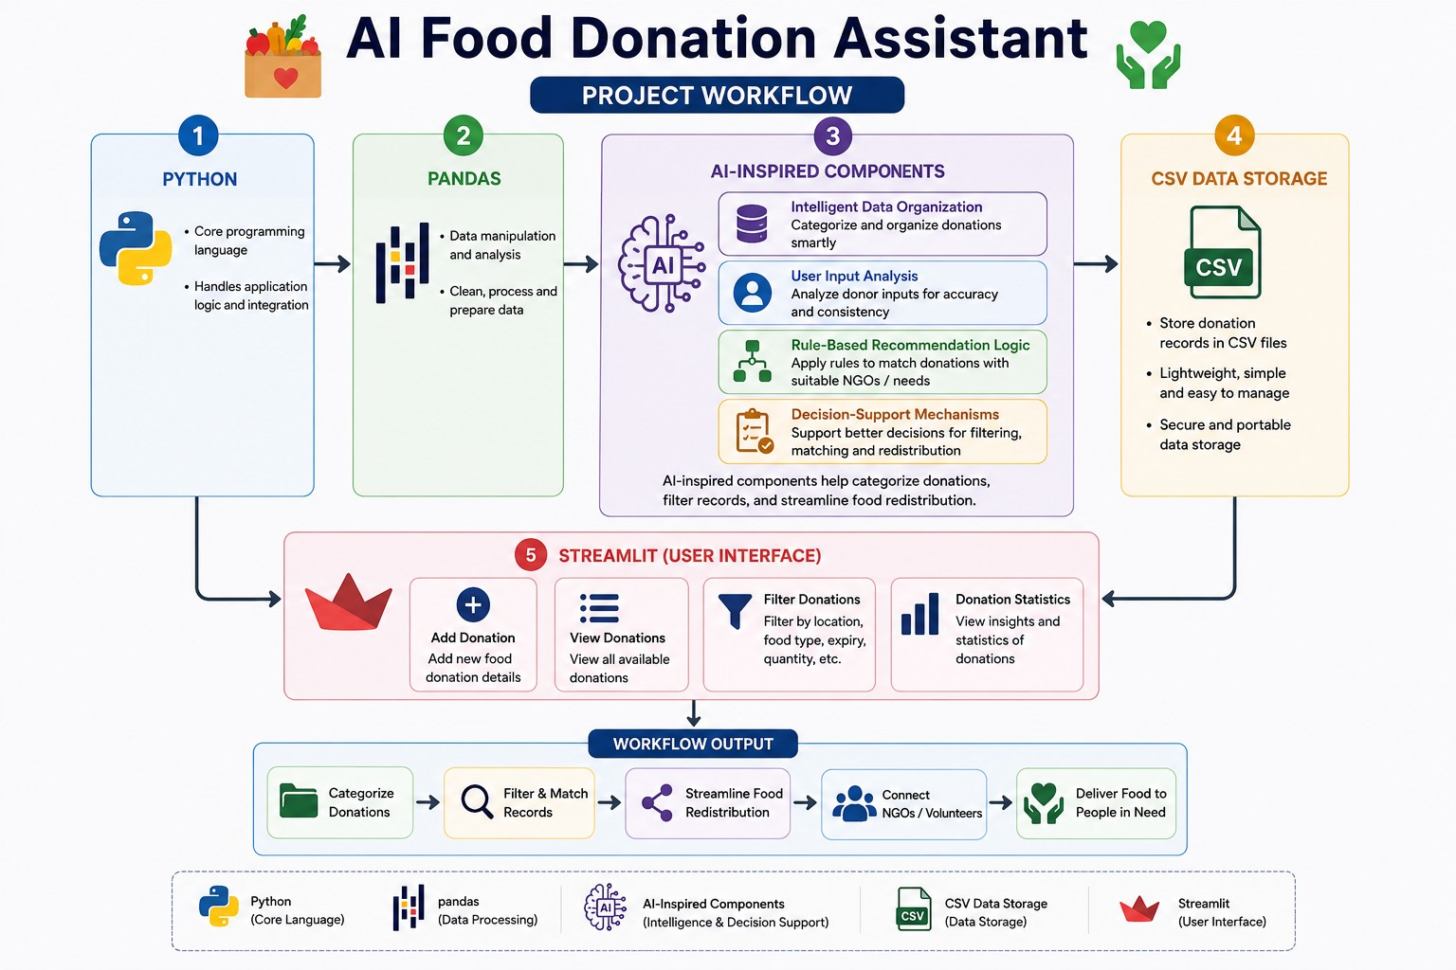
Project WorkFlow

Slide 5
Technologies Used
Python
Streamlit
Pandas
CSV Data Storage
AI-inspired Components:
User Input Analysis
Intelligent Data Organization
Rule-Based Recommendation Logic
Decision Support Mechanisms

Slide 6
Impact
Supports SDG 2: Zero Hunger by encouraging food donation, reducing food waste, and helping NGOs and volunteers identify available food resources.

Slide 7
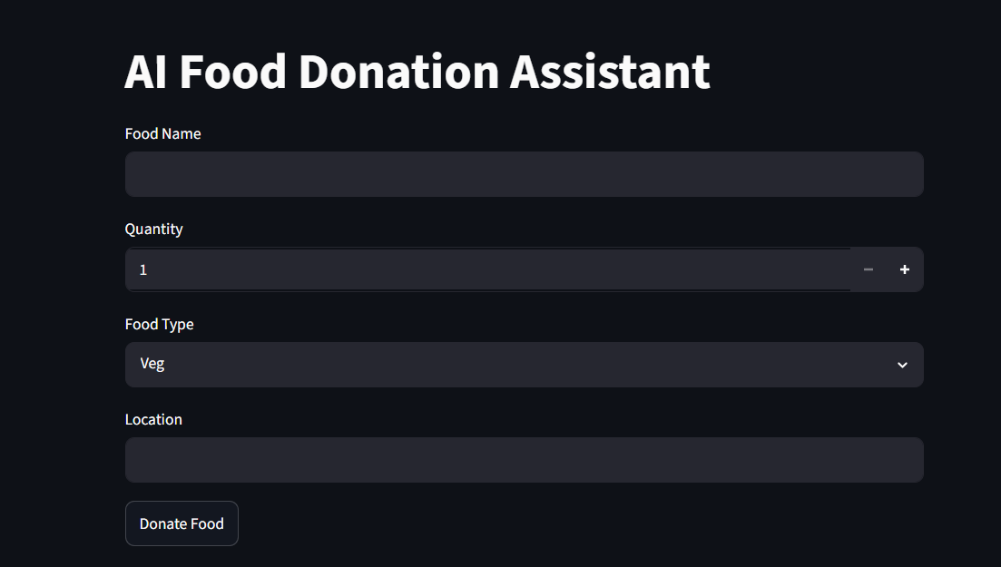
Result Images AI Food Donation Assistant Streamlit application user interface-

Slide 8
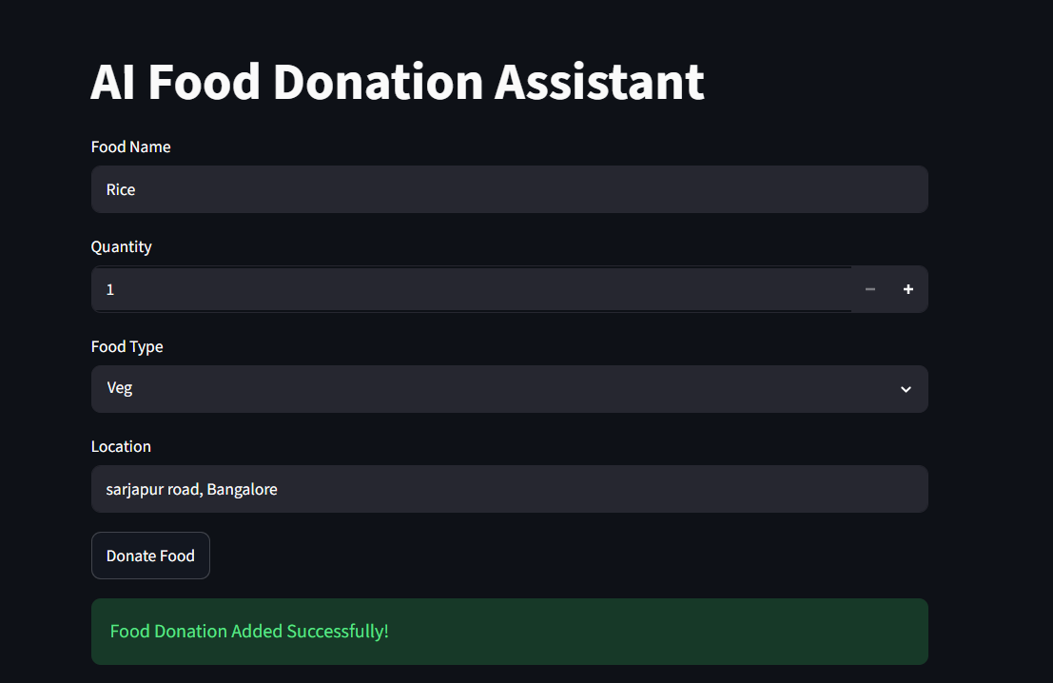
AI Food Donation Assistant user interface result-

Slide 9
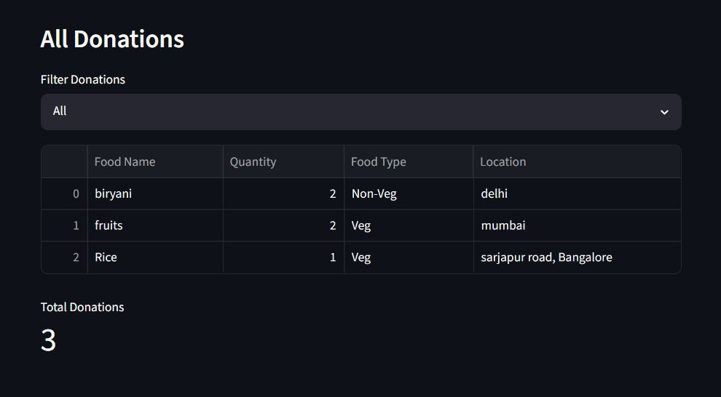
AI Food Donation Assistant application csv data storage of all donations-

Slide 10
Project links -
Github repository link – https://github.com/mohdrahman-ai/AI-Food-Donation-Assistant
Streamlit app link - https://ai-food-donation-assistant.streamlit.app/

