Slide 1

Project Title - Seasonal Agriculture Performance Analysis
Student Name – Mohammad Sahil
College Name - Rajkiya Engineering College Azamgarh
AICTE STU ID : STU69b7b6fc933501773647612

Slide 2

PROBLEM STATEMENT
Farming outcomes change a lot from one season to the next — rainfall, temperature, soil conditions, resource use and market prices all shift with the season.
But raw agricultural data alone doesn't clearly explain how performance changes across seasons, or what patterns lie behind those changes.
This project analyzes real farm-level data across three seasons — Kharif, Rabi and Zaid — to uncover meaningful seasonal patterns, relationships and differences in yield, cost, profit and resource use

Slide 3
Project Description
We analyzed 4,000 farm records spanning 8 states, 8 crops and 3 seasons — covering rainfall, soil health, resource usage, yield, cost, revenue and profit.
The workflow: clean and prepare the data (season + crop specific handling of missing rainfall, soil moisture and yield readings), add performance metrics like profit margin and cost per tonne, then compare yield, cost, profit, resource use and risk across the three seasons.
The findings are visualized through 9 charts and a summary dashboard, and turned into clear, evidence-based recommendations for seasonal agricultural planning.

Slide 4

WHO ARE THE END USERS?
Farmers and agronomists planning sowing, irrigation and fertilizer schedules season by season
Agricultural departments and policymakers designing season-specific advisories
Agri-input companies planning fertilizer and pesticide supply around seasonal demand
Researchers and students studying seasonal trends in agricultural performance
Agri-fintech and crop insurance providers assessing seasonal risk

Slide 5

Technology Used
Python (Pandas, NumPy) — loading, cleaning and feature engineering
Matplotlib and Seaborn — visual analysis (9 charts + summary dashboard)
Jupyter Notebook — complete, documented, function-based analysis
IQR method — outlier detection on yield, profit and production values
Group-by based statistics — season-wise and state-wise performance comparison

Slide 6
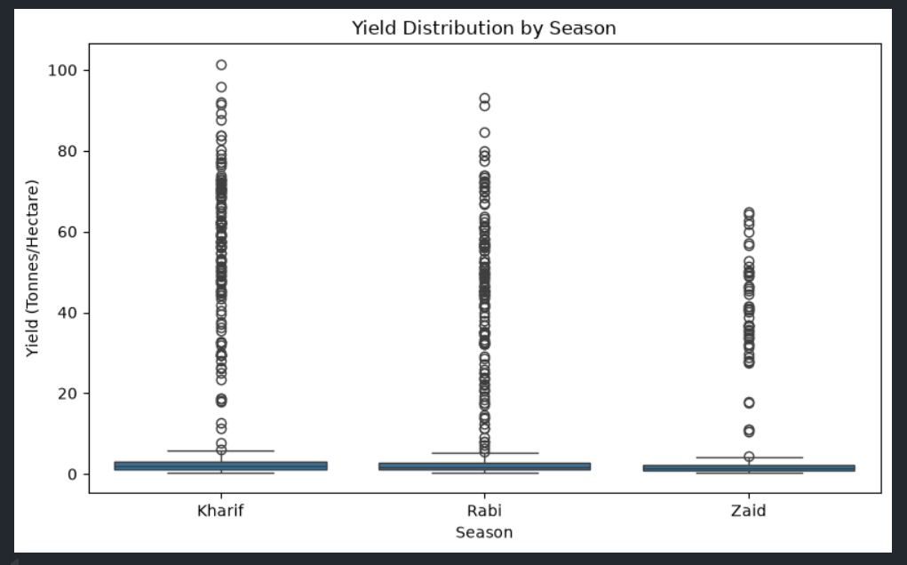
RESULTS
Yield Varies Sharply Across Seasons
Kharif farms average the highest yield (5.63 t/ha), helped by monsoon rainfall and high humidity. Zaid — the hot, dry season — averages the lowest yield (4.64 t/ha).

Slide 7
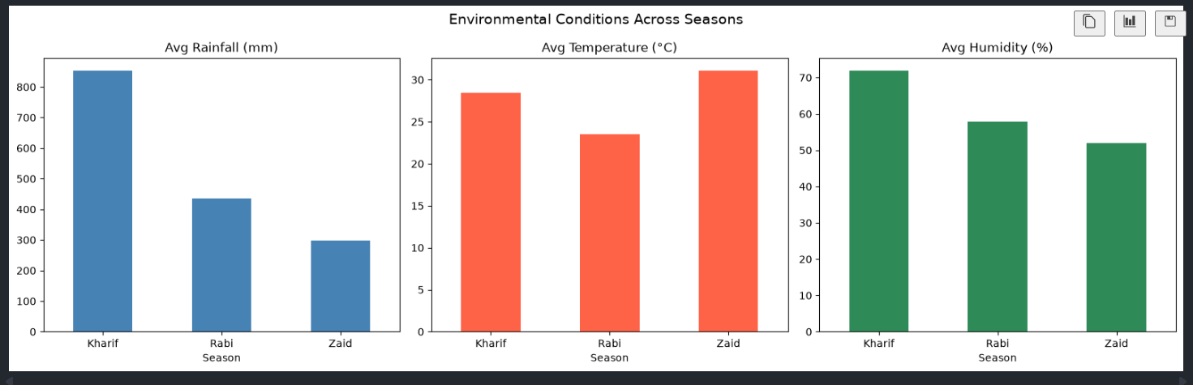
RESULTS
Environmental Conditions Shift Dramatically by Season
Rainfall falls nearly 65% from Kharif (852 mm) to Zaid (299 mm), while Zaid is also the hottest (31°C) and driest (52% humidity) season — a tough combination for crops.

Slide 8
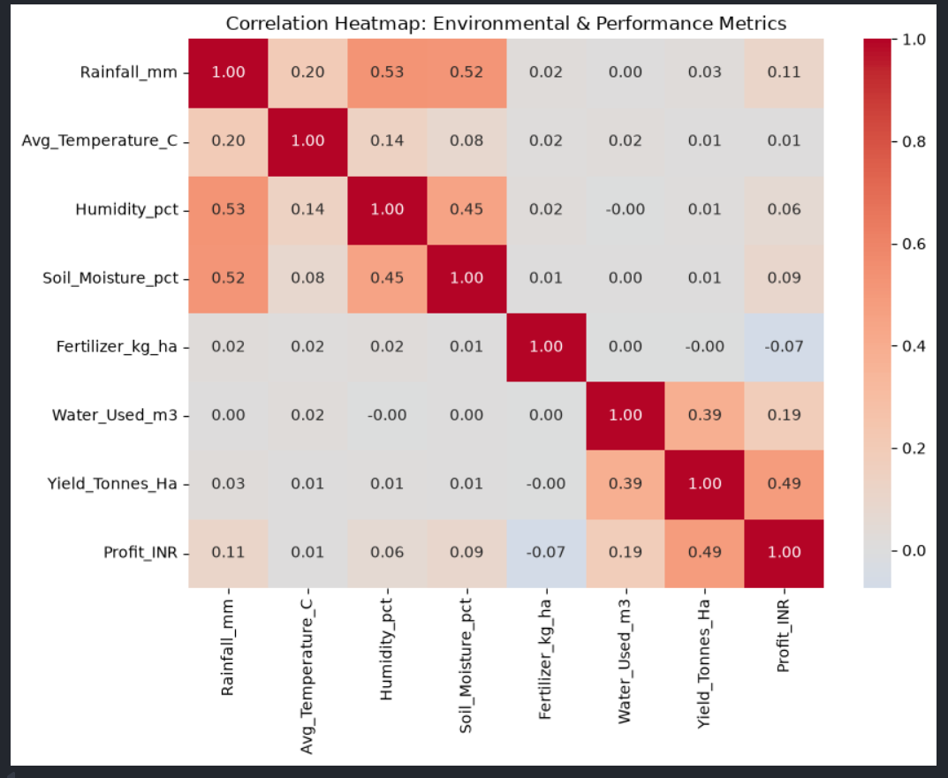
RESULTS
Water Use Matters More Than Rainfall Alone
Among environmental factors, water usage has the strongest link to yield (correlation 0.39) — much stronger than rainfall, temperature or humidity, showing irrigation management is key.

Slide 9
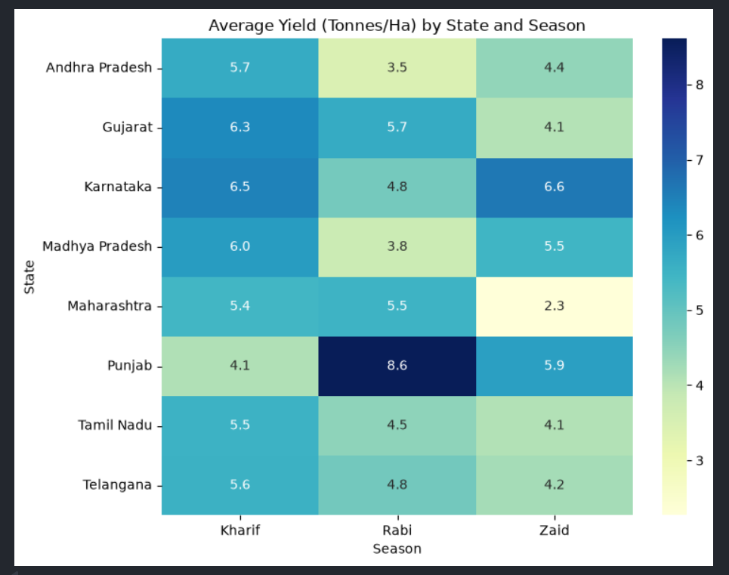
RESULTS
Seasonal Patterns Differ From State to State
Punjab bucks the overall trend — its best season is Rabi (8.61 t/ha), not Kharif. Maharashtra sees the steepest seasonal drop, falling to 2.27 t/ha in Zaid.

Slide 10
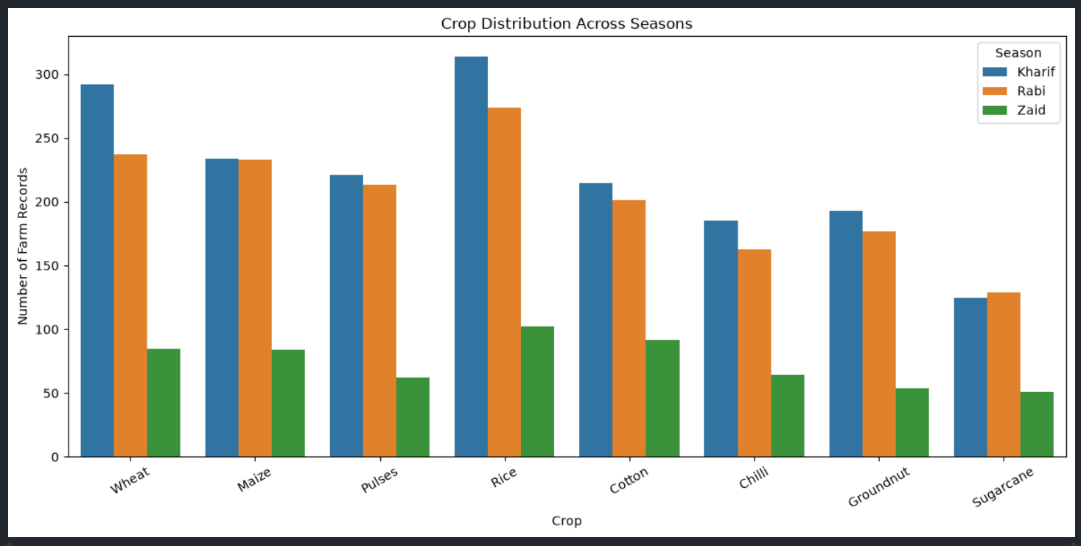
RESULTS
Crop Distribution Across Seasons

Slide 11
Future scope
Build a season-wise yield and profit prediction model using regression or machine learning
Create an interactive dashboard (Power BI / Streamlit) for real-time seasonal advisories
Bring in weather-forecast data to move from descriptive analysis to predictive planning
Investigate why Zaid season shows losses despite lower pest/disease risk — a deeper cost study
Expand the dataset to more states and years for broader, more generalizable insights

Slide 12
GitHub Link
GitHub Link - https://github.com/mohdsahil00736/Seasonal-Agriculture-Performance-Analysis

Slide 13
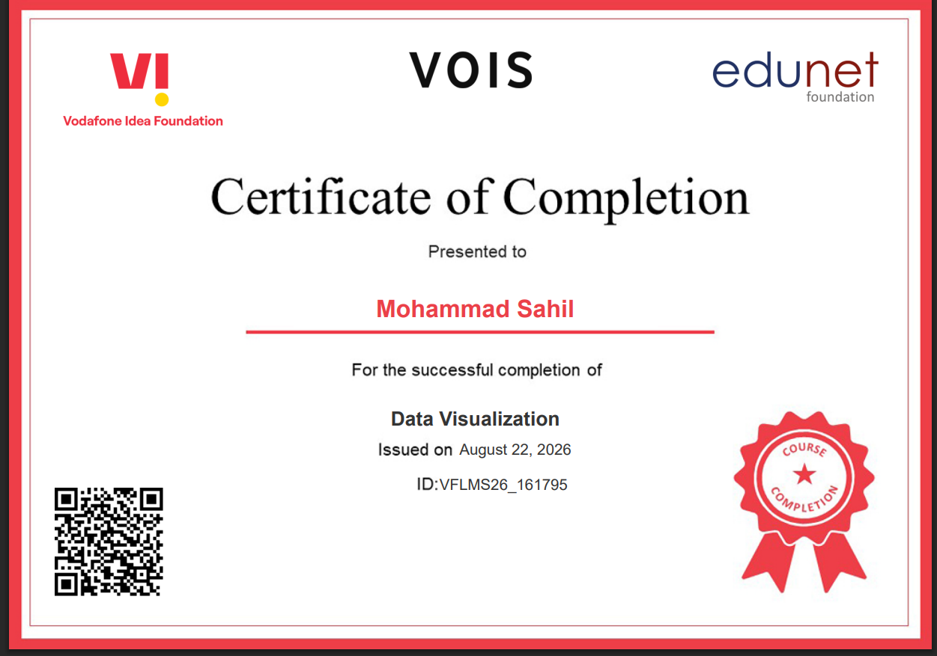
VOIS Course completion certificate -
Course name- Data Visualization

Slide 14
Thank you
.
.

