Slide 1
PUNE VIDYARTHI GRIHA’S COLLEGE OF ENGINEERING AND TECHNOLOGY DEPARTMENT OF E&TC AY:2020-21
IITB DSP MOOC INTERNSHIP
Guided By: Vikram Gadre Sir

Slide 2
IMAGE STEGANOGRAPHY USING DISCRETE WAVELET TRANSFORM
SUBMITTED BY:
Suraj Swamy
Shruti Katyarmal
Sonal Datere

Slide 3
MOTIVE:
Image Steganography is the practice of concealing an image within another, such that no one, other than the sender and the intended recipient, even suspects the existence of the image.
One very famous way of doing this is to use Cryptography. But the problem with this method is that the encrypted message is easily identifiable as it is not directly legible.
If someone intercepts this, they would try hard to decrypt it or may not let this message pass ahead.
Message
“Confidential Application Assignment”
Encrypted Message
a743c52e9f1565b32e4f877745db0cbad65e945360fecf4a39a8ca9f21fb9c2

Slide 4
WHAT IS IMAGE STEGANOGRAPHY?
It is the process of concealing an image within another, such that no one, other than the sender and the intended recipient, even suspects the existence of the image.
Unlike Cryptography, where an encrypted message is obvious, Steganography is a form of Security through Obscurity.

Slide 5
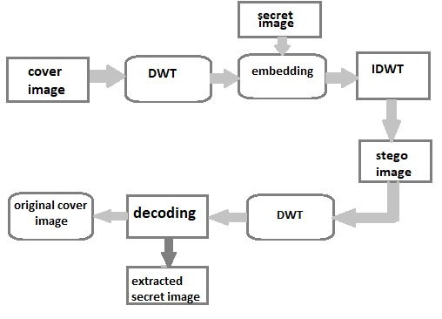
BLOCK DIAGRAM:
TEXT
TEXT

Slide 6
MAJOR STEPS
Embedding text in Cover_Image using DWT [PART-1]
Image steganography using DWT [PART-2]

Slide 7
WHAT ARE DISCRET WAVELET TRANSFORM?
The Discrete Wavelet Transform is similar to the Discrete Fourier Transform other than the fact that instead of decomposing a signal into complex exponentials, it decomposes it into mutually orthogonal functions which are localized in both the real and Fourier space, called wavelets.
These wavelets can be of various types. In our approach, we shall be using the Haar Wavelet.

Slide 8
WHAT IS MULTI STEGANOGRAPHY?
The main idea of this advancement is to embed more than one message.
The hidden secrets can be used as real and false messages, respectively.
This may find many different applications, especially in situations where communication channel between a transmitter and a receiver is closely monitored and the warden suspects that the steganography is used.

Slide 9
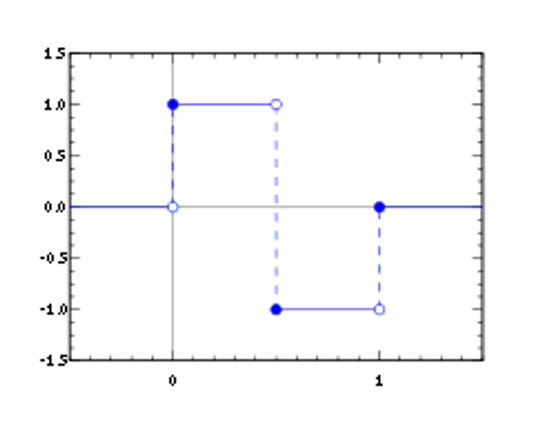
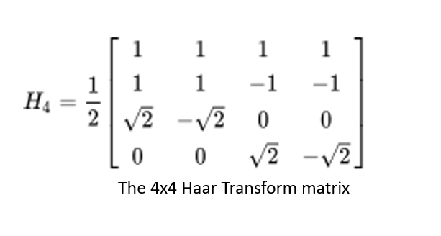
THE HAAR WAVELET
The Haar Wavelet is a sequence of rescaled ‘square-shaped’ functions which together form an orthonormal basis.

Slide 10
TERMINOLOGY
Secret Image - The image which we want to hide
Cover Image - The image in which we want to hide the secret image
Stegano Image - The resultant image which we want to transmit
Embedding Procedure - Culmination of the Secret Image and the Cover Image into the Stegano Image before transmission.
Extraction Procedure - Retrieval of the Secret Image from the Stegano Image after receival of the message.

Slide 11
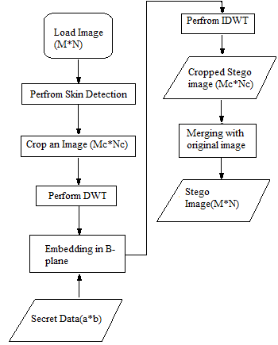
EMBEDDING TEXT IN COVER_IMAGE USING DWT[PART-1]
Flowchart of Embedding Process

Slide 12
STEPS
Step 1: Once image is loaded, apply skin tone detection on cover image. This will produce mask image that contains skin and non skin pixels.
Step 2: Ask user to perform cropping interactively on mask image (Mc×NC). After this original image is also cropped of same area.
Cropped area must be in an exact square form as we have to perform Haar DWT later and cropped area should contain skin region such as face, hand etc since we will hide data in skin pixels of one of the sub-band of DWT.
Here cropping is performed for security reasons. Cropped rectangle will act as key at receiving side. If it knows then only data retrieval is possible.
Eavesdropper may try to perform DWT on whole image; in such a case attack will fail as we are applying DWT on specific cropped region only.

Slide 13
Step 3: Apply DWT to only cropped area (Mc×Nc) not hole image (M×N). This yields 4 sub-bands denoted as HLL, HHL, HLH, and HHH. (All 4 sub-band are of same size of Mc/2, Nc/2).
Payload of image to hold secret data is determined based on no. of skin pixels present in one of high frequency sub-band in which data will be hidden.
Step 4: Perform embedding of secret data in one of sub-band that we obtained earlier by tracing skin pixels in that sub-band.
Other than the LL, low frequency sub-band any high frequency sub-band can be selected for embedding as LL sub-band contains significant information.
Embedding in LL sub-band affects image quality greatly. We have chosen high frequency HH sub-band.
While embedding, secret data will not be embedded in all pixels of DWT sub-band but to only those pixels that are skin pixels

Slide 14
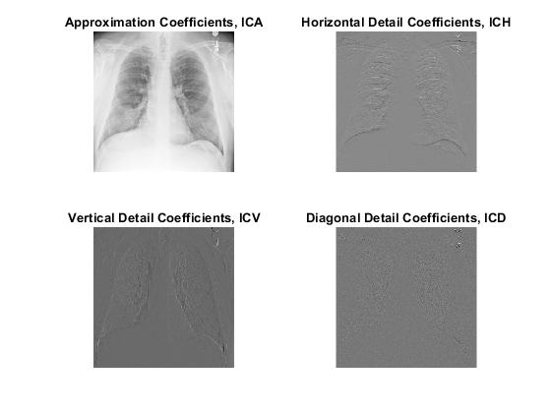
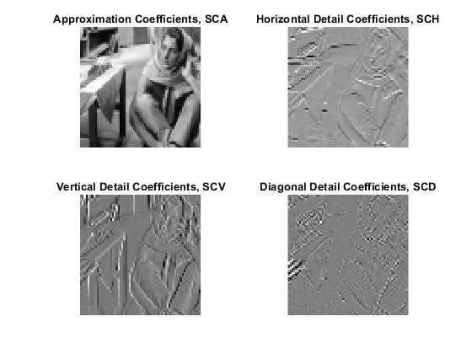
Image steganography using DWT [PART-2]
STEPS FOR EMBEDDING
Step1: With the Discrete Wavelet Transform, convert -
the cover image, I, into the 4 subimages: (ICA, ICH, ICV, ICD) and
the secret image, S, into the 4 subimages: (SCA, SCH, SCV, SCD)
DWT of Cover Image
DWT of Secret Image

Slide 15
step2:Each of SCA, ICA and ICD are partitioned into 4x4 pixels -
SCA = {BSi , 1<=i<=ns}
ICA = {BCj , 1<=j<=nc}
ICD = {BDk , 1<=k<=nc}
where BSi , BCj and BDk represent the ith block in SCA, jth block in ICA, kth block in ICD respectively, ns is the total number of 4× 4 blocks in SCA and nc is the total number of the 4× 4 blocks in each of ICA and ICH.
step3:For each block BSi in SCA, the best matched block BCj of minimum error in ICA is searched by using the root mean squared error (RMSE).
The first secret key K1 consisting of the addresses, j, of the best matched blocks in ICA.
step4:Calculate the error block EBi between BSi and BCj as follows:
EBi = (BCj - BSi) / K3
Where K3 is a secret key chosen randomly between 100 and 170.

Slide 16
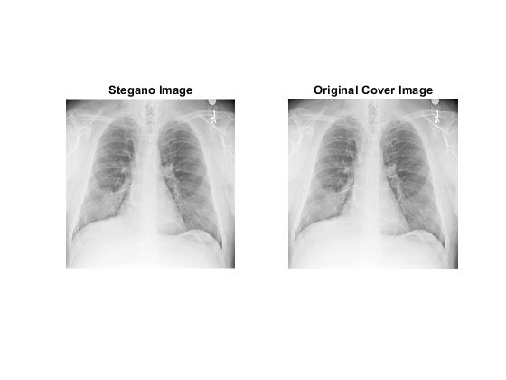
step5: For each error block EBi , the best matched block BDk in ICD is searched for using the RMSE criteria as before, and that BDk is replaced with the error block EBi .
The second secret key K2 consists of the addresses, k of the best matched blocks in ICD.
step6:Repeat the steps 3 to 5 until all the produced error blocks are embedded in ICD.
step7:Apply the inverse DWT to the sub-images - ICA, ICV, ICH and the modified ICD to obtain the stegano image.

Slide 17
STEPS FOR EXTRACTION
Step1:With the Discrete Wavelet Transform, convert the stegano image, G, into the four subimages: (GCA, GCH, GCV, GCD).
Step2:The extracted secret image coefficients, eBSi , are obtained by -
eBSi = eBCK1(i) - K3 * eBDK2(i)
where
{ eBCj } = GCA
{ eBDk } = GCD
Step3:Repeat Step 2 until all secret blocks are extracted and form the subimage, eSCA, as follows:
eSCA = { eBSi }
Step4:Assign each of eSCD, eSCV and eSCH as zeros and apply the inverse DWT to obtain the retrieved Secret Image.

Slide 18
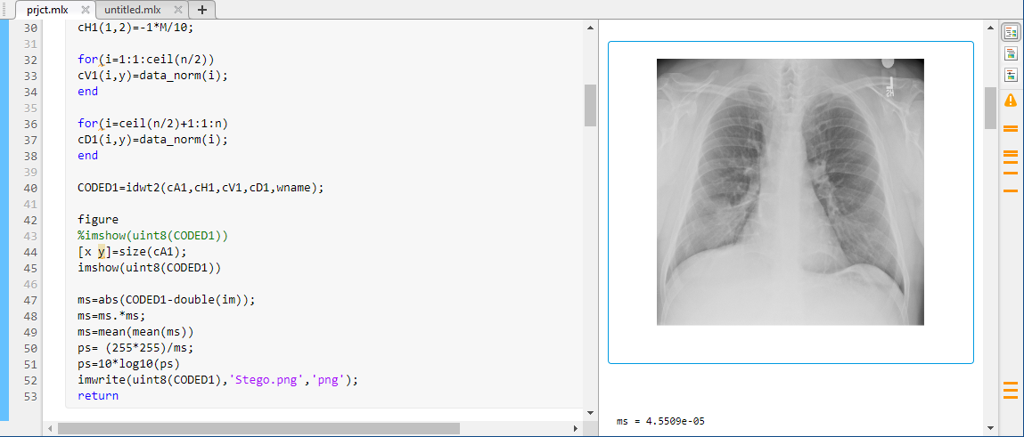
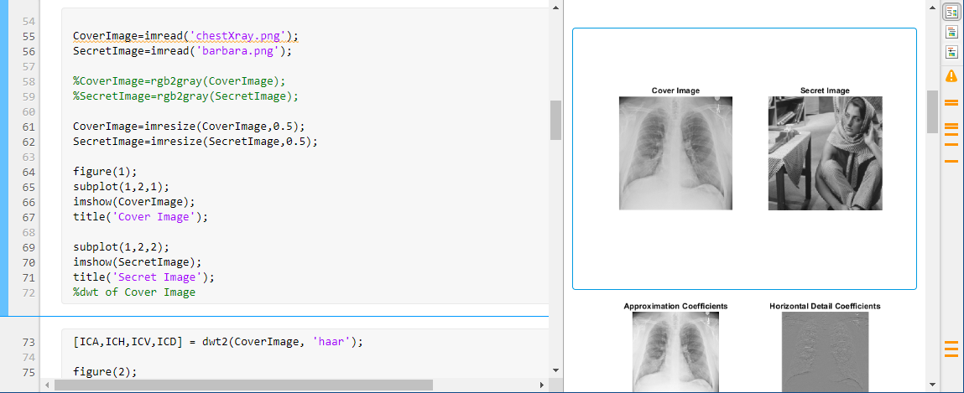
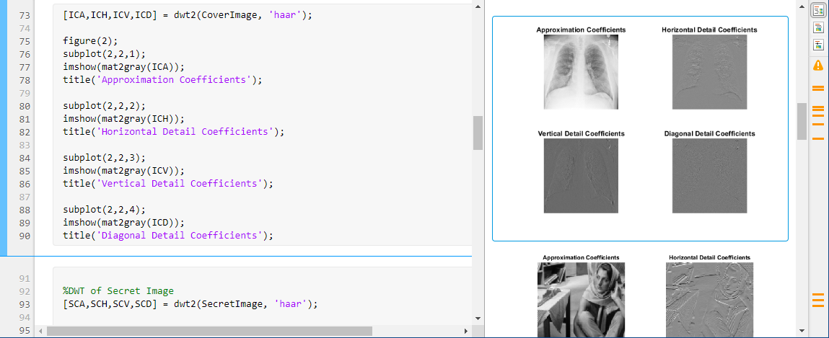
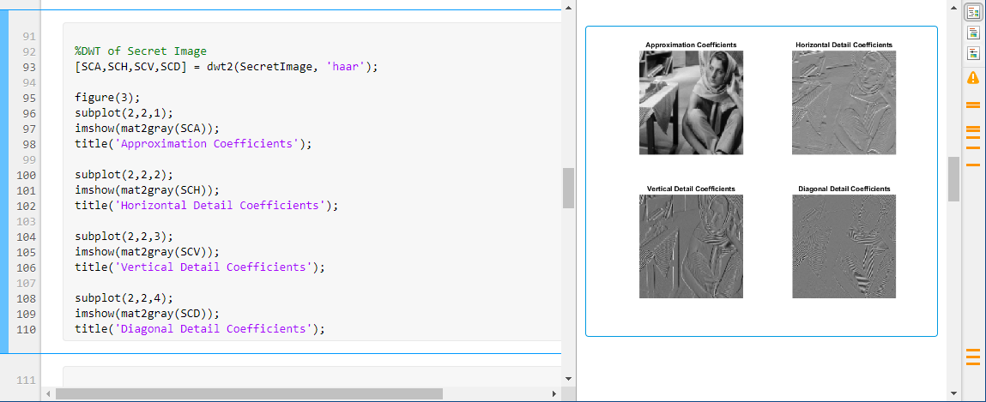
RESULTS
DWT of cover image
DWT of secret image

Slide 19
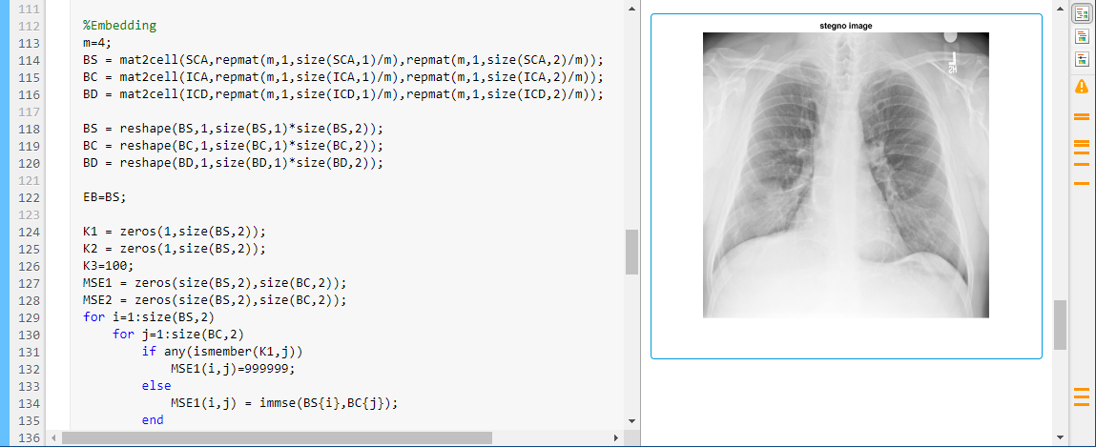
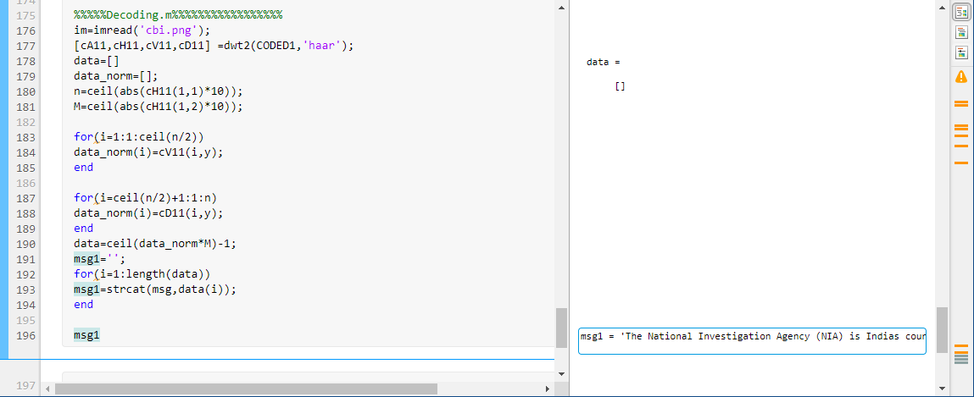
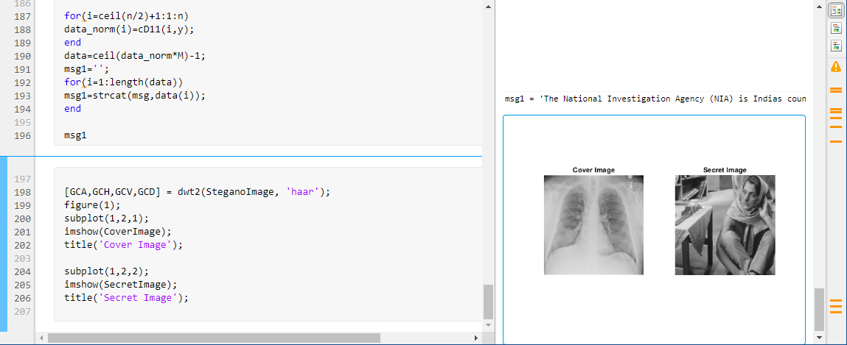
Embedding
Extraction
Final output

Slide 20
REFERENCE
Vijay Kumar, Dinesh Kumar, “Performance Evaluation of DWT Based Image Steganogra_x0002_phy,” IEEE 2nd International Advance Computing Conference (IACC), 2010
• Po-Yueh Chen and Yue-chi Tseng, “A Study of DWT based steganography using Coefficient
analysis,” pp.242-248, 2007
• Pommer and A. Vhl, “Wavelet Packet methods for multimedia compression and encryption,”
IEEE Pacific Rim Conference on Communications, Computer and signal processing, pp.1-4,
Victoria, Canada, 2001
• MAB. Younes, A. Jantan, “Image Encryption using Block-Based Transformation Algorithm,”
International Journal of Computer Science, vol. 35, issue 1, pp.15-23, 2008
• Ahmed A. Abdelwahab and Lobha A. Hassan, “A Discrete Wavelet Transform based Tech_x0002_nique for image data hiding,” 2nd National Radio Science Conference, pp. 1-9, Egypt, 2008

Slide 21
THANK YOU

