Slide 1


GOVERNMENT OF TELANGANA
Revenue Department · Land Acquisition
National Land Acquisition &
Management System — NLAMS
GIS-powered, real-time monitoring of land acquisition across all 33 districts of Telangana —
from notification to compensation, on one map.
TEAM <TEAM NAME> · <COLLEGE NAME>
Problem Statement ID: <PS-xxxx> · Team ID: <SIH-xxxxx> · Smart India Hackathon 2026
Notes:
30 seconds.
Say: 'Namaste jury. We are building NLAMS — a single GIS map where the Government of Telangana can watch every land-acquisition project in the state in real time — which land is notified, verified, awarded, and which family is still waiting for compensation.'
Fill in team name, college and PS ID before presenting.

Slide 2
The Problem
02
Land acquisition is slow, opaque and fragmented — for officials and for families
Fragmented records
Zero real-time visibility
Compensation delays
No spatial context
Notifications, survey numbers, awards and payment records sit in separate department silos — Revenue, R&B, I&CAD, TSIIC. No single view of a project exists.
State and district officials discover stalled projects only through escalations, media or protests — months after the delay began.
The verification → award → payment chain drags on. Every delay beyond the legal timeline pushes families toward litigation and disputes.
Spreadsheets and PDFs cannot show where parcels lie, which corridor is blocked, or which villages remain — so planning is guesswork.
The law already prescribes the process — monitoring it is still manual.
The RFCTLARR Act, 2013 mandates a strict stage-wise acquisition workflow (notification → verification → award → possession → compensation). What is missing is a system that watches every stage, everywhere, live.
NLAMS · Telangana Smart India Hackathon 2026
Notes:
60–75 seconds.
Key line: 'The process is legal, the data exists — but it is scattered and invisible. Nobody in the Secretariat can answer 'which village of which project is stuck today?' without phone calls.'
Do NOT read every card aloud — pick Fragmented records and Compensation delays, gesture at the rest.

Slide 3
Why existing systems are not enough
03
What changes with NLAMS
AREA
TODAY (EXISTING WAY)
WITH NLAMS
Land records & project data
Scattered across portals, PDFs and paper files
✓ One source of truth — every project, district and parcel in one place
Visualisation
Tabular registers; no maps at parcel level
✓ Real GIS — 33 district boundaries + route-level parcel mapping of each corridor
Process tracking
Manual follow-ups; status known after delays
✓ Digital RFCTLARR workflow — 7 stages with live stage-gates and dates
Risk & delays
Reactive — escalations, protests, court cases
✓ Alerts & risk scores — projects flagged before they breach SLA
Compensation
Disbursal status opaque to families & officers
✓ DBT ledger with paid / pending status and one-click release
NLAMS · Telangana Smart India Hackathon 2026
Notes:
45 seconds.
Don't read the table. Say: 'Existing portals publish documents. NLAMS watches the process itself — the difference is documents versus decisions.' Then move quickly to the solution.

Slide 4
Our Solution — NLAMS at a glance
04
One platform from proposal to compensation, built around the official RFCTLARR workflow
Dashboard
Projects
GIS Land Map
State KPIs — projects, land, compensation, families at risk, district league table
Single source of truth per project — land, budget, families, stage, timeline
All 33 districts + route-alignment view with parcels in their acquisition stage
Acquisition
Compensation
Alerts & Risk
Proposal → Scrutiny → Notification → Verification → Award → Possession, with actions
CFMS-style DBT ledger — release payments, track SLA, see pending families
Risk-scored alerts with recommended action — before projects derail
NLAMS · Telangana Smart India Hackathon 2026
THE DIGITAL ACQUISITION PIPELINE (RFCTLARR 2013)
Proposal
→
Scrutiny
→
Notification
→
Verification
→
Award
→
Possession
→
Compensation
Every stage transition is actioned inside the system — approve, verify, publish, release — and fully audited.
Notes:
60 seconds.
Walk the module cards left to right, then point at the pipeline: 'The heart of NLAMS is the official 2013 Act workflow, digitised — an officer can actually approve a scrutiny, verify a parcel, publish a Section-11 notification and release a payment. This is a working system, not a mockup.'

Slide 5
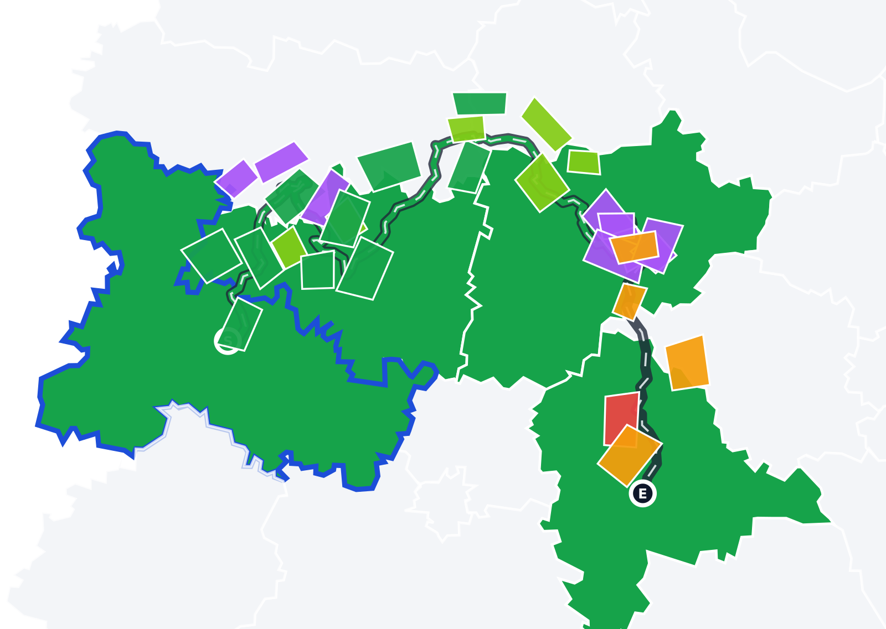
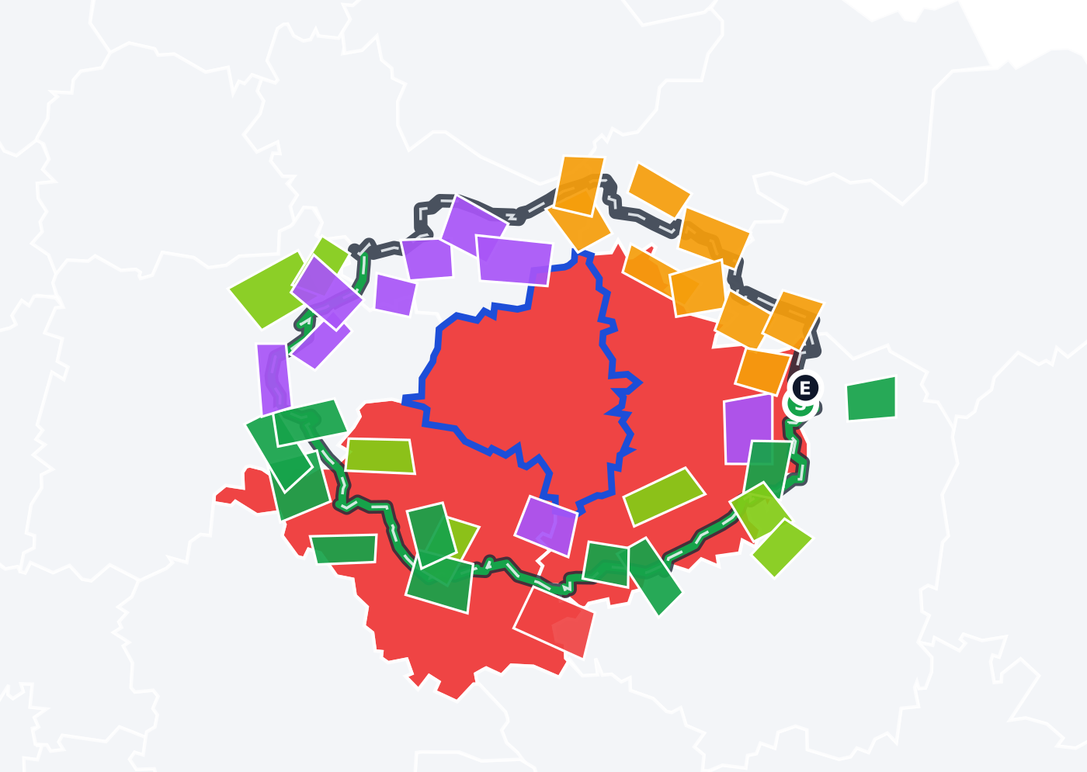
The GIS core — see the land, not just the numbers
05
Real Telangana geometry · route alignment · parcels coloured by workflow stage
Regional Ring Road — Northern Arc: 4 districts, corridor parcels along the alignment
Warangal Outer Ring Road: closed ring, acquisition completing around it
Route-level alignment view
Click a project → its exact land corridor is drawn over real district boundaries; green segment = land already acquired.
Parcels in workflow colours
Every parcel on the corridor is Notified / Verified / Awarded / Possession / Compensated / Disputed — the acquisition story, visible.
Interactive drill-down
Filter parcels by stage, hover for owner & survey no., zoom & pan, district dashboards — all live.
NLAMS · Telangana Smart India Hackathon 2026
Notes:
75–90 seconds. THIS IS THE WOW SLIDE.
Say: 'This is not a static map. Left — the Regional Ring Road alignment: the dark line is the route, the green segment is how much land is already acquired, and each coloured patch is an actual land parcel in a specific legal stage. Right — Warangal ORR: you can see acquisition completing around the ring. If a farmer asks 'what is the status of my survey number?' — this map answers.'
If demoing live, switch to the app here.

Slide 6
Live demo — the 3-minute walkthrough
06
One login → one at-risk project → follow it across the whole system
Login with role
Role-based access — Central / State / District / Field
Dashboard
State KPIs; spot the red flag — Warangal ORR at risk 87/100
1
2
GIS Land Map
Telangana status map → click the red district → drill in
Alignment view
RRR / ORR corridor: route, acquired %, parcels by stage
3
4
Project deep-dive
Single source of truth — land, budget, families, timeline
Acquisition actions
Scrutiny → approve · Verification → verify parcel · Award calculator (Sec 26–30)
5
6
Compensation
Release a pending DBT payment — watch state totals update
Alerts & Risk
Risk-scored alerts with recommended actions
7
8
Everything shown is clickable and stateful — approvals, verifications and payments update across all pages instantly. Fallback: recorded demo + these screenshots.
NLAMS · Telangana Smart India Hackathon 2026
Notes:
This slide IS your demo script.
Time budget: 20s per step. Do steps 1-4 live in the app (login → dashboard → GIS → alignment). For 5-8, if time is short, talk over this slide. Closing line of demo: 'We followed one project from a red alert on a map to releasing money into a family's account — in under three minutes.'

Slide 7
How it is built — and where the data comes from
07
Honest architecture: what runs today, what integrates in production
DATA STRATEGY
TECHNOLOGY
Prototype (now)
Open government district boundaries (33 districts of Telangana) rendered as native SVG — no external map service needed; realistic parcel data seeded per project following RFCTLARR stage distribution.
Production integration
Dharani (land records) · Bhuvan / NIC GIS cadastral layers · CFMS (payments & DBT) · e-Gazette (notifications) via standard APIs.
Why it is credible
The data model mirrors the actual legal workflow — every record a DLAO or MRO files today has a home in NLAMS.
Zero-dependency web app
Single-file HTML/JS/SVG build — no frameworks, no server, no internet needed. Runs offline in any browser on a ₹10,000 laptop.
GIS engine in-house
Real GeoJSON boundaries projected to SVG with route-spline alignment and corridor mapping — built from scratch, no paid APIs.
Enterprise-ready design
Role-based access (4 levels), session management, audited actions, API-ready module boundaries for goIT-grade integration.
NLAMS · Telangana Smart India Hackathon 2026
Notes:
45–60 seconds.
Juries always ask 'where does data come from?' — answer before they ask. Emphasise: 'Prototype uses open boundaries + realistic synthetic parcels; production plugs into Dharani, Bhuvan and CFMS — all government-owned systems. And because it is a single file, it works even in a district office with no internet.'

Slide 8
Impact, scalability & the road ahead
08
Built for Telangana — designed for every state in India
For families
Status transparency — a farmer sees exactly where their parcel stands and when money moves. Fewer disputes, fewer protests.
SCALE & ROADMAP
Next 3 months
Telugu UI · field-officer mobile app with GPS parcel capture
For officers
Real-time district & state visibility; alerts flag SLA breaches early; one source of truth replaces files and phone calls.
6–12 months
AI/ML risk scoring from delay patterns · SMS/WhatsApp status to families
For the state
Faster, fairer acquisition = infrastructure projects that start on time, with a complete audit trail.
National scale
Same engine, any state — only boundaries & records change. A true National Land Acquisition grid.
One land map. One workflow. Every family's compensation visible — from the Secretariat to the village.
Thank you — we welcome the jury's questions.
NLAMS · Telangana Smart India Hackathon 2026
Notes:
45 seconds + Q&A.
Close with: 'Land acquisition delays cost the nation more than any software ever will. NLAMS gives the state eyes on every parcel — starting with Telangana, ready for India. Thank you.'
Likely jury questions: data authenticity (→ slide 7), security (→ roles, session, audit), why not ArcGIS/Google Maps (→ offline single file, govt boundaries, no license cost), team roles (prepare!).

