Slide 1

SMART INDIA HACKATHON 2026
Idea Submission — Problem Statement Details
PS ID
26016
Problem Statement ID
26016
Problem Statement Title
Real-Time National Land Acquisition & Management System for End-to-End Digital Monitoring and Decision Support
Theme
Smart Automation
PS Category
Software
Team ID
<Team ID — as registered on SIH portal>
Team Name
<Team Name — as registered on SIH portal>
Organization / Department
Ministry of Rural Development · Dept. of Land Resources (DoLR)
Proposed by: <Team Name> · <College / Institute Name>
<Your Team Name>
1 @ SIH Idea submission- Template
Notes:
Fill Team ID, Team Name, College. Keep PS title wording exactly as on the portal.

Slide 2
IDEA TITLE — NLAMS: A GIS-Powered Digital Twin of the Land Acquisition Lifecycle
Proposed Solution (Describe your Idea/Solution/Prototype)
Detailed explanation of the proposed solution
How it addresses the problem
Innovation and uniqueness
▪ Web platform — digitises the complete acquisition lifecycle — Proposal → Scrutiny → Notification → Verification → Award → Possession → Compensation, exactly as per the RFCTLARR Act, 2013.
▪ GIS core — real boundaries of all 33 Telangana districts rendered as vector maps; every project's land corridor drawn as a route alignment with individual land parcels on it.
▪ Stage-native parcels — each parcel carries its live legal stage (Notified / Verified / Awarded / Possession / Compensated / Disputed) — colour-coded on the map.
▪ Role-based access — separate views & powers for Central / State / District / Field officers; every action audited.
▪ Compensation ledger — DBT-style payment tracking per affected family with SLA clocks and one-click release.
▪ Alerts & risk engine — projects scored 0–100; breaches raise alerts with recommended actions.
▪ Single source of truth — projects, parcels, families & payments in one database — no more silos across Revenue, R&B, I&CAD, TSIIC.
▪ Real-time monitoring — officials see stage-wise progress live on dashboards & map — delays surface in hours, not months.
▪ Spatial intelligence — maps show exactly where acquisition is stuck (village / survey no.) — impossible in registers & PDFs.
▪ Faster compensation — verification → award → payment chain tracked per family; SLA alerts stop cases crossing 90+ days.
▪ Transparency for families — any family can be shown its parcel status & payment date — builds trust, reduces protests.
▪ Alignment-corridor GIS — first-of-its-kind view: parcels strung along the actual route (e.g., Regional Ring Road arc, Warangal ORR ring) in workflow colours — not dots on a map.
▪ Legal-workflow-native — data model mirrors the 2013 Act itself — Sec 4/11/26/30/38 map 1:1 to screens, forms & actions; an officer's file becomes a workflow.
▪ Zero-infrastructure deploy — prototype runs offline as a single file in any browser — works in low-connectivity district offices; no licence cost.
▪ Stage-click filtering — click any pipeline stage on the map to highlight only parcels at that stage — instant ground truth.
▪ State-agnostic engine — swap boundary & records data → same system for any state, scaling to a true national grid for DoLR.
<Your Team Name>
2 @ SIH Idea submission- Template
Notes:
2-3 min. Lead with the corridor-GIS innovation — that is the differentiator every other team will lack.

Slide 3
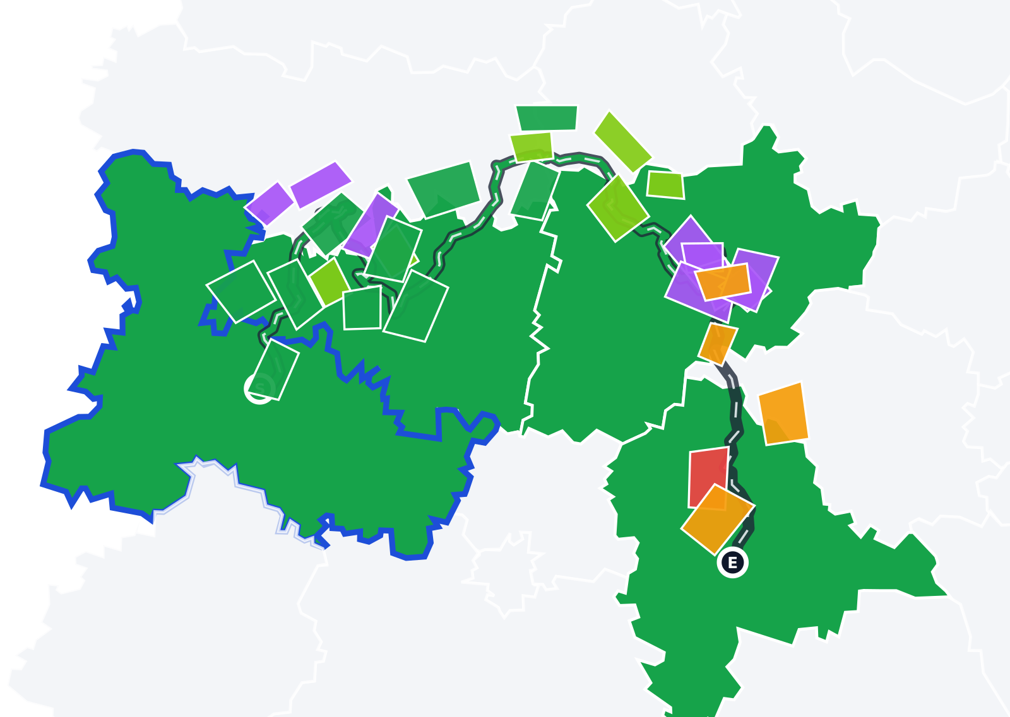

TECHNICAL APPROACH
Technologies used
Working prototype — screenshots
▪ Prototype (working today) — HTML5 · CSS3 · Vanilla JS · in-house SVG GIS engine · GeoJSON → SVG boundary pipeline (Python). Zero dependencies, runs offline.
▪ Production stack (planned) — React + TypeScript front-end · Node.js/NestJS APIs · PostgreSQL + PostGIS spatial DB · Redis queue · S3-style object store for documents.
▪ Government integrations — Dharani (land records) · Bhuvan / NIC GIS cadastral layers · CFMS (DBT payments) · e-Gazette (notifications) via secure API gateway.
▪ Smart automation — rule-engine SLA alerts · anomaly checks on payments · AI risk-scoring roadmap (delay-pattern ML).
Methodology — implementation flow
Route-alignment GIS: RRR Northern Arc — corridor parcels in workflow colours, green = land acquired
Ingest boundaries
& records
Digitise lifecycle
(RFCTLARR stages)
Map parcels to
route corridors
Monitor · Alert
· Action
DBT compensation
& audit trail
→
→
→
→
▪ Process — requirements from Act → data model → GIS engine → workflow module → integration APIs → field pilot with 1 district → state rollout.
▪ Prototype status — fully interactive end-to-end system already built — every action (approve, verify, publish, pay) works live in this presentation.
State dashboard map: live district status across all 33 districts of Telangana
<Your Team Name>
3 @ SIH Idea submission- Template
Notes:
Emphasise: prototype already works (right side is OUR app, not a mockup). Production stack is standard govt-grade tech.

Slide 4
FEASIBILITY AND VIABILITY
Analysis of the feasibility of the idea
✓ Already built
working end-to-end prototype demonstrated today — not a concept
✓ Legal alignment
digitises the existing RFCTLARR 2013 process — no policy change needed
✓ Open data ready
district boundaries & geoportals are public; records APIs are govt-owned
✓ Zero-cost pilot
single-file tech deploys in any district office browser; scales via standard cloud
✓ DILRMP synergy
complements the Digital India Land Records Modernization Programme
Potential challenges & risks — and strategies to overcome them
CHALLENGE / RISK
MITIGATION STRATEGY
⚠ Integration with Dharani / CFMS legacy systems
→ Standard REST/CSV fallback formats; phased integration starting read-only; DoLR-led API gateway under Digital India framework
⚠ Field data quality (GPS surveys, owner records)
→ Mobile app with offline capture, mandatory validation rules, cross-check against Dharani before stage promotion
⚠ Adoption & change management for officers
→ Role-simple UI (3 clicks per action); training modules; state-level SOP notification; pilot district first
⚠ Security & privacy of land & family data
→ RBAC (4 levels) · encryption in transit & at rest · complete audit trail · DPDP Act 2023 compliance by design
⚠ National scale (36 States/UTs)
→ State-agnostic engine — boundaries, categories & rates are configuration, not code
<Your Team Name>
4 @ SIH Idea submission- Template
Notes:
Key message: feasibility is proven (working prototype + open data + legal alignment). The risk table preempts the jury's toughest questions.

Slide 5
IMPACT AND BENEFITS
Potential impact on the target audience
Affected families
Field & district officers
State & Central Govt
Citizens at large
See their parcel's exact stage & payment date — dignity, predictability, faster money in hand
3-click actions, GPS-verified parcels, SLA clocks — files move without files
Live corridor-level visibility across the state; early alerts prevent escalations & litigation
Highways, irrigation & industry projects start on time — growth is not stuck in land disputes
Benefits of the solution
SOCIAL
ECONOMIC
ENVIRONMENTAL / GOVERNANCE
▪ Transparency ends information asymmetry between State and families
▪ Fewer disputes & protests → less displacement distress
▪ Telugu UI + SMS/WhatsApp status (roadmap) for every affected family
▪ Full audit trail = fair, defensible awards
▪ Faster commissioning of highways, irrigation & industrial corridors
▪ Every month saved on a mega-project avoids crores in cost escalation & interest
▪ DBT-linked ledger plugs leakage; accurate budgeting from live data
▪ Lower litigation spend for the exchequer
▪ Early forest & land-overlap screening (FCA) before alignment freeze
▪ Digitised records cut paper, travel & re-surveys
▪ Data-driven planning avoids re-alignments that waste acquired land
▪ Reusable national asset for DoLR — one engine, every state
<Your Team Name>
5 @ SIH Idea submission- Template
Notes:
Tie benefits back to the PS: 'end-to-end digital monitoring' = social transparency + economic speed + governance quality.

Slide 6
RESEARCH AND REFERENCES
Details / Links of the reference and research work
1
The Right to Fair Compensation and Transparency in Land Acquisition, Rehabilitation and Resettlement Act, 2013 (RFCTLARR)
Dept. of Land Resources, MoRD — https://dolr.gov.in · Act & Rules text: https://indiacode.nic.in
1
2
Digital India Land Records Modernization Programme (DILRMP)
DoLR framework guiding digitisation of land records — https://dolr.gov.in/programmes/dilrmp
2
3
Dharani — Telangana Integrated Land Records Management System
Govt. of Telangana Revenue Dept. — https://dharani.telangana.gov.in
3
4
CFMS — Comprehensive Financial Management System, Telangana
DBT/payment backbone integration reference — https://cfms.telangana.gov.in
4
5
Bhuvan — ISRO Geoportal & NIC GIS services
cadastral & thematic layers for production integration — https://bhuvan.nrsc.gov.in
5
6
Survey of India / open district boundary datasets (GeoJSON)
boundary geometry used in our prototype (33 districts of Telangana) — https://india-maps-data.open (Survey of India derived)
6
7
PM Gati Shakti National Master Plan
multi-ministry infrastructure planning context — https://gatishakti.gov.in
7
8
e-Gazette — Gazette of India / Telangana State Gazette
legal publication channel for Sec-11 notifications — https://egazette.gov.in
8
9
World Bank & NITI Aayog studies on land acquisition & infrastructure delays
problem-validation research on acquisition-driven project delays (background study)
9
10
SIH Problem Statement 26016 (official)
MoRD · DoLR · Theme: Smart Automation · Category: Software — source of requirements
10
Prototype dataset note: boundaries from open Survey-of-India-derived GeoJSON; parcel/family records are realistic synthetic data seeded per project — production links to Dharani/Bhuvan/CFMS as listed above.
<Your Team Name>
6 @ SIH Idea submission- Template
Notes:
If jury asks for 'research': point to Act + DILRMP + Gati Shakti + delay studies, and our dataset honesty note.

