Slide 1


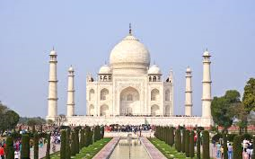
TAJ MAHAL!!!!!

Slide 2
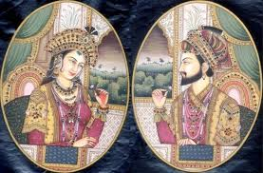
WHO BUILT THE TAJ MAHAL?
In spite of various traditions and conspiracy theories that pop up every other day, most of the historians have reached to a conclusion that Mogul Emperor Shah Jahan built Taj Mahal. The order of the construction was passed in the year 1631 A.D and the construction started that very year. According to the rock edict that is place at the gateway of Taj, it has been concluded that the construction work was carried by 22,000 laborers and was completed in the year 1654.
The chief designer of this mausoleum was Isa Mohammad Khan who was assisted by Ustad Isa of Persia. Qazim Khan of Lahore did the golden embroidery works where as Amanat Ali Khan of Iran did the calligraphy. Mohammad Arif was the chief supervisor.
It was later claimed that Italian designer Geronimo Veroneo, designed the Taj Mahal but there is no solid proof to corroborate the fact. The confusion might have arisen because of the fact that Isa of Isa Khan means Christ in Arabic and that led European to believe that the designer was a christen.
P.N. Oak claimed in his book that Taj Mahal was a Hindu Temple but both Judiciary as well as body of the historians thrashed his bizarre and laughable arguments.
Shan Jhan built the Taj Mahal so he could remember his wife!

Slide 3
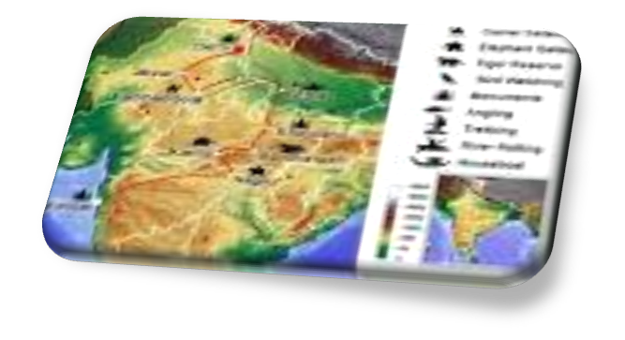
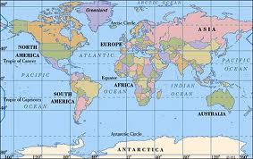
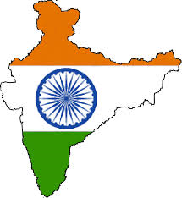
Where is it?
The Taj Mahal is in India (the capital is New Deli). Did you know that the Taj Mahal is in Asia?(That’s a content!)
Agra, Uttar Pradesh 282001, India This is the Taj Mahal’s address

Slide 4
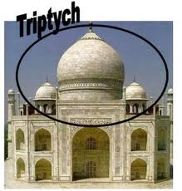
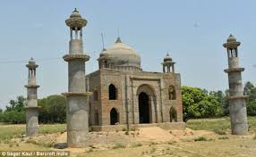
TOP 5 FACTS!
1
* THE TAJ MAHAL WAS COPIED FROM OTHER BUILDINGS!!!!

Slide 5
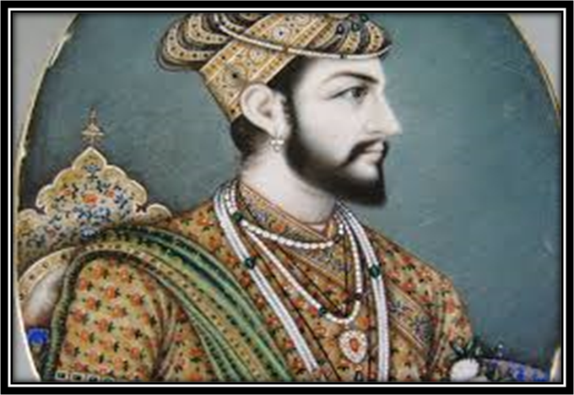
2
* THE TAJ MAHAL WAS BUILT BY SHAN JHAN FROM LOVING MEMORIES OF HIS WIFE!

Slide 6
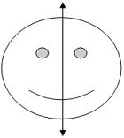
3
* THE TAJ MAHAL WAS SYMETRICAL INSIDE AND OUT, BUT IT ISN’T NOW BECAUSE ONE OF THE TOMBS IS BIGGER!

Slide 7
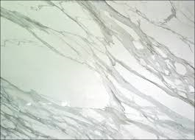
4
* THE TAJ MAHAL IS MADE OUT OF DIFFERENT TYPES OF MARBLE!

Slide 8
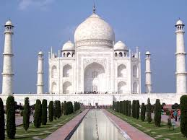
5
* THE TAJ MAHAL IS 171 METERS TALL!
WHICH IS AS TALL AS A SKY SCRAPER….

Slide 9





TIME FOR THE 5 question QUIZ!!!!

Slide 10

1
*Which content is the Taj Mahal in?
A, Africa
B, Asia
C, Antarctica

Slide 11
ANSWER
1
B,Asia!

Slide 12
2
*Who built the Taj Mahal?
A, Shan Jhan
B , Oman Jhan
C, Bhan Jhan

Slide 13
ANSWER
2
A, Shan Jhan

Slide 14
3
* Is the Taj Mahal symmetrical?
A, YES
B, IT USED TO BE
C, NO

Slide 15
ANSWER
3
B, It used to be

Slide 16
4
*How many different types of marble were used?
A, 1
B, LOTS
C,10

Slide 17
ANSWER
4
B, Lots

Slide 18
5
* How many people were buried in the Taj Mahal?
A,2
B, 30
C, 12

Slide 19
ANSWER
5
B,30

Slide 20




THANK YOU FOR TAKING PART IN MY QUIZ!
Before you go, one last thing…..

Slide 21
10 minutes to spare?
watch this video
Click here

Slide 22
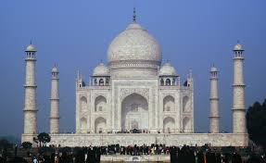
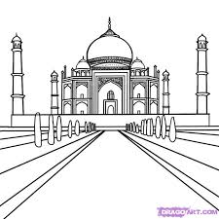
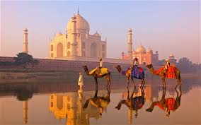
By Sienna Loveridge
TAJ MAHAL

