Slide 1
JSON & Python
Dr. Ziad Al-Sharif
Spring 2020
(in the time of corona-virus)

Slide 2
What is JSON?
JSON is a standard format for data exchange:
stands for JavaScript Object Notation
Originally inspired by JavaScript
Nowadays, most languages provide JSON pressers
Generally, JSON is in string or text format
Textual
Human Readable
you can open/edit any JSON file using any text editor such as notepad, notepad++, etc.)
The syntax of JSON:
JSON is written as key and value pair
A collection of name/value pairs.

Slide 3
Languages
ActionScript
C
C++
C#
Cold Fusion
Delphi
E
Erlang
Java
JavaScript
Lisp
Objective-C
Objective CAML
Perl
PHP
Python
Rebol
Ruby
Scheme
Squeak

Slide 4
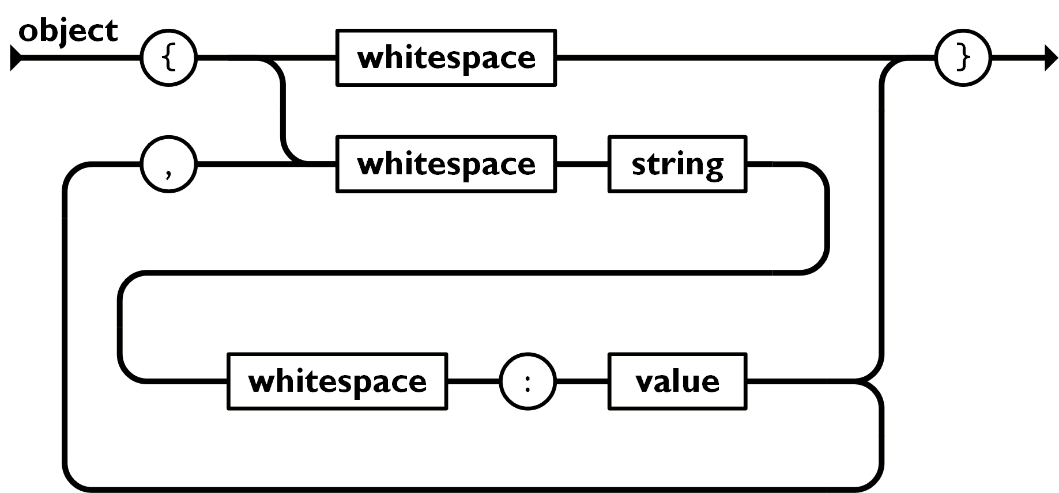
JSON Object
An object is an unordered set of name/value pairs.
An object begins with {left brace and ends with }right brace.
Each name is followed by colon (:)
the name/value pairs are separated by comma (,)

Slide 5
Object
Objects are unordered containers of key/value pairs
equivalent to dict() in Python
Objects are wrapped in { }
Commas , separate key/value pairs
Colons : separate keys and values
Keys are strings
Values are any valid JSON value
number, dict, list, string, etc.

Slide 6
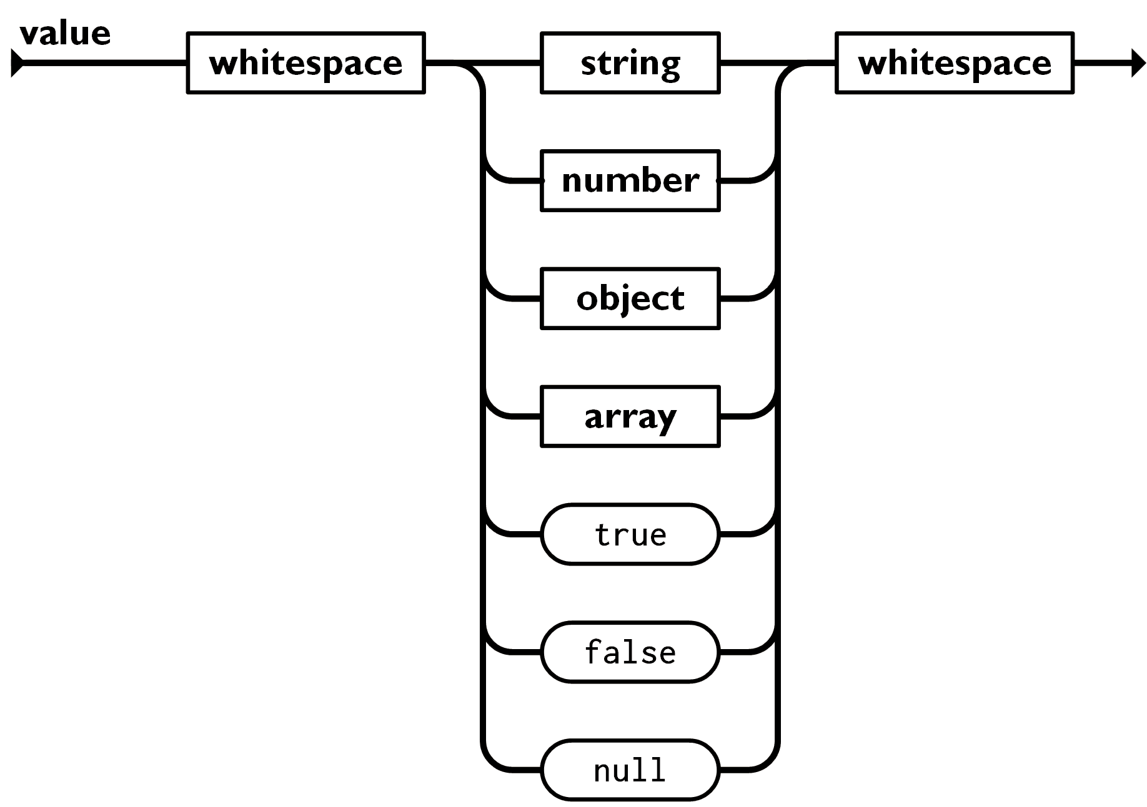
Values
Value can be any of
Strings
Numbers
int
float
Booleans
true
false
Objects
Arrays
null
A value that isn't anything

Slide 7
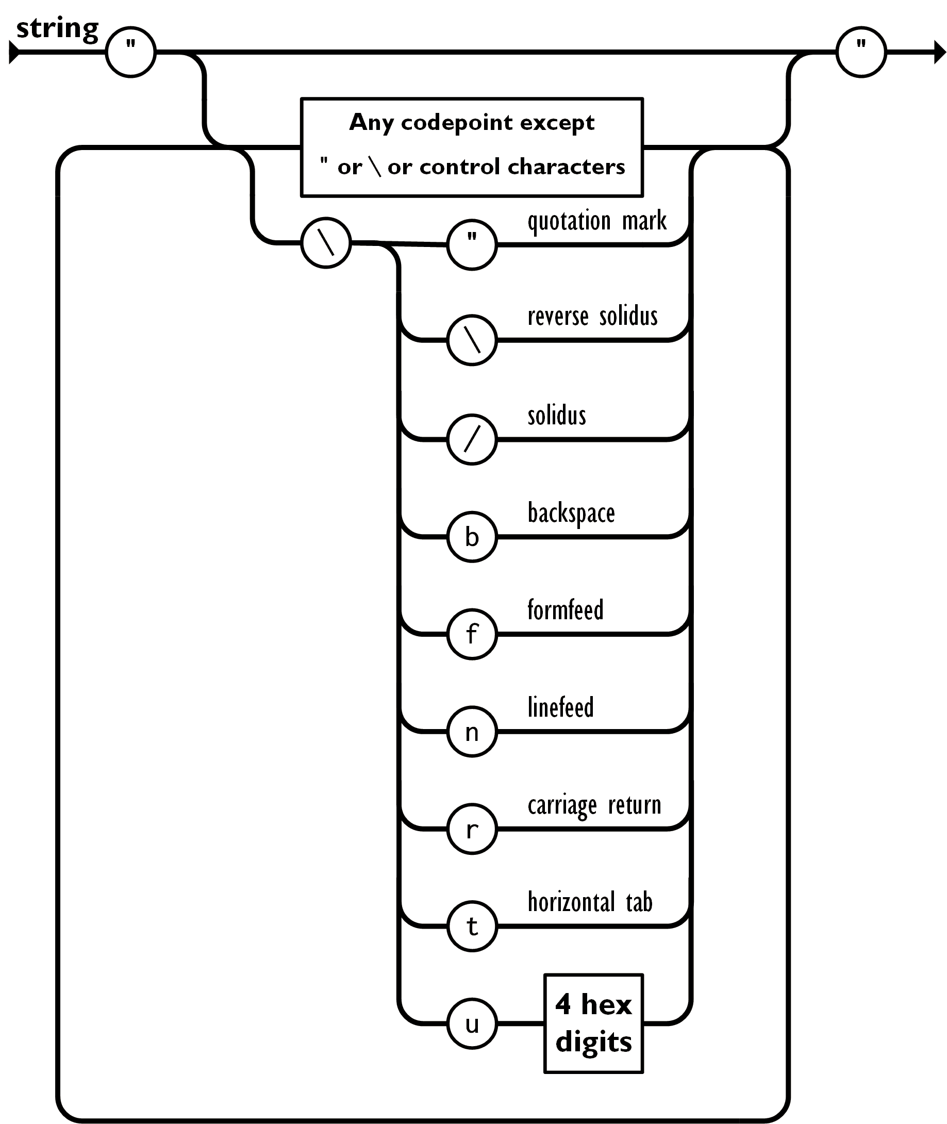
Strings
Sequence of 0 or more Unicode characters
No separate character type
Double quotes, E.g. “??”
not the single quote
Backslash escapement

Slide 8
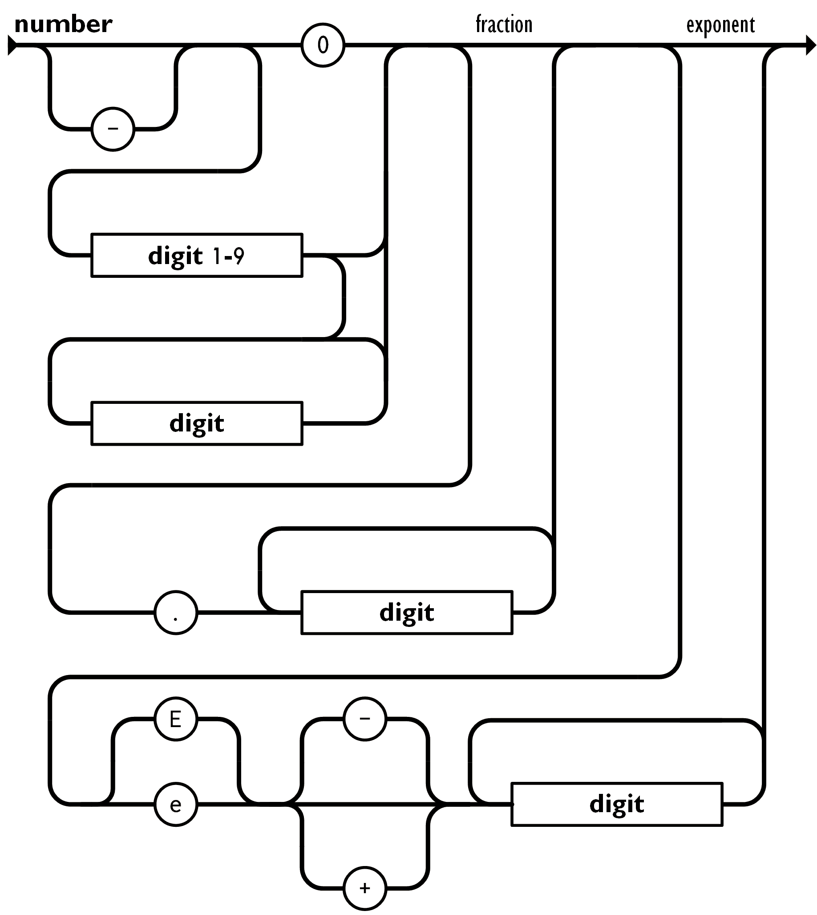
Numbers
Integer
Real
Scientific
No octal or hex
No NaN or Infinity
Use null instead

Slide 9
Object
{
"name": "Ahmed",
"class": "Python",
"birthday": "2000-02-10",
"graduated": false,
"age": 20,
"grades": {
"first": "10",
"second": 25,
"final": 37
},
"car": null,
"favorite_foods": [
"cookie",
"fish",
"chips"
]
}

Slide 10
Array
Arrays are ordered sequences of values
equivalent to the list() in python
Arrays are wrapped in []
Commas , separate values
JSON does not talk about indexing.
An implementation can start array indexing at 0 or 1.

Slide 11
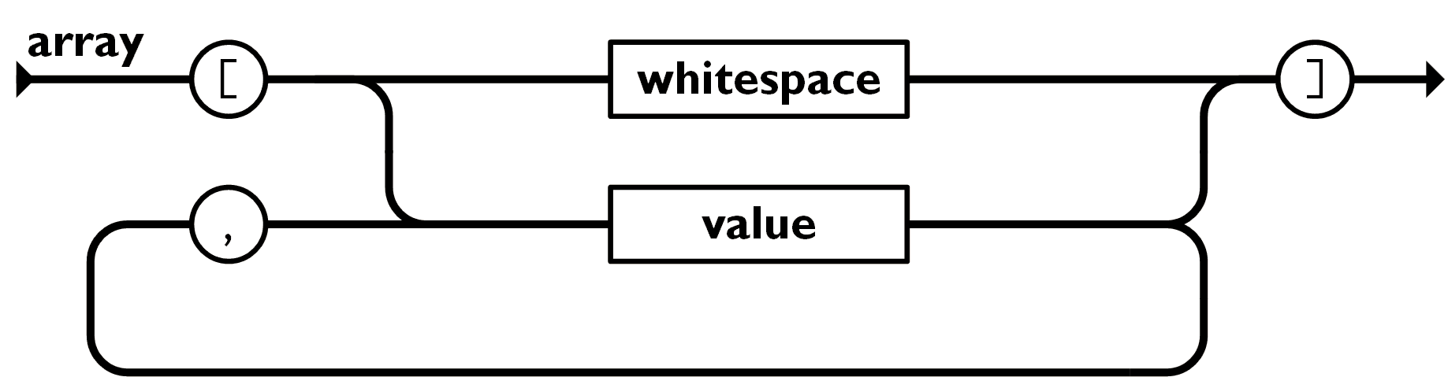
Array
["Sunday", "Monday", "Tuesday", "Wednesday", "Thursday", "Friday", "Saturday“
]
[
[0, -1, 0],
[1, 0, 0],
[0, 0, 1]
]

Slide 12
Rules: Encoder vs. Decoder
A JSON encoder must only produce well-formed JSON text.
A JSON decoder must accept all well-formed JSON text.
A JSON decoder may also accept non-JSON text.
Be conservative in what you do, be liberal in what you accept from others.
JSON's simple values are the same as used in programming languages.
No restructuring is required: JSON's structures look like conventional programming language structures.
JSON's object is object, dictionary, lists ...
JSON's array is array, vector, sequence, list...

Slide 13
JSON Library in Python
To perform JSON related operations like encoding and decoding in Python you need first to import JSON library into your .py file.
import json
Then, you may use the following methods from your JSON module
Method | Description
dumps() | Encodes a python structure into JSON and returns a string
dump() | Encodes a python structure into JSON and writes the results into the file
loads() | Decode the JSON string and generates an equivalent python structure
load() | Decode the contents of the given JSON file while reading its contents and generates an equivalent python structure

Slide 14
Python to JSON (Encoding)
Converting Python data to JSON is called an Encoding operation. Encoding is done with the help of JSON library method – dumps()
dumps() method converts dictionary object of python into JSON string data format.
JSON encoder for Python data structures.
Supports the following objects and types by default:
Python | JSON
dict | object
list, tuple | array
str | string
int, float | number
True | true
False | false
None | null

Slide 15
JSON to Python (Decoding)
JSON string decoding is done with the help of inbuilt method loads() & load() of JSON library in Python. Here translation table show example of JSON objects to Python objects which are helpful to perform decoding in Python of JSON string.
Performs the following translations in decoding by default:
JSON | Python
object | dict
array | list
string | str
number (int) | int
number (real) | float
true | True
false | False
null | None

Slide 16
Summary
JSON
Language Independent.
Text-based.
Light-weight.
Easy to parse.
Not a document format.

Slide 17
References
JSON — JSON encoder and decoder
https://docs.python.org/3/library/json.html
Introducing JSON
https://www.json.org/json-en.html

