Slide 1
Principles of Testing
Chapter 1
Software Testing
ISTQB / ISEB Foundation Exam Practice
1 Principles
2 Lifecycle
3 Static testing
4 Dynamic test
techniques
5 Management
6 Tools

Slide 2
Contents
Principles
1
2
3
ISTQB / ISEB Foundation Exam Practice
4
5
6
Why testing is necessary
Fundamental test process
Psychology of testing
Re-testing and regression testing
Expected results
Prioritisation of tests

Slide 3
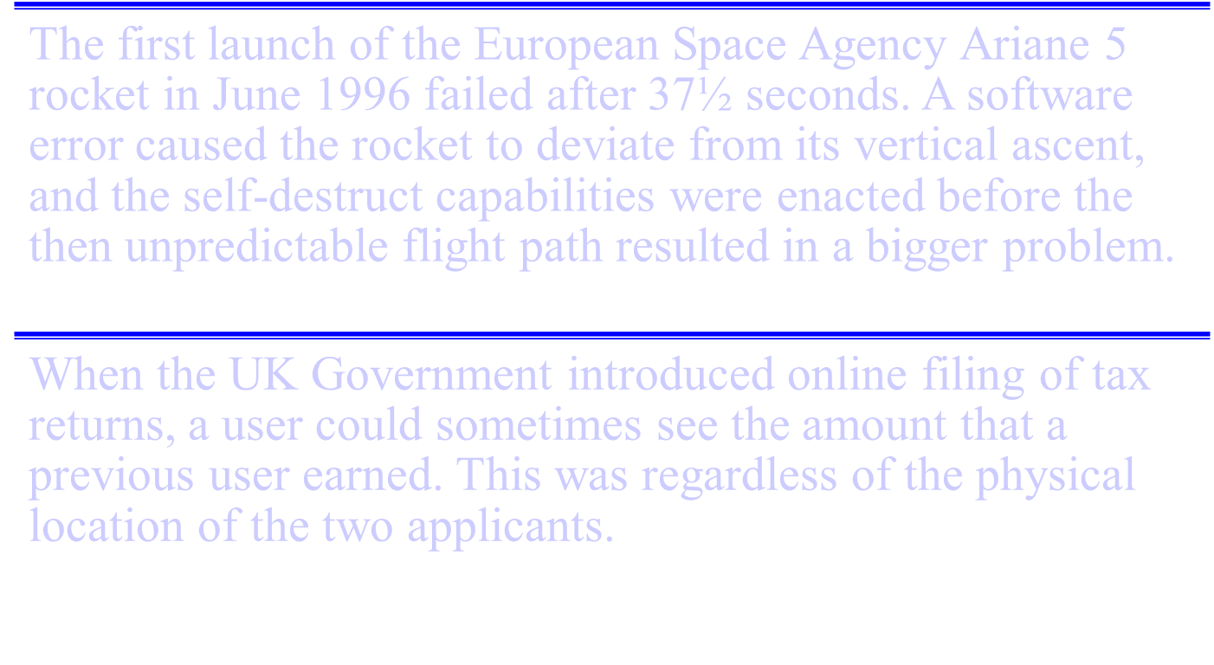
Examples of software failure

Slide 4
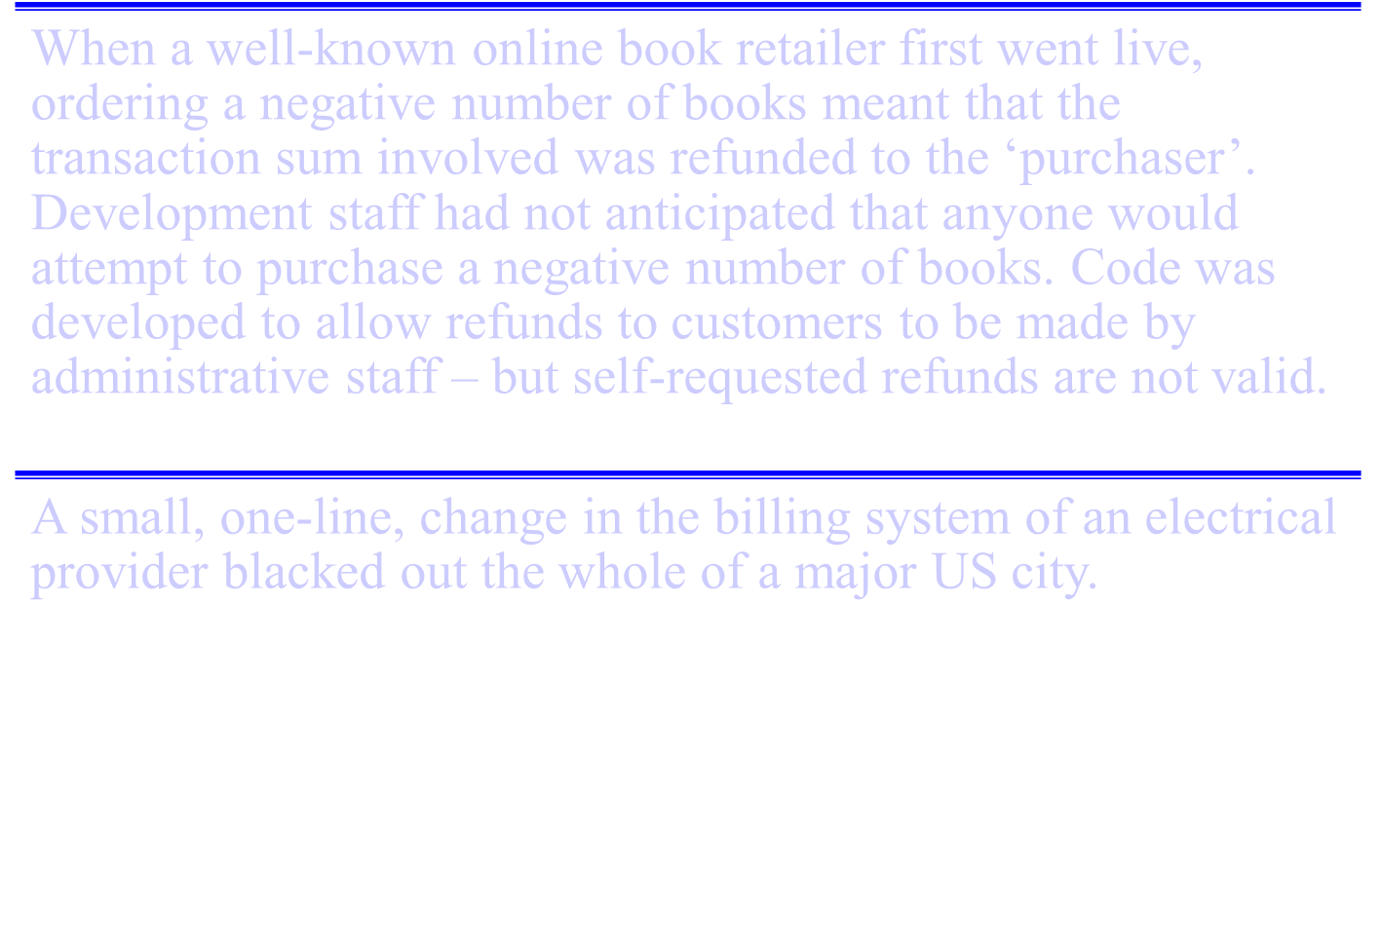

Slide 5
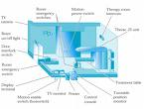



Spectacular Software Failures
NASA’s Mars lander: September 1999, crashed due to a units integration fault
THERAC-25 design
Mars Polar
Lander crash
site?
THERAC-25 radiation machine : Poor testing of safety-critical software can cost lives : 3 patients were killed
Ariane 5:
exception-handling
bug : forced self
destruct on maiden
flight (64-bit to 16-bit
conversion: about
370 million $ lost)
Ariane 5 explosion : Very expensive
Intel’s Pentium FDIV fault : Public relations nightmare
We need our software to be dependable
Testing is one way to assess dependability

Slide 6

Northeast Blackout of 2003
508 generating units and 256 power plants shut down
Affected 10 million people in Ontario, Canada
Affected 40 million people in 8 US states
Financial losses of
$6 Billion USD
The alarm system in the energy management system failed due to a software error and operators were not informed of the power overload in the system

Slide 7
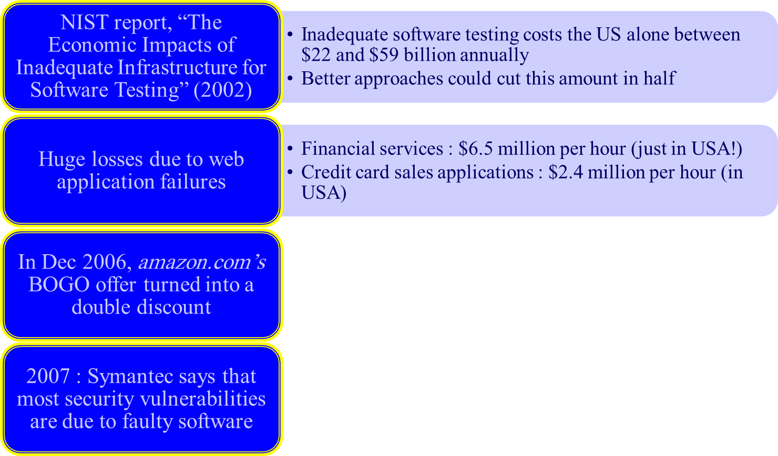
Costly Software Failures
World-wide monetary loss due to poor software is staggering

Slide 8
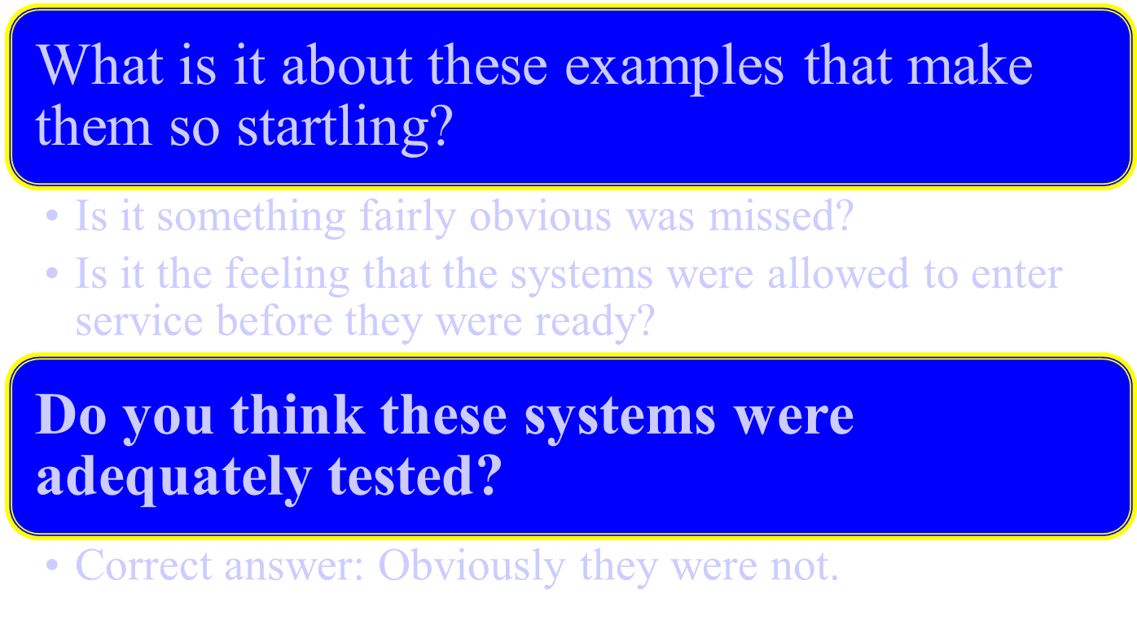
Why?

Slide 9
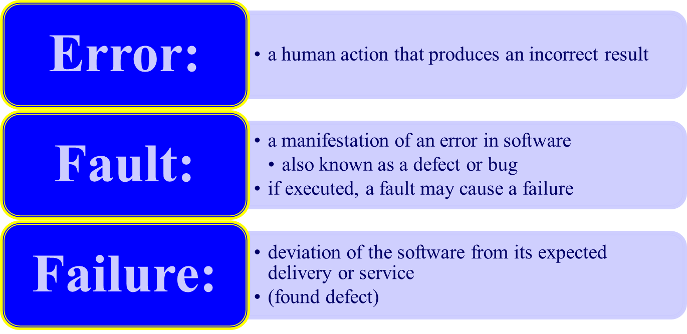
What is a “bug”?
Failure is an event; fault is a state of
the software, caused by an error

Slide 10
Error - Fault - Failure
A person makes
an error ...
… that creates a
fault in the
software ...
… that can cause
a failure
in operation

Slide 11
A Concrete Example
Fault: Should start searching at 0, not 1
public static int numZero (int [ ] arr)
{ // Effects: If arr is null throw NullPointerException
// else return the number of occurrences of 0 in arr
int count = 0;
for (int i = 1; i < arr.length; i++)
{
if (arr [ i ] == 0)
{
count++;
}
}
return count;
}
Test 1
[ 2, 7, 0 ]
Expected: 1
Actual: 1
Error: i is 1, not 0, on the first iteration
Failure: none
Test 2
[ 0, 2, 7 ]
Expected: 1
Actual: 0
Error: i is 1, not 0
Error propagates to the variable count
Failure: count is 0 at the return statement

Slide 12
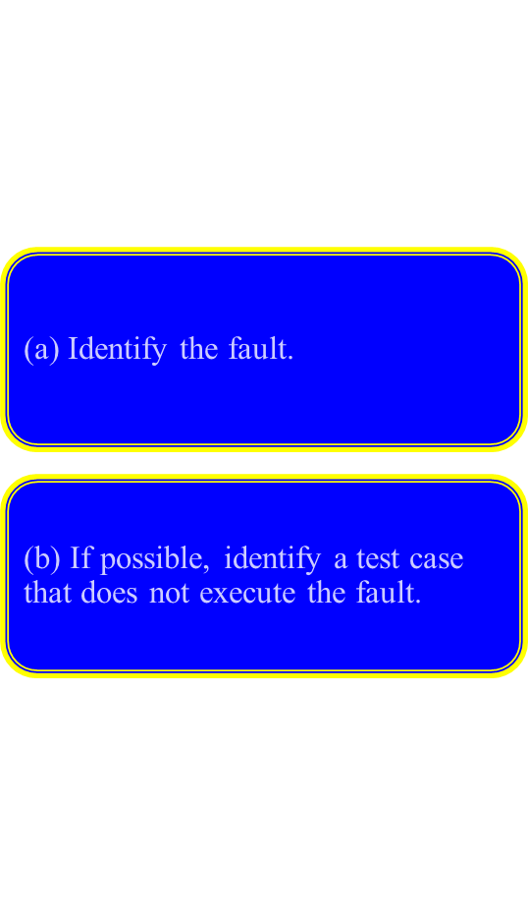
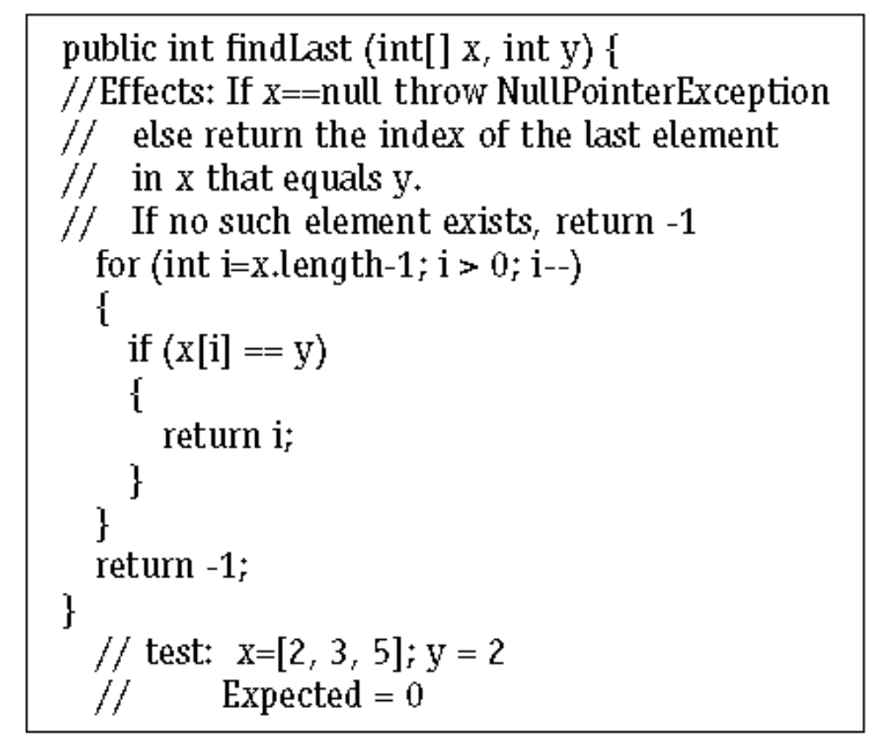

Slide 13
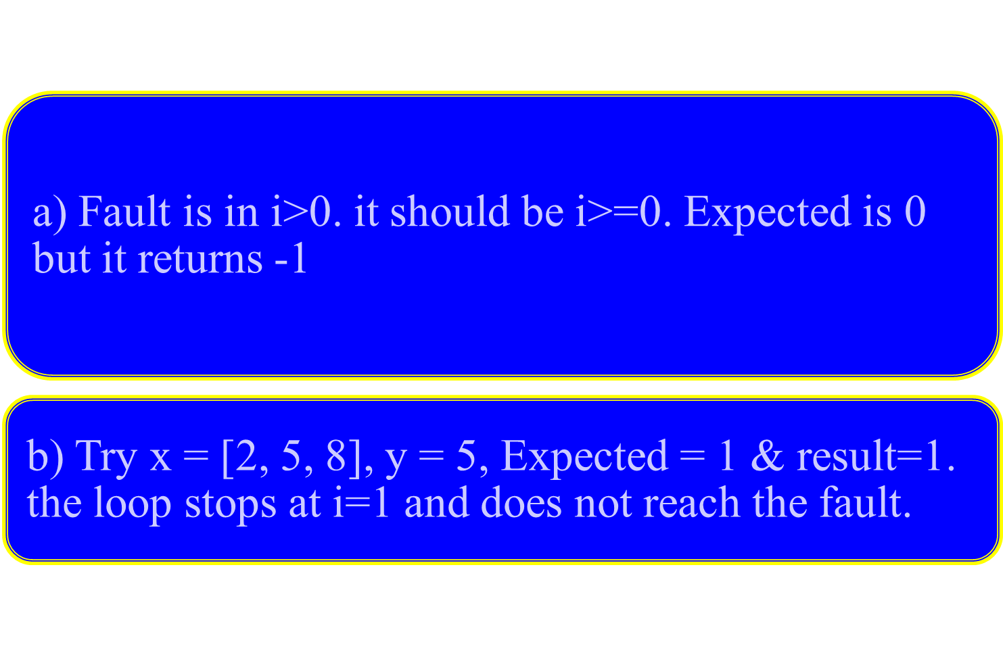

Slide 14
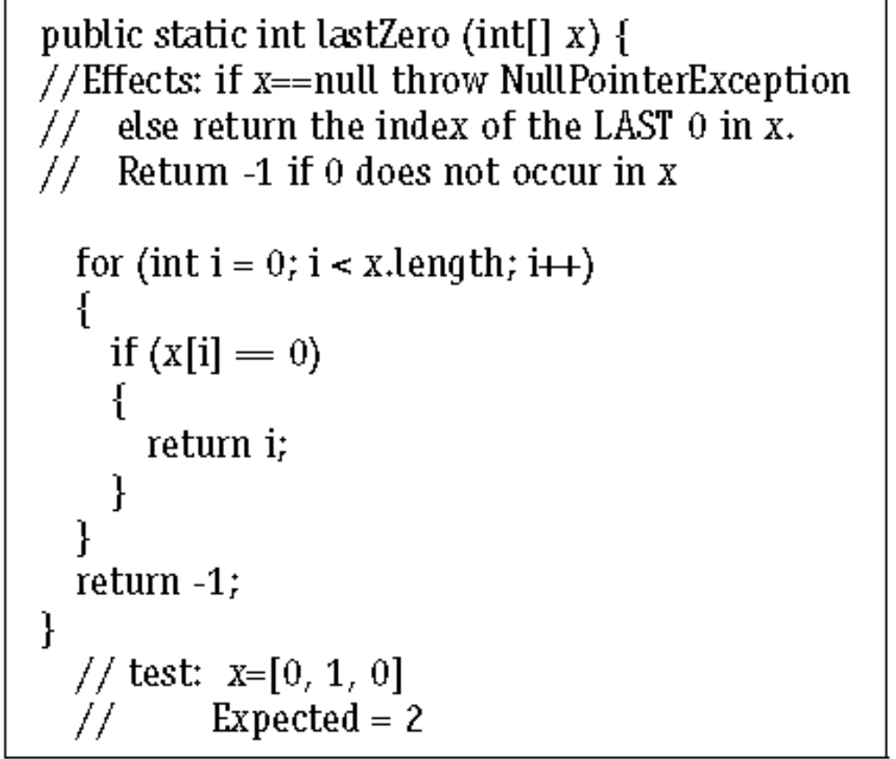
Solve this problem

Slide 15
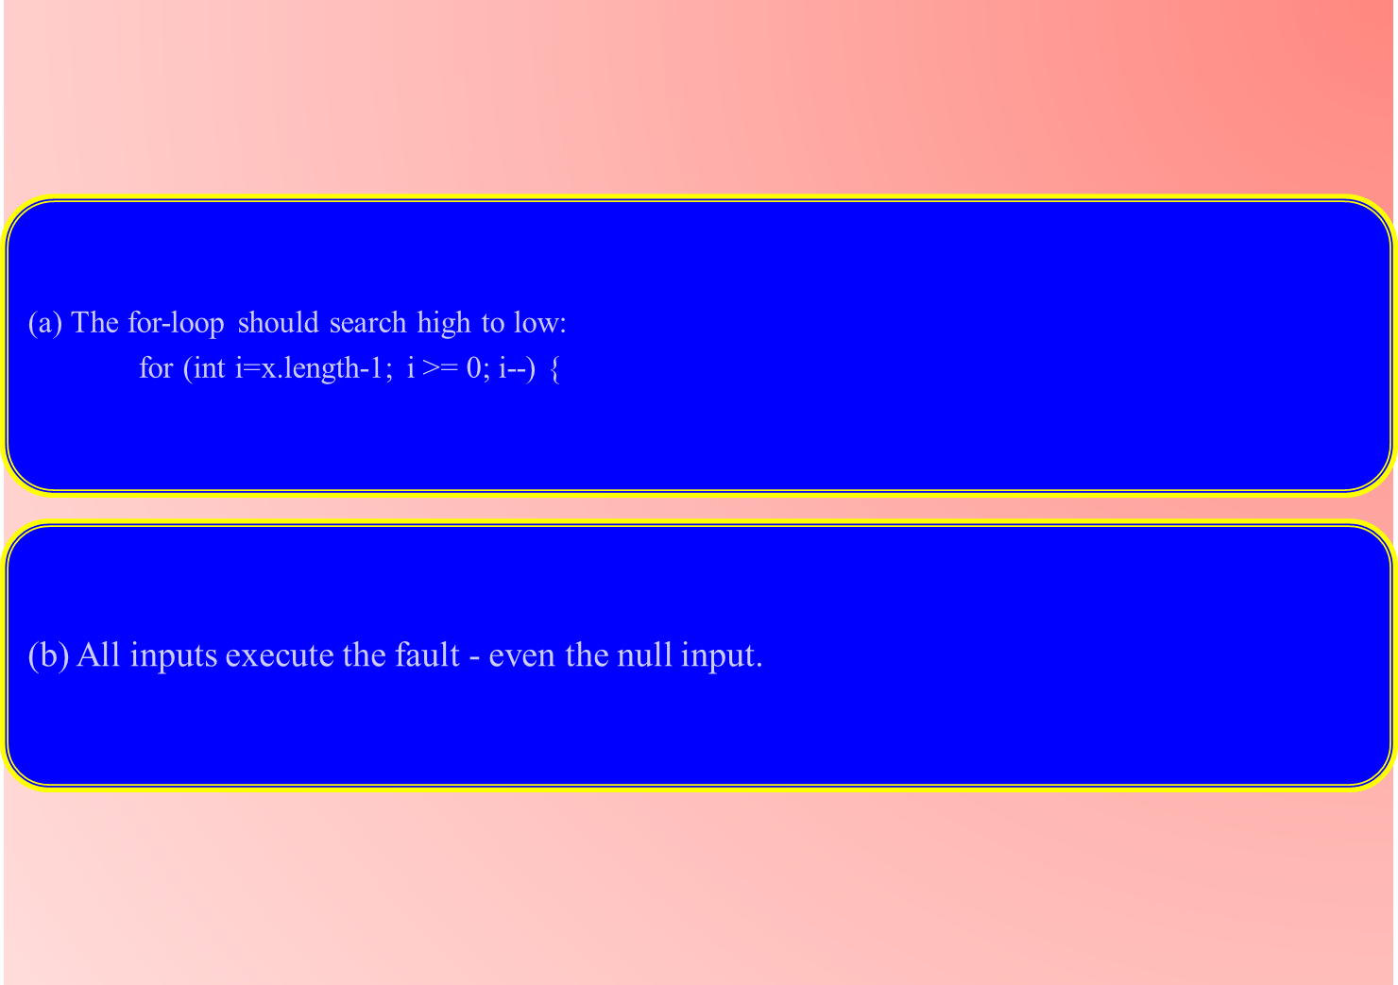

Slide 16
Reliability versus faults
Reliability: the probability that software will not cause the failure of the system for a specified time under specified conditions
  Can a system be fault-free? (zero faults, right first time)
  Can a software system be reliable but still have faults?
  Is a “fault-free” software application always reliable?

Slide 17
Why do faults occur in software?
software is written by human beings
  who know something, but not everything
  who have skills, but aren’t perfect
  who do make mistakes (errors)
under increasing pressure to deliver to strict deadlines
  no time to check but assumptions may be wrong
  systems may be incomplete

Slide 18
What do software faults cost?
huge sums
  Ariane 5 ($7billion)
  Mariner space probe to Venus ($250m)
  American Airlines ($50m)

Slide 19
Safety-critical systems
software faults can cause death or injury
  radiation treatment kills patients (Therac-25)
  train driver killed
  aircraft crashes (Airbus & Korean Airlines)
  bank system overdraft letters cause suicide

Slide 20
So why is testing necessary?
(True/False)
  because software is likely to have faults
  to learn about the reliability of the software
  to fill the time between delivery of the software and the release date
  to prove that the software has no faults
  because testing is included in the project plan
  because failures can be very expensive
  to avoid being sued by customers
  to stay in business

Slide 21
Why not just "test everything"?
Avr. 4 menus
3 options / menu
system has
20 screens
Average: 10 fields / screen
2 types input / field
(date as Jan 3 or 3/1)
(number as integer or decimal)
Around 100 possible values
Total for 'exhaustive' testing:
  20 x 4 x 3 x 10 x 2 x 100 = 480,000 tests
If 1 second per test, 8000 mins, 133 hrs, 17.7 days
(not counting finger trouble, faults or retest)
10 secs = 34 wks, 1 min = 4 yrs, 10 min = 40 yrs

Slide 22
Exhaustive testing?
What is exhaustive testing?
  when all the testers are exhausted
  when all the planned tests have been executed
  exercising all combinations of inputs and preconditions
How much time will exhaustive testing take?
  infinite time
  not much time
  impractical amount of time

Slide 23
How much testing is enough?
  it’s never enough
  when you have done what you planned
  when your customer/user is happy
  when you have proved that the system works correctly
  when you are confident that the system works correctly
  it depends on the risks for your system

Slide 24
How much testing?
It depends on RISK
  risk of missing important faults
  risk of incurring failure costs
  risk of releasing untested or under-tested software
  risk of losing credibility and market share
  risk of missing a market window
  risk of over-testing or ineffective testing
Intuitively, we would expect to test an automatic flight control system more than we would test a video game system.

Slide 25
So little time, so much to test ..
test time will always be limited
use RISK to determine:
  what to test first
  what to test most
  how thoroughly to test each item
}
i.e. where to
place emphasis
  what not to test (this time)
use RISK to
  allocate the time available for testing by prioritising testing ...

Slide 26
Most important principle
Prioritise tests
so that,
whenever you stop testing,
you have done the best testing
in the time available.

Slide 27
Testing and quality
testing measures software quality
testing can find faults; when they are removed, software quality (and possibly reliability) is improved
what does testing test?
  system function,
  correctness of operation
  non-functional qualities:
    reliability, usability, maintainability, reusability, testability, etc.

Slide 28
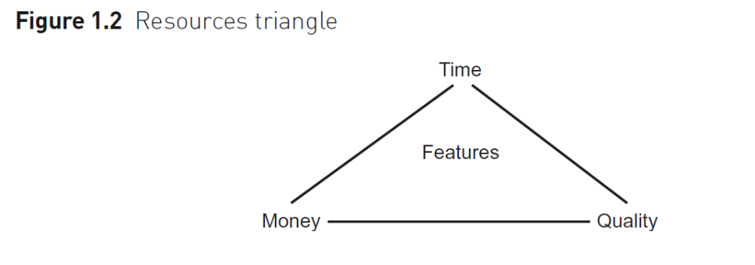
Balance competing demands for resources
If we need to deliver a system faster (i.e. in less time), for example, it will usually cost more.
These three affect one another, and also influence the features that are or are not included in the delivered software.

Slide 29
Contents
Principles
1
2
3
ISTQB / ISEB Foundation Exam Practice
4
5
6
Why testing is necessary
Fundamental test process
Psychology of testing
Re-testing and regression testing
Expected results
Prioritisation of tests

Slide 30
Test Planning - different levels
Test
Policy
What “Testing” means for organization
Company level
Test
Strategy
defines "Testing Approach" to achieve testing objective.
High Level
Test Plan
Project level
1) What to test? 2) How to test ? 3) When to test ?
4) Who to test?
High Level
Test Plan
Detailed
Test Plan
Test stage level (IEEE 829)
(one for each stage within a project,
e.g. Component, System, etc.)
Detailed
Test Plan
Detailed
Test Plan
Detailed
Test Plan

Slide 31
The test process
Planning (detailed level)
specification
execution
recording
check
completion

Slide 32
Test planning
how the test strategy and project test plan apply to the software under test
document any exceptions to the test strategy
  e.g. only one test case design technique needed for this functional area because it is less critical
other software needed for the tests, such as stubs and drivers, and environment details
set test completion criteria

Slide 33
Test specification
Planning (detailed level)
specification
execution
recording
check
completion
Identify conditions
Design test cases
Build tests

Slide 34
A good test case
Finds faults
effective
exemplary
evolvable
economic
Represents others
Easy to maintain
Cheap to use

Slide 35
Test specification
test specification can be broken down into three distinct tasks:
  1. identify: determine ‘what’ is to be tested (identify
  test conditions) and prioritise
  2. design: determine ‘how’ the ‘what’ is to be tested
  (i.e. design test cases)
  3. build: implement the tests (data, scripts, etc.)

Slide 36
Task 1: identify conditions
(determine ‘what’ is to be tested and prioritise)
list the conditions that we would like to test:
  use the test design techniques specified in the test plan
  there may be many conditions for each system function or attribute
  e.g.
    “life assurance for a winter sportsman”
    “number items ordered > 99”
    “date = 29-Feb-2004”
prioritise the test conditions
  must ensure most important conditions are covered

Slide 37
Task 2: design test cases
(determine ‘how’ the ‘what’ is to be tested)
design test input and test data
  each test exercises one or more test conditions
determine expected results
  predict the outcome of each test case, what is output, what is changed and what is not changed
design sets of tests
  different test sets for different objectives such as regression, building confidence, and finding faults

Slide 38
Task 3: build test cases
(implement the test cases)
prepare test scripts
  less system knowledge tester has the more detailed the scripts will have to be
  scripts for tools have to specify every detail
prepare test data
  data that must exist in files and databases at the start of the tests
prepare expected results
  should be defined before the test is executed

Slide 39
Example for test cases
Using the sales software, the car dealer is able to define discount rules for his salespeople:
With a price of less than $15.000, no discount shall be given. For a price of $20.000, 5% is OK. If the price is below $25.000, a 7% discount is possible. For higher prices, 8.5% can be granted.
From this, the following cases can be derived:
  Price < 15.000 discount = 0%
  15.000 <= price <= 20.000 discount = 5%
  20.000 < price < 25.000 discount = 7%
  price >= 25.000 discount = 8.5%

Slide 40
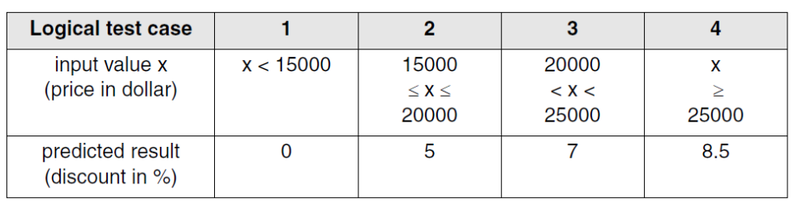
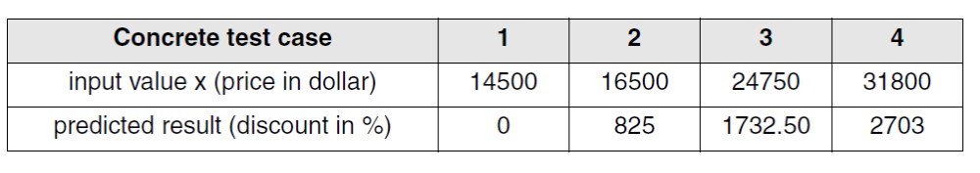

Slide 41
Test execution
Planning (detailed level)
specification
execution
recording
check
completion

Slide 42
Execution
Execute prescribed test cases
  most important ones first
  would not execute all test cases if
    too many faults found by early test cases
    time pressure
  can be performed manually or automated

Slide 43
Test recording
Planning (detailed level)
specification
execution
recording
check
completion

Slide 44
Test recording 1
The test record contains:
  identities and versions (unambiguously) of
    software under test
    test specifications
Follow the plan
  mark off progress on test script
  document actual outcomes from the test
  capture any other ideas you have for new test cases
  note that these records are used to establish that all test activities have been carried out as specified

Slide 45
Test recording 2
Compare actual outcome with expected outcome. Log discrepancies accordingly:
  software fault
  test fault (e.g. expected results wrong)
  environment or version fault
  test run incorrectly
Log coverage levels achieved (for measures specified as test completion criteria)
  .e,g, 80% coverage
After the fault has been fixed, repeat the required test activities (execute, design, plan)

Slide 46
Check test completion
Planning (detailed level)
specification
execution
recording
check
completion

Slide 47
Check test completion
Test completion criteria were specified in the test plan
If not met, need to repeat test activities, e.g. test specification to design more tests
Coverage too low
specification
execution
recording
check
completion
Coverage
OK

Slide 48
Test completion criteria
Completion or exit criteria apply to all levels of testing - to determine when to stop
  coverage, using a measurement technique, e.g.
    branch coverage for unit testing
    user requirements
    most frequently used transactions
  faults found (e.g. versus expected)
  cost or time

Slide 49
Contents
Principles
1
2
3
ISTQB / ISEB Foundation Exam Practice
4
5
6
Why testing is necessary
Fundamental test process
Psychology of testing
Re-testing and regression testing
Expected results
Prioritisation of tests

Slide 50
Why test?
build confidence
prove that the software is correct
demonstrate conformance to requirements
find faults
reduce costs
show system meets user needs
assess the software quality

Slide 51
Confidence
Confidence
Fault found
Faults found
Time
No faults found = confidence?

Slide 52
A traditional testing approach
Show that the system:
  does what it should
  doesn't do what it shouldn't
Goal: show working
Success: system works
Fastest achievement: easy test cases
Result: faults left in

Slide 53
A better testing approach
Show that the system:
  does what it shouldn't
  doesn't do what it should
Goal: find faults
Success: system fails
Fastest achievement: difficult test cases
Result: fewer faults left in

Slide 54
The testing paradox
Finding faults destroys confidence
Purpose of testing: to find faults
Purpose of testing: destroy confidence
Purpose of testing: build confidence
The best way to build confidence
is to try to destroy it

Slide 55
Who wants to be a tester?
A destructive process
Bring bad news (“your baby is ugly”)
Under worst time pressure (at the end)
Need to take a different view, a different mindset (“What if it isn’t?”, “What could go wrong?”)
How should fault information be communicated (to authors and managers?)

Slide 56
Independence
Test your own work?
  find 30% - 50% of your own faults
  same assumptions and thought processes
  see what you meant or want to see, not what is there
  emotional attachment
    don’t want to find faults
    actively want NOT to find faults

Slide 57
Levels of independence
None: tests designed by the person who wrote the software
Tests designed by a different person
Tests designed by someone from a different department or team (e.g. test team)
Tests designed by someone from a different organisation (e.g. agency)
Tests generated by a tool (low quality tests?)

Slide 58
Contents
Principles
1
2
3
ISTQB / ISEB Foundation Exam Practice
4
5
6
Why testing is necessary
Fundamental test process
Psychology of testing
Re-testing and regression testing
Expected results
Prioritisation of tests

Slide 59
Re-testing after faults are fixed
Run a test, it fails, fault reported
New version of software with fault “fixed”
Re-run the same test (i.e. re-test)
  must be exactly repeatable
  same environment, versions (except for the software which has been intentionally changed!)
  same inputs and preconditions
If test now passes, fault has been fixed correctly - or has it?

Slide 60
Regression testing
Regression tests are performed
  after software changes, including faults fixed
  when the environment changes, even if application functionality stays the same
  for emergency fixes (possibly a subset)
Regression test suites
  evolve over time
  are run often
  may become rather large

Slide 61
Regression testing
Maintenance of the regression test pack
  eliminate repetitive tests (tests which test the same test condition)
  combine test cases (e.g. if they are always run together)

Slide 62
Regression testing and automation
Test execution tools (e.g. capture replay) are regression testing tools - they re-execute tests which have already been executed
Once automated, regression tests can be run as often as desired (e.g. every night)
Automating tests is not trivial (generally takes 2 to 10 times longer to automate a test than to run it manually
Don’t automate everything - plan what to automate first, only automate if worthwhile

Slide 63
Contents
Principles
1
2
3
ISTQB / ISEB Foundation Exam Practice
4
5
6
Why testing is necessary
Fundamental test process
Psychology of testing
Re-testing and regression testing
Expected results
Prioritisation of tests

Slide 64
Expected results
Should be predicted in advance as part of the test design process
Why not just look at what the software does and assess it at the time?
  subconscious desire for the test to pass

Slide 65
A test
expected
outputs
inputs
A Program:
3
6?
Read A
IF (A = 8) THEN
PRINT (“10”)
ELSE
PRINT (2*A)
8
10?
Source: Carsten Jorgensen, Delta, Denmark

Slide 66
Contents
Principles
1
2
3
ISTQB / ISEB Foundation Exam Practice
4
5
6
Why testing is necessary
Fundamental test process
Psychology of testing
Re-testing and regression testing
Expected results
Prioritisation of tests

Slide 67
Prioritising tests
We can’t test everything
There is never enough time to do all the testing you would like
So what testing should you do?

Slide 68
Most important principle
Prioritise tests
so that,
whenever you stop testing,
you have done the best testing
in the time available.

Slide 69
How to prioritise?
Possible ranking criteria (all risk based)
  test where a failure would be most severe
  test where failures would be most visible
  test where failures are most likely
  ask the customer to prioritise the requirements
  what is most critical to the customer’s business
  areas changed most often
  areas with most problems in the past
  most complex areas, or technically critical

Slide 70
Summary: Key Points
Principles
1
2
3
ISTQB / ISEB Foundation Exam Practice
4
5
6
Testing is necessary because people make errors
The test process: planning, specification, execution, recording, checking completion
Independence & relationships are important in testing
Re-test fixes; regression test for the unexpected
Expected results from a specification in advance
Prioritise to do the best testing in the time you have

