Slide 1
PHP
Learning PHP
By:Dr. Qusai Abuein

Slide 2
19.1 Introduction
PHP: Hypertext Preprocessor, has become the most popular server-side scripting language for creating dynamic web pages.
PHP is
open source.
platform independent—implementations exist for all major UNIX, Linux, Mac and Windows operating systems.
supports a large number of databases.

Slide 3
Basic PHP Syntax
A PHP script can be placed anywhere in the document.
A PHP script starts with <?php and ends with ?>:
<?php // PHP code goes here ?>
The default file extension for PHP files is ".php".
A PHP file normally contains HTML tags, and some PHP scripting code.
PHP statements terminate with a semicolon (;).

Slide 4
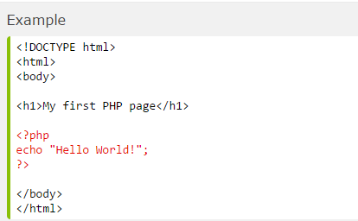
Example 1

Slide 5
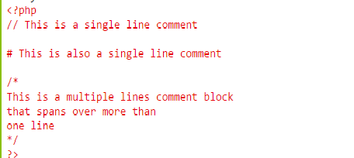
Comments in PHP
A comment in PHP code is a line that is not read/executed as part of the program. Its only purpose is to be read by someone who is editing the code!

Slide 6

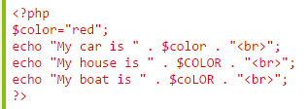
PHP Case Sensitivity
In PHP, all user-defined functions, classes, and keywords (e.g. if, else, while, echo, etc.) are NOT case-sensitive.
In the example below, all three echo statements below are legal (and equal):
in PHP, all variables are case-sensitive.

Slide 7
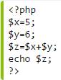
PHP 5 Variables
Variables are "containers" for storing information:
Rules for PHP variables:
A variable starts with the $ sign, followed by the name of the variable
A variable name must start with a letter or the underscore character
A variable name cannot start with a number
A variable name can only contain alpha-numeric characters and underscores (A-z, 0-9, and _ )
Variable names are case sensitive ($y and $Y are two different variables)
Remember that PHP variable names are case-sensitive!

Slide 8

Creating (Declaring) PHP Variables
PHP has no command for declaring a variable.
A variable is created the moment you first assign a value to it:
PHP is a Loosely Typed Language
PHP automatically converts the variable to the correct data type, depending on its value.

Slide 9
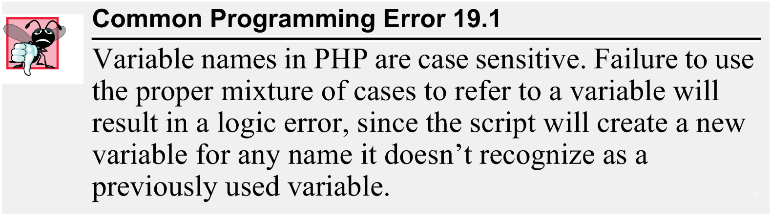
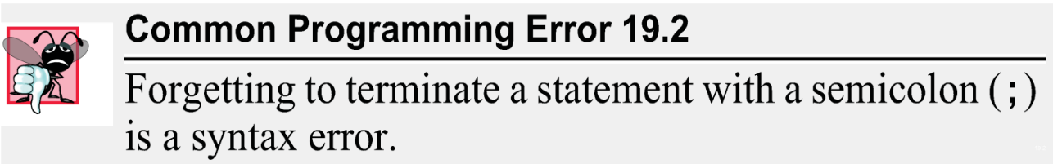
19.2 A Simple PHP Program
When a variable is encountered inside a double-quoted ("") string, PHP interpolates the variable. In other words, PHP inserts the variable’s value where the variable name appears in the string.
All operations requiring PHP interpolation execute on the server before the HTML5 document is sent to the client.

Slide 10
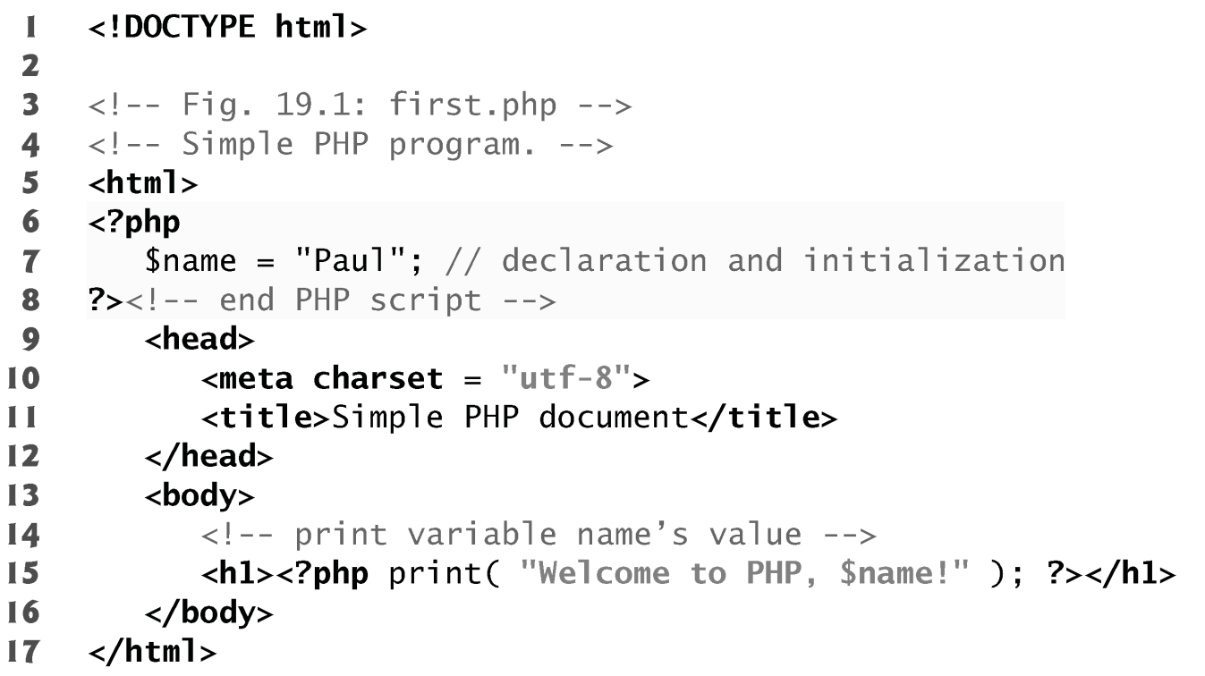
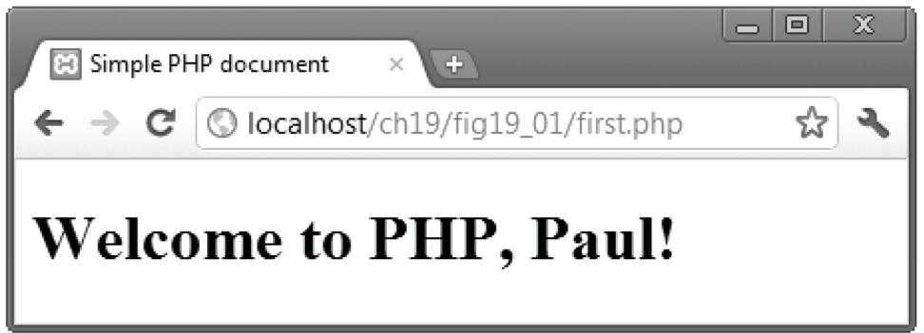

Slide 11
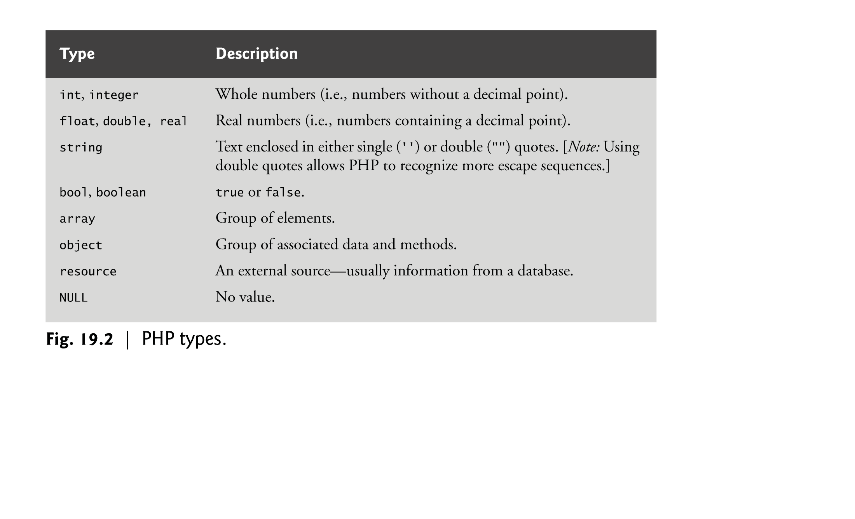

Slide 12
PHP Variables Scope
In PHP, variables can be declared anywhere in the script.
The scope of a variable is the part of the script where the variable can be referenced/used.
PHP has three different variable scopes:
local
global
static

Slide 13
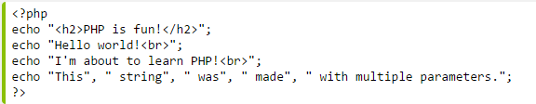

PHP 5 echo and print Statements
There are some differences between echo and print:
echo - can output one or more strings
print - can only output one string, and returns always 1

Slide 14
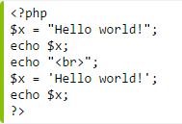
PHP Strings
A string is a sequence of characters, like "Hello world!".
A string can be any text inside quotes. You can use single or double quotes:

Slide 15
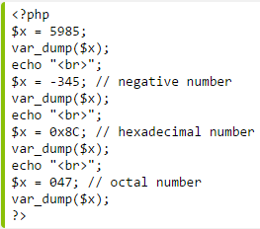
PHP Integers
An integer is a number without decimals.
Rules for integers:
An integer must have at least one digit (0-9)
An integer cannot contain comma or blanks
An integer must not have a decimal point
An integer can be either positive or negative
Integers can be specified in three formats: decimal (10-based), hexadecimal (16-based - prefixed with 0x) or octal (8-based - prefixed with 0)
The PHP var_dump() function returns the data type and value of variables

Slide 16
PHP Floating Point Numbers
A floating point number is a number with a decimal point or a number in exponential form.
PHP Booleans
Booleans can be either TRUE or FALSE.
$x=true; $y=false;

Slide 17

PHP NULL Value
The special NULL value represents that a variable has no value. NULL is the only possible value of data type NULL.
The NULL value identifies whether a variable is empty or not. Also useful to differentiate between the empty string and null values of databases.
Variables can be emptied by setting the value to NULL:

Slide 18
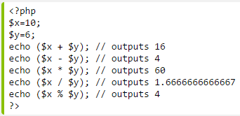
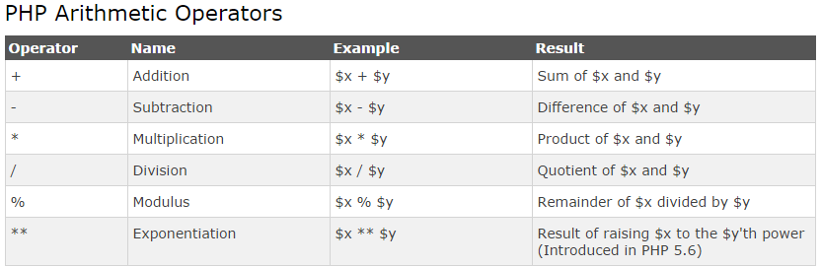
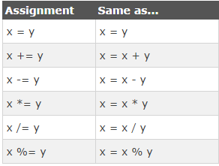
PHP 5 Operators

Slide 19
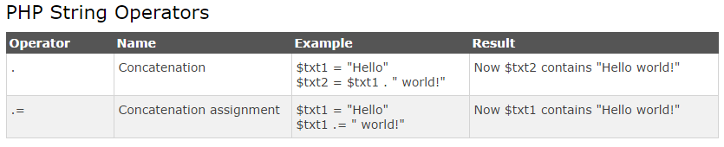
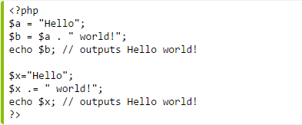

Slide 20
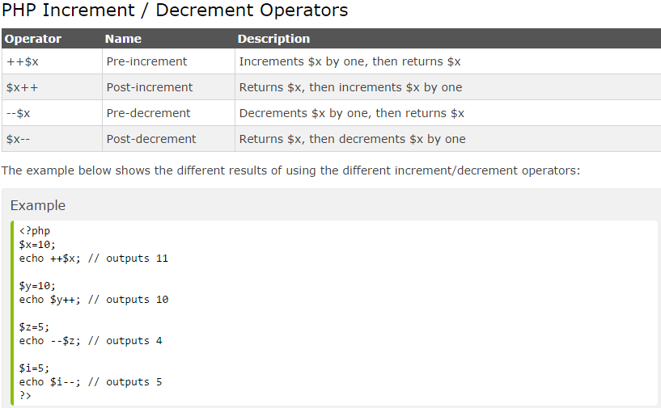

Slide 21
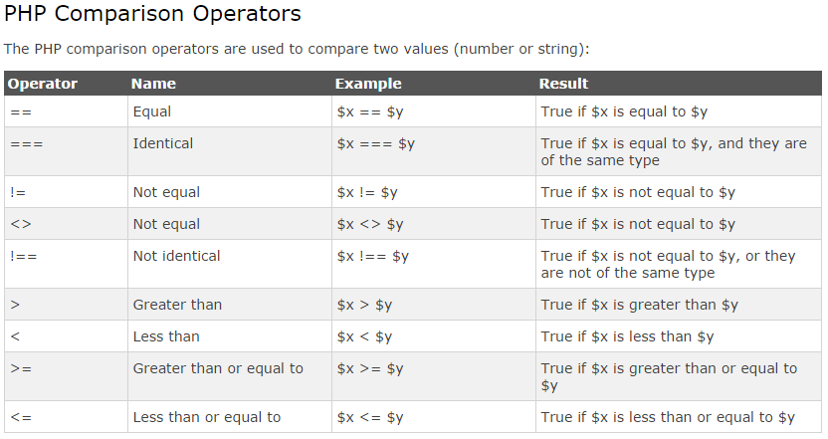

Slide 22
<?php
if ($a > $b) {
echo "a is bigger than b";
} elseif ($a == $b) {
echo "a is equal to b";
} else {
echo "a is smaller than b";
}
?>

Slide 23
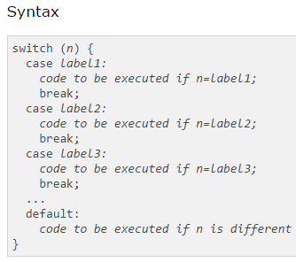
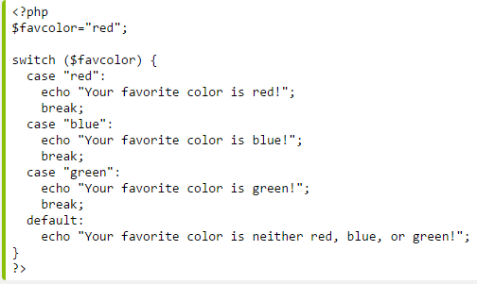
Switch

Slide 24
While Loops
<?php
$count=0;
While($count<3)
{
Print “hello PHP. ”;
$count += 1;
// $count = $count + 1;
// or
// $count++;
?>
While (condition)
{
Statements;
}
hello PHP. hello PHP. hello PHP.

Slide 25
Functions
Functions MUST be defined before the calling
Function headers are of the format
Note that no return type is specified
Unlike variables, function names are not case sensitive (foo(…) == Foo(…) == FoO(…))
function functionName($arg_1, $arg_2, …, $arg_n)

Slide 26
Functions example
<?php function sum($x,$y) { $z=$x+$y; return $z; } echo "5 + 10 = " . sum(5,10) . "<br>"; echo "7 + 13 = " . sum(7,13) . "<br>"; echo "2 + 4 = " . sum(2,4); ?>

Slide 27
19.3 Converting Between Data Types
Type conversions can be performed using function settype. This function takes two arguments—a variable whose type is to be changed and the variable’s new type.
Variables are typed based on the values assigned to them.
Function gettype returns the current type of its argument.
Calling function settype can result in loss of data. For example, doubles are truncated when they are converted to integers.
When converting from a string to a number, PHP uses the value of the number that appears at the beginning of the string. If no number appears at the beginning, the string evaluates to 0.

Slide 28
19.3 Converting Between Data Types
Another option for conversion between types is casting (or type casting). Casting does not change a variable’s content—it creates a temporary copy of a variable’s value in memory.
The concatenation operator (.) combines multiple strings.
A print statement split over multiple lines prints all the data that is enclosed in its parentheses.

Slide 29
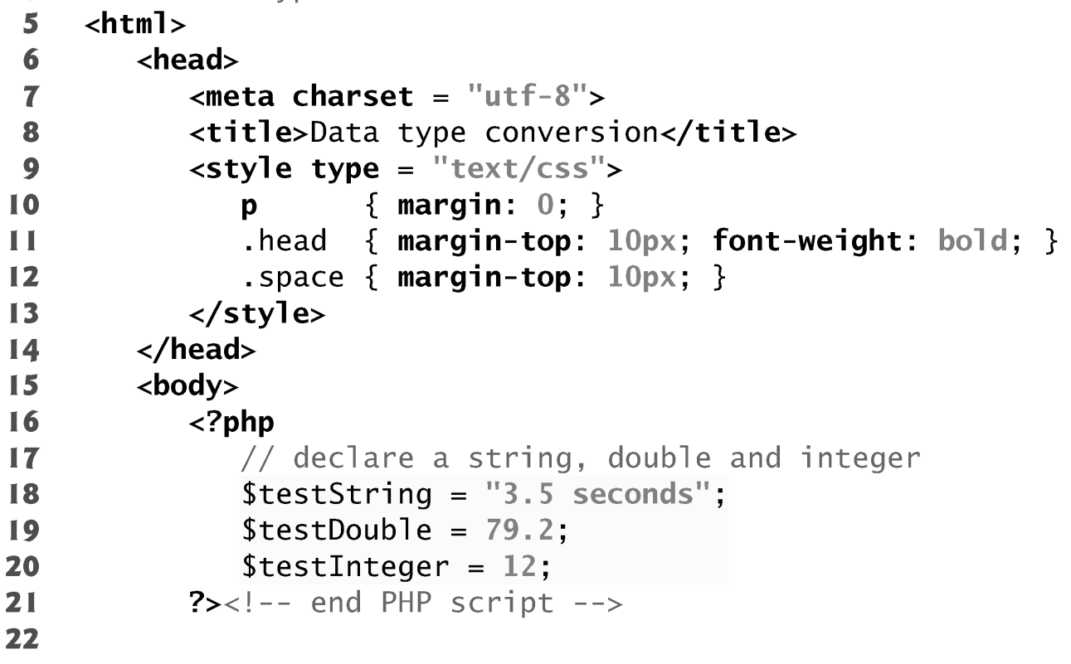
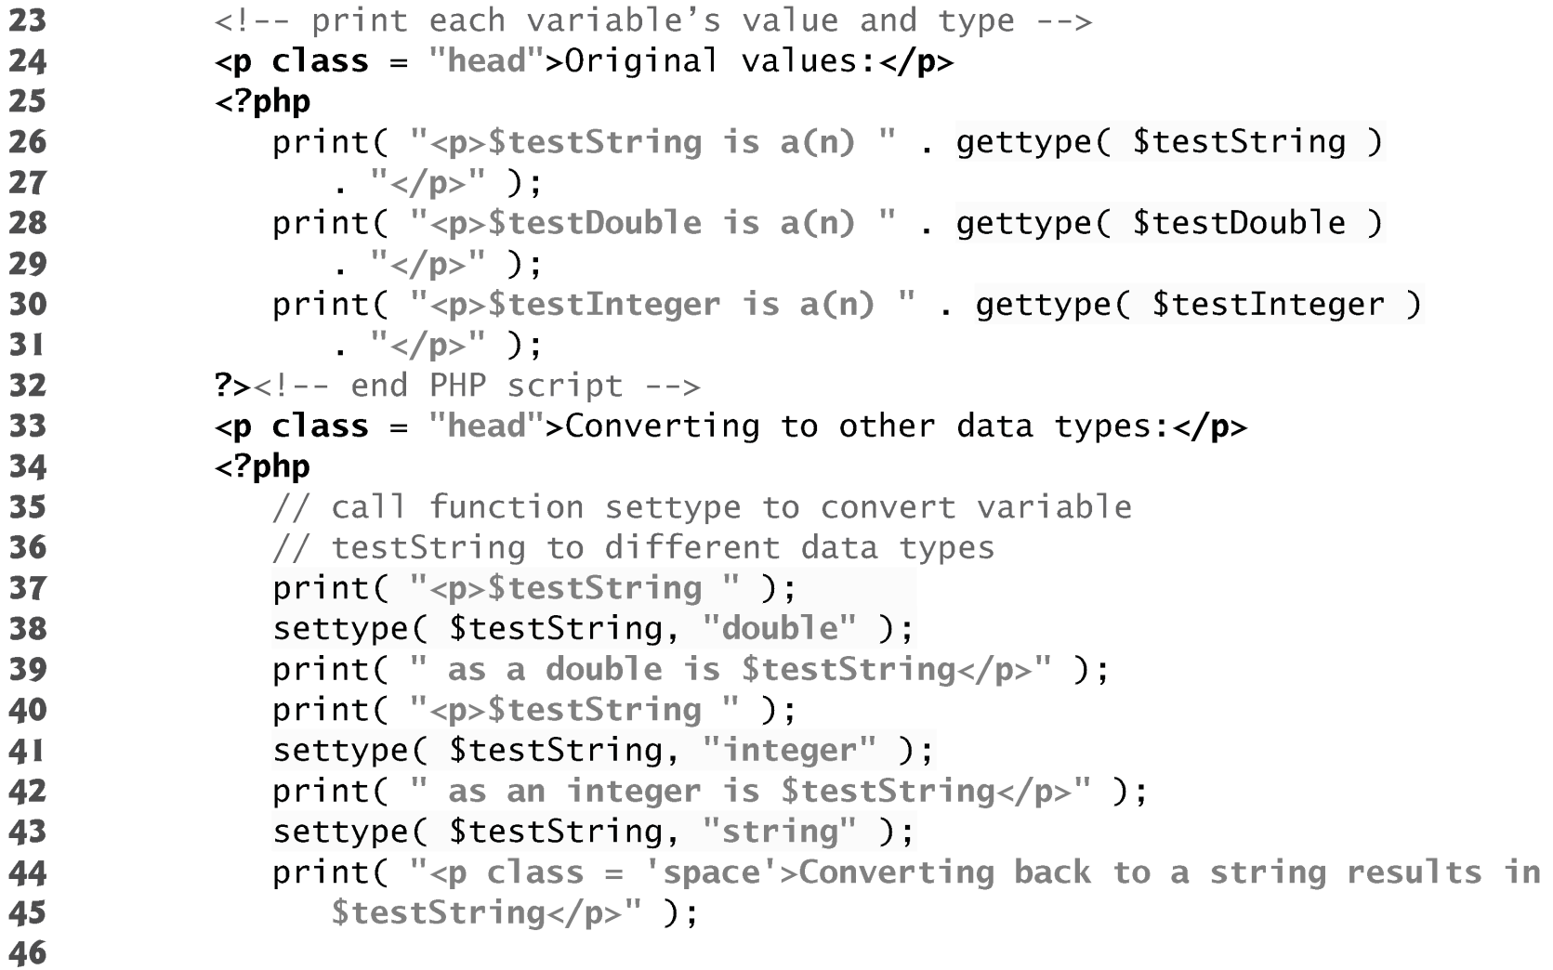

Slide 30
