Slide 1

Business Performance Dashboard
Comprehensive analysis of revenue, delivery, and customer metrics from October 2016 to July 2018.

Slide 2

Executive Overview
16.19M
101K
$159.77
Total Revenue
Total Orders
Avg Order Value
Overall revenue generated
Orders processed
Per transaction
6.72%
Late Delivery
Orders delayed

Slide 3
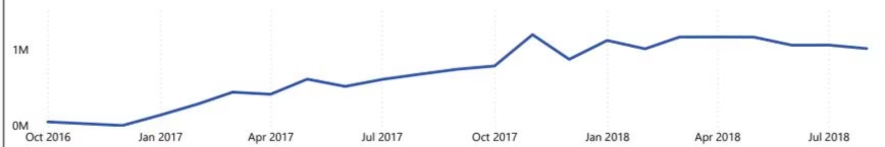
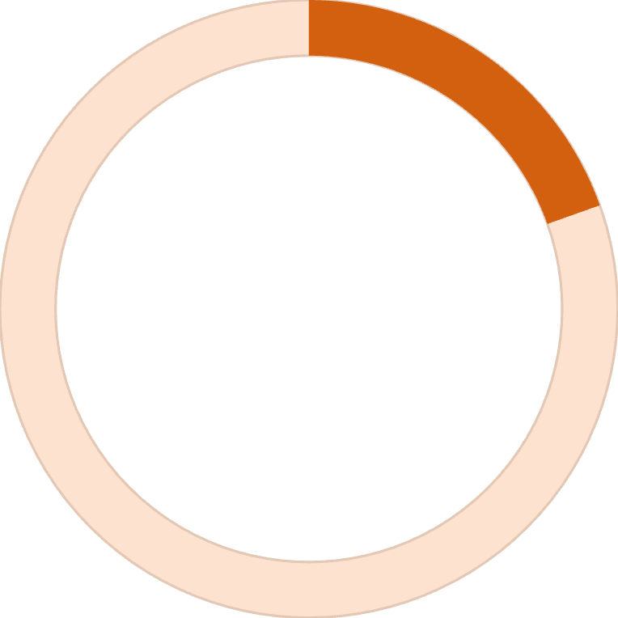
Revenue Growth Trajectory
Impressive Growth
Revenue climbed from near zero in October 2016 to approximately 1.2M by November 2017, stabilizing around 1M through July 2018.
19.56%
YOY Revenue Growth

Slide 4


Delivery Performance
On Time
Slight Delay
90K orders delivered on schedule
5K orders with minor delays
Major Delay
5K orders significantly delayed

Slide 5
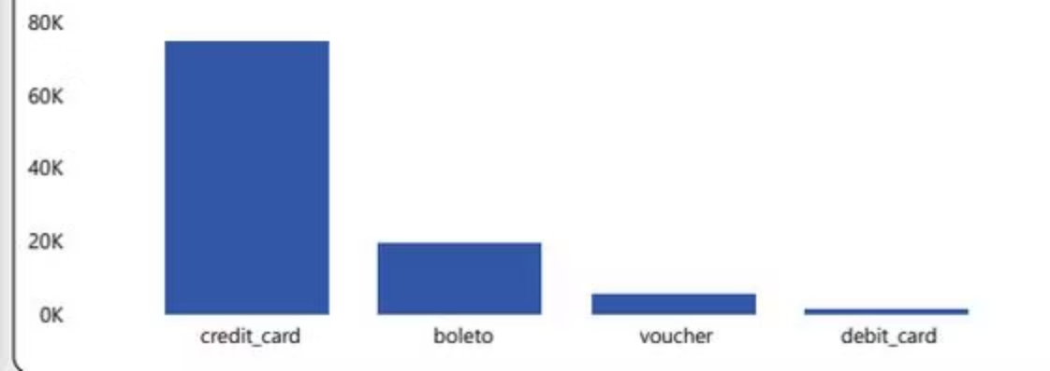
Payment Method Preferences
Primary Payment Methods
Credit Card: 75K orders (dominant method)
Boleto: 20K orders
Voucher: 5K orders
Debit Card: 1K orders

Slide 6
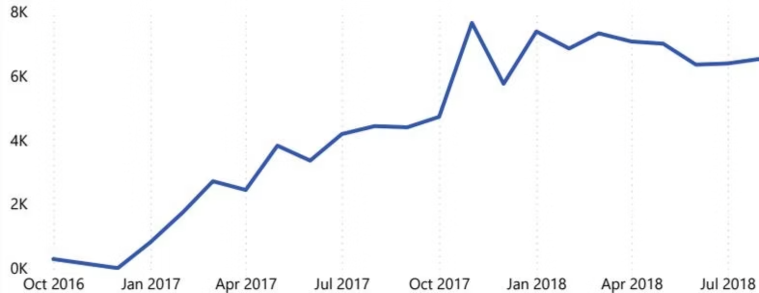
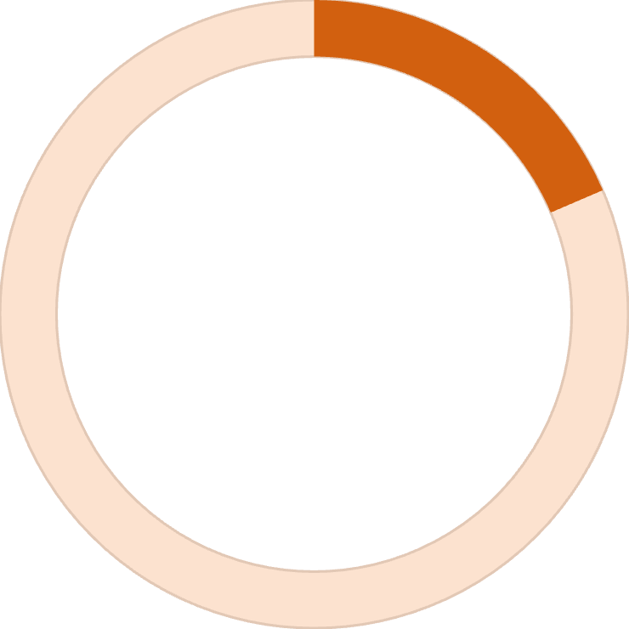
Orders Trend Analysis
18.55%
YOY Orders Growth
Order volume grew steadily from 0.5K in October 2016 to 7.5K peak in October 2017, ending at 6.5K in July 2018.

Slide 7

Customer Insights
3,384
20.80%
Returning Customers
YOY Customers Growth

Slide 8
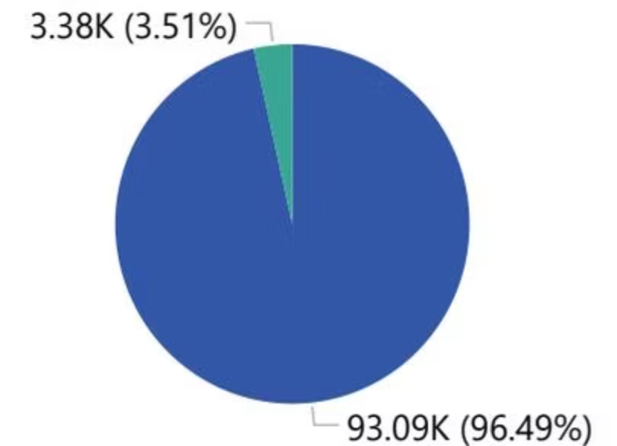
New vs Returning Customers
Customer Distribution
96.49% (93.09K) are returning customers, while only 3.51% (3.38K) are new customers.

Slide 9

Delivery Performance Metrics
6.72%
93.28%
11.90
Late Delivery
On Time Delivery
Avg Early Delivery
Days

Slide 10

Key Takeaways
Strong Revenue Growth
Excellent Delivery
19.56% year-over-year revenue increase with consistent upward trajectory
93.28% on-time delivery rate with most orders arriving early
High Retention
96.49% of customers are returning, indicating strong satisfaction

