Slide 1

MAJOR PROJECT PHASE-1 · REVIEW-2
HRCompanion
Generative AI–Powered Employee Engagement Platform
TEAM MEMBERS
PROJECT GUIDE
[Mohd Yousuf Jameel] – [160923748050]
[Rahman Ullah Khan ] – [160923748058]
[Mohammed Sameer] – [160923748057]
[Mohammed Feroz] – [160923748041]
Sadia kausar
[CSE-AIML, Lords Institute of Engineering and Technology ]
Notes:
Introduce the project, team members and guide. Replace bracketed placeholders with real names, roll numbers and designation.

Slide 2









Table of Contents
03
04
05
Abstract
Introduction
Overview
06
07
08
Literature Survey
Existing System & Disadvantages
Proposed System & Advantages
09
10
11
System Architecture
Modules
Algorithms
Notes:
Slide numbers shown on each card match the slide order.

Slide 3




Abstract
AI HR assistant
Understands natural-language queries and gives context-aware answers on policies, leave, benefits and onboarding.
An intelligent, conversational digital HR companion for employees and HR teams.
Feedback & sentiment
Employees share feedback; AI classifies sentiment as positive, neutral or negative and flags recurring concerns.
Dashboards & reports
Engagement trends and AI-generated insights help HR take informed action.
Unified platform
Generative AI · NLP · RAG
Employee management, knowledge base, surveys, notifications and analytics in one place.
Notes:
Goal: reduce HR workload, improve response time and enhance employee experience.

Slide 4



Introduction
Employee engagement and HR support in many organizations still depend on emails, calls, static intranets and manual replies. HRCompanion applies Generative AI and Natural Language Processing to make HR services instant, consistent and personalized.
The Need
The Idea
The Impact
Routine HR questions on leave, benefits and policies consume HR time and make employees wait.
A conversational AI HR companion grounded in the organization's own policies and handbooks.
Faster support for employees, data-driven engagement insights for HR, and a more connected workplace.

Slide 5


Overview
14
10
4
3
Functional modules
Employee panel features
Core system layers
AI techniques: RAG, NLP, Sentiment
Ask HR in natural language
Policies, handbooks and FAQs on demand
Feedback, surveys and pulse checks
AI sentiment analysis of feedback
Engagement dashboards and reports
Announcements and notifications

Slide 6
Literature Survey
S.No | Paper / Author (Year) | Technique Used | Key Findings | Limitations
1 | [As per Review-1] | [ ] | [ ] | [ ]
2 | [As per Review-1] | [ ] | [ ] | [ ]
3 | [As per Review-1] | [ ] | [ ] | [ ]
4 | [As per Review-1] | [ ] | [ ] | [ ]
5 | [As per Review-1] | [ ] | [ ] | [ ]
Notes:
Fill this table with the same papers presented in Review-1.

Slide 7

Existing System & its Disadvantages
Disadvantages
Existing System
1
Long response times for routine HR queries
2
Manual searching of lengthy policy documents
Email, phone calls, static intranets, spreadsheets and manual HR contact
Basic surveys and record keeping, with no conversational interface
Policies, feedback and analytics split across separate tools
3
HR time lost on repetitive questions
4
Limited conversational, personalized help
5
Feedback reviewed and classified manually
6
Periodic surveys miss changing sentiment
7
Information fragmented across multiple tools
8
No automatic detection of recurring concerns
9
No real-time engagement trends or insights
10
Inconsistent communication, weaker experience

Slide 8
Proposed System & its Advantages
Advantages
Proposed System
1
Instant AI answers to common HR queries
2
Less repetitive workload for HR teams
Centralized GenAI platform for HR assistance, feedback, surveys, notifications and analytics
RAG grounds answers in approved handbooks, policies and FAQs
Sentiment analysis, AI summaries and dashboards guide HR decisions
3
Context-aware answers from company knowledge
4
Engagement, feedback and policies in one place
5
AI-based sentiment analysis of feedback
6
Insights summarized from large feedback volumes
7
Easy access to policies, benefits and guidelines
8
Dashboards and trends for HR decisions
9
Simple participation in surveys and pulse checks
10
Faster, more consistent employee experience

Slide 9
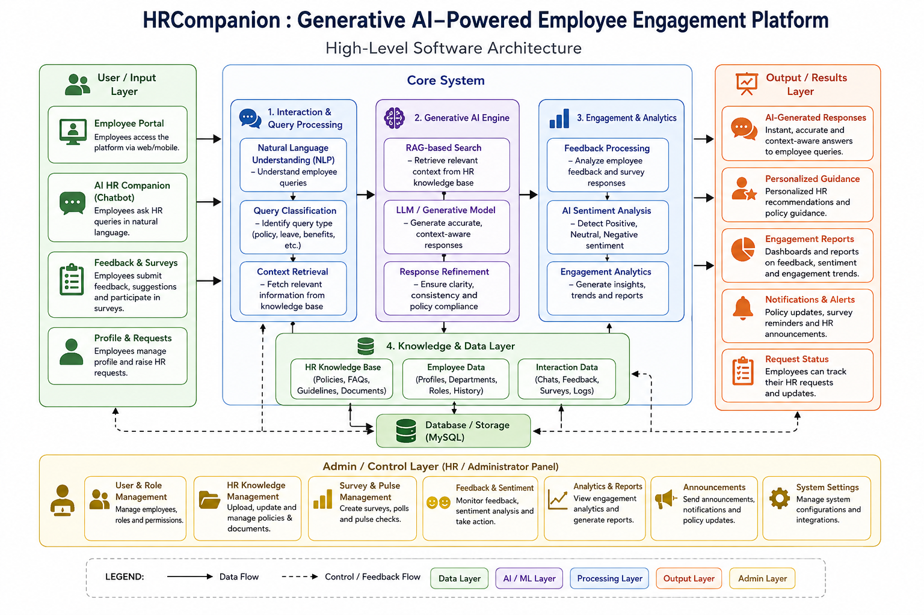
System Architecture
User / Input Layer
Portal, chatbot, feedback, requests
Core System
NLP, GenAI engine, analytics, data layer
Output Layer
Answers, guidance, reports, alerts
Admin Layer
HR panel: roles, knowledge, surveys
Notes:
Walk left to right: input layer, core system (interaction & query processing, generative AI engine, engagement & analytics, knowledge & data layer on MySQL), output layer; admin layer below.

Slide 10
Modules
Admin / HR
Employee
Employee Management
Department & Designation
1
2
3
4
Central control and reports
Personalized HR workspace
Profiles and status
Org structure and roles
GenAI HR Companion
HR Knowledge Base & RAG
Feedback & Suggestions
AI Sentiment Analysis
5
6
7
8
Conversational HR Q&A
Approved policy sources
Employee voice channel
Positive, neutral, negative
Survey & Pulse Check
Engagement Analytics
AI Insights & Recommendation
Announcements & Notifications
9
10
11
12
Continuous measurement
Trends and participation
Themes and suggestions
News and reminders
Reports & Analytics
Help & Support
Employee Panel – 10 features
13
14
Dashboard · Profile · AI Chatbot · Policy Center · Feedback · Surveys · Personalized Guidance · Announcements · Interaction History · Help & Support
Structured HR reports
Escalation to HR
Notes:
14 modules: modules 1-2 are the two user roles; 3-14 are functional modules.

Slide 11


Algorithms
NLP
RAG
NLP
GenAI
Query Understanding & Classification
Retrieval-Augmented Generation
Sentiment Analysis
Insights & Summarization
Interpret the employee's natural-language query
Classify type: policy, leave, benefits, onboarding
Route to context retrieval
Maintain approved HR documents as knowledge base
Retrieve content relevant to the query
Pass it as context to the GenAI model
Generate and refine a grounded response
Preprocess feedback and text interactions
Classify as positive, neutral or negative
Aggregate by department and time period
Group recurring themes in feedback
Summarize large feedback volumes
Present recommendations for HR review
Notes:
The four algorithms map to the Generative AI Engine and Engagement & Analytics blocks in the architecture.

